Slide 1
Connect Four AI
Jason Pearson

Slide 2
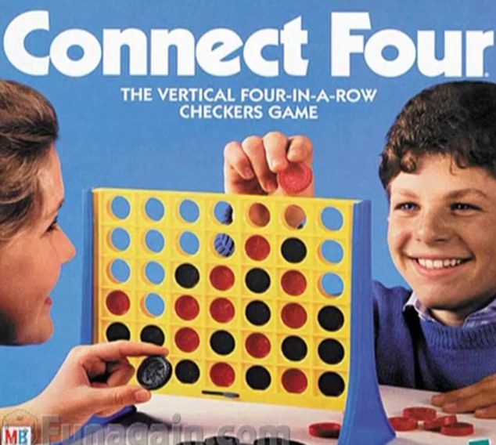
What Is Connect Four
Turn Based Game
Line 4 pieces in a row
Horizontally
Vertically
Diagonally

Slide 3
Why Connect Four
Simple Game
Solved Game

Slide 4

First Moves
Winner
P2
P2
Tie
P1
Tie
P2
P2

