Slide 1
Elevator Simulator
Jason Pearson

Slide 2
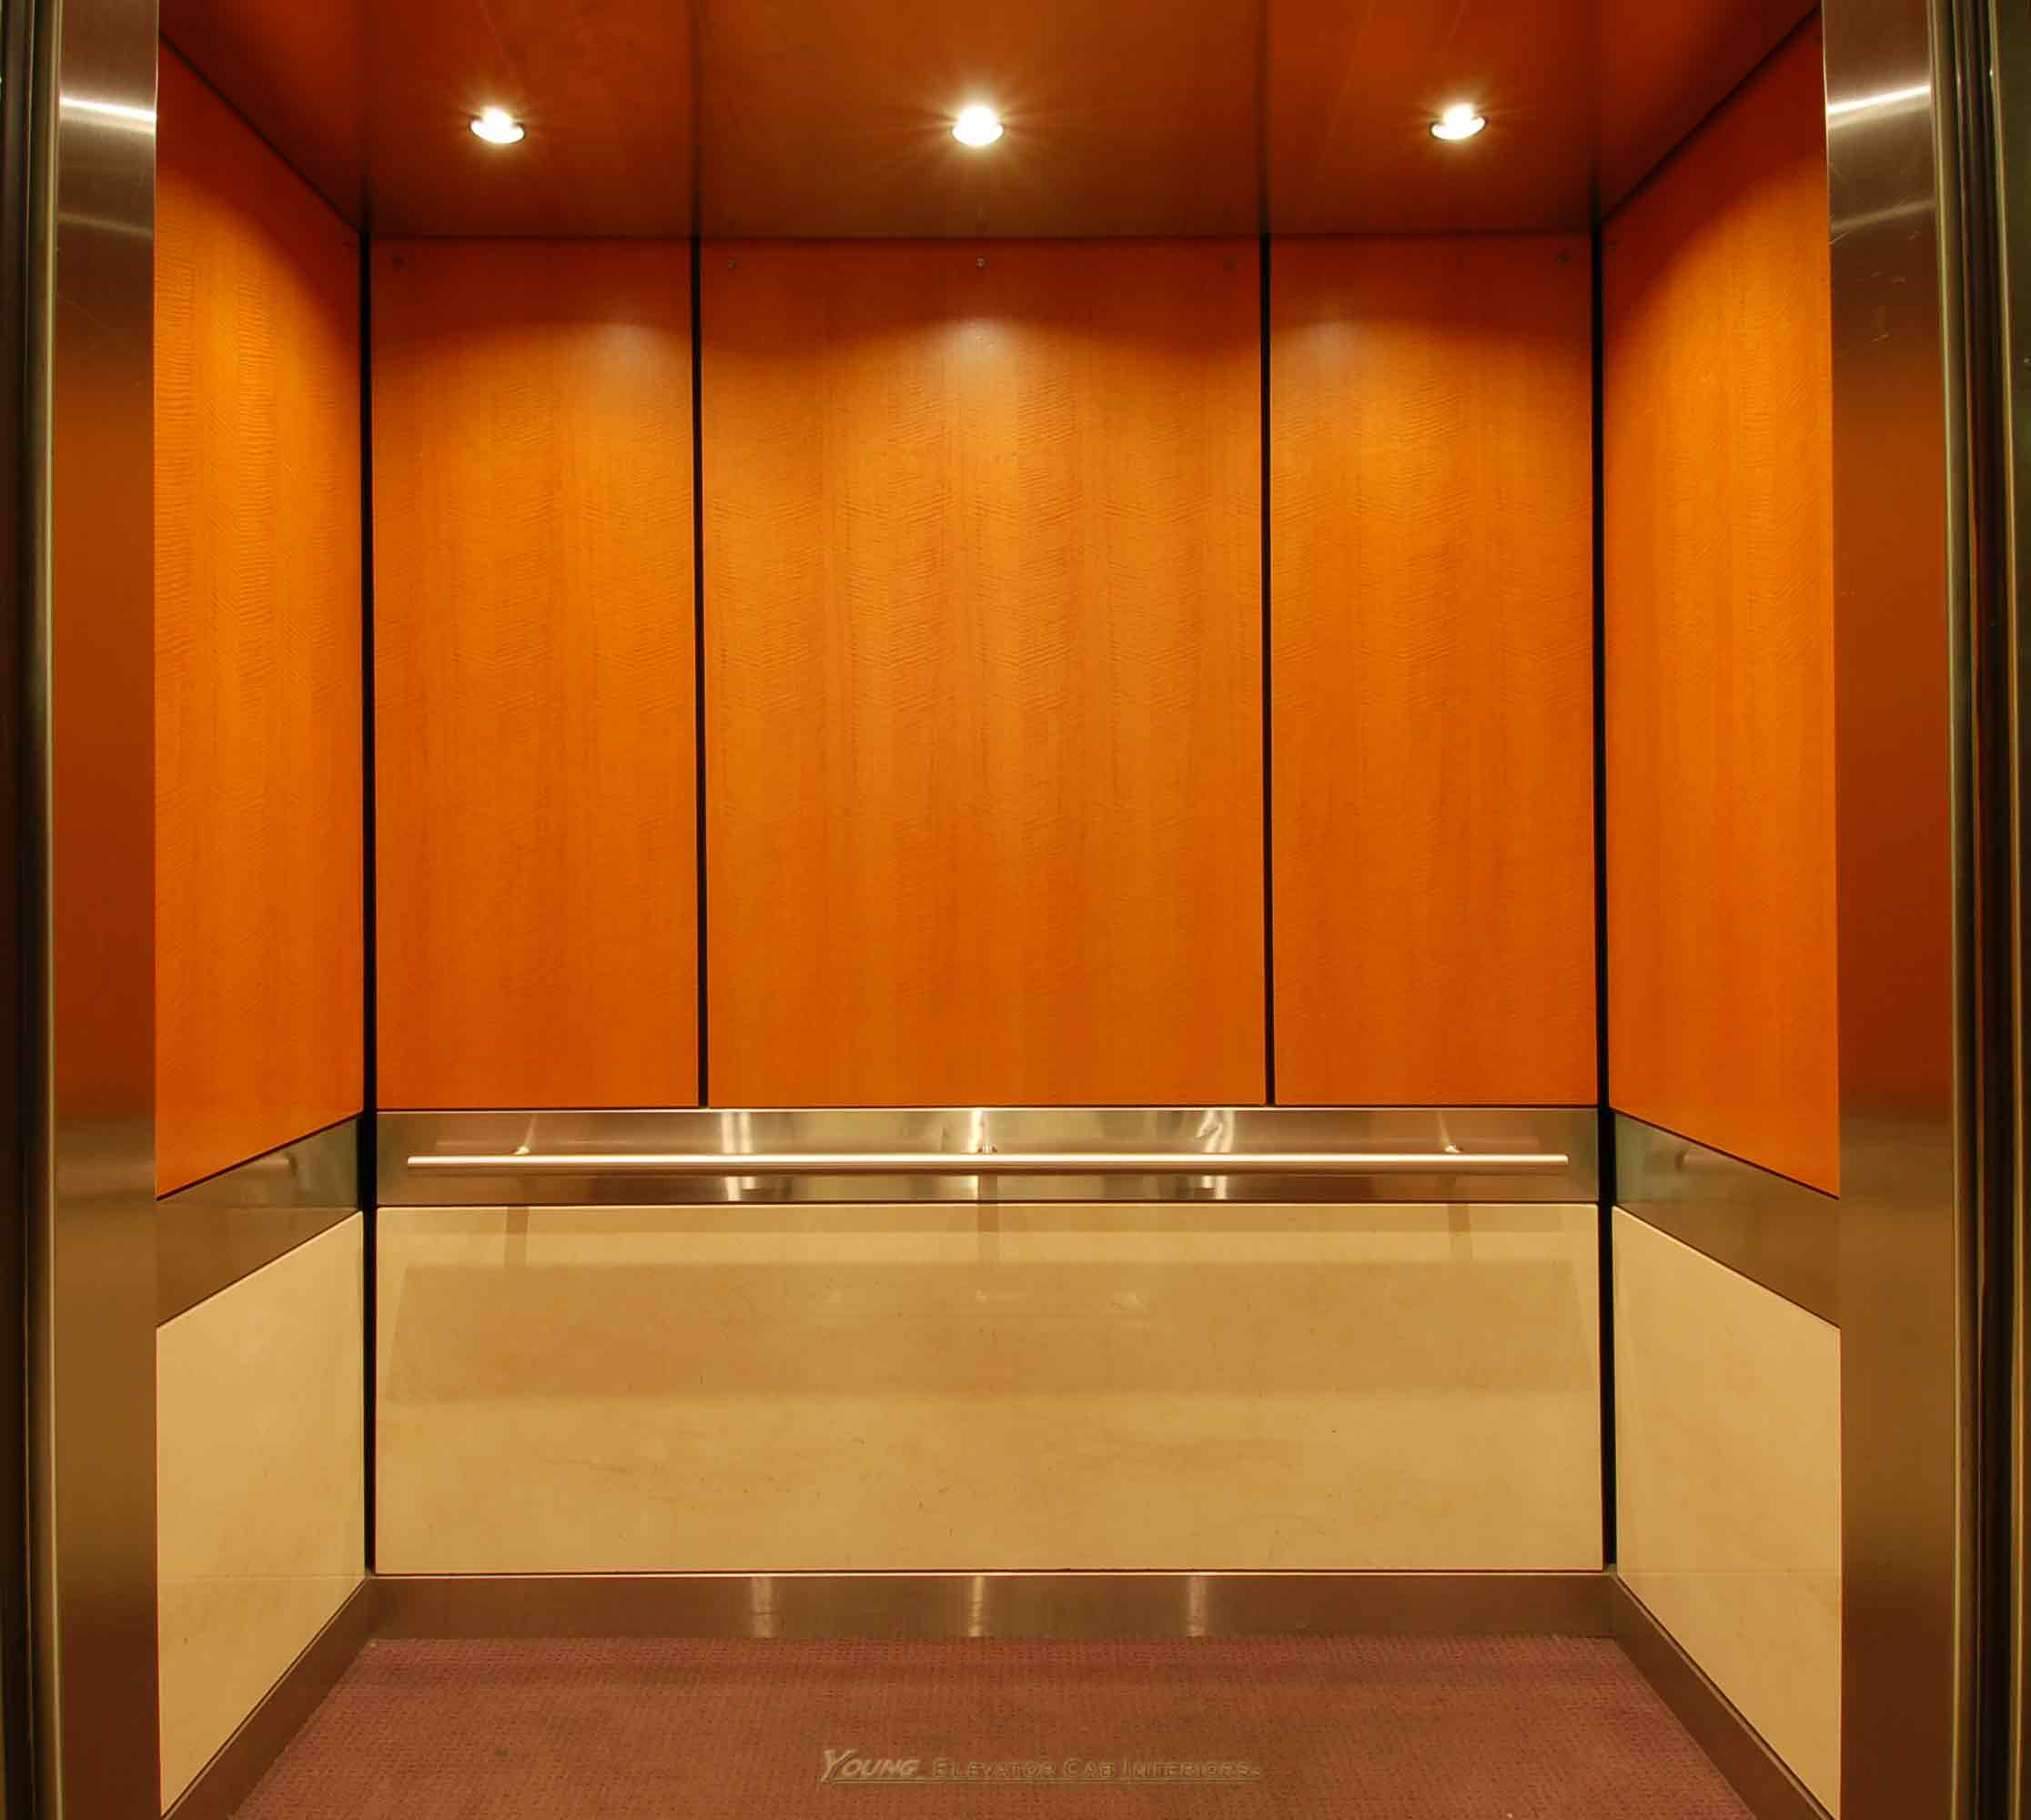
Introduction
What is an elevator?
What algorithm does it use?
How do we represent it?

Slide 3
SCAN Algorithm
General Idea:
People wanting to go up
Get all people going up on the way
Until all up people dropped off or at the top
Grab all people going down on the way back
Repeat until no more people in queue

Slide 4
DFA Representation – 2 Floors
Open
U/L
2
Close
Down
Up
Open
U/L
1
Close
Down
Up
Open
U/L
G
Close

Slide 5
The Program
Written in C#
GUI creates an Elevator Cart object that handles the Cart movement
The cart and waiting lines are populated by Person objects who have starting floor and destination floor

Slide 6
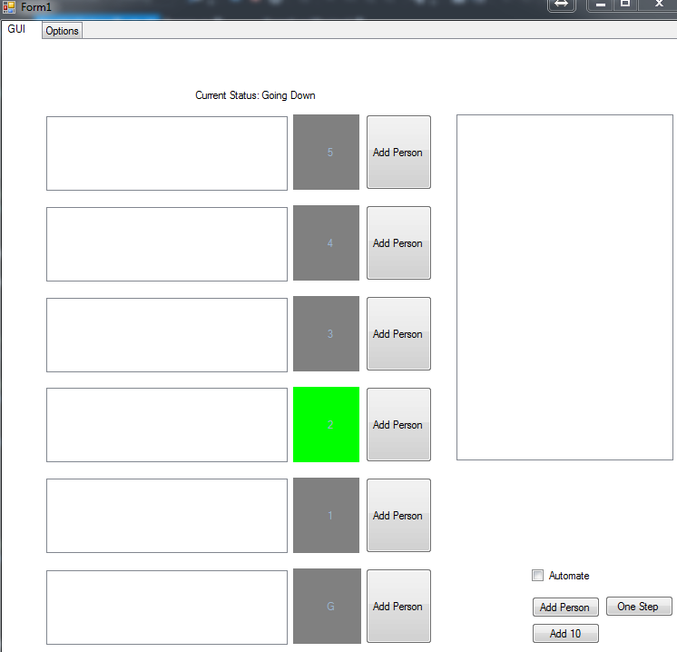
Sample UI

Slide 7
Questions/Demo

