Slide 1
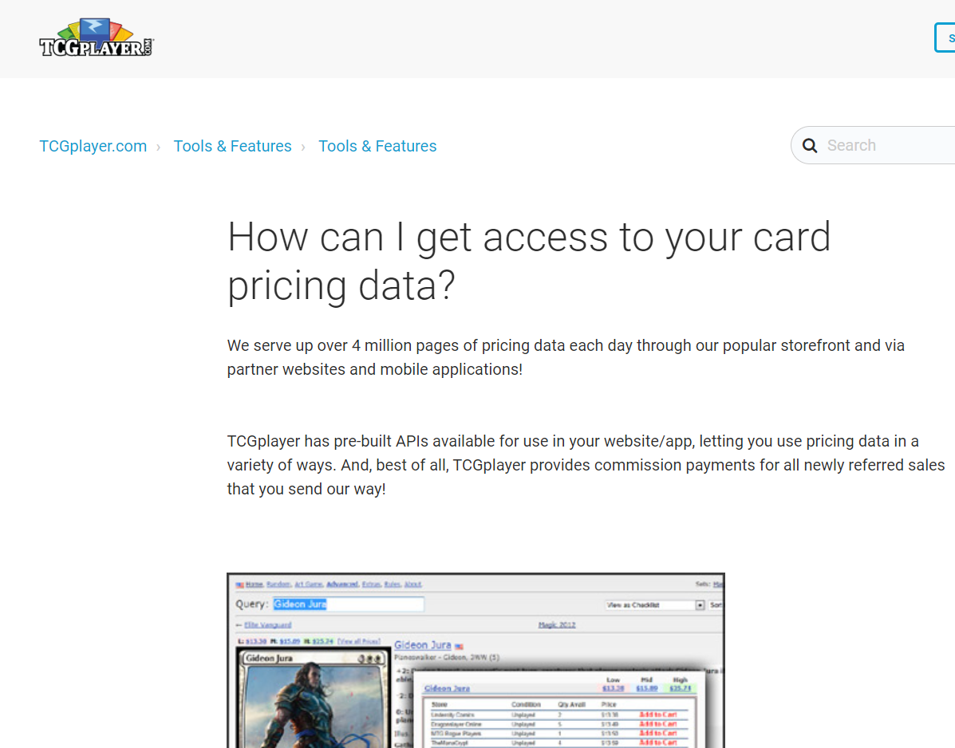
TCG Player
Applying Financial Market Style Research and Technology to the Trading Card Game Secondary Market

Slide 2
Overview and Origin
Incorporated in 1998
Founded by Chedy Hampson
The founders worked at hobby stores and from the interest they saw at the shop, they created content websites and later incorporated databases of articles, decks, and prices
Today they operate as a major price data index for collectible cardgames and have created a card selling marketplace to connect hobby stores to enthusiasts. - (tcgplayer.com - about us)

Slide 3
Business Activities
Price discovery for an unconventional market
Incorporating technology solutions for the type of purchasing collectors do at hobby shops
A market place – match making
A fee based business – commissions
Inventory Management – Database and card cataloging

Slide 4
The Tech
Real Time Price Database
The basket – match making algorithms
The Buylist – match making – many to many to replenish store inventory and help collectors unload
Store inventory by picture
In-store sales through app

Slide 5
Landscape
Pricing Services
Marketplace – connecting sellers and buyers
Hobby Shops with an ecommerce presence
eBay

Slide 6
Results
Measured by API use
Marketplace data – sales versus listings
Fee based revenue and commission growth
Hobby Store subscription growth

Slide 7
Recommendations
The biggest competitor is eBay
What does eBay have that TCG Player doesn’t
Collector Bids
Auctions
Best Offers
Improve
Bids for collectors not just Hobby Store Buylists
Auction Match Making – find the best deal on a basket of cards – Dutch Auction

