Slide 1


Bolt Workshop
Puppetize PDX

Slide 2


Slide 3
Important Information
Student Bolt Instances Linux: bolt-pdxnix#.classroom.puppet.com Windows: bolt-pdxwin#.classroom.puppet.com
Credentials Linux: centos / http://bit.ly/B0ltk3y Windows: puppetinstructor / @Pupp3t1abs
PE Master: bolt-pdx-master.classroom.puppet.com
Tip: To change the frame color of these slides, just right click anywhere outside of the slide, (or on its thumbnail in the left panel) and choose “Format Background”. Then change the background color in the “Format Background” panel to the right.

Slide 4
All About Bolt
Bolt provides a simple way to execute agentless automation against remote hosts
Zero requirements to the remote host. No agents, no python, no nothing
Authenticate via SSH, WinRM, PCP
Execute arbitrary commands, scripts, Bolt Tasks and Bolt Plans
Use scripts in any language the remote host can execute
Mature at your own pace from scripts → tasks → plans → puppet code
If you have Puppet Enterprise, leverage PE from Bolt
Tip: To change the frame color of these slides, just right click anywhere outside of the slide, (or on its thumbnail in the left panel) and choose “Format Background”. Then change the background color in the “Format Background” panel to the right.

Slide 5
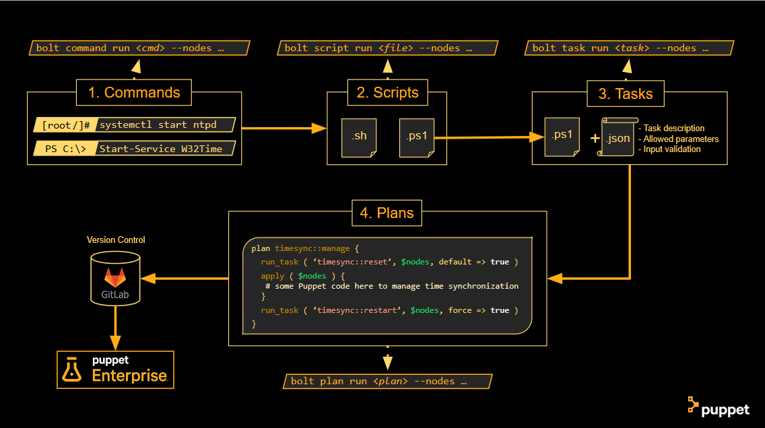

Slide 6
Lab One:
Install Bolt

Slide 7
Installing Bolt
Windows Download https://downloads.puppet.com/windows/puppet6/puppet-bolt-x64-latest.msi Install the MSI
Windows with Chocolatey choco install puppet-bolt
MacOS Download https://downloads.puppet.com/mac/puppet6/10.13/x86_64/puppet-bolt-latest.dmg Double-click the DMG, then double-click the package to install
MacOS with Homebrew brew cask install puppetlabs/puppet/puppet-bolt
Tip: To change the frame color of these slides, just right click anywhere outside of the slide, (or on its thumbnail in the left panel) and choose “Format Background”. Then change the background color in the “Format Background” panel to the right.

Slide 8
Installing Bolt (Linux Edition)
Red Hat / CentOS rpm -Uvh https://yum.puppet.com/puppet6/puppet6-release-el-7.noarch.rpm yum install puppet-bolt
SUSE Enterprise Linux sudo rpm -Uvh https://yum.puppet.com/puppet6/puppet6-release-sles-12.noarch.rpm sudo zypper install puppet-bolt
Ubuntu wget https://apt.puppet.com/puppet6-release-bionic.deb sudo dpkg -i puppet6-release-bionic.deb sudo apt-get update sudo apt-get install puppet-bolt
Tip: To change the frame color of these slides, just right click anywhere outside of the slide, (or on its thumbnail in the left panel) and choose “Format Background”. Then change the background color in the “Format Background” panel to the right.

Slide 9
Using Bolt
Bolt command line syntax: bolt [command|script|task|plan] run <name> --nodes <nodes> [options]
To run a simple Bash command on a remote SSH host: bolt command run 'echo Hello World!' --nodes 10.0.0.1,10.0.0.2 --user root --private-key /path/to/key --transport ssh --no-host-key-check
To run a simple PowerShell command on a remote WinRM host: bolt command run 'write-host Hello World!' --nodes 10.0.0.1,10.0.0.2 --user administrator --password 'P@ssw0rd' --transport winrm --no-ssl
Tip: To change the frame color of these slides, just right click anywhere outside of the slide, (or on its thumbnail in the left panel) and choose “Format Background”. Then change the background color in the “Format Background” panel to the right.

Slide 10
Lab Two:
Bolt Command

Slide 11
Lab Two Instructions
Student Bolt Instances Linux: bolt-pdxnix#.classroom.puppet.com Windows: bolt-pdxwin#.classroom.puppet.com
Credentials Linux: centos / http://bit.ly/B0lts5h Windows: puppetinstructor / @Pupp3t1abs
Run these from the command line
bolt command run 'ping 8.8.8.8 -c2' --nodes <linux_node> --user centos --private-key /path/to/key --no-host-key-check bolt command run 'ping 8.8.8.8 -n 2' --nodes <win_node> --user puppetinstructor --pass '@Pupp3t1abs' --transport winrm --no-ssl
Tip: To change the frame color of these slides, just right click anywhere outside of the slide, (or on its thumbnail in the left panel) and choose “Format Background”. Then change the background color in the “Format Background” panel to the right.

Slide 12
Easing Bolt Configuration
http://www.puppet.com/docs/bolt
Bolt provides ways to make common activities more efficient
Use a bolt.yaml file to store generic settings like modulepath or PE integration
Use an inventory.yaml file to prevent typing in connection info every time
Use a Boltdir to bundle all the files you need and have Bolt automatically use it
Tip: To change the frame color of these slides, just right click anywhere outside of the slide, (or on its thumbnail in the left panel) and choose “Format Background”. Then change the background color in the “Format Background” panel to the right.

Slide 13
Bolt Configuration File
Bolt supports a configuration file to manage default configuration settings
The configuration file is YAML and can have any name you want
If unspecified, Bolt will look in these locations for an configuration file
./Boltdir/bolt.yaml
./bolt.yaml
~/.puppetlabs/bolt/bolt.yaml (~ = %HOMEPATH%)
A custom configuration file can be specified at runtime with –configfile [full path]
Tip: To change the frame color of these slides, just right click anywhere outside of the slide, (or on its thumbnail in the left panel) and choose “Format Background”. Then change the background color in the “Format Background” panel to the right.

Slide 14
Bolt Configuration File Syntax
http://www.puppet.com/docs/bolt/latest/bolt_configuration_options.html
modulepath: "/path/one:/path/two:/path/three“ inventoryfile: "~/.puppetlabs/bolt/inventory.yaml“ [options]
ssh: host-key-check: false [options]
winrm: ssl: false [options]
pcp: [options]
log: console: # or /path/to.log level: info
Tip: To change the frame color of these slides, just right click anywhere outside of the slide, (or on its thumbnail in the left panel) and choose “Format Background”. Then change the background color in the “Format Background” panel to the right.

Slide 15
Lab Three:
Use Bolt with bolt.yaml

Slide 16
Lab Three Instructions
Create a folder for this workshop and create a bolt.yaml in it
add host-key-check: false to SSH section of bolt.yaml
add ssl: false to WinRM section of bolt.yaml
run commands to nodes without specifying these 2 options
Tip: To change the frame color of these slides, just right click anywhere outside of the slide, (or on its thumbnail in the left panel) and choose “Format Background”. Then change the background color in the “Format Background” panel to the right.

Slide 17
Bolt Inventory
Bolt supports an inventory file to maintain a list of known targets
The inventory file is YAML and can have any name you want
If unspecified, Bolt will look in these locations for an inventory file:
./Boltdir/inventory.yaml
./Inventory.yaml (only when ./bolt.yaml is present)
~/.puppetlabs/bolt/inventory.yaml (~ = %HOMEPATH%)
A custom inventory file can be specified on the command line with --inventoryfile [full path]
A custom inventory file can be specified in bolt.yaml with the inventoryfile keyword.
Tip: To change the frame color of these slides, just right click anywhere outside of the slide, (or on its thumbnail in the left panel) and choose “Format Background”. Then change the background color in the “Format Background” panel to the right.

Slide 18
Bolt Inventory
groups: - name: group_name nodes: - IP_address_or_name_of_node1 - IP_address_or_name_of_node2 config: transport: [ ssh | winrm ] ssh: user: user_name run-as: root_name private-key: /path/to/key host-key-check: [ true | false ] winrm: user: user_name password: password ssl: [ true | false ]
Nesting of groups is allowed:
groups: - name: top_group
groups:
- name: sub_group
nodes:
- …
Tip: To change the frame color of these slides, just right click anywhere outside of the slide, (or on its thumbnail in the left panel) and choose “Format Background”. Then change the background color in the “Format Background” panel to the right.

Slide 19
Lab Four:
Build an Inventory File

Slide 20
Lab Four Instructions
Create an inventory.yaml in your workshop folder
One group for your Linux node, connecting over SSH
One group for your Windows node, connecting over WinRM
Reference:
Template: https://github.com/puppetlabs-seteam/bolt-timesync
Tip: To change the frame color of these slides, just right click anywhere outside of the slide, (or on its thumbnail in the left panel) and choose “Format Background”. Then change the background color in the “Format Background” panel to the right.

Slide 21
Lab Five:
Use Bolt with Inventory

Slide 22
Lab Five Instructions
Run bolt command run 'ping 8.8.8.8 -c2' --nodes linux
Run bolt command run 'ping 8.8.8.8 -n 2' --nodes windows
Run bolt command run 'hostname' --nodes linux,windows
Tip: To change the frame color of these slides, just right click anywhere outside of the slide, (or on its thumbnail in the left panel) and choose “Format Background”. Then change the background color in the “Format Background” panel to the right.

Slide 23
The Boltdir
To assist in packaging Bolt with source code, Bolt supports a Boltdir
When Bolt sees a directory called ./Boltdir it overrides all other configuration
The Boltdir has the following structure:
./Boltdir/bolt.yaml # Configuration settings
./Boltdir/inventory.yaml # Node inventory
./Boltdir/Puppetfile # Additional Forge modules
./Boltdir/modules # Path where modules are installed
./Boltdir/modules/mymod/tasks # Bolt Tasks in module ‘mymod’
./Boltdir/modules/mymod/plans # Bolt Task Plans in module ‘mymod’
Tip: To change the frame color of these slides, just right click anywhere outside of the slide, (or on its thumbnail in the left panel) and choose “Format Background”. Then change the background color in the “Format Background” panel to the right.

Slide 24
Running Scripts
Bolt will copy the script file to the remote host and run it in the native shell
Linux = Bash
Powershell = Windows
Bolt expects the shell to execute the correct parser (based on file extension)
You can pass arguments, but Bolt doesn’t do input validation for scripts
bolt script run <script> [[arg1] ... [argN]] [options]
Tip: To change the frame color of these slides, just right click anywhere outside of the slide, (or on its thumbnail in the left panel) and choose “Format Background”. Then change the background color in the “Format Background” panel to the right.

Slide 25
Lab Six:
Run Scripts with Bolt

Slide 26
Lab Six Instructions
On your laptop, recreate the timesync.ps1 script at https://github.com/puppetlabs-seteam/bolt-timesync
Use Bolt to run the script on your Windows node bolt script run timesync.ps1 --nodes windows
Tip: To change the frame color of these slides, just right click anywhere outside of the slide, (or on its thumbnail in the left panel) and choose “Format Background”. Then change the background color in the “Format Background” panel to the right.

Slide 27
Scripts into Tasks!
Make your scripts more useful in Bolt by turning them into Puppet Tasks
Any script file in a tasks directory of a module becomes a Task
Tasks are name spaced automatically, using familiar Puppet syntax:
modules/mymod/tasks/script1.ps1 # mymod::script1
modules/aws/tasks/show_vpc.sh # aws::show_vpc
modules/mysql/tasks/sql.rb # mysql::sql
modules/yum/tasks/init.rb # yum
Tip: To change the frame color of these slides, just right click anywhere outside of the slide, (or on its thumbnail in the left panel) and choose “Format Background”. Then change the background color in the “Format Background” panel to the right.

Slide 28
Lab Seven:
Convert a Script to a Task

Slide 29
Lab Seven Instructions
Create ./modules/tools/tasks
Move the timesync.ps1 script into the tasks directory
Run bolt task show to verify the new task is available
Run bolt task run tools::timesync --nodes windows to execute the task.
Tip: To change the frame color of these slides, just right click anywhere outside of the slide, (or on its thumbnail in the left panel) and choose “Format Background”. Then change the background color in the “Format Background” panel to the right.

Slide 30
Bolt Task Metadata
Make your Tasks more useful and robust by writing metadata files for them
A metadata file has the same name as the script file, but with a .json extension
Metadata files using the following (JSON) syntax:
{ "description": "Description of your Puppet Task", "input_method": "environment | stdin | powershell", "parameters": { "param1": { "description": "Description of the parameter usage", "type": "String | Enum | Pattern | Integer | Array | Hash | Boolean“ } } }
Tip: To change the frame color of these slides, just right click anywhere outside of the slide, (or on its thumbnail in the left panel) and choose “Format Background”. Then change the background color in the “Format Background” panel to the right.

Slide 31
Bolt Task Input Methods
The chosen input method determines how variables are accessible in the script "input_method": "environment | stdin | powershell“
environment: creates environment variable for each parameter as $PT_<variable>
stdin: creates a JSON hash of all parameters and passes it via stdin
powershell: creates a PowerShell named argument for each parameter
The default for Linux is environment and stdin
The default for Windows is powershell
Tip: To change the frame color of these slides, just right click anywhere outside of the slide, (or on its thumbnail in the left panel) and choose “Format Background”. Then change the background color in the “Format Background” panel to the right.

Slide 32
Lab Eight:
Install Bolt
http://pup.pt/installbolt

Slide 33
Lab Eight:
Create and Run Bolt Task with Metadata

Slide 34
Lab Eight Instructions
Copy timesync.json and timesync.ps1 from modules/tools/tasks at https://github.com/puppetlabs-seteam/bolt-timesync to ./modules/tools/tasks
Run bolt task show
Run bolt task show tools::timesync
Run bolt task run tools::timesync -n windows restart=true
Tip: To change the frame color of these slides, just right click anywhere outside of the slide, (or on its thumbnail in the left panel) and choose “Format Background”. Then change the background color in the “Format Background” panel to the right.

Slide 35
Writing Bolt Plans
Bolt Plans can use all of the previously covered capabilities, and more, in a single plan. It’s ideally suited to:
Orchestrate multiple tasks
Perform more complex logic & error handling, or interact with Puppet Enterprise
Combine command/scripts/Tasks with applying desired-state Puppet code
Plans are stored in a plans directory of a module and have a .pp extension
Plans must be name spaced according to their module & plan name
Tip: To change the frame color of these slides, just right click anywhere outside of the slide, (or on its thumbnail in the left panel) and choose “Format Background”. Then change the background color in the “Format Background” panel to the right.

Slide 36
Writing Bolt Plans
located in modules/my_mod/plans/my_plan.pp
plan my_mod::my_plan( String[1] $load_balancer, TargetSpec $frontends, TargetSpec $backends ) { # process frontends run_task('my_mod::lb_remove', $load_balancer, frontends => $frontends) run_task('my_mod::update_frontend_app', $frontends, version => '1.2.3’) run_task('my_mod::lb_add', $load_balancer, frontends => $frontends) }
Tip: To change the frame color of these slides, just right click anywhere outside of the slide, (or on its thumbnail in the left panel) and choose “Format Background”. Then change the background color in the “Format Background” panel to the right.

Slide 37
Bolt Functions
Puppet Task Plans are written in Puppet DSL, with extra plan-specific functions:
add_facts, apply, apply_prep, facts, fail_plan, get_targets, puppetdb_fact, puppetdb_query, run_command, run_plan, run_script, run_task, set_feature, set_var, upload_file, vars, wait_until_available, without_default_logging
Tip: To change the frame color of these slides, just right click anywhere outside of the slide, (or on its thumbnail in the left panel) and choose “Format Background”. Then change the background color in the “Format Background” panel to the right.

Slide 38
Bolt Plan with Functions
plan loop( TargetSpec $nodes ) { $targets = get_targets($nodes) $certnames = $targets.map |$target| { $target.host } $targets.each |$target| { run_task('my_task', $target, certificate => $certnames[$target.host] ) } }
Tip: To change the frame color of these slides, just right click anywhere outside of the slide, (or on its thumbnail in the left panel) and choose “Format Background”. Then change the background color in the “Format Background” panel to the right.

Slide 39
Lab Nine:
Create and Run a Bolt Plan

Slide 40
Bolt Plan with Functions
Copy timesync.pp from modules/tools/plans at https://github.com/puppetlabs-seteam/bolt-timesync to ./modules/tools/plans
Run bolt plan show
Run bolt plan show tools::timesync
Run bolt plan run tools::timesync --nodes windows
Tip: To change the frame color of these slides, just right click anywhere outside of the slide, (or on its thumbnail in the left panel) and choose “Format Background”. Then change the background color in the “Format Background” panel to the right.

Slide 41
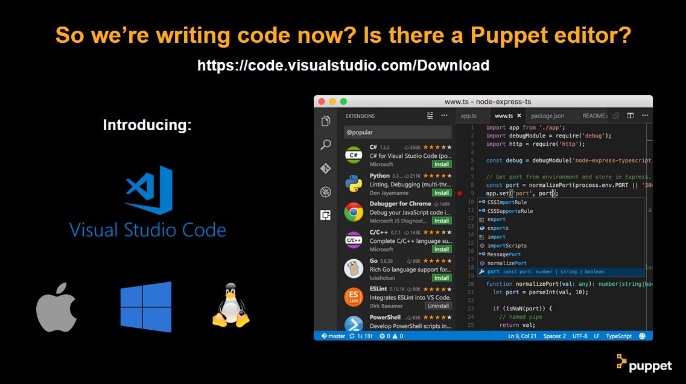

Slide 42
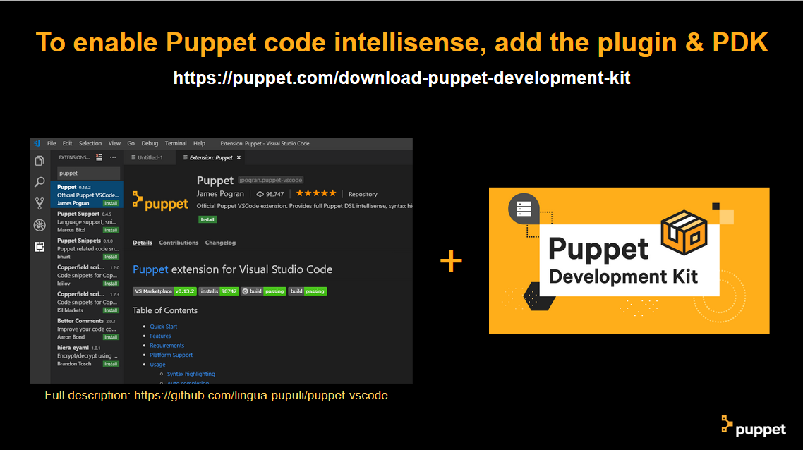

Slide 43
Lab Ten:
Install VS Code

Slide 44
Lab Ten Instructions
Go to https://code.visualstudio.com/Download
Install VS Code
Launch VS Code, Go to Extensions, search for ‘puppet’
Install the official ‘Puppet’ extension by James Pogran
Go to https://puppet.com/download-puppet-development-kit
Download and install for your machine.
In VS Code, change the Puppet: Install Type setting to ‘pdk’
Tip: To change the frame color of these slides, just right click anywhere outside of the slide, (or on its thumbnail in the left panel) and choose “Format Background”. Then change the background color in the “Format Background” panel to the right.

Slide 45
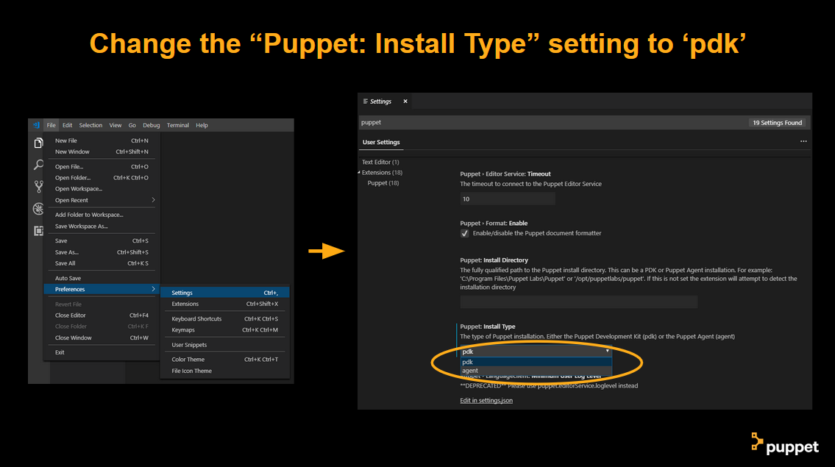

Slide 46
Desired State What Now?
So far, we’ve been using scripting approaches to fix time synchronization issues
But the script only works on Windows
If we also built a script for Linux, it wouldn’t look anything like the Windows one
We don’t *want* to keep running scripts on systems over and over
How would we know if we needed to run the script again? Would that even work?
Surely *someone* has solved this issue already, right?!
Tip: To change the frame color of these slides, just right click anywhere outside of the slide, (or on its thumbnail in the left panel) and choose “Format Background”. Then change the background color in the “Format Background” panel to the right.

Slide 47
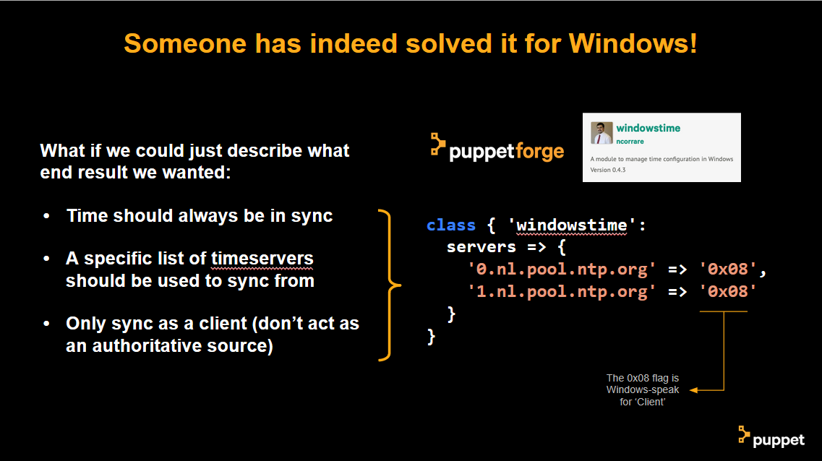

Slide 48
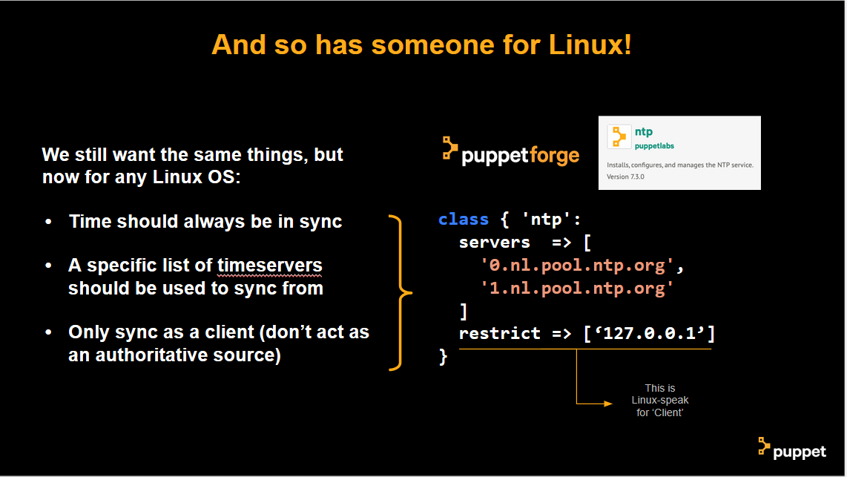

Slide 49
Desired State What Now?
To ensure Puppet modules are easy to use, the attributes a module supports for configuration often align fairly closely to the technology the module manages.
Time synchronization on Linux and Windows are different enough that the attributes for one platform are difficult to understand on the other
It does not often happen that someone builds a fully cross platform module
A fully cross platform time synchronization module could still emerge at some point, it will just have to use more generic attributes for configuration and translate those to each platform as appropriate.
^^^ Which is exactly what desired state configuration is all about!
Tip: To change the frame color of these slides, just right click anywhere outside of the slide, (or on its thumbnail in the left panel) and choose “Format Background”. Then change the background color in the “Format Background” panel to the right.

Slide 50
Lab Eleven:
Apply a Puppet Manifest

Slide 51
Lab Eleven Instructions
In VS Code, create and save a new file called timesync_windows.pp
Copy the Puppet code from the same file on https://github.com/puppetlabs-seteam/bolt-timesync and then run:
bolt apply timesync_windows.pp --nodes windows
Tip: To change the frame color of these slides, just right click anywhere outside of the slide, (or on its thumbnail in the left panel) and choose “Format Background”. Then change the background color in the “Format Background” panel to the right.

Slide 52
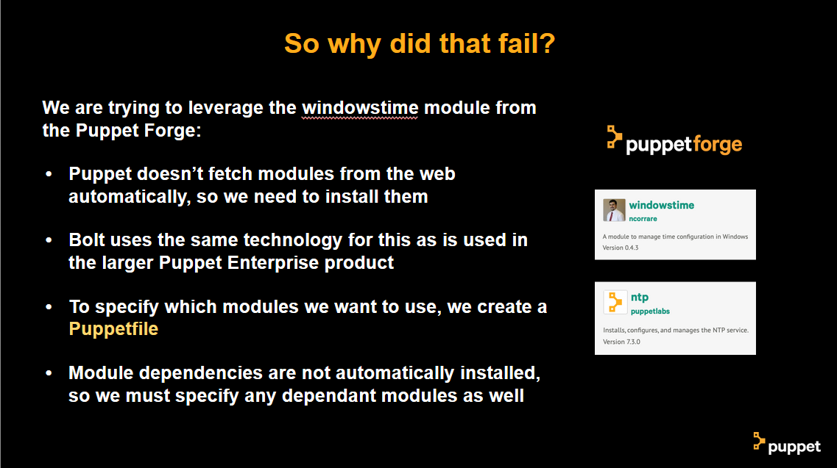

Slide 53
Lab Eleven:
Apply a Puppet Manifest with a Puppefile

Slide 54
Lab Eleven Instructions
In VS Code, create a file called Puppetfile in the workshop folder
Copy and save the contents from the Puppetfile on https://github.com/puppetlabs-seteam/bolt-timesync and then run:
bolt puppetfile install
With the modules now installed, let’s try this again: bolt apply timesync_windows.pp --nodes windows
Tip: To change the frame color of these slides, just right click anywhere outside of the slide, (or on its thumbnail in the left panel) and choose “Format Background”. Then change the background color in the “Format Background” panel to the right.

Slide 55
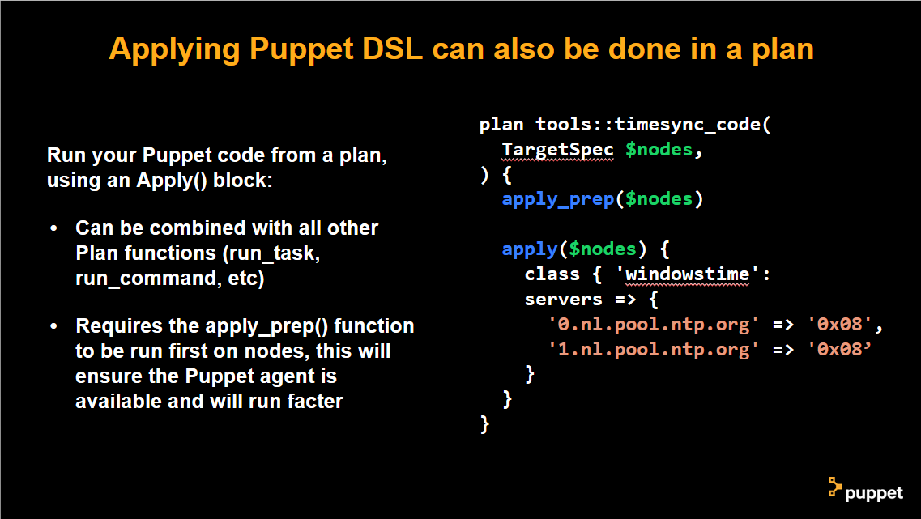

Slide 56
Lab Twelve:
Cross Platform Plans

Slide 57
Lab Twelve Instructions
In VS Code, edit timesync_code.pp and replace the contents with the contents of timesync_code_cross.pp in the root of https://github.com/puppetlabs-seteam/bolt-timesync
Run bolt plan run tools::timesync_code --nodes windows,linux
Tip: To change the frame color of these slides, just right click anywhere outside of the slide, (or on its thumbnail in the left panel) and choose “Format Background”. Then change the background color in the “Format Background” panel to the right.

Slide 58
Recap Time!
We’ve now learned how with Puppet Bolt:
Commands, scripts, tasks, plans and manifests can be run with Puppet Bolt
What the natural progression of automation looks like
Turning interactive commands into scripts
Turning scripts into tasks
Turning tasks into plans
Leveraging existing desired state modules and manifests
Incorporating desired state code into plans
Tip: To change the frame color of these slides, just right click anywhere outside of the slide, (or on its thumbnail in the left panel) and choose “Format Background”. Then change the background color in the “Format Background” panel to the right.

Slide 59
Connecting to Puppet Enterprise
To complete the automation journey, all that’s left to do is maturing into PE
Leverage PE to continuously & automatically enforce desired state code
Gain auditability in PE on Bolt Tasks, Task Plans and manifests
Use RBAC in PE to delegate permissions to other teams/coworkers
Connect Bolt to PE to gain direct control over PE-managed nodes
Tip: To change the frame color of these slides, just right click anywhere outside of the slide, (or on its thumbnail in the left panel) and choose “Format Background”. Then change the background color in the “Format Background” panel to the right.

Slide 60


