Slide 1
Encryption at Rest
JJ Quinlivan
Akron Linux Users Group
October 4th, 2018
Notes:
At Rest Encryption
https://www.linuxjournal.com/content/rest-encryption
17 things everyone should do to protect yourself
https://www.linuxjournal.com/content/security-17-things

Slide 2
JJ Quinlivan
Computer Consultant for 25 Years
Disabled for last 10 years
Linux Enthusiast
  Lots of time to research and play with Linux and open source software!
Not an Expert!

Slide 3
Agenda
Encryption Overview
Encryption at Rest
  Full Disk Encryption: SED, LUKS, VeraCrypt
  File Encryption: Encryptfs, Cryptomator, GPG
  Encryption in the Cloud: Zero Knowledge

Slide 4
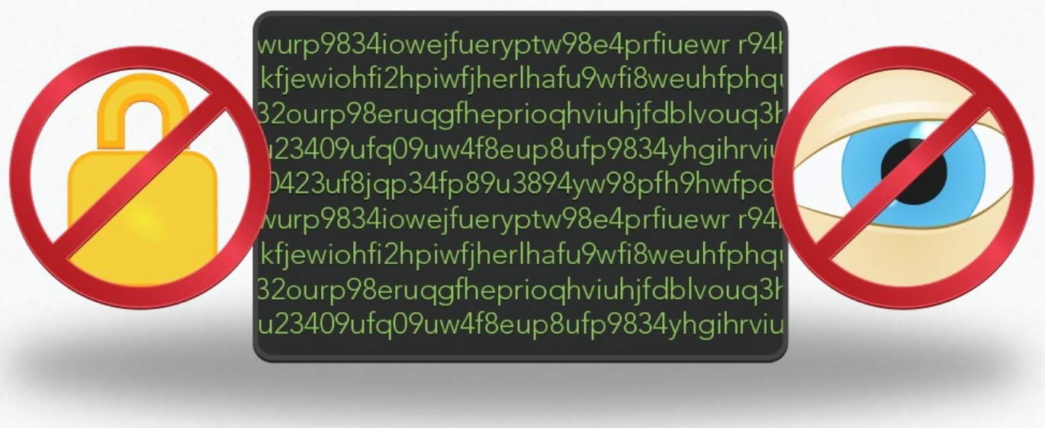
Encryption: What is it for?
Encryption is not security
Encryption is about privacy

Slide 5
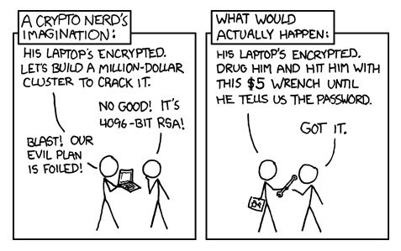
Encryption Myths
Notes:
Five Encryption Myths
https://www.makeuseof.com/tag/dont-believe-5-myths-encryption/

Slide 6
What to worry about
Strength of Algorithm used
Prefer Open Source Software
  Code can be audited and reviewed by public
Hide file structure/location of files
  More difficult to locate and decrypt sensitive files
Plausible Deniability?

Slide 7
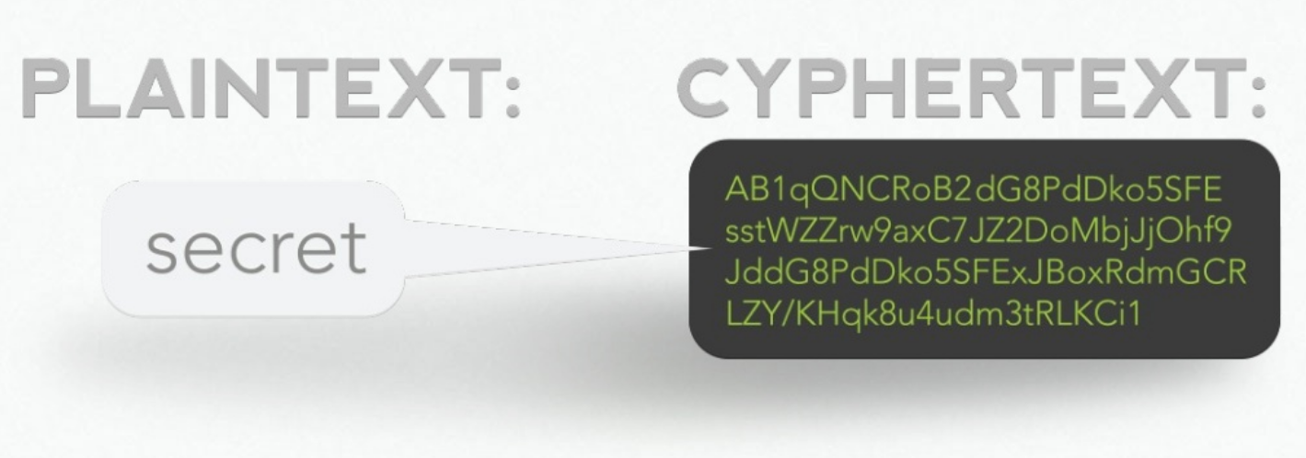
How Encryption Works
Uses a encryption algorithm and key to convert data to cyphertext

Slide 8
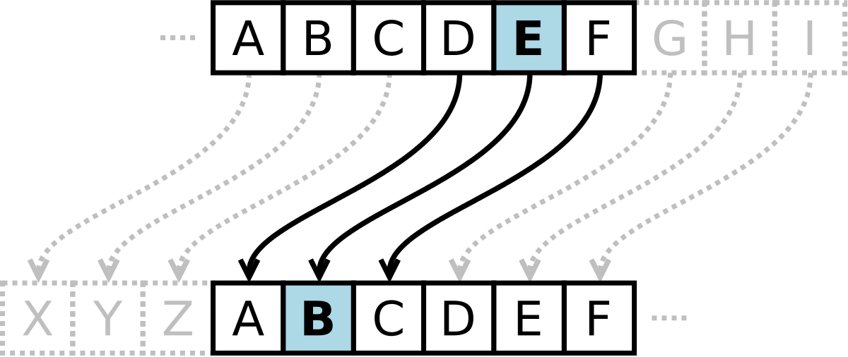
Caesars Cypher
  One of the first recorded encryption standards
  Moved each letter a fixed number of spaces
Notes:
Encryption 101: What is it? When should I use it?
https://www.welivesecurity.com/2016/02/04/encryption-101-useful/

Slide 9
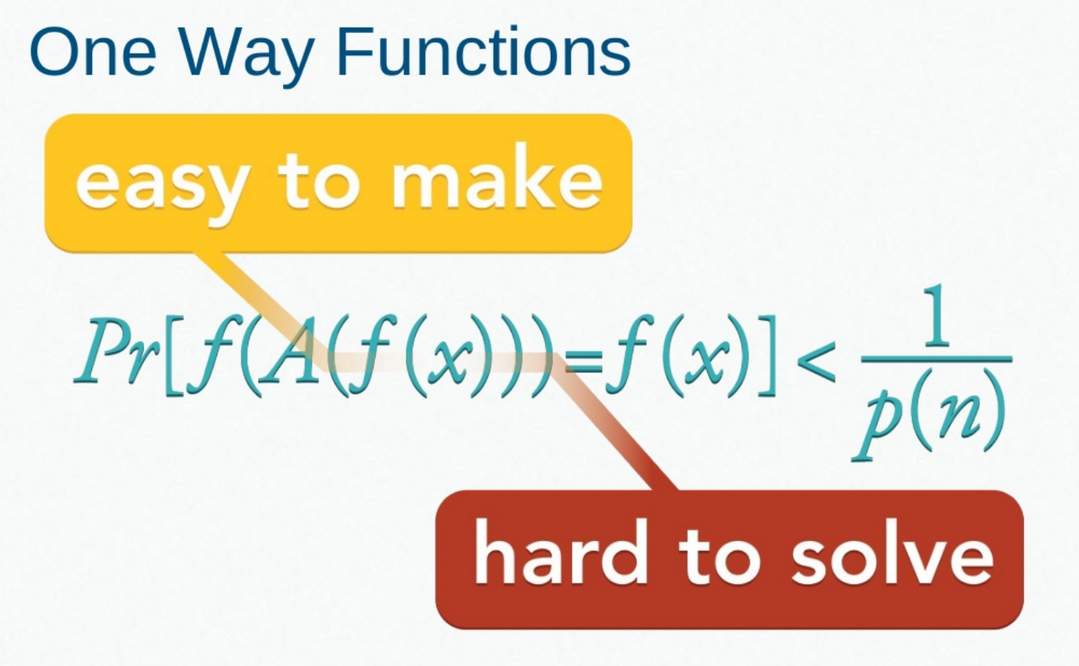
Today's Encryption Algorithms
Uses complex math called:
Notes:
Video - One Way Function – Applied Cryptography
https://www.youtube.com/watch?v=GE3dsA5S7M8
Cryptography Lecture Slides
https://www.icg.isy.liu.se/courses/tsit03/forelasningar/cryptolecture06.pdf

Slide 10
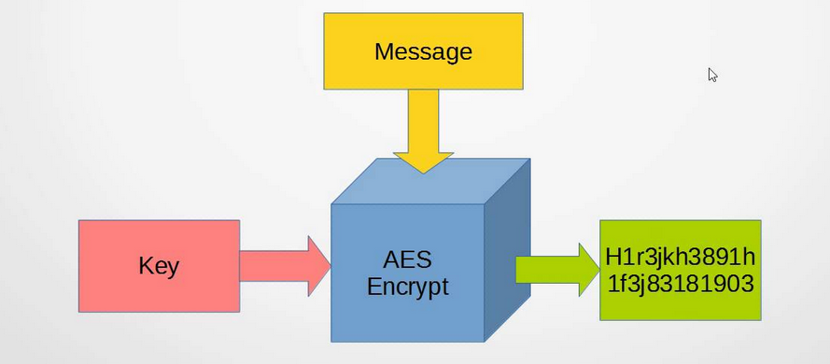
Advanced Encryption Standard (AES)
Adopted in 2001 by NIST
Considered best symmetric algorithm available today
Key sizes of 128, 192, 256 or 512
Notes:
What is Advanced Encryption Standard (AES)
https://thebestvpn.com/advanced-encryption-standard-aes/
Video: AES a Conceptual Review
https://www.youtube.com/watch?v=liKXtikP9F0

Slide 11
Symmetric vs Asymmetric Encryption
Symmetric means the same key used to encrypt the message will also decrypt it
  Very efficient = can easily and quickly encrypt and decrypt
  Key distribution is a problem
Asymmetric means uses a key pair one to encrypt, one to decrypt
  One of the keys is designated as private, the other public
  Arbitrary which is which
  Requires more resources/slower than symmetric

Slide 12
Importance of strong Passphrase
Encryption is only as good as the passphrase used to secure it
Use passphrases not passwords
Use Password Manager:
  Open Source Password Managers
    Bitwarden – similar to LastPass
    KeePassXC – Passwords stored locally
    Master Password – No stored passwords
Notes:
Bitwarden
https://bitwarden.com/
KeePassXC
https://keepassxc.org/
Master Password
http://www.masterpasswordapp.com/

Slide 13
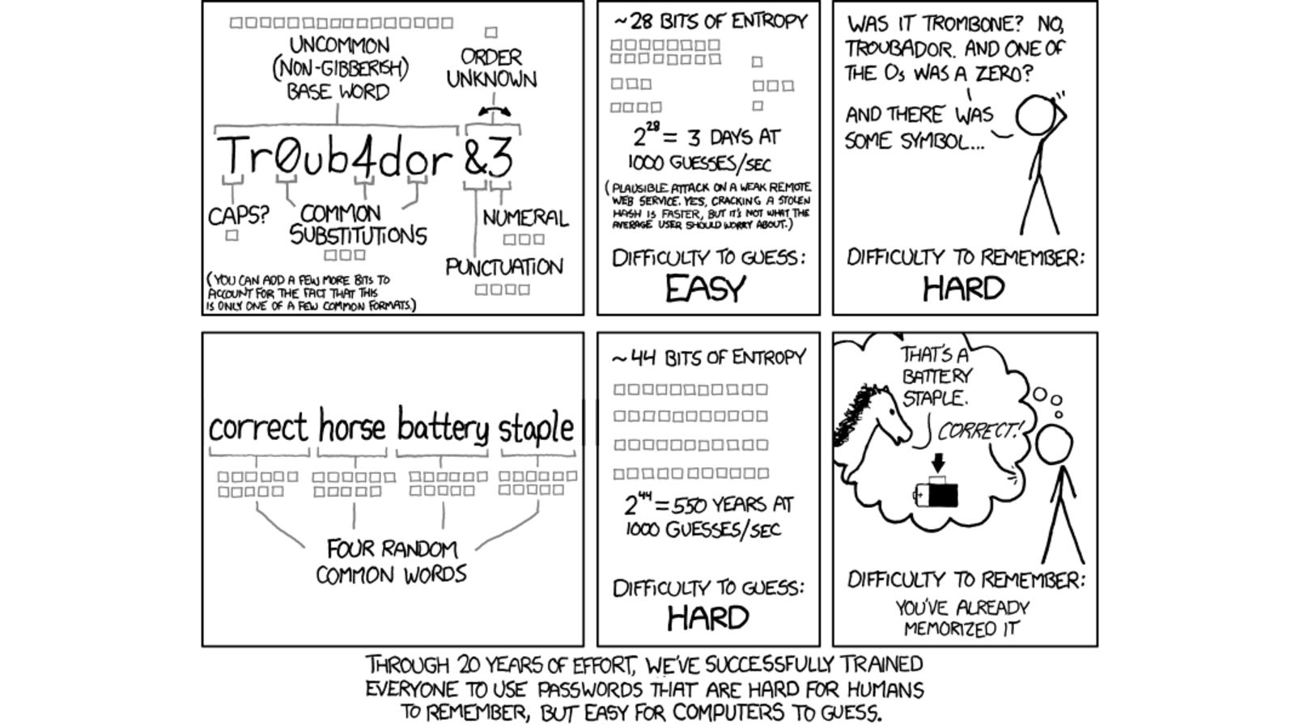
Good Passphrases
Group of random words
Use Diceware
Notes:
EFF Dice-Generated Passprases
https://www.eff.org/dice
EFF’s New Diceware Wordlists
https://www.eff.org/deeplinks/2016/07/new-wordlists-random-passphrases
Original Diceware website
http://world.std.com/~reinhold/diceware.html

Slide 14
Types of Encryption
Full Disk Encryption
  Protection from Physical Theft, Law Enforcement Seizure
File Encryption
  Protection of sensitive files while computer is running
  Protection of files stored in the cloud
Encryption in Transit
  Not covered today
Notes:
Why you need Disk and File Encryption
https://microage.com/blog/why-you-need-disk-file-encryption/

Slide 15
Full Disk Encryption
Self-Encrypting Drives (SED)
DM-Crypt/LUKS
  (Linux Unified Key Setup)
VeraCrypt

Slide 16
Use Full Disk Encryption Everywhere
Don’t Encrypt just your sensitive files
Anyone who picks up your device even if locked can attach the storage to another machine and access your files
Your data can be stored in:
/tmp
Swapfile
/var subdirectories
Notes:
LUKS vs ECryptFS Home Folder Encyption Performance Benchmarks
https://www.phoronix.com/scan.php?page=article&item=ubuntu-1804-encrypt&num=1

Slide 17
Self-Encrypting Drives (SED)
What is it:
  Hardware encryption built-in to SSD and spinning disks
  Opal 2.0 Standard
  Drives are always encrypted – unlocked until passphrase added
How to use it:
  Boot drives are split into small hidden boot partition and rest of drive.
  While locked only small partition is available
  Download SEDUTIL to lock drives and set passphrase
Notes:
SEDUTIL Encrypting Your Hard Drive
https://github.com/Drive-Trust-Alliance/sedutil/wiki/Encrypting-your-drive
Video: Bypassing 0f Self-Encrypting Drives
https://www.youtube.com/watch?v=dG7RQgBK0Zo

Slide 18
Self-Encrypting Drives (SED)
Pros
  Encryption on by default
  Does not use CPU to decrypt/encrypt
  Very Fast
  All drives set with same password
  Does not require BIOS support (SEDUTIL)
Cons
  Drive unlocked until PC loses power
  Drive easily accessible if PC is powered or suspended
  Does not support External drives
  Some BIOS confused about boot partitions when locked

Slide 19
Self-Encrypting Drives (SED)
When to use:
  Desktop Computers
  Most SSDs support Opal 2.0 standard today
Do not use on Notebooks unless you always poweroff (no suspend)

Slide 20
SEDUTIL
Download SEDUTIL USB Image
#linuxpba
DTA LINUX Pre Boot Authorization
Please enter pass-phrase to unlock OPAL drives: *****
Scanning....
Drive /dev/nvme0 Samsung SSD 960 EVO 250GB is OPAL NOT LOCKED
Drive /dev/sda Crucial_CT250MX200SSD1 is OPAL NOT LOCKED
Drive /dev/sdb Samsung SSD 850 EVO 500GB is OPAL NOT LOCKED
Drive /dev/sdc ST500LT025-1DH142 is OPAL NOT LOCKED
Drive /dev/sdd Samsung SSD 850 EVO 250GB is OPAL NOT LOCKED
sedutil-cli --initialsetup debug /dev/sdc
sedutil-cli --enablelockingrange 0 debug /dev/sdc
sedutil-cli --setlockingrange 0 lk debug /dev/sdc
sedutil-cli --setmbrdone off debug /dev/sdc
gunzip /usr/sedutil/UEFI64-n.nn.img.gz <-- Replace n.nn with the release number.
sedutil-cli --loadpbaimage debug /usr/sedutil/UEFI64-n.nn.img /dev/sdc <-- Replace n.nn with the release number.

Slide 21
DM-Crypt/LUKS
What is it:
  LUKS – Linux Unified Key Setup
  Widely used Encryption standard used in Linux
  Encrypts Entire drive or partition
  Can be used to Encrypt Files
  Many distributions support LUKS encryption for root by default in installer
  LUKS Header can hold 8 separate passphrases
  One master key unlocked with passphrase
Notes:
DM-Crypt/LUKS main site:
https://gitlab.com/cryptsetup/cryptsetup/wikis/home
Arch LInux Wiki on DM-Crypt/LUKS
https://wiki.archlinux.org/index.php/dm-crypt/Device_encryption
Ubuntu Wiki on Manual Full System Encryption
https://help.ubuntu.com/community/ManualFullSystemEncryption
Great Videos on Setting up LUKS for data drive (Playlist)
https://www.youtube.com/watch?v=ch-wzDyo-wU&list=PLSmXPSsgkZLs7eIWJAiEDqehgDaZItim_

Slide 22
DM-Crypt/LUKS
Pros
  Long lasting encryption standard
  Independently audited
  Easy to setup
Cons
  Drive must be wiped to setup
  *nix only (No Windows/MAC Support)
  Although rare LUKS header can be corrupted
    Header can be backed up or even removed

Slide 23
DM-Crypt/LUKS
When to use:
  All bootable drives be encrypted with either SED or LUKS
  Any USB flash drives that hold sensitive data
  All drives used for backup

Slide 24
Cryptsetup
Demo

Slide 25
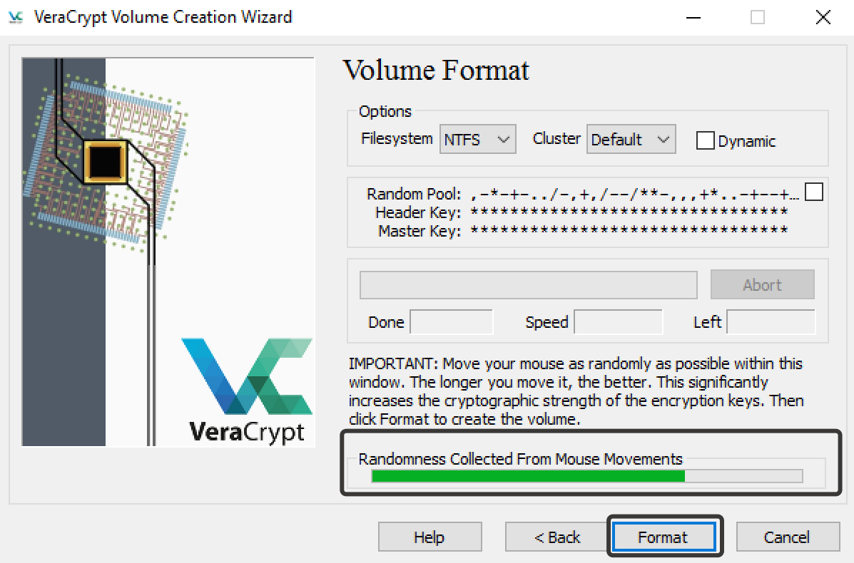
VeraCrypt
What is it:
  Cross Platform Encryption Software
  Based on TrueCrypt
    TrueCrypt no longer updated
    Fixed security bugs in TrueCrypt
  Can be used to encrypt
  drives or files
Notes:
VeraCrypt Home
https://archive.codeplex.com/?p=veracrypt
How to use VeraCrypt on Linux
https://www.addictivetips.com/ubuntu-linux-tips/use-veracrypt-on-linux/
Video VeraCrypt on Linux
https://www.youtube.com/watch?v=cFipj_GOWjU

Slide 26
VeraCrypt
Pros
  Cross Platform
  Easy Graphical Interface
  Can create hidden encrypted partition
Cons
  More difficult than LUKS to setup as Linux boot/root drive
  One large container created for file encryption
When to use
  Need to access partitions between different operating systems

Slide 27
File Encryption
Encryptfs
Cryptomator
GPG

Slide 28
Encryptfs
What is it
  GPG as a file system
  Uses master key to encrypt each file in directory automatically
Pros
  Many distributions make it easy to encrypt home directory with Encryptfs
Cons
  Linux Only
  Does not hide filenames
When to use
  Don’t
Notes:
(I don’t recommend this but If you really want to)
Debian Wiki on Encrypting Home Folder
https://wiki.debian.org/TransparentEncryptionForHomeFolder
Video: Encrypt Home Folder
https://www.youtube.com/watch?v=LJ9vOuYvGLo

Slide 29
Cryptomator
What is it
  Cross Platform
  Encrypts files automatically stored in directory
  Splits files into small encrypted parts
Pros
  Easy to use
  Can be used to sync encrypted files between PC and cloud storage (i.e. Dropbox)
When to use
  Encrypt sensitive files while computer is running or synced to cloud storage
Notes:
Cryptomator Home Page
https://cryptomator.org/
Instructions on use:
https://www.addictivetips.com/ubuntu-linux-tips/secure-cloud-data-on-linux-with-cryptomator/
Videos on Cryptomator:
https://www.youtube.com/channel/UCEGvhHt_j1pQtsHCPc_9Ptg

Slide 30
Cryptomator Setup
Demo

Slide 31
GnuPG (GPG)
What is it
  Open source version of Pretty Good Privacy
  Both Symmetric and Asymmetric Encryption
  Primarily used to transfer files/emails to others
Pros
  Can easily encrypt single file
  Public/Private Key Encryption and signing
Cons
  Can be confusing to learn
  Command line interface
When to use
  Encrypting an individual file
  Create for encrypting compressed files (tar files)
  Sending a file to another person
Notes:
Ways to Encrypt Files in Linux
http://www.linuxandubuntu.com/home/ways-to-encrypt-files-in-linux
Protect your files with these tools:
https://www.techrepublic.com/blog/five-apps/protect-your-data-with-these-five-linux-encryption-tools/
How to Encrypt Files and Folders in Ubuntu:
https://www.makeuseof.com/tag/encrypt-files-folders-ubuntu/

Slide 32
Encrypt/Decrypt Files with GPG
Encrypt Command:
Will be asked for a passprase twice
Creates file with .gpg extension
Decrypt Command
gpg --symmetric --cipher-algo AES256 ~/Documents/PrivateFiles/MyPrivateFile.txt
gpg -o ~/Documents/PrivateFiles/DecryptedFile.txt -d ~/Documents/PrivateFiles/MyPrivateFile.txt.gpg

Slide 33
Other options:
Gnome Encfs Manager
  Encfs Insecure
KDE Vault
  Supports Encfs and CryFS
KGpg
OpenSSL
Notes:
Video on KDE Plasma Vaults
https://www.youtube.com/watch?v=5vxlIXnuVuM
How to Create Encrypted Folders on KDE Linux
https://www.addictivetips.com/ubuntu-linux-tips/create-encrypted-folders-on-kde-linux-desktop-with-vaults/

Slide 34
Encryption in the Cloud
Zero Knowledge
  End-to-End Encryption
  Cloud storage service has know nothing about your data stored on their servers
  Data is encrypted and decrypted on the client
  Service has no access to the encryption key
Why?
  Service cannot access your data
  Government cannot demand your data from the cloud service
Notes:
What is Zero Knowledge Encryption
https://tresorit.com/blog/zero-knowledge-encryption/
Best Cloud Storage for Linux
https://www.cloudwards.net/cloud-storage-for-linux/
Best Zero-Knowledge Cloud Services
https://www.cloudwards.net/best-zero-knowledge-cloud-services/

Slide 35
Encryption in the Cloud
Options
  Manually with Cryptomator, GPG, etc.
Services that provide Zero Knowledge Cloud Storage (for Linux)
  tresorit $10.42/200GB
  pCloud $3.99/500GB + $4.99 for Crypto addon
  SpiderOak $4.92/150GB
  iDrive $4.34/2TB (Backup service)

