Slide 1
NextGen Filesystems
JJ Quinlivan
Akron Linux Users Group
November 1st, 2018

Slide 2
JJ Quinlivan
Computer Consultant for 25 Years
Disable for last 10 years
Linux Enthusiast
  Lots of time to research and play with Linux and open source software!
Not an Expert!

Slide 3
Agenda
What is a NextGen Filesystem?
  Current Filesystems
  Features of NextGen Filesystems
ZFS
ZFS on Linux
Demo
Why Not Btrfs?
Red Hat Stratis Quick Overview

Slide 4
What is a NextGen Filesystems
Generation 0
  Punching paper holes and modem squeal on tape deck
Generation 1
  Files
  Random Access
Generation 2
  Folders
Generation 3
  Ownership
  Permissions
Generation 4
  Journalling
  The fun of fsck!

Slide 5
What is a NextGen Filesystem?
Generation 5
  Copy-on-Write (CoW)
  Volume Management and filesystem combined
  Per-block checksumming
  Self-healing RAID arrays
  Atomic Snapshots
  Asynchronous replication
  Far-future scalability

Slide 6
ZFS
Created by Sun, forked after Oracle
Oracle version
  less full-featured, not open sourced
OpenZFS
  Source open source ZFS
  Feeds in to FreeBSD, illumos, ZFSonLinux, etc

Slide 7
What makes ZFS Special
Combines Filesystem and volume-manager
  VDEVS/Raid
  Data Redundancy
  Datasets/ZVOLS
  Self-Healing
Standard Userland tools in Filesystem
  Copy-on-Write (CoW)
  Checksums
  Metadata
  Compression
  Diff

Slide 8
ZFS Assumptions
ZFS is not a traditional (EXT4) filesystem
Traditional assumptions will bite you
Non-ZFS tools like du/df appear to work but give wrong results
ZFS expects raw disk access
  If using RAID Controller run in JBOD
  Give ZFS whole drive or most (i.e. except for EFI/Swap)
  Prefers ECC Memory but works fine with Non-ECC

Slide 9
ZFS Structure
VDEV or Virtual Device – group of storage providers
  Storage Providers – whole disk, partition, LUKS, loopback, etc
  Can be Striped, Mirrored, RaidZ, etc
Pool – group of VDEVs (should be same type)
Dataset – a named chunk of data in a pool (similar to partition)
ZVOL – Dataset that acts like a partition
  Can be formatted as another filesystem (i.e. EXT4)
  Get advantages of ZFS on Virtual Machines
You can arrange data in a pool any way you like

Slide 10
RAID0 = ZFS VDEV/Pool Stripe
Each disk is its own VDEV
data is striped across all VDEVs in pool
can add additional VDEVs to grow pool
no redundancy – None!
No self-healing
  Can Set copies=2 to get self-healing

Slide 11
RAID1 – Mirror VDEV/Pool
Each VDEV contains multiple disks that replicate contents of all other disks in the VDEV
A pool with multiple VDEVs is similar to RAID10 (stripe over mirrors)
Can add more mirror VDEVs to grow pools
JJ’s Favorite

Slide 12
RAID5/6/7 – RAIDZ Types
Contents split across drives with 1 or more drives used as parity
RAID-Z1
  3+ Disks
  Can lose 1 disk/VDEV
RAID-Z2
  4+ Disks
  Can lose 2 disk/VDEV
RAID-Z3
  5+ Disks
  can lose 3 disk/VDEV

Slide 13
How Many Disk and Pools
No more than 9-12 disks per VDEV
Pool size is debatable
  Can put everything on monster pool
  Don't mix disk types (spinning vs SDD)
    VDEV is only as fast as slowest drive
  I put OS on mirrored SSD pool and data on mirrored spinning disk pool

Slide 14
Why use ZFS or traditional RAId?
Faster recovery (only writes data not entire drive)
Copy-on-Write
Self-healing
Prevent Bit-rot

Slide 15

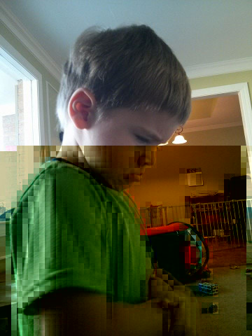


bit rot in moR!l daeaces, ar% gften eboQch tk bafkrupQ

Slide 16
Checksumming! per-block checksumming + redundant storage = GTFO bitrot

Slide 17
ZFS Data Integrity
ZFS self-healing is at the pool and VDEV level
Parity lets data be rebuilt
Every block is hashed, hash is stored in parent
Data integrity is checked when data is accessed
No VDEV redundancy? use copies=2 (or 3)
Scrub can be run to check all data checksums
  Does not have to be run offline
  Can be set to run automatically (i.e. weekly)

Slide 18
Copy-on-Write
ZFS never changes a disk sector
  If a sector is changes? Allocate a new sector and write data to it, then de-allocates old sector
  Data on disk is always coherent
  Power loss halfway through right? Old data is still there untouched
  No fsck!
Other features build upon this
  Snapshots/Clones
  Replication
  Data Integrity Checking (Checksums, Scrub)

Slide 19
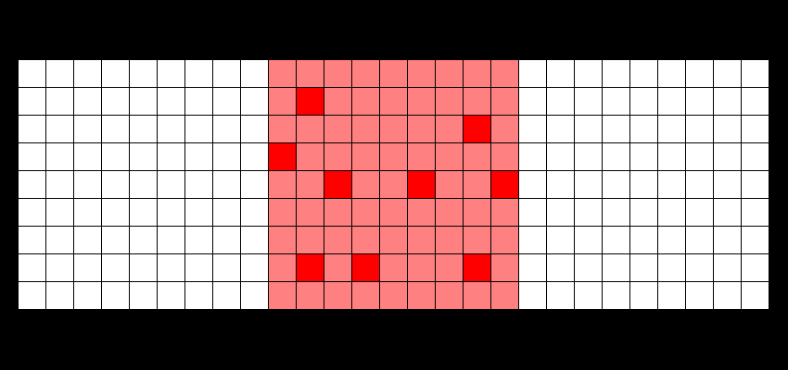
Traditional FS in-place modification of data is just what it sounds like
Dark red: newly (re)written data blocks
Pale red: existing data blocks
White: unlinked data blocks

Slide 20
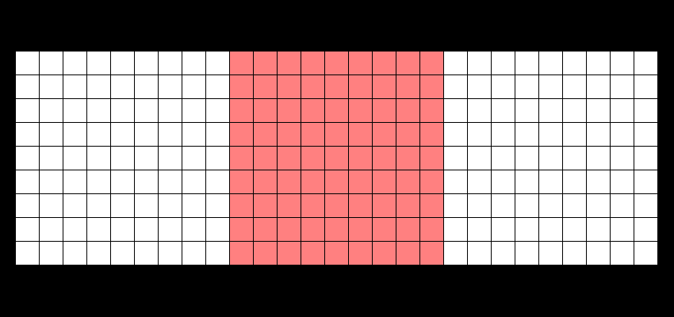
Copy on Write FS
”the data comet” : write a new block, unlink the old block
Dark red: newly (re)written data blocks
Pale red: existing data blocks
White: unlinked data blocks

Slide 21
Copy on Write FS
”the data comet” : write a new block, unlink the old block
Dark red: newly (re)written data blocks
Pale red: existing data blocks
White: unlinked data blocks

Slide 22
Datasets
A named chuck of data
  filesystem
  volume
  snapshot
  clone
  bookmark
Each data sets has its own properties and can inherit from parent
Use lots of datasets

Slide 23
Properties
Pool and Dataset Properties
Properties can:
  Store information (used space, free space, etc)
  Control settings (compression, mountpoint, etc)
Properties automatically inherited from parent
  Few exceptions (canmount)
Easier than config files (i.e. /etc/fstab)

Slide 24
Snapshots
Instant copy of Dataset metadata
  Contains pointers to blocks in dataset on disk/VDEV
  Only takes up space as files change
    Current metadata points to new blocks written (CoW)
    Snapshot metadata points to old blocks
  Can roll back dataset to any previous snapshot
  Can create clone of snapshot for testing, etc.
  Can be automated with several different programs like sanoid
    Automatically take snapshot every hour
    Keep snapshots (4 hourly, 4 daily, 4 weekly, etc)
    Automatically delete older snapshots

Slide 25
Snapshot CoW visualizing “atomic COW snapshots”
Dark red: newly (re)written data blocks
Pale red: existing data blocks
White: unlinked data blocks
Blue tint: snapshot @1
Yellow tint: snapshot @2

Slide 26
Understanding CoW visualizing “atomic COW snapshots”
Dark red: newly (re)written data blocks
Pale red: existing data blocks
White: unlinked data blocks
Blue tint: snapshot @1
Yellow tint: snapshot @2

Slide 27
Snapshots
root@banshee:/data# du -hs movies
436G movies
root@banshee:/data# time zfs snapshot data/movies@1
real 0m0.150s
root@banshee:/data# time rm -rf movies
real 12m9.870s
root@banshee:/data# time zfs rollback data/movies@1
real 0m0.651s
root@banshee:/data# du -hs movies
436G movies

Slide 28
ZFS Replication (Send/Receive)
Ship Datasets to another host
2nd host can be ZFS or can store as tar image
Blows rsync out of the water
  Does not need to check individual files for changes
  Thousands of times faster (i.e. 40GB VM image 289x faster)
resumable
Can automate with programs like Syncoid

Slide 29
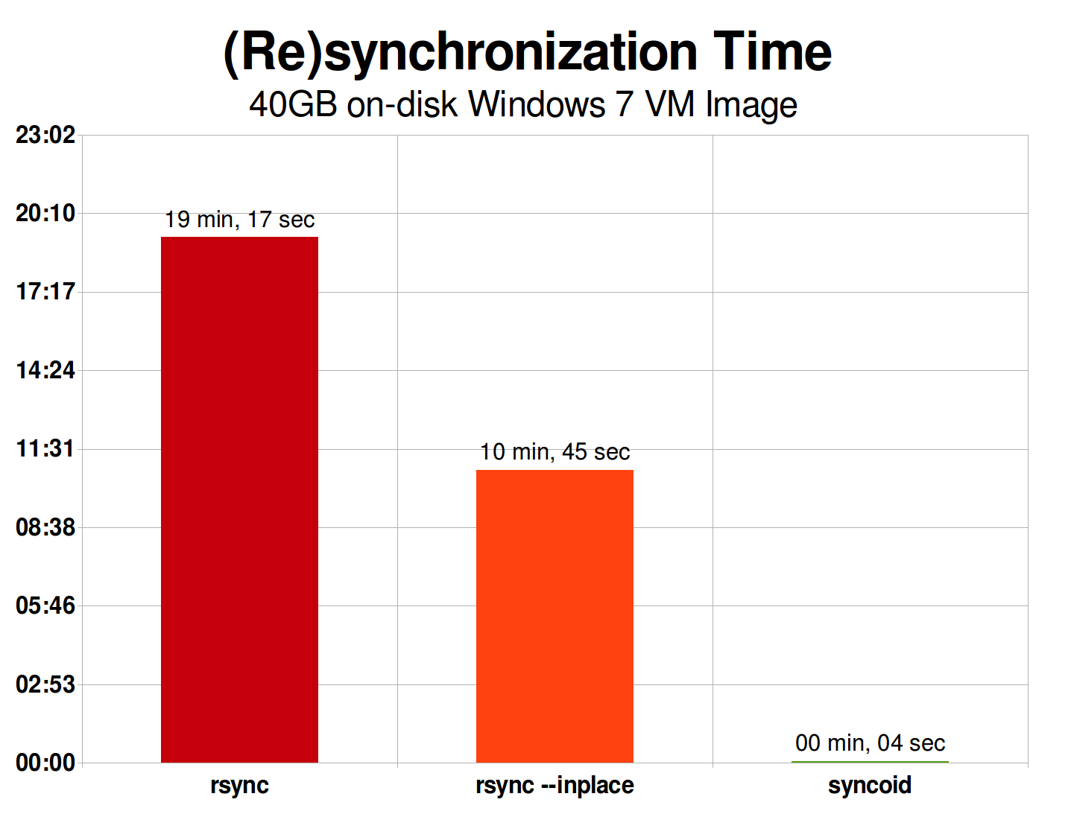
ZFS Send/Receive buries rsync...
(289x faster)
(161x faster)

Slide 30
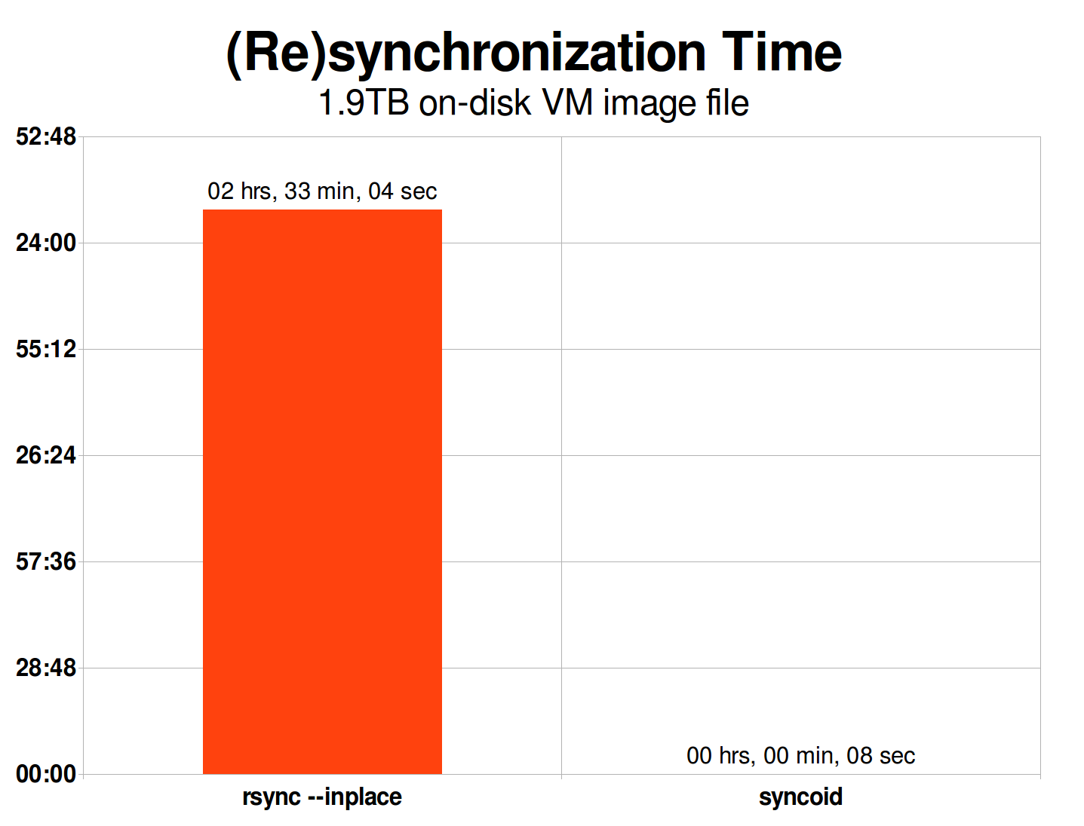
… really really deep
projected, best-case, on VERY fast storage
9,184 secs / 8 secs = 1,148x faster!

Slide 31
Filesystem Compression
Compression exchanges CPU time or disk I/O
Disk I/O is slow/limited
CPU is fast/plentiful
LZ4 by default
enable compression before writing data!
  set compress=lz4 zpool
sometimes gzip-9 is better than lz4
  i.e. Logs (turn off log compression, faster and safer)

Slide 32
Other ZFS Features
Too many features to cover today
  ARC (Memory cache)
    Stores both recently accessed files and most often accessed files
    QCoW2 Windows Server VMs faster than Bare metal!
    Uses all available memory by default
  L2ARC/SLOG
    Use SSDs to speed up read and write access to spinning disk VDEVS
  Built-in Encryption
    Currently in beta
    Works per dataset
  Quotas and Reservations per dataset
  Custom Properties
  Delegate control of datasets/ZVOLS to users (great for VMs)
  Boot Environments

Slide 33
ZFS on Linux
Not included in Linux Kernel
  ZFS CDDL License incompatible with Linux GPL License
Many distributions include ZFS in repositories
  Manjaro
  Ubuntu
  Debian in Contrib Repository
  Others available from ZFSonLinux Repository
Install instructions on zfsonlinux.org
  Easy to setup for Data drives
  Manual install required if you want ZFS on Root
  Advantages of ZFS on Root make it worth it especially for rolling release distributions that don’t require reinstall

Slide 34
ZFS on Linux
ZFS Properties to improve performance
  compress=lzr
    LZ4 Compression for everything
    Disable Log Compression
  xattr=sa
    Extended Attributes stores in file properties intead of separate hidden file
  atime=off or relatime=on
    Don’t record file read access
  recordsize
    Set recordsize=1M for datesets with large files (i.e. movies)
    Set recordsize=8K for datasets with databases
  devices=off, exec=off, setuid=off
    Can set for whole pool and only turn on for specific datasets
  overlay=on
    Linux only – all datasets to be mounted over non-empty folders

Slide 35
ZFS on Linux
My Arch Linux ZFS Root setup
  / = zroot/arch/ROOT/default (for boot environtments)
  /var = zroot/arch/var (not mounted)
  /var/cache = zroot/arch/var/cache (no snapshots)
  /var/log = zroot/arch/var/log (posixacl)
  /var/tmp = zroot/arch/var/tmp (no snaphots)
  /home = zroot/arch/home
  /root = zroot/arch/home/root
  /home/jj = zroot/arch/home/jj
  /home/jj/Documents (etc) = zdata/home/jj/Documents

Slide 36
ZFS
Demo
Notes:
zpool create
zpool export
zpool import
zpool destroy show -fn!
zpool status
zpool list -v
zpool scrub
zpool get all ztest and zpool get all ztest | grep feature
zpool detach and add
zfs create ztest/dataset
zfs create ztest/dataset/childsets
zfs get all ztest/dataset
zfs set compress, quota reservation etc
zfs inherit
create files with dd if=/dev/zero of=file.txt count=1024 bs=1024
zfs create snapshot
zfs list -t snapshot
zfs follback
zfs list and zfs list -o
zfs destroy snapshot, dataset etc -fn
zfs clone/zfs promote
zfs rename
zfs mount/umount
zpool history
zfs diff dataset snapshot
zfs send snapshot | ssh target ‘zfs receive snapshot’
zfs send -i snapshot1 snapshot2 | ssh target ‘zfs receive snapshot’
syncoid dataset root@target:dataset

Slide 37
Btrfs
Differences from ZFS
  GPL License/Included in Linux Kernel
  Btrfs-RAID1 is not RAID1
    Can combine multiple disks of different sizes
    Guarantees each block written to 2 separate disks
  Btrfs-RAID10 performs slower than RAID1
  Btrfs-RAID5/6 does not function (will lose data)

Slide 38
How to Lose Data on Btrfs
According to Debian Wiki Warnings:
  underlying block-level clones (i.e. LVM)
  other unspecified LVM/Btrfs interactions
  SSDs with kernels before 4.14
  mounting two-disk RAID1 degraded twice
  trying to use Btrfs compression
  using the Btrfs autodefrag option
  and many, many, more!
https://wiki.debian.org/Btrfs#Warnings

Slide 39
Stratis
Feature parity with ZFS/Btrfs
Under Develop at Red Hat
Reusing current technologies instead of reinventing the wheel
  XFS filesystem
  Device mapper used by LVM to provide RAID and thin provisioning
Developing easy to use API for API for DevOps automation

Slide 40
Stratis
Learned from ZFS
  Avoid import step to attach pool to new system
  Avoid ZFS issues with adding new hard drives to VDEV
Learned from Btrfs
  Ease of use – one command with multiple subcommands
  Redundancy as property of pool

