Slide 1
Containers 101
Author: JJ Quinlivan
Date: November 7, 2019

Slide 2

Containers 101 Agenda
What is a Container?
  Containers vs Virtual Machines
Where are Container Technologies used today?
Container Technologies
Docker/OCI vs Linux Containers (LXC)
Docker/OCI Overview
Orchestration Overview

Slide 3
Where are Container Technologies used Today?
Docker/OCI Containers
Linux Containers (LXC)
Snaps/Flatpaks
FireJail
The dreaded Google Chrome
Kubernetes, Amazon ECS etc.

Slide 4

What is a Container
Sandbox for a process
Uses technologies built-in to the Linux Kernel

Slide 5
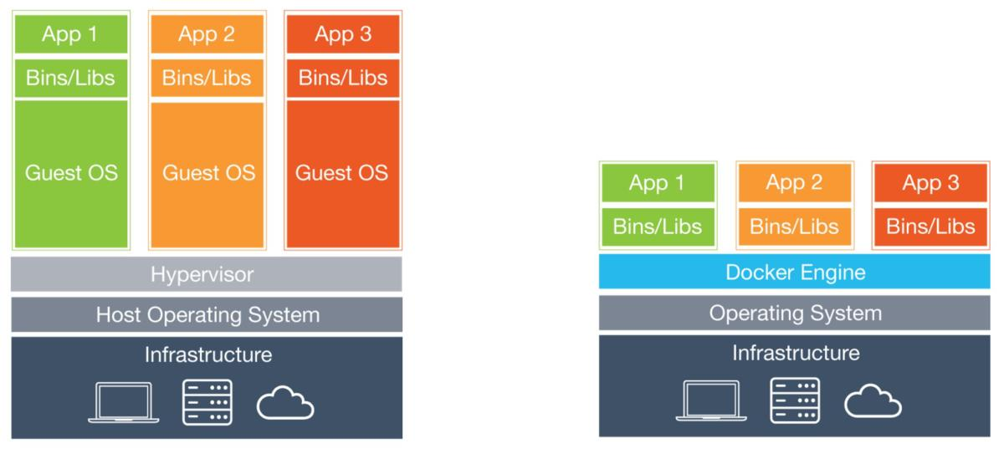
Containers vs Virtual Machines

Slide 6
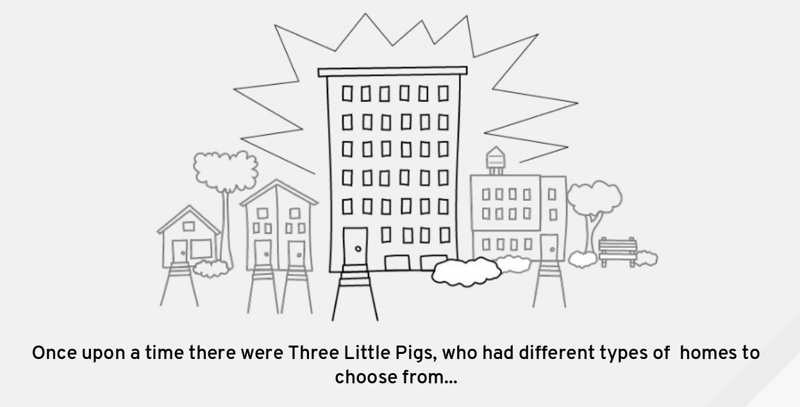
Three Little Pigs by Dan Walsh

Slide 7
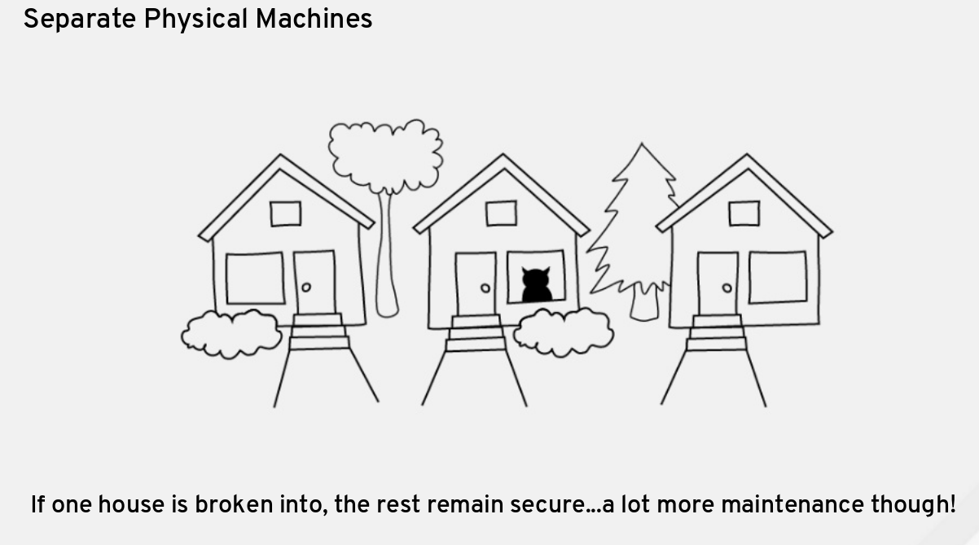
Standalone Homes

Slide 8
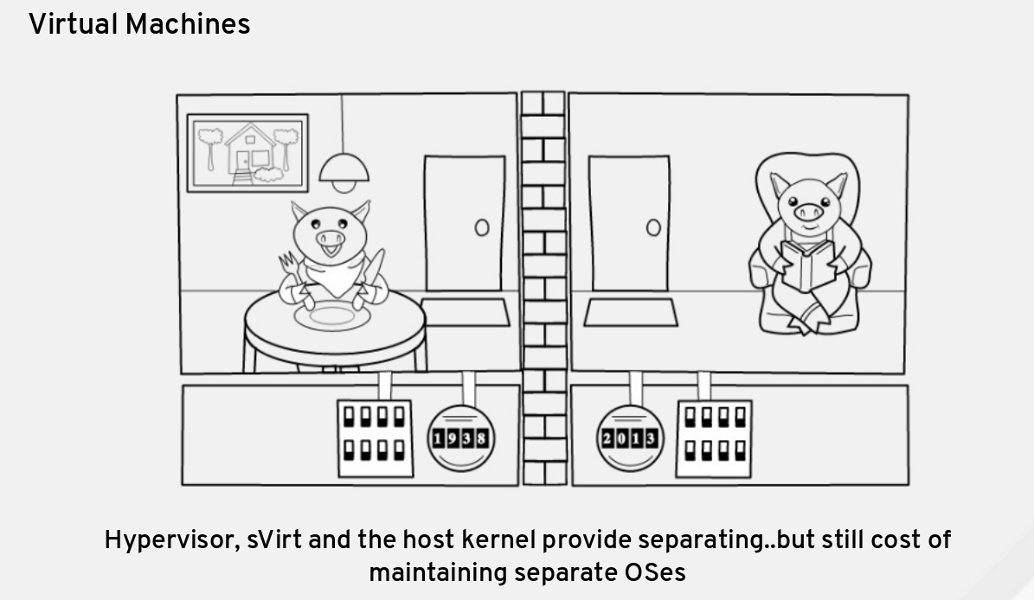
Duplex Home

Slide 9
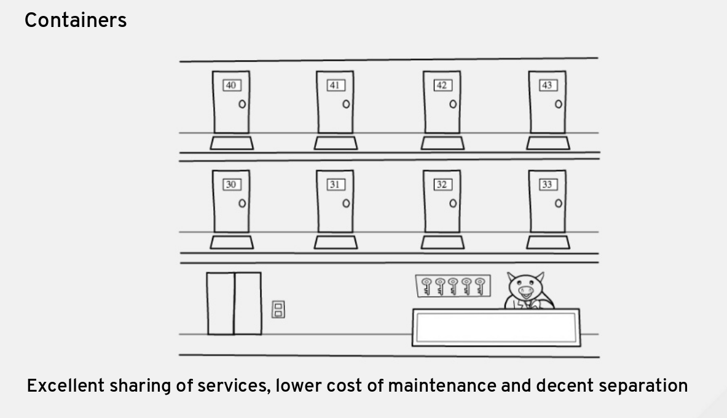
Apartment Building

Slide 10
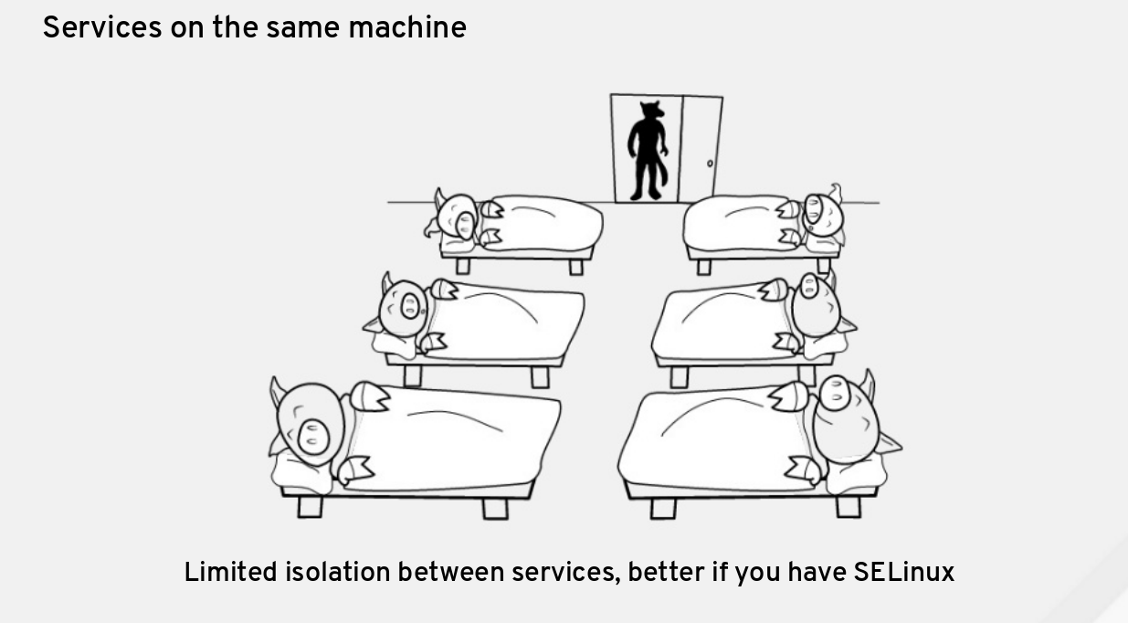
Hostel

Slide 11
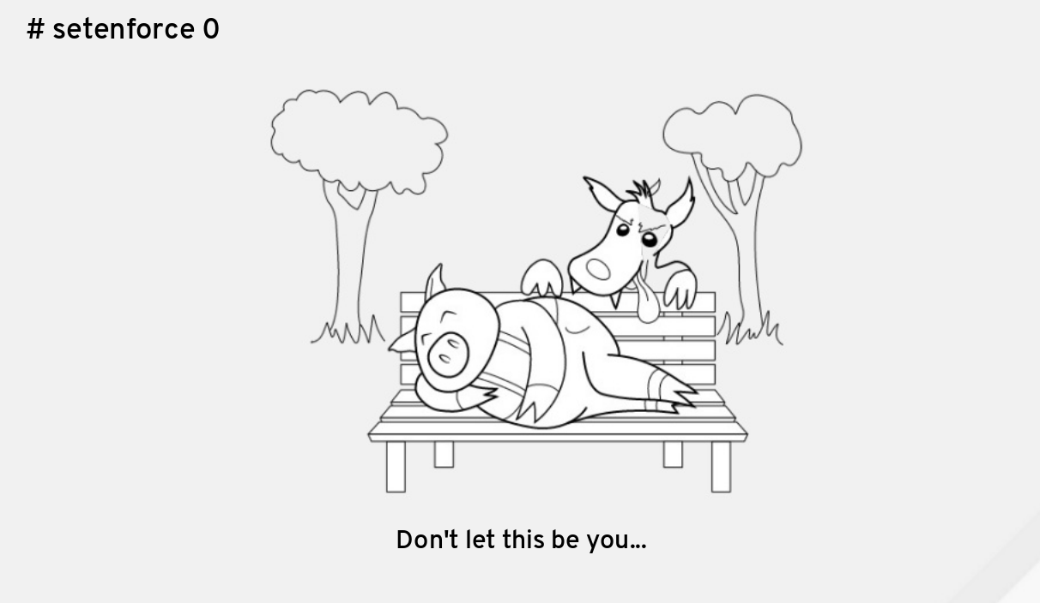
Park Bench

Slide 12
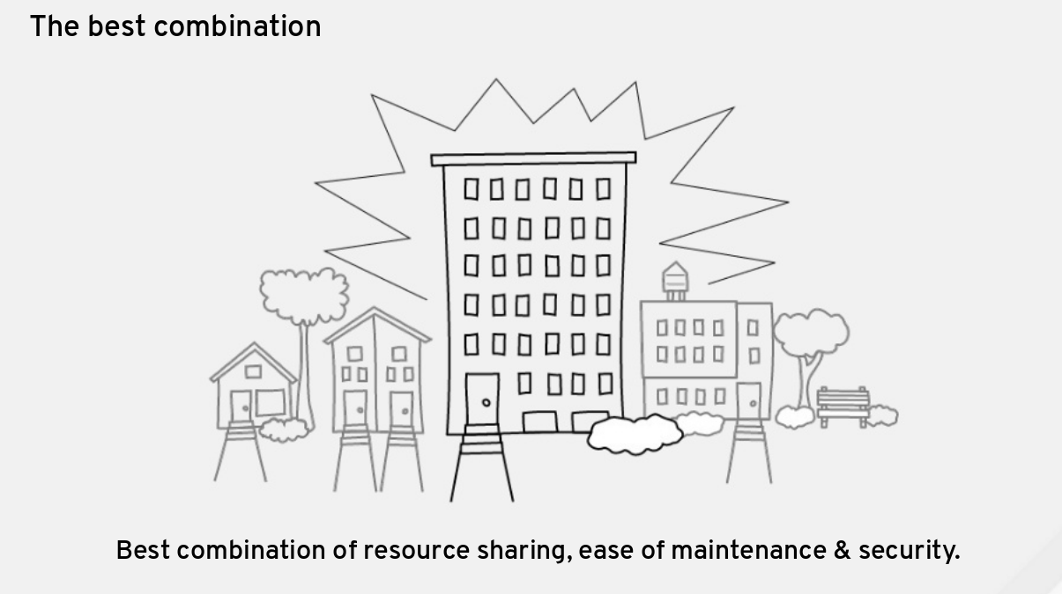
Pigs in Apartment Building

Slide 13
What’s a Container Made of
Chroot
Linux Namespaces
Cgroups
Linux Capabilities
SECCOMP

Slide 14
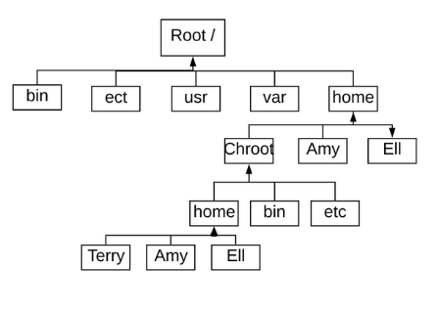
Chroot
Chroot = Change root
  Changes the apparent root directory.
  A new “root” directory becomes the root directory for both the current and running processes and all of the children processes.
  A new “root” directory is known as a jailed directory or “Chroot jail”.
  Chroot must be run as privileged user.

Slide 15
Chroot Demo

Slide 16
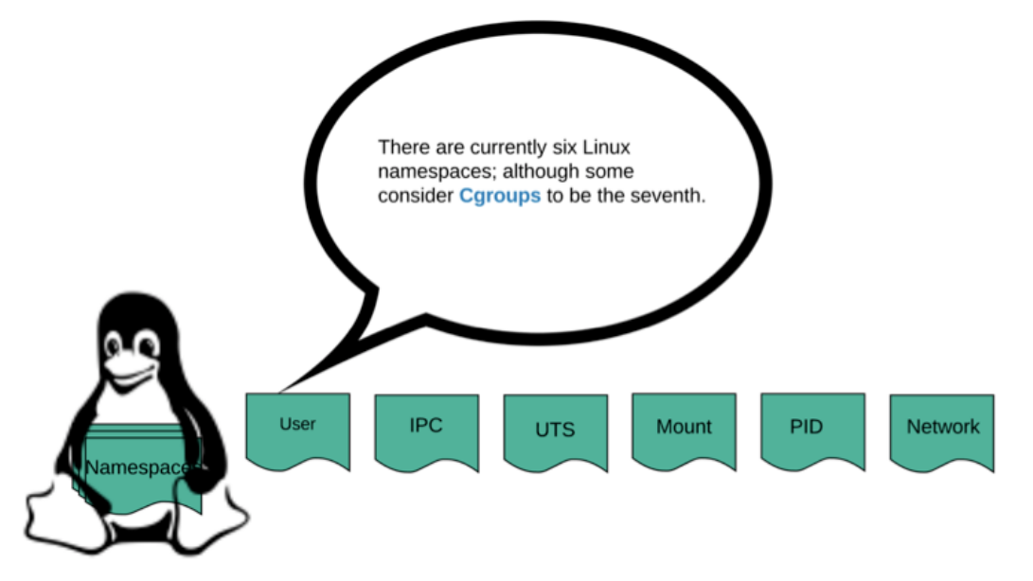
Linux Namespaces

Slide 17
Linux Namespace
User
  Maps non-root user ID on the host to root user ID in the namespace
  Can map non existent user ID on the host (i.e. ID above 65000)
IPC – Interprocess communication
UTS – different host and domain names
Mount
  Isolates the mount table
  Mount / Unmount operations isolated to the namespace
PID – Process IDs
Network
  Virtualize the network stack
  Each namespace can have it’s own virtual or physical network interface, resources and firewall rules.

Slide 18
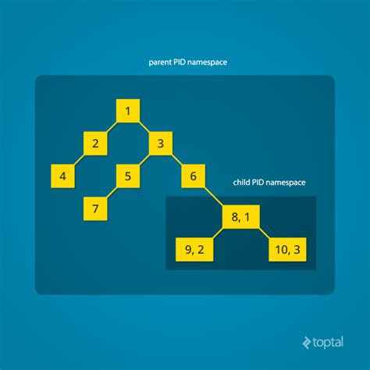
PID Namespace
Allows a container its own isolated instances of global resources
  I.E. PID namespace can only see processes running in the container

Slide 19
Network Namespace Demo

Slide 20
Cgroups – Control Groups
Limits the usage of resources to the container/process
  Number of CPU cores
  % of CPU usage
  Amount of memory
Control which device nodes can be created within a namespace
  i.e. /dev/console, /dev/tty, /dev/random used by kernel and by default not available to containers
Access in /sys/fs/cgroup

Slide 21
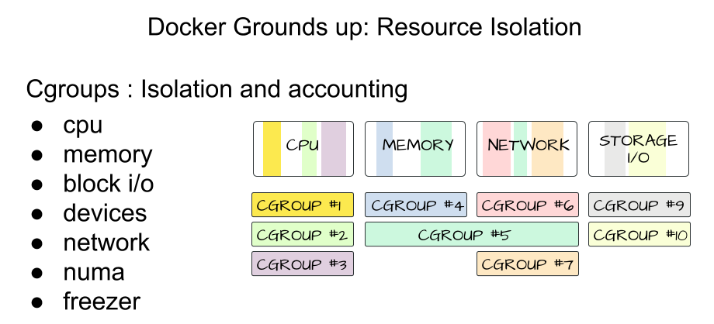
Cgroups – Control Groups

Slide 22
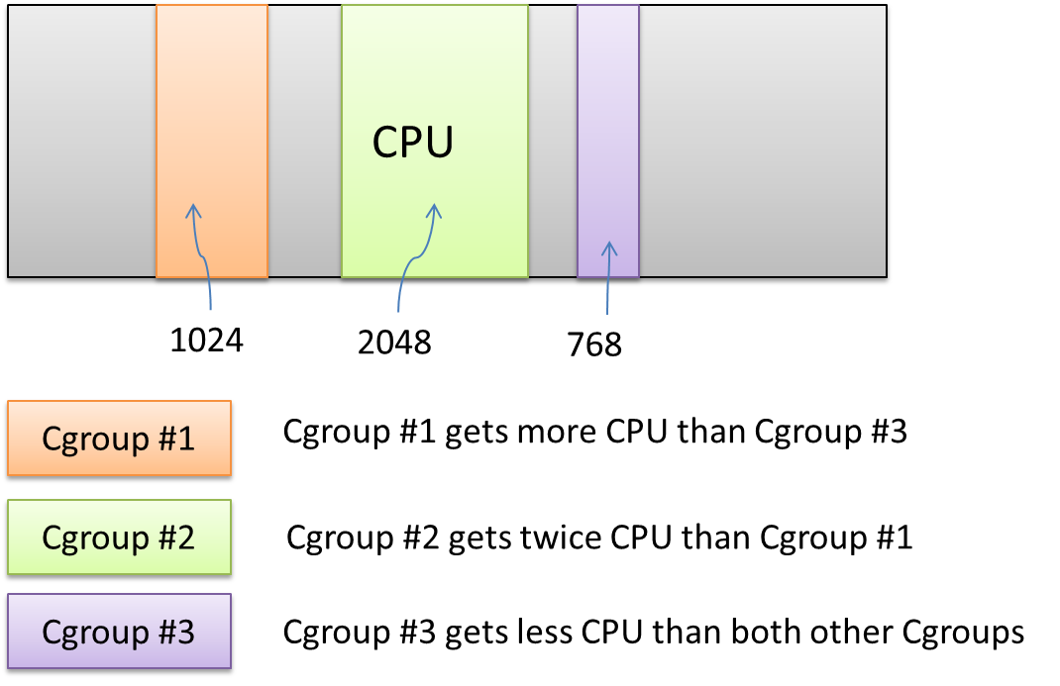
Cgroups – Control Groups

Slide 23
Linux Capabilities
Linux root privileges broken down into 32 capabilities
Capabilities can be disabled per container.
Two capabilities always dropped:
  CAP_NET_ADMIN: capability to configure network (i.e. ip routes, firewall rules, etc.)
  CAP_SYS_ADMIN: catch all capability, used to control mounts

Slide 24
SECCOP
Containers can interact with kernel system calls (syscalls)
  i.e. bind, accept, fork
SECCOMP limits the number of syscalls a container can access
Docker disables around 44 of 300+ system calls with default aptions
  i.e. mount, settimeofday

Slide 25
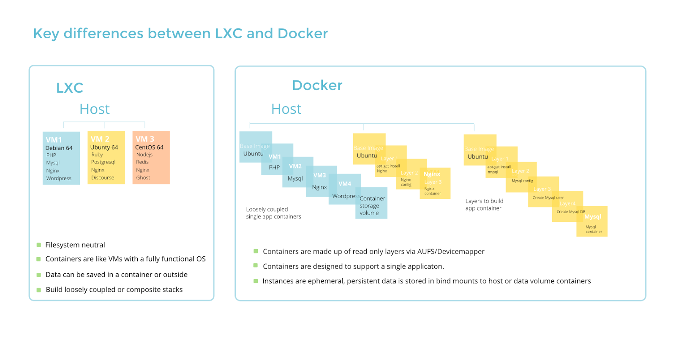
Docker/OCI vs Linux Containers/LXC

Slide 26
Benefits of Docker/OCI Containers
Portable Deployment Across Machines
App Centric
  Sometimes referred to application containers vs machine containers
Automatic Build
Versioning
Component re-use
Sharing

Slide 27
Docker/OCI: Images
What is an Image?
  Fully self-contained “thing” that contains everything an app needs to run
    Application source code
    All runtime dependencies, config files, and binaries
  At the end of the day, it’s basically just a transportable file system
  Images are Stateless and Immutable!
  Share images by pushing to a registry
    Docker Hub is the default Docker registry
    Many other third-party registries exist
    Once shared, others can pull the image

Slide 28
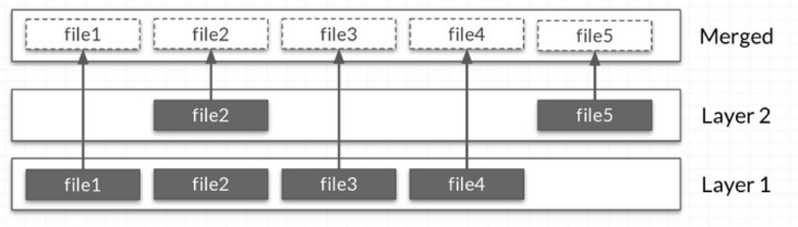
Docker/OCI: Image Layers
Images are composed of layers of filesystem changes
Each layer can add or remove from the previous layer
Each layer’s filesystem changes are stored as a single tar file
Joined together layers provide a full filesystem
Container uses the merged view

Slide 29
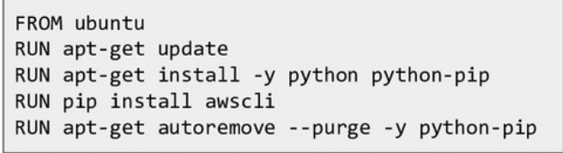
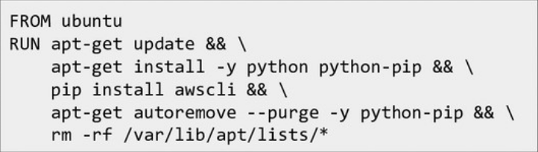
Docker/OCI: DockerFile
Text file that contains a script to create an image
  Each line creates a layer
  Chain RUN commands together
Allows various commands:
  FROM – specify the parent image
  COPY – copy files from the host into the image
  RUN – run a command using binaries inside container (i.e. install)
  CMD – specify the default command
Verses

Slide 30
Docker/OCI: Volumes
Volumes provide the ability to persist/supply data in containers
Bind mount volumes
  You choose where to persist the data
  Example: -v /docker-data/mysql:/var/lib/mysql
Named volumes:
  Let Docker choose where to persist the data
  Example: -v mysql-data:/var/lib/mysql
Issues with user permissions when accessing same files from both host and the container
  Map a user ID in container to a host user ID

Slide 31
Orchestration Overview
Provides the ability to manage the running of container workloads, often over a fleet of machines
As an administrator, you device the expected state, or the desired state
  Includes service definitions, (images, ports, volumes, etc.), replica counts (how many of each to run), update policies, and more.
The system then tries to make the actual state reflect the expected state
  If a container exits, it’ll try to restore it. If you change the expected state, it’ll try to reconcile it.

Slide 32
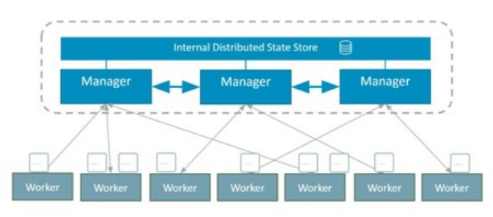
Actors in Orchestrators
Every orchestrator has the concept of two types of nodes
Managers
  Serve the brains of the cluster
  Maintain state & schedule work
  Sometimes called masters
Worker nodes
  Perform the actual work, as instructed by a manager
  Sometimes called agents or nodes

Slide 33
Different type of Orchestrators
Docker Swarm
  Shipped with the Docker Engine
  Very user friendly and easy to get up and running
  Satisfies most needs, though not all; theoretically extensible, but takes a little work
Kubernetes
  Spun out of the work done within Google and contributed to CNCF
  Think of it as a toolkit – so not as easy to get setup and running
  Very configurable and extensible
Amazon ECS
Hashicorp – Separate Products for easier management
  Terraform – Provision and Manage Bare Metal and Virtual Machines
  Nomad – Provision and Manage Containers and legacy applications
  Vault – Handle password, secret, and key management
  Consul – Orchestrate and Manage worker nodes and provide connections to outside world

