Slide 1
Computational Modeling of the Stark Effect for Solar-Relevant Materials
Camille Houferak
Emily Rabe
Joseph J. Radler

Slide 2
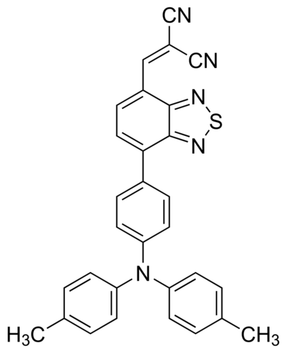
DTDCPB – What is it?
It’s a mouthful, for starters!
Importance of OPVs – cost effective, flexible
Molecular configuration exhibits relatively small bandgap and low HOMO
PCE of 9.6±0.5%
Among the highest of small-molecule OPV devices
2-[(7-(4-[N,N-bis(4-methylphenyl)amino]phenyl)-2,1,3-benzothia-diazol-4-yl)methylene] propane-dinitrile

Slide 3
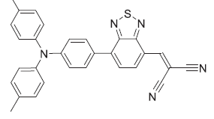
DTDCPB: A promising push-pull chromophore
Possesses a ground state dipole
“d-a-a” configuration
Enhances hole-hopping
Decreases charge recombination
Nitrile groups ideal for IR spectroscopy
Strong vibrational signature at 2260-2220 cm⁻¹
Allows us to track Stark Shifts
2-[(7-(4-[N,N-bis(4-methylphenyl)amino]phenyl)-2,1,3-benzothia-diazol-4-yl)methylene] propane-dinitrile
Griffith, O. L. et al. Phys Rev B 92, (2015).
Notes:
“d-a-a” means donor-acceptor-acceptor”

Slide 4
Stark Effect Introduction
Effect of an electric field on absorption or emission spectrum
Change in dipole moment, Δμ
Degree of charge separation for a transition
Change in polarizability, Δα
Sensitivity of transition to the field

Slide 5
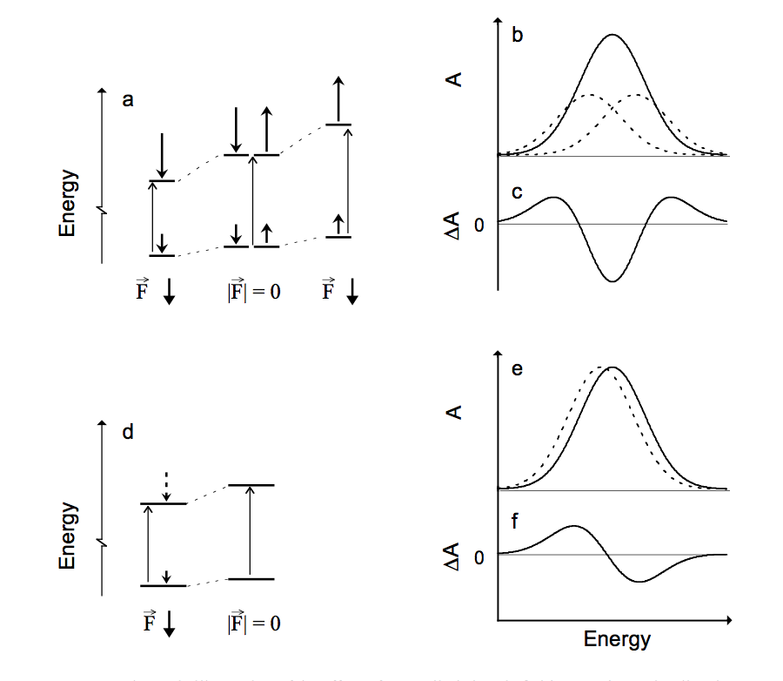
Expected Effect on Spectra
Linear Stark effect: line broadening
Quadratic Stark effect: frequency shift
Stark spectrum = “field on minus field off”
Analyze this based on derivatives

Slide 6
Experimental Plan
Perform a calibration curve for DTDCPB under various applied electric fields
Determine dependent parameters ( Δα and Δµ)
Allows us to back out the electric field felt by the molecule during a transition
Perform pump-probe spectroscopy in a DTDCPB:PCBM blend
Electric fields created by charge-transfer states and free charges will be distinct
This experiment allows for in-operando studies of these pathways
Future studies hope to correlate the local dielectric constant of the material with the dominant pathway
It is crucial to first understand DTDCPB’s response to electric fields in both the ground and excited state, before moving to complex in operando studies.
Notes:
Okay, so this slide is a clusterfuck. I decided to put a bunch of crap in, feel free to take out whatever you want.

Slide 7
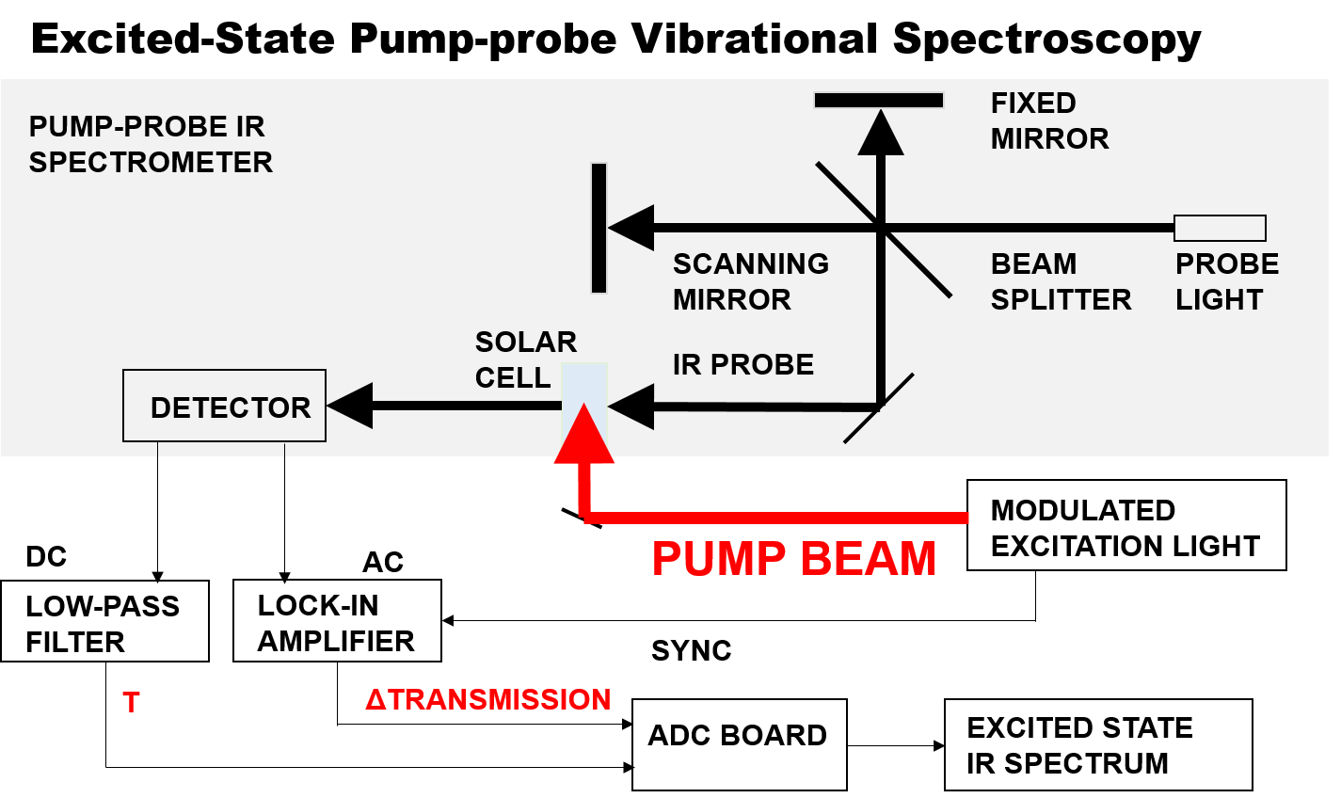
Excited-State Pump-probe Vibrational Spectroscopy
Notes:
You can feel free not to use this. Basically it just shows that we will be collecting the difference spectrum with and without the pump light (UV-vis range).

Slide 8
Computational Overview
Frequencies of ground and excited states to obtain equilibrium behavior.
With and without static electric field
Move on to dynamics with BOMD
Again with and without field for ground and excited states
Calibrate Stark shifts from static electric field to understand the surrounding media
This tells us how polarized the environment is.
Compare this to experiment.

Slide 9
Some Nuts and Bolts
Level of theory
B3LYP/6-311G(d,p)
DFT functional scales well for larger molecules
Electric Field strengths
Examine two dipole orientations (+/- along Z)
Calibrate Stark effect as a function of field magnitude
Create ensemble of different orientations
Check to see if field orientation does in fact affect the frequencies and Stark shift.

Slide 10
DTDCPB IR Spectrum - No Field

Slide 11
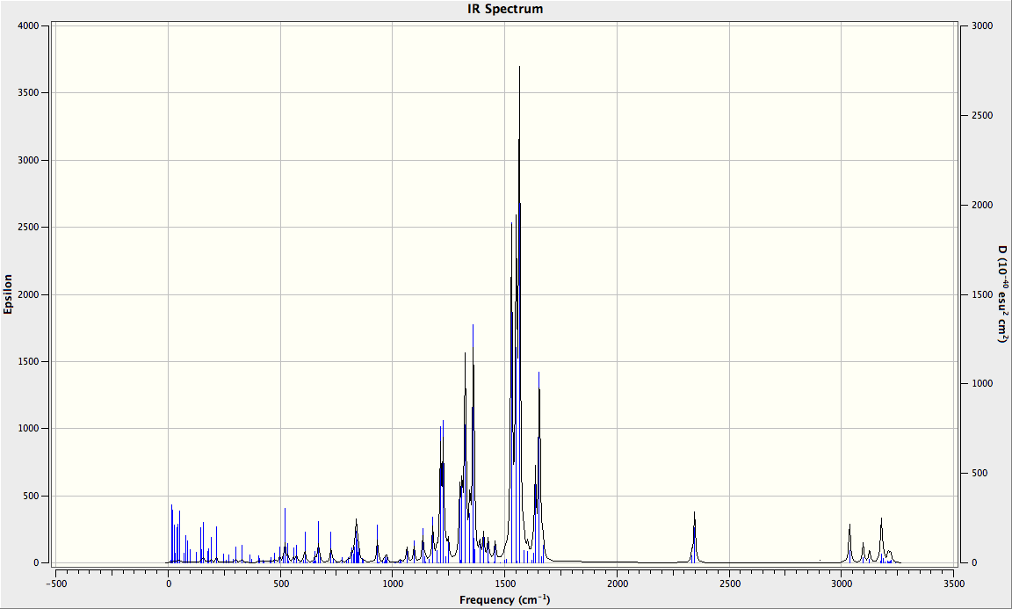
DTDCPB Baseline: IR Spectrum with no Field
CN stretching frequencies

Slide 12
Looking at CN Frequencies in External Field
Applied Field | Symmetric Stretch (cm⁻¹) | Asymmetric Stretch (cm⁻¹)*
0.5 V/Å | 2331.56 | 2316.55
0.25 V/Å | 2338.33 | 2326.76
0 V/Å | 2346.48 | 2334.28
-0.25 V/Å | 2338.97 | 2328.01
-0.5 V/Å | 2331.21 | 2318.22
*Asymmetric stretch very low intensity

Slide 13
BOMD Introduction
I’mma put the process in broad strokes for BOMD set up and job submission in Gaussian here… sometime... (Jay)

Slide 14



Simulating Spectra from BOMD
Dipole moment calculation from BOMD:
BOMD dipole derived from electron density
Opt+Freq in Gaussian simply uses the Hessian.
Velocity Verlet Algorithm
Obtaining spectra in Postprocessing for BOMD

Slide 15
BOMD Flowchart
No E-Field
E-Field Applied in Gaussian
E₁^{field} BOMD Trajectory 1
E₁^{field} IR Spectrum
E₁^{field} BOMD Trajectory 2
DTDCPB + E₁^{field} opt+freq
DTDCPB + E₁^{field} Thermal Sampling
E₁^{field} BOMD Trajectory 3
E₂^{field} BOMD Trajectory 1
E₂^{field} IR Spectrum
DTDCPB
opt+freq
DTDCPB + E₂^{field} opt+freq
DTDCPB + E₂^{field} Thermal Sampling
E₂^{field} BOMD Trajectory 2
DTDCPB + E₃^{field} opt+freq
DTDCPB + E₃^{field} Thermal Sampling
E₂^{field} BOMD Trajectory 3
E₃^{field} BOMD Trajectory 1
E₃^{field} IR Spectrum
E₃^{field} BOMD Trajectory 2
E₃^{field} BOMD Trajectory 3

Slide 16
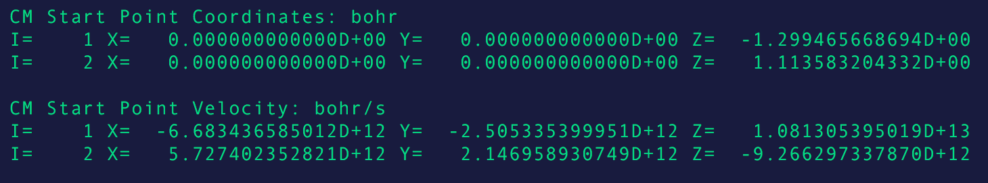
BOMD Test Case: Cyanide
Thermal sampling provides initial conditions for positions and velocities
Each set of values can then be used as a staring point for the production of a trajectory in time

Slide 17
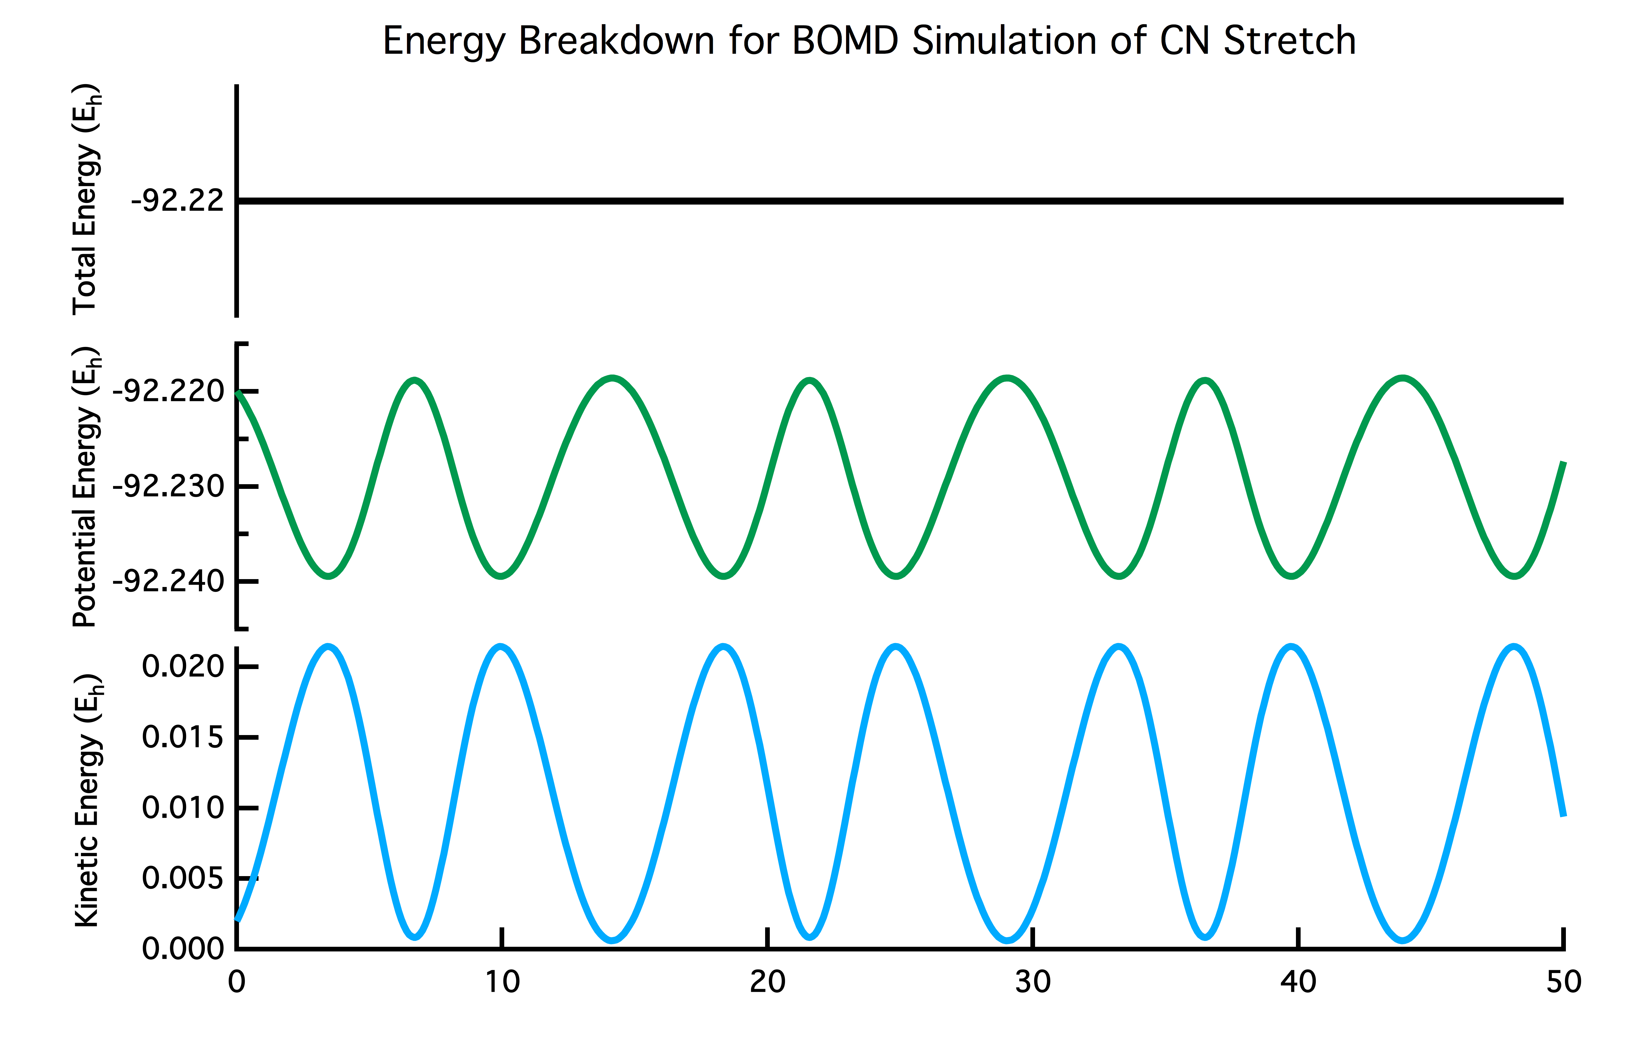
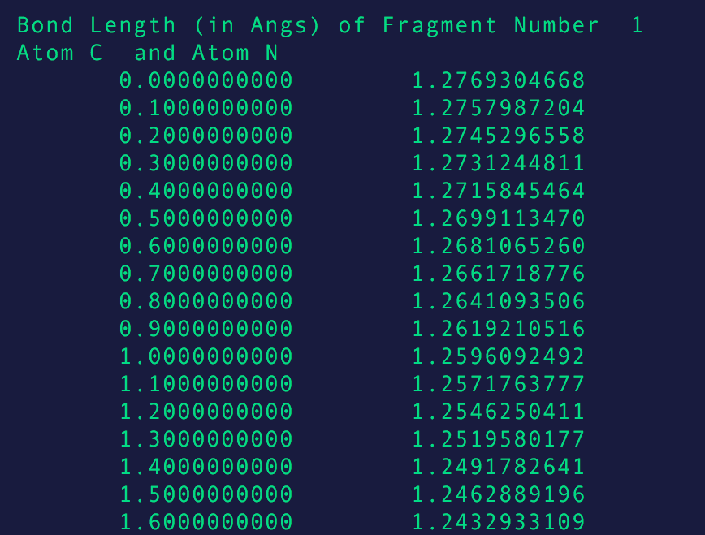
BOMD Test Case: Cyanide
Results for one trajectory: molecular vibration in a diatomic
Total energy conserved!

Slide 18
Tentative DTDCPB BOMD Results

Slide 19
Conclusions and Future Directions
We’ve only looked at the ground state as a baseline
Experiment will probe excited state and look at the evolution
Time-resolved spectroscopy will come into play – thus techniques need to developed from our foundation to model this

Slide 20
Questions Slide

