Slide 1
ArchiCop – Developer
Generate solution files for selection of projects
MSBuild the selection of projects
Sanity check for selection of projects
Show projects & edges with details
Show graph for selection of projects
Show summary (e.g. chart for selection of projects)

Slide 2
ArchiCop - Architect
Define a graph source
  Excel, Xml, Source, etc
Create a graph from graph source
  Cluster a graph
  Filter a graph
  Comapare two graphs

Slide 3
Settings
Help
About
Toolbar 1
Toolbar 2
Toolbar 3
Menubar Action > Navbar Action
Content

Slide 4
Settings
Help
About
Toolbar 1
Toolbar 2
Toolbar 3
Toolbar Action
Content

Slide 5
Settings
Help
About
Toolbar 1
Toolbar 2
Toolbar 3
Toolbar Action
Toolbar Action > Navbar Action
Navbar action 1
Content
Navbar action 2
Navbar action 3
Summary Title

Slide 6
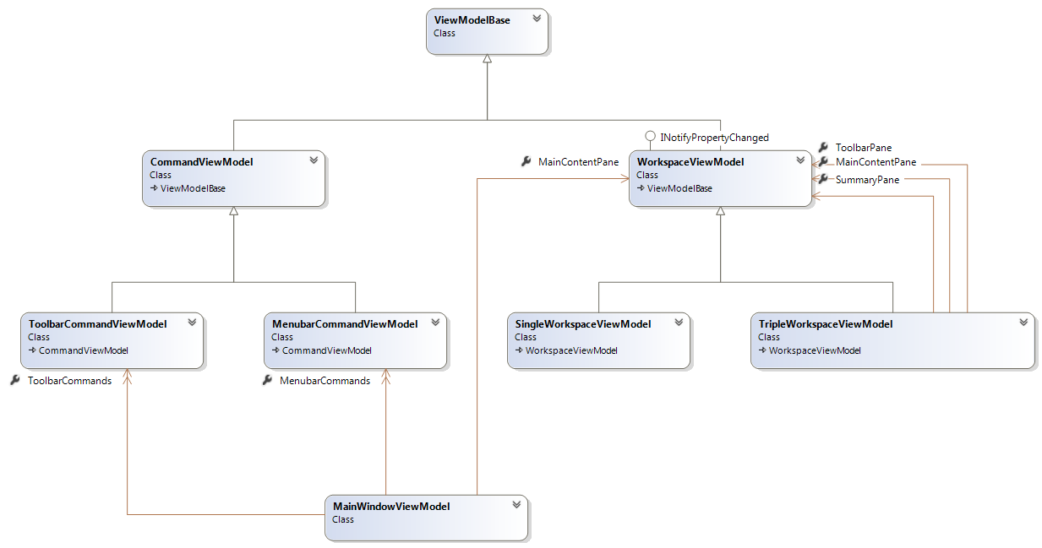

Slide 7
class MainWindowViewModel
{
public ObservableCollection<MenubarCommandViewModel> MenubarCommands { get; set; }
public ObservableCollection<ToolbarCommandViewModel> ToolbarCommands { get; set; }
public WorkspaceViewModel MainContentPane { get; set; }
}
class CommandViewModel : ViewModelBase
{
public ICommand Command { get; set; }
}
class SingleWorkspaceViewModel : WorkspaceViewModel
{
}
class TripleWorkspaceViewModel : WorkspaceViewModel
{
public WorkspaceViewModel ToolbarPane { get; set; }
public WorkspaceViewModel SummaryPane { get; set; }
public WorkspaceViewModel MainContentPane { get; set; }
}
class WorkspaceViewModel : ViewModelBase, INotifyPropertyChanged
{
public event PropertyChangedEventHandler PropertyChanged;
}
class ViewModelBase
{
public string DisplayText { get; set; }
}
class ToolbarCommandViewModel : CommandViewModel
{
public string ImageSource { get; set; }
}
class MenubarCommandViewModel : CommandViewModel
{
}

