Slide 1
Manual: R shiny based interactive web app for metabolite identification
Jaesik Jeong, Yeongjae Oh
Chonnam national university
Seongho Kim
Karmanos Cancer Institute

Slide 2
Contents 1. Help tab 2. Data load tab 2.1. Loading query data 2.2. Loading library data 3. Settings tab 3.1. Choice of similarity measure 3.2. Parameter tuning 4. Result tab 4.1. Graphical representation of identification 4.2. Table of Top k matching results 5. Toy example

Slide 3
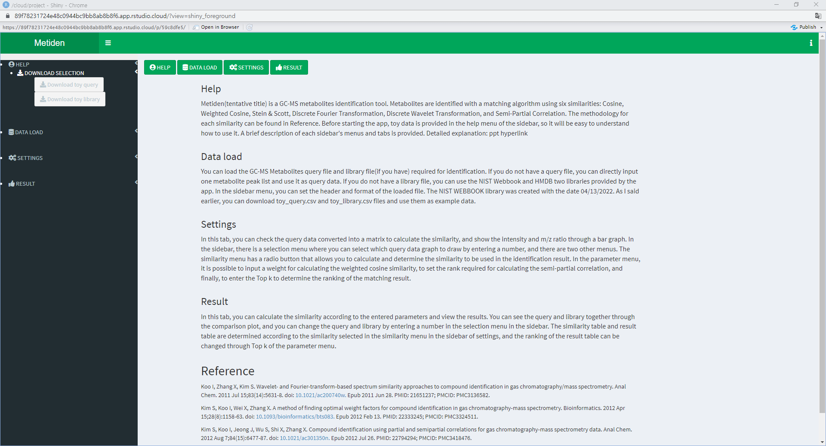
1. Help tab

Slide 4
1. Help tab
This is the first screen you see when you start the app.
This app consists of 4 buttons that can move to each tab and 4 sidebar menus.
You can download both toy data from the HELP menu in the sidebar.
Both toy data were sampled from the NIST Webbook library and consisted of 30 and 50 metabolites, respectively.

Slide 5
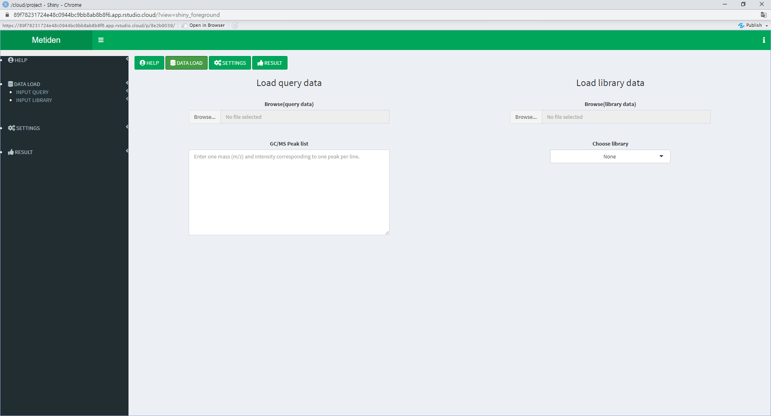
2. Data load tab

Slide 6
2. Data load tab
There are two menus in the sidebar’s DATALOAD menu. INPUT QUERY & INPUT LIBRARY.
Both menus have the same checkboxes and radio buttons.
Check the checkbox if the file contains variable names in the first line. It is checked by default.
The radio button determines the file format. The default is .csv format.

Slide 7

2.1. Loading query data

Slide 8
2.1. Loading query data
Loading query file: data matrix including multiple metabolites.
Change the options to match the file and load the file.
Inputting query data: single metabolite
When you do not have a query file, you can directly input the peak list line by the line and use it as query data.

Slide 9
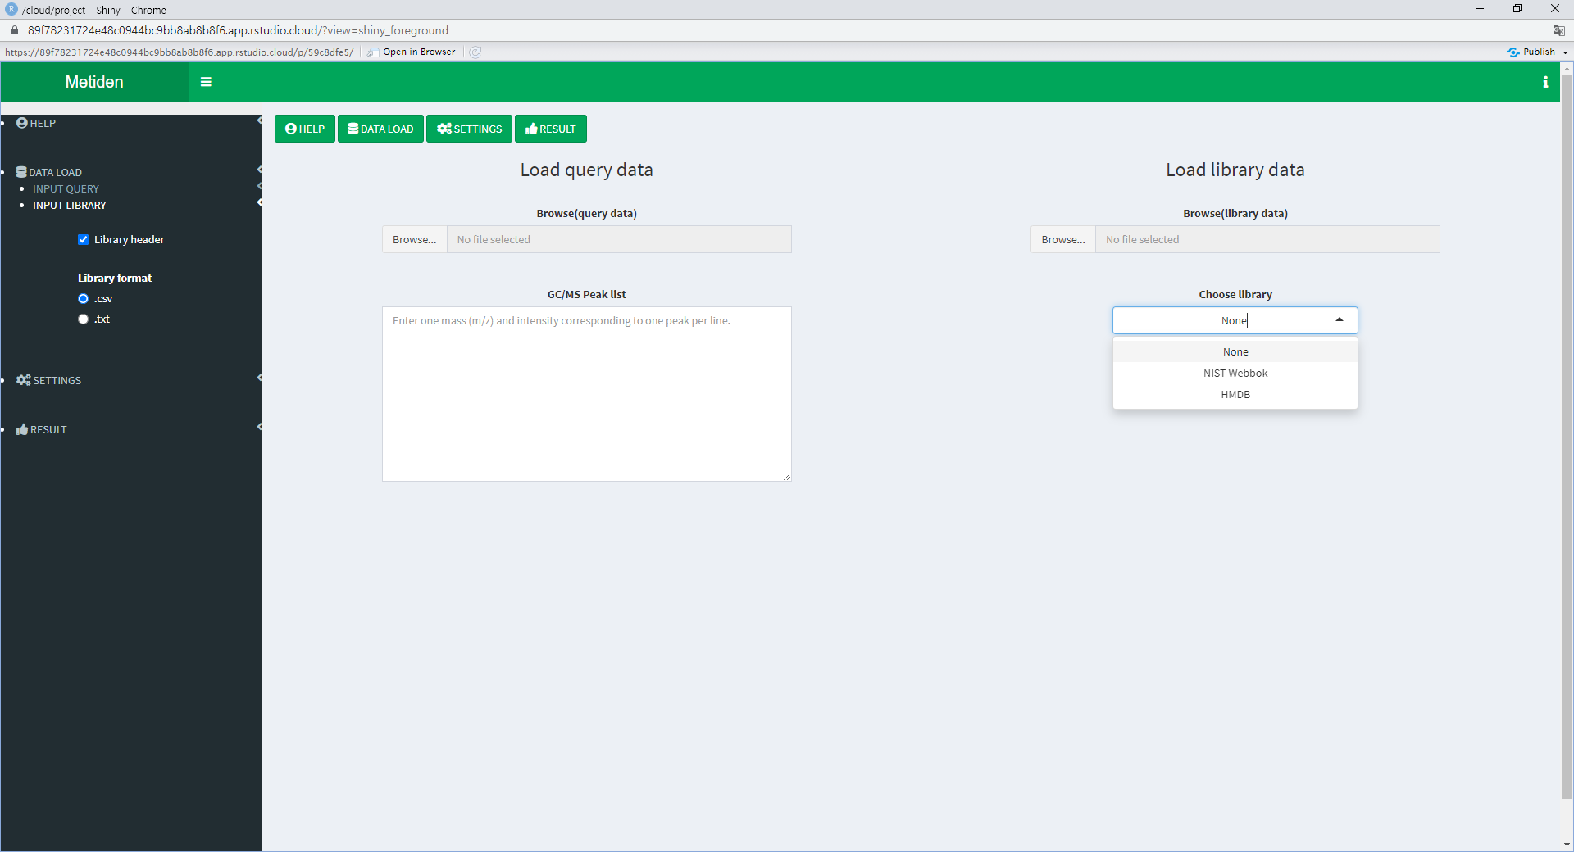
2.2. Loading library data

Slide 10
2.2. Loading library data
Uploading your own library
Change the options to match the file and load the file.
Choice of library: select one of two given library(NIST Webbook, HMDB)
When you do not have a library file, you can use the library file provided by the app instead. Both libraries are made with the data of April 13, 2022.

Slide 11
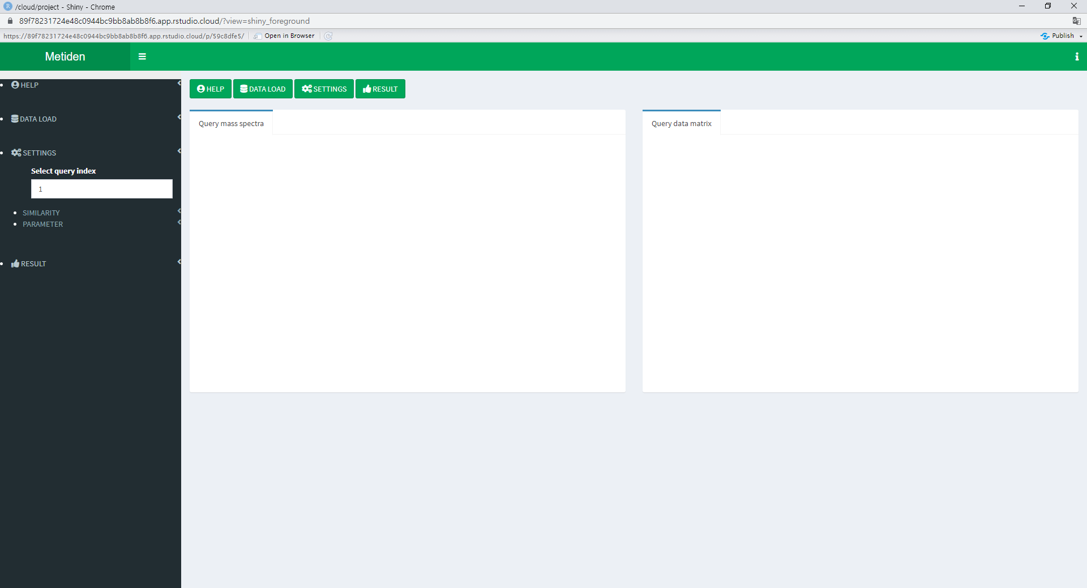
3. Settings tab

Slide 12
3. Settings tab
You can see the query converted into a matrix, and the specified mass spectra is displayed as a graph.
There are three menus in the SETTINGS menu in the sidebar. The first is the menu to select the metabolite to be drawn on the graph.
The second is a radio button menu to select similarities.
Finally, it is the parameter input menu of the similarity and result table.

Slide 13
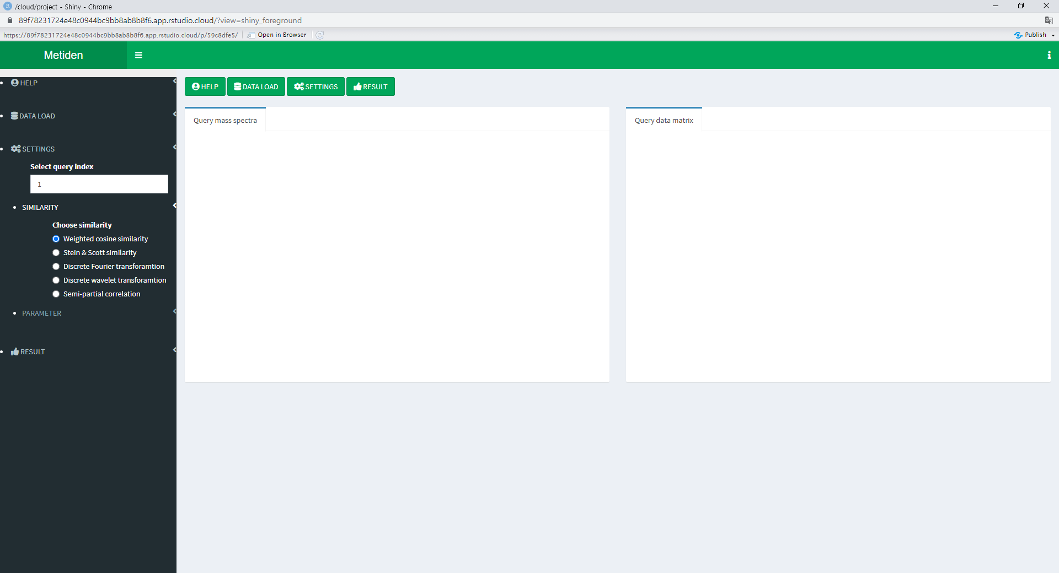
3.1. Choice of similarity measure

Slide 14
3.1. Choice of similarity measure
If you click the radio button of the desired similarity in the similarity menu of the sidebar, all similarities up to the selected similarity are displayed.
By default, weighted cosine similarity is selected, so you can see the results using the two similarities of cosine and weighted cosine.
The results of the matching algorithm using the selected similarity and the similarity matrix can be viewed in the result tab.

Slide 15
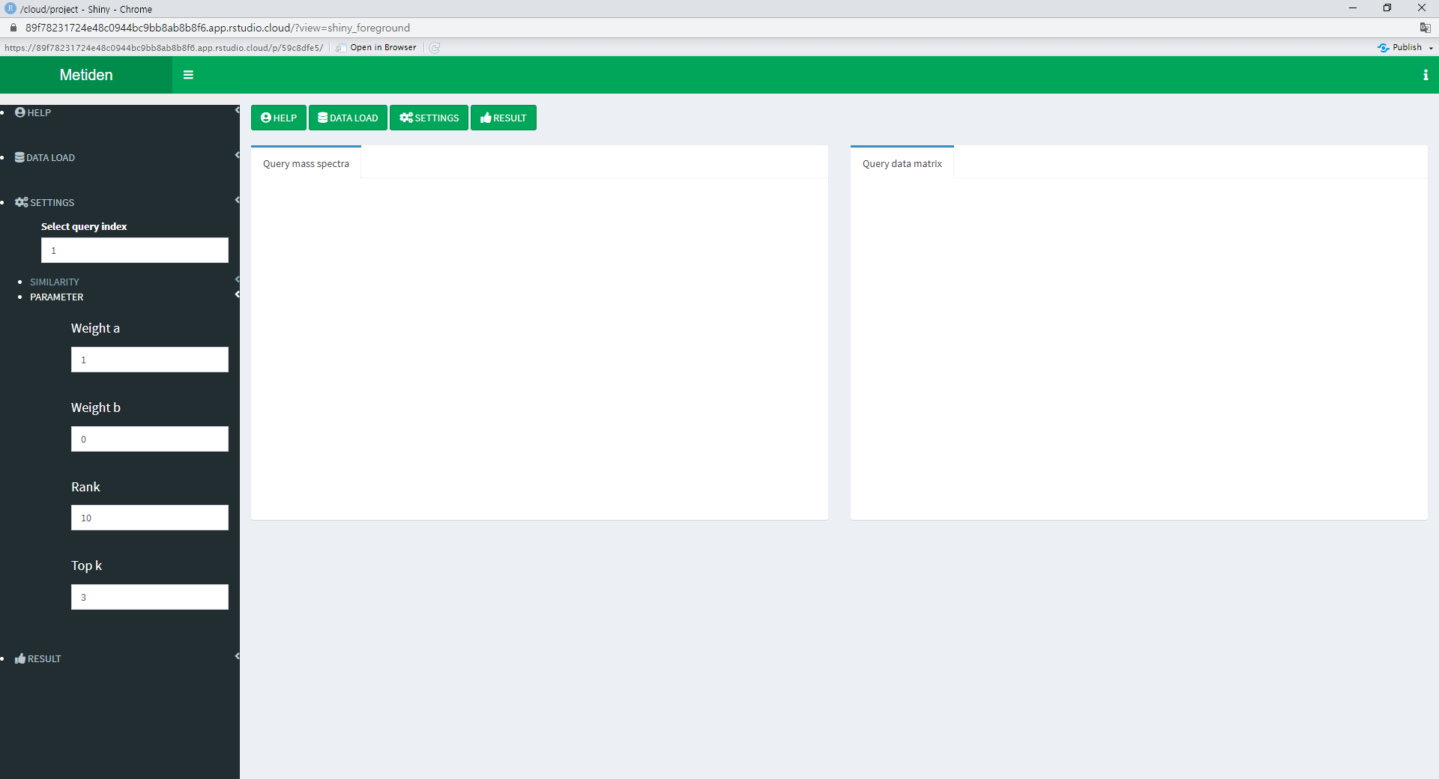
3.2. Parameter tuning

Slide 16
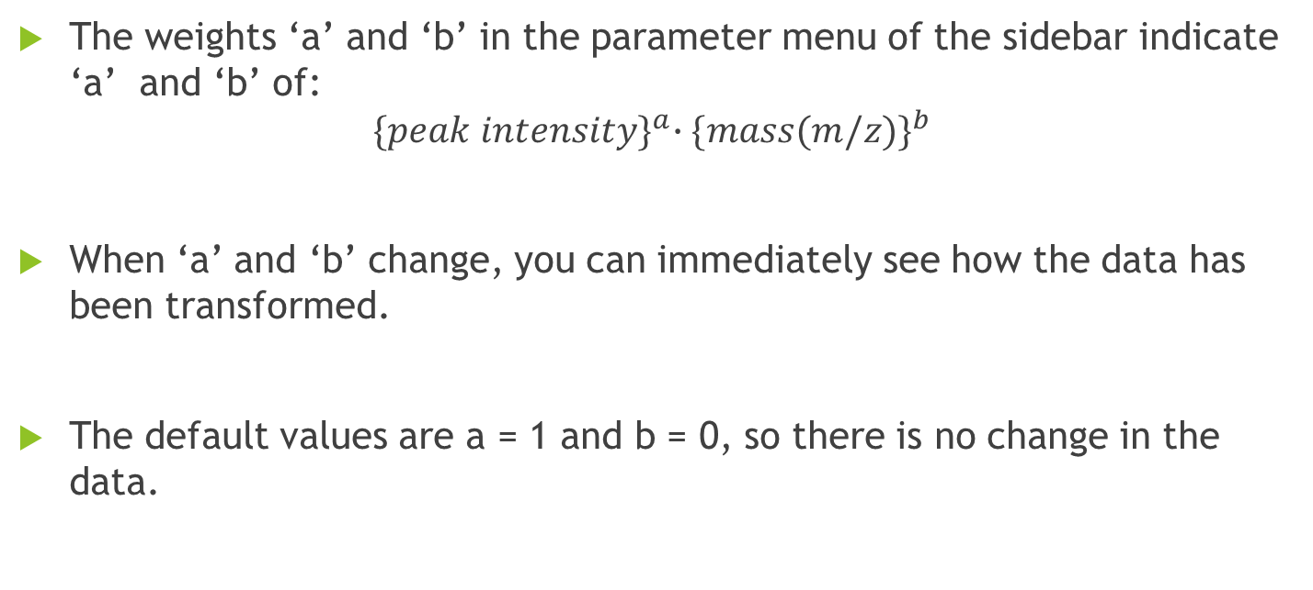
3.2. Parameter tuning
The weights ‘a’ and ‘b’ in the parameter menu of the sidebar indicate ‘a’ and ‘b’ of:
$${\{peak intensity\}}^{a}{∙\{mass(m/z)\}}^{b}$$
When ‘a’ and ‘b’ change, you can immediately see how the data has been transformed.
The default values are a = 1 and b = 0, so there is no change in the data.

Slide 17
3.2. Parameter tuning
Rank in the parameter menu is a parameter used when calculating semi-partial correlation. The default value is 10
In the semi-partial correlation, first, the semi-partial correlation is calculated using only the rank size among the query data matched through cosine similarity.
Top k of the parameter menu is a parameter for which library data is considered to be matched up to the highest rank in the results obtained by the matching algorithm. The default value is 3.

Slide 18
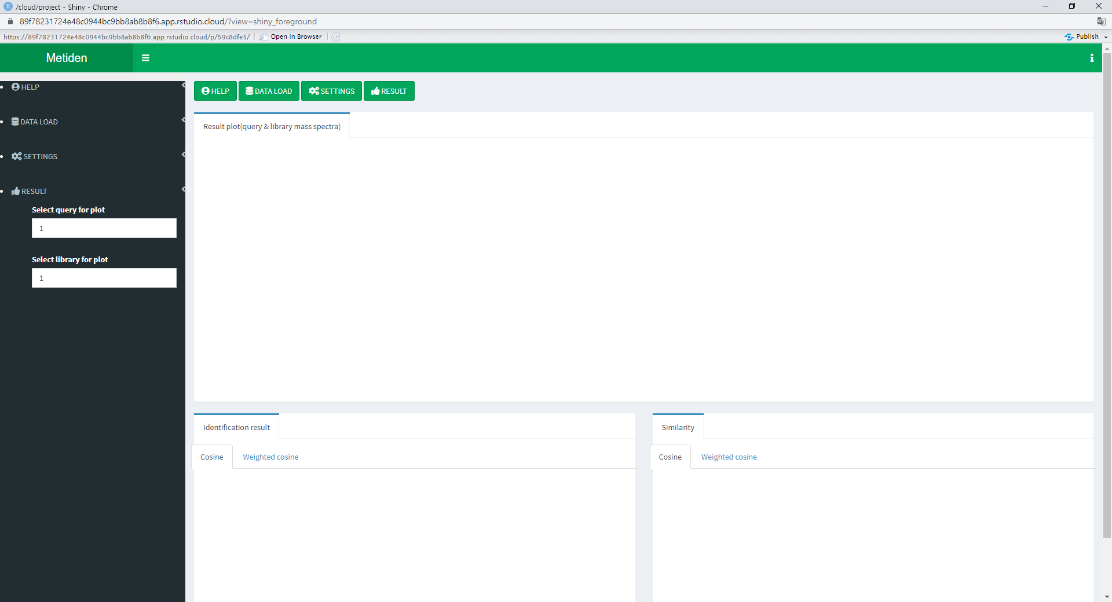
4. Result tab

Slide 19
4. Result tab
As the last tab, you can see the results obtained by the matching algorithm using the selected parameters and similarities.
In the RESULT menu in the sidebar, there is index input menu that will be drawn on the graph.

Slide 20
4.1. Graphical representation of identification

Slide 21
4.1. Graphical representation of identification
The graph is a comparison bar graph of the specified index of the query and the library.
Select matched query and library by inputting indexes in the RESULT menu.
The graph can be downloaded as a file in png format.

Slide 22
4.2. Table of Top k matching results

Slide 23
4.2. Table of Top k matching results
Table including Top k matching name in library for each metabolite in query.
Table including corresponding Top k matching similarity score in library.
Each table can be downloaded in csv, excel or pdf format.

Slide 24
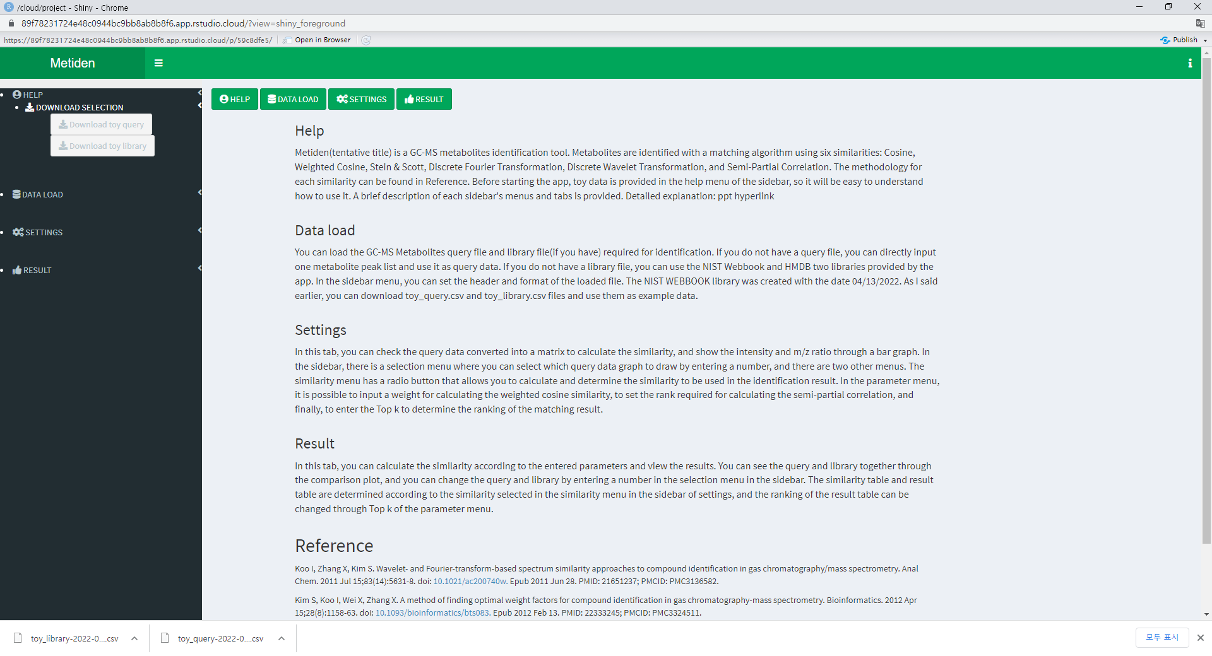
5. Toy example
First screen of the app
Information of the app
4 Buttons and 4 sidebar menu
Download toy data

Slide 25
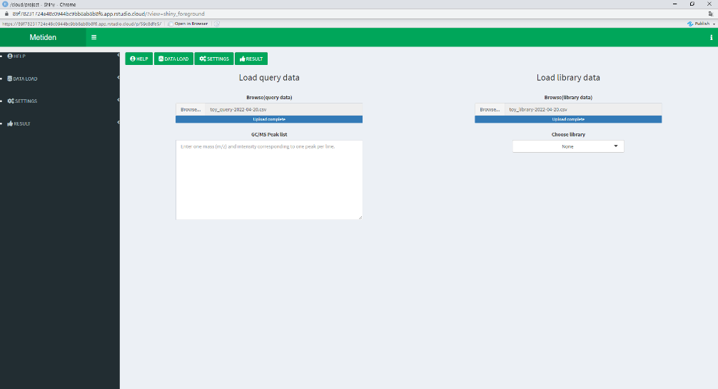
5. Toy example
Check the options in the DATALOAD menu in the sidebar
It can be loaded with default options
Let's load the toy_query_data and toy_library_data

Slide 26
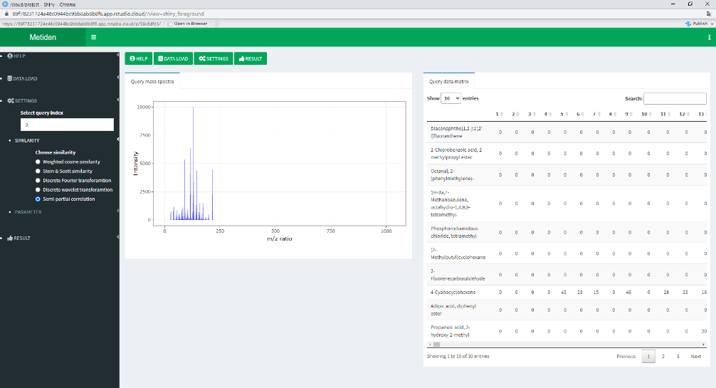
5. Toy example
Matrix of the loaded toy_query_data
Bar graph of the third metabolite of toy_query_data
Select similarity

Slide 27
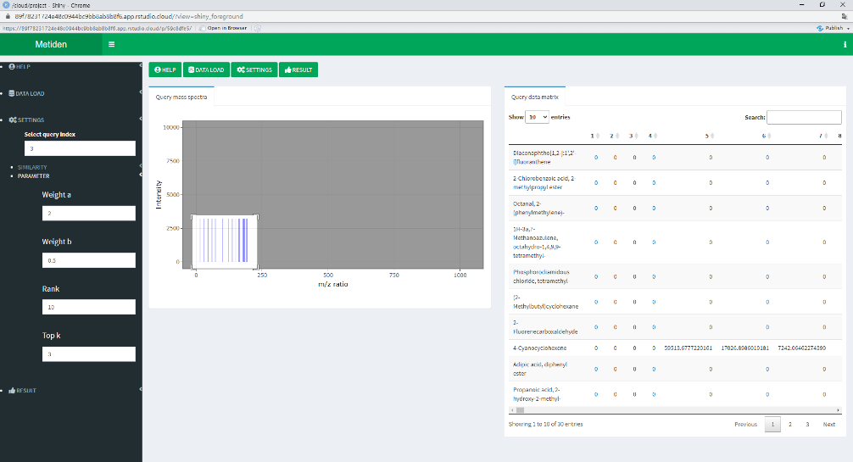
5. Toy example
Change weight ‘a’ and ‘b’
Weighted data and graph of the weighted data
Zoom in and out the graph

Slide 28
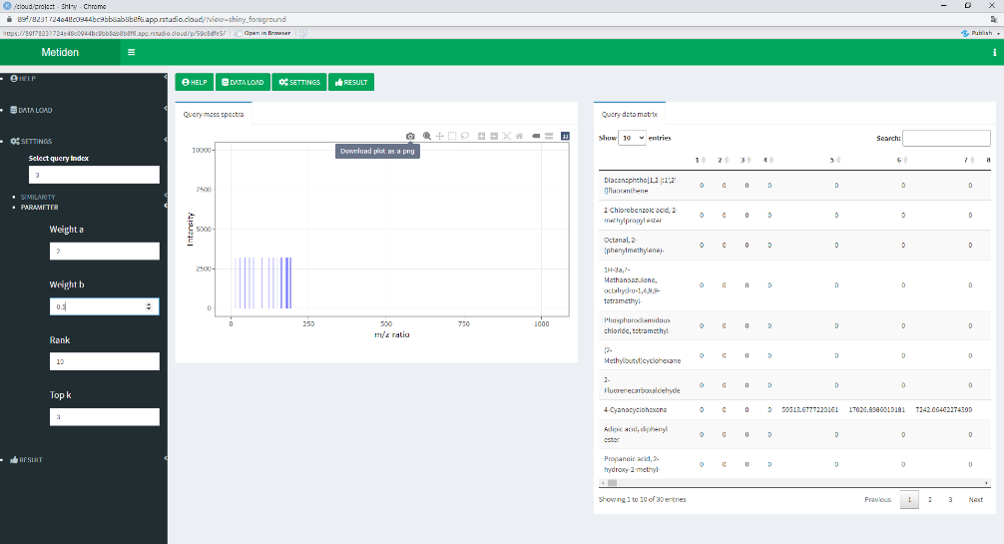
5. Toy example
There are many options in the graph
You can download the graph

Slide 29
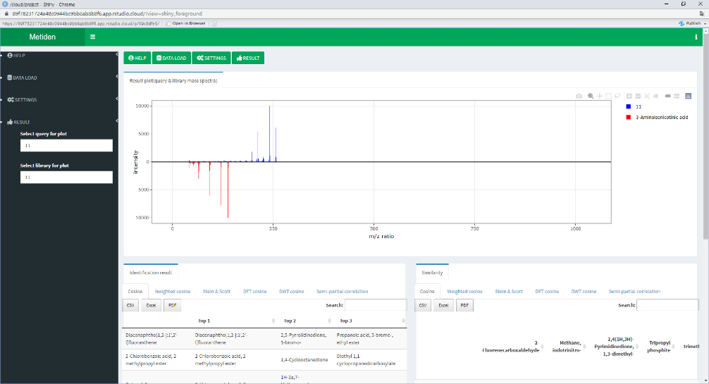
5. Toy example
Compare the 11th data in the query with the 11th data in the library
Same option as in the previous graph

Slide 30
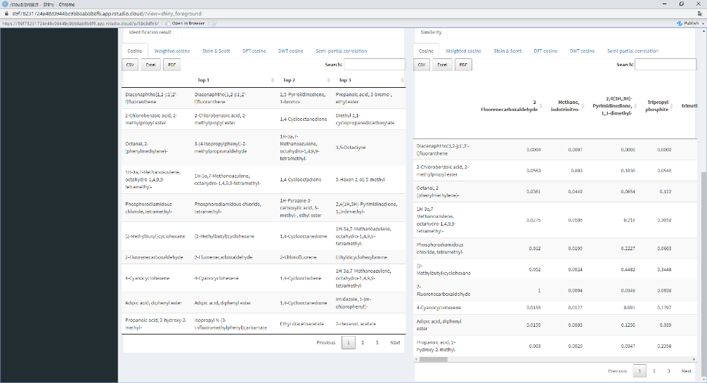
5. Toy example
Result table and similarity table
Table including Top 3 matching name in library for each metabolite in query
Table including corresponding Top 3 matching similarity score in library

