Slide 1
ShinyMetID: An R shiny package for metabolite identification by mass spectral matching
Yeongjae Oh, Shin June Kim, Seongho Kim, Jaesik Jeong

Slide 2
Contents 1. Help tab 2. Data load tab 2.1. Loading query 2.2. Loading library 3. Settings tab 3.1. Choice of similarity measure 3.2. Parameter tuning 4. Result tab 4.1. Graphical representation of identification 4.2. Table of Top k matching results 5. Toy example

Slide 3
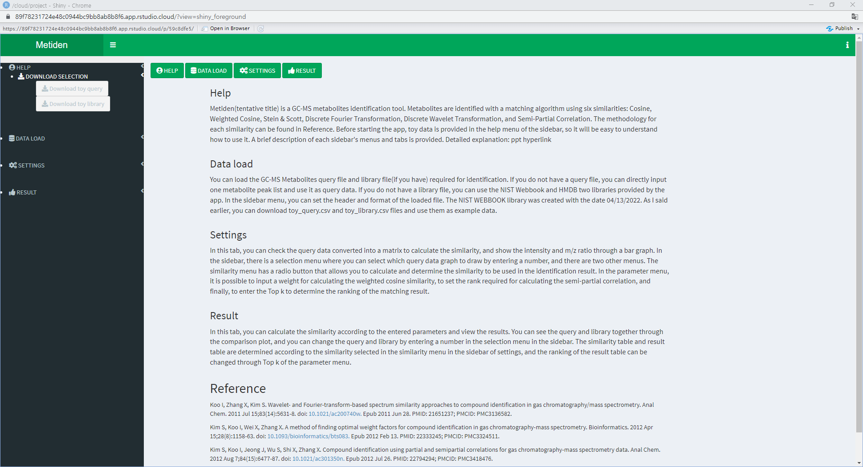
1. Help tab

Slide 4
1. Help tab
This package consists of 4 buttons that can move to each tab and 4 sidebar menus.
Brief explanation of 4 buttons is provided in this tab.
All references, which correspond to the methodologies given in this package, are mentioned.
You can test this package with toy data. Toy query and library consist of 30 and 50 metabolites, respectively.

Slide 5
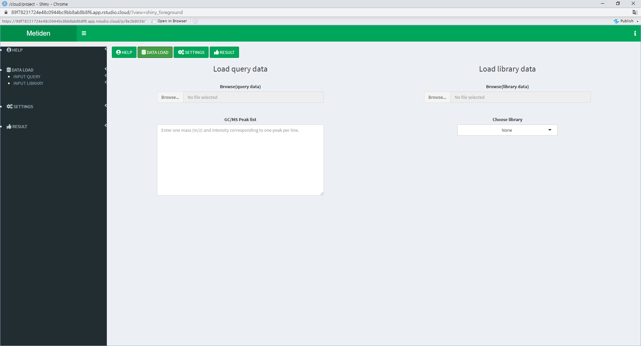
2. Data load tab

Slide 6
2. Data load tab
There are two menus in the sidebar’s DATALOAD menu.
INPUT QUERY & INPUT LIBRARY.
INPUT QUERY: load query file or input single metabolite directly
INPUT LIBRARY: choose one from two built-in libraries or load your own library
Checkbox: whether the file contains variable names in the first line or not(checked by default). Also, .csv format as default.

Slide 7

2.1. Loading query data

Slide 8
2.1. Loading query data
Loading query file
1) Browse the file including mass spectra information.
2) Change the options to match the file and load the file.
Typing query data: only for single metabolite
1) Type a pair of numbers (m/z : intensity)
2) Put only one pairs in one line

Slide 9
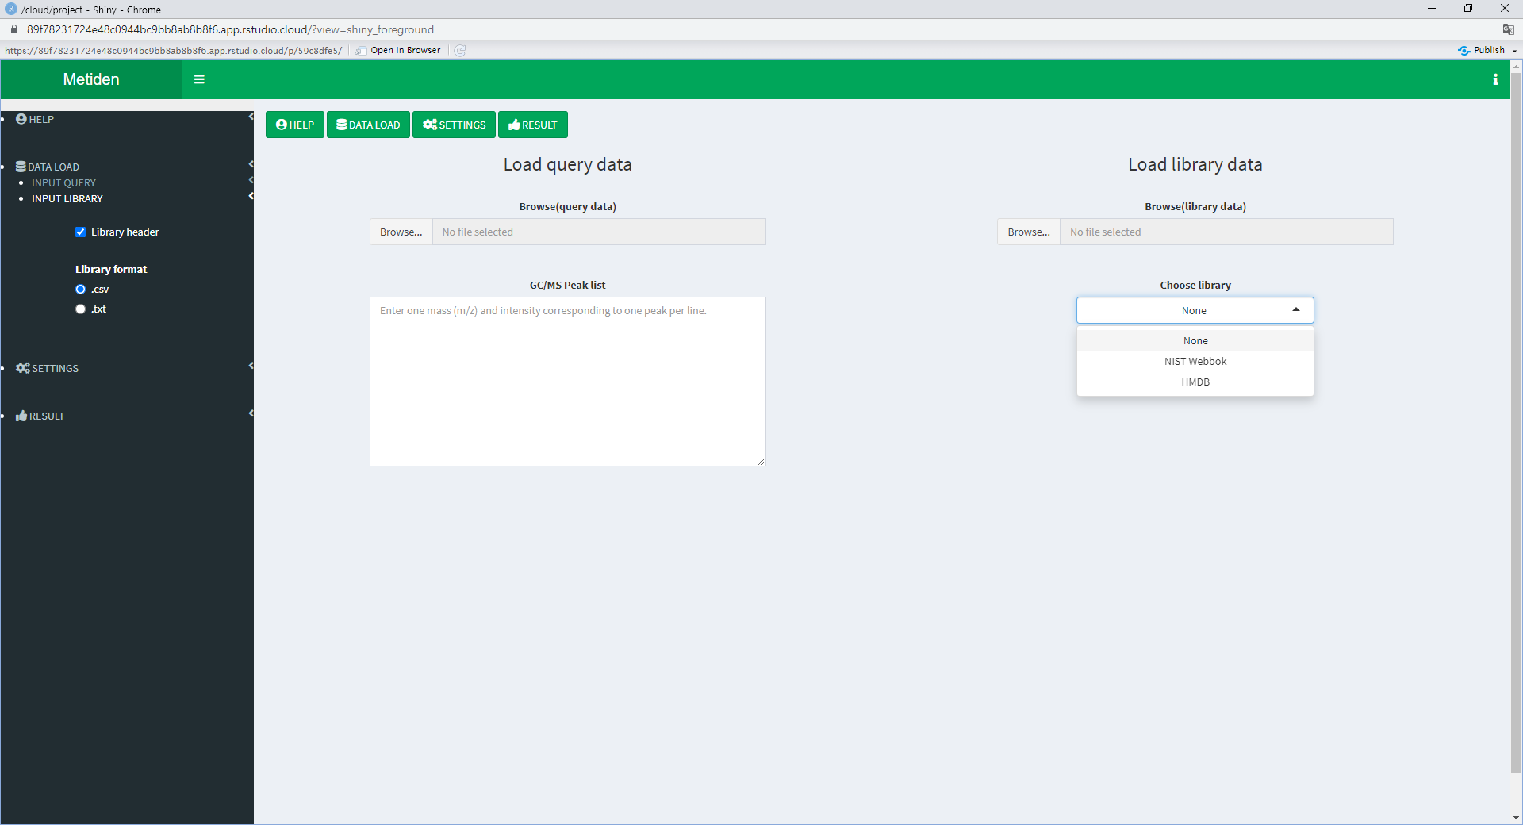
2.2. Loading library data

Slide 10
2.2. Loading library
Choose library: select one of two built-in libraries (NIST Webbook, HMDB)
Use your own library: browse and load the library you have
Two built-in libraries: as of April 13, 2022.
1) NIST Webbook: https://webbook.nist.gov/chemistry/
2) HMDB: https://hmdb.ca/

Slide 11
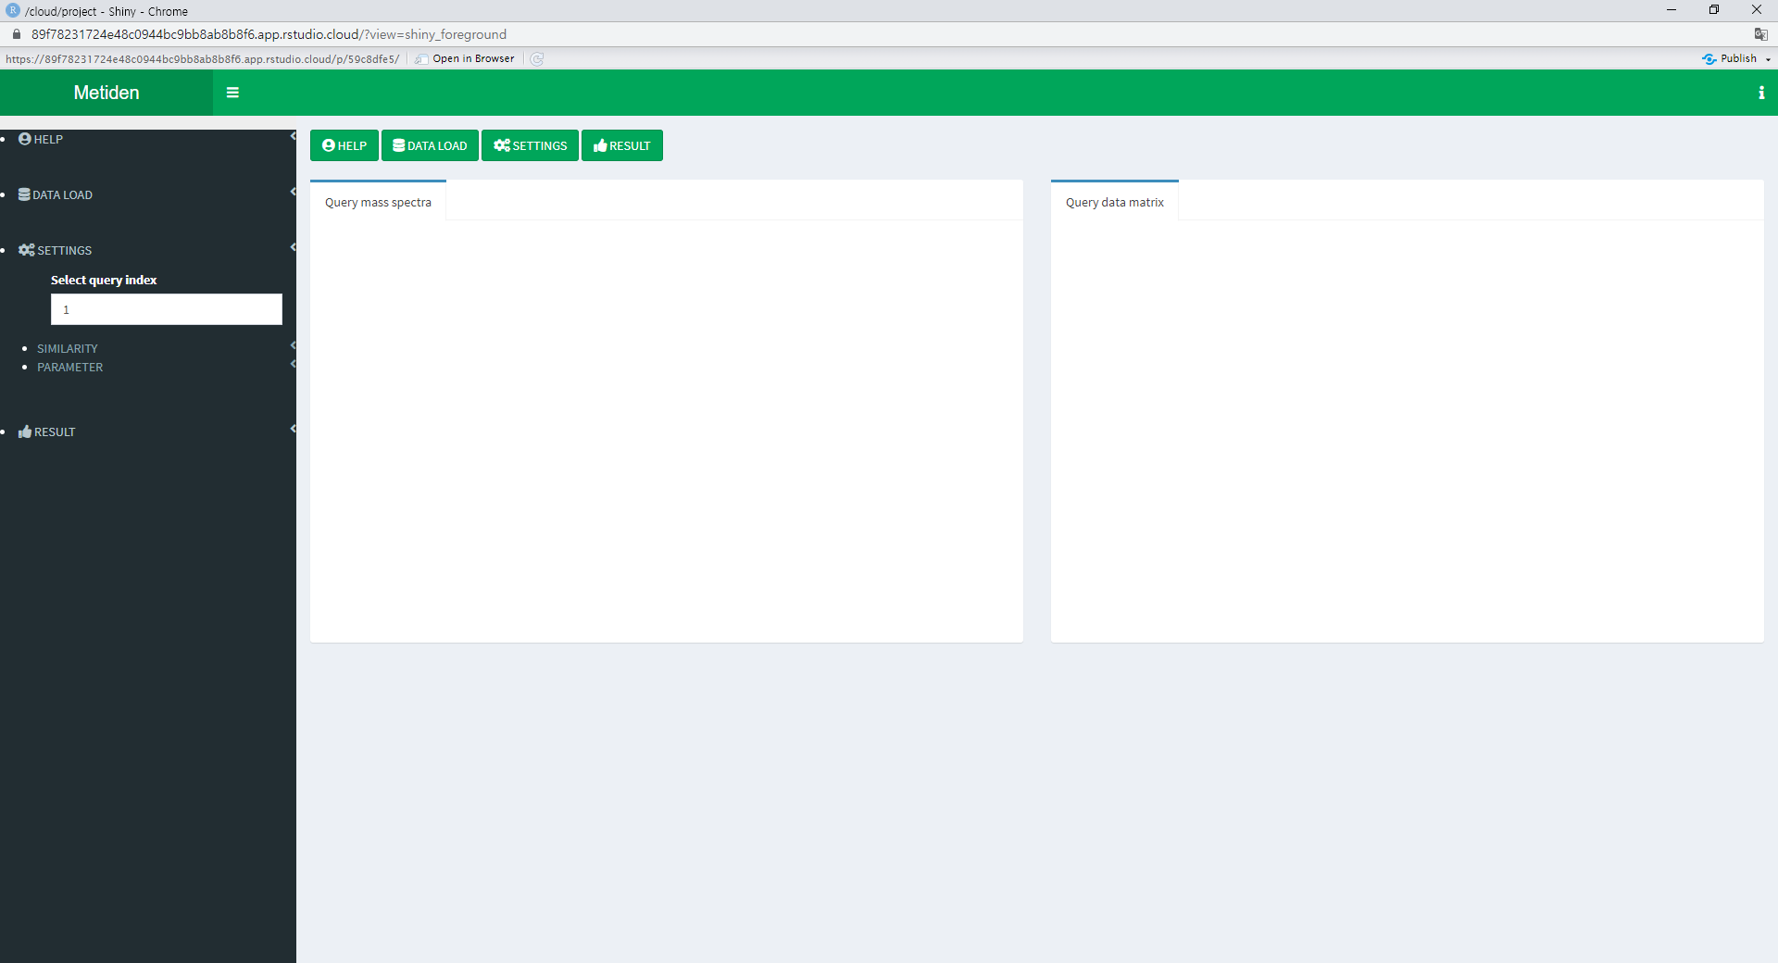
3. Settings tab

Slide 12
3. Settings tab
Three menus in the SETTINGS menu in the sidebar.
1) Select the metabolite to be drawn on the graph.
2) Select similarity measure.
3) Specify parameter

Slide 13
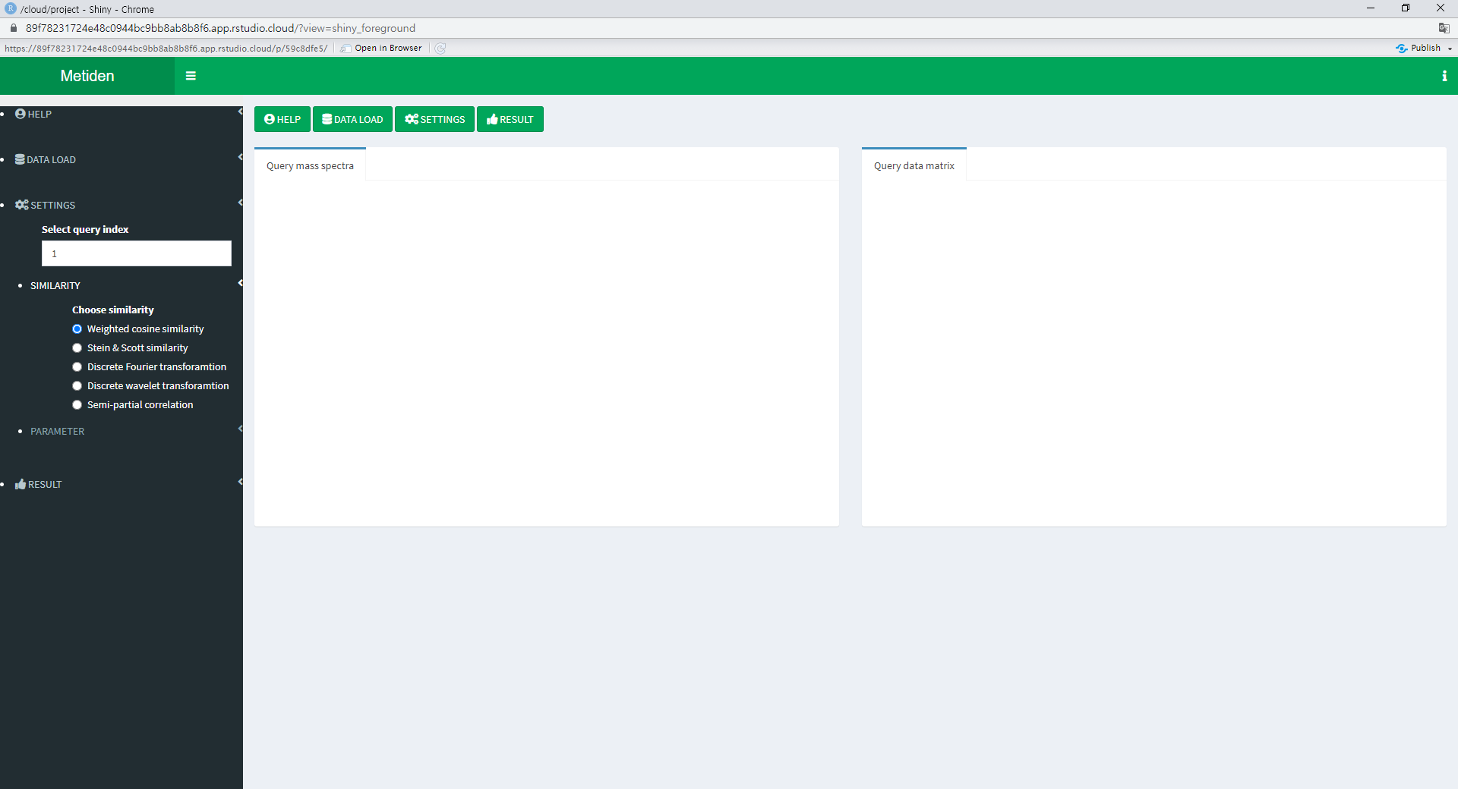
3.1. Choice of similarity measure

Slide 14
3.1. Choice of similarity measure
If you select a similarity measure to use, all similarity measures up to the selected one are selected.
Cosine similarity is included as default.

Slide 15
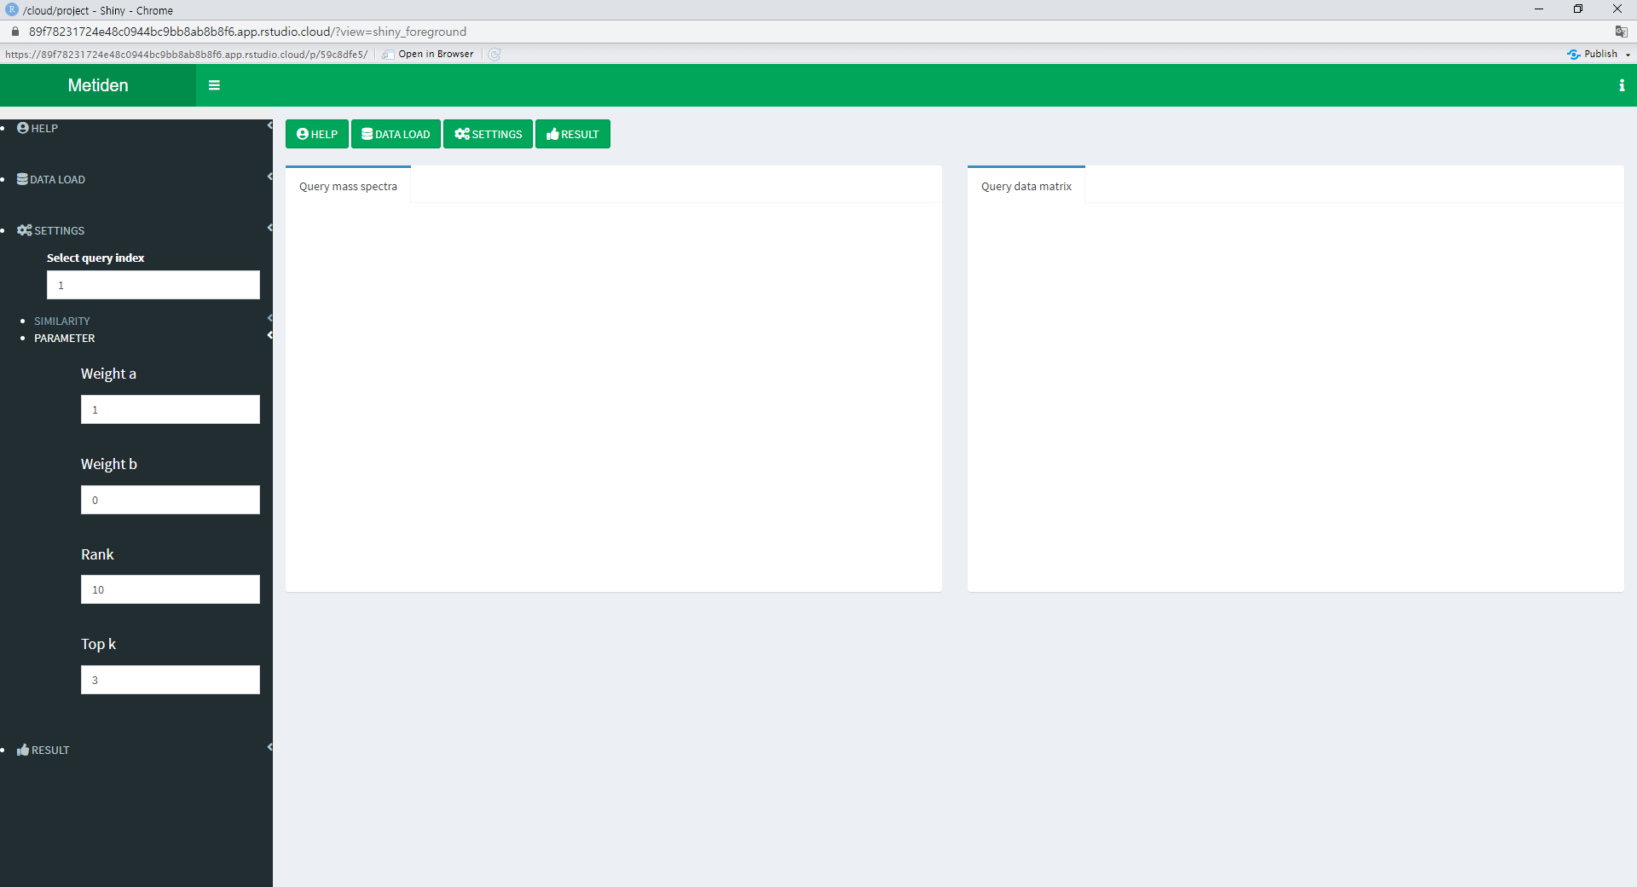
3.2. Parameter tuning

Slide 16
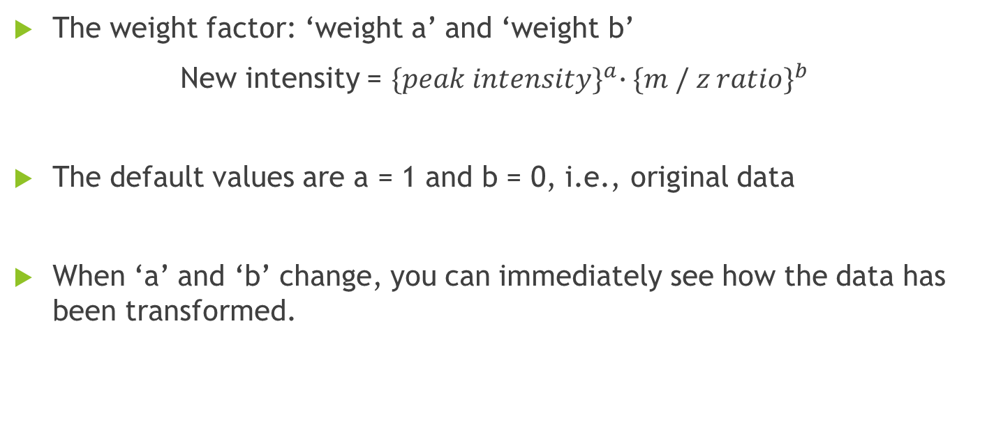
3.2. Parameter tuning
The weight factor: ‘weight a’ and ‘weight b’
New intensity = ${\{peak intensity\}}^{a}{∙\{m / z ratio\}}^{b}$
The default values are a = 1 and b = 0, i.e., original data
When ‘a’ and ‘b’ change, you can immediately see how the data has been transformed.

Slide 17
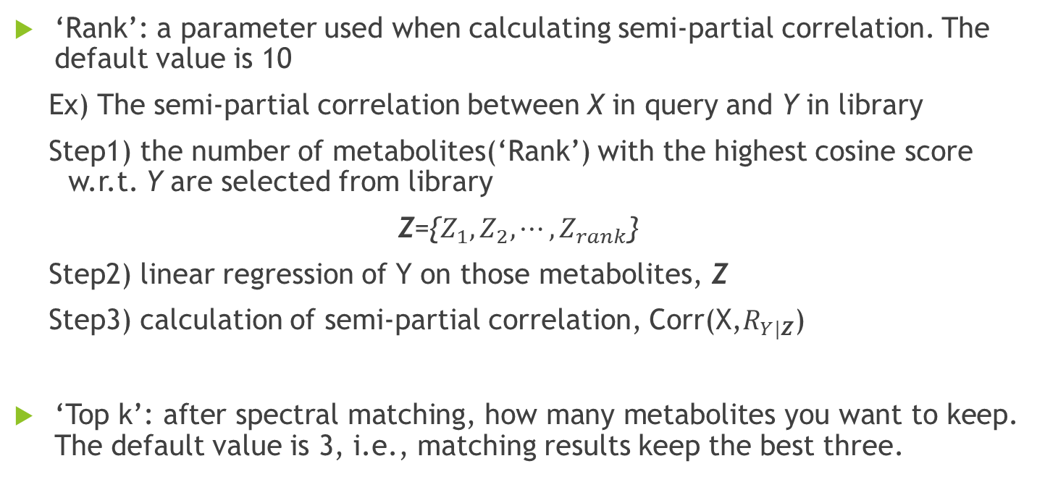
3.2. Parameter tuning
‘Rank’: a parameter used when calculating semi-partial correlation. The default value is 10
Ex) The semi-partial correlation between X in query and Y in library
Step1) the number of metabolites(‘Rank’) with the highest cosine score w.r.t. Y are selected from library
Z={$Z_{1}, Z_{2}, ⋯, Z_{rank}$}
Step2) linear regression of Y on those metabolites, Z
Step3) calculation of semi-partial correlation, Corr(X,$R_{Y|Z}$)
‘Top k’: after spectral matching, how many metabolites you want to keep. The default value is 3, i.e., matching results keep the best three.

Slide 18
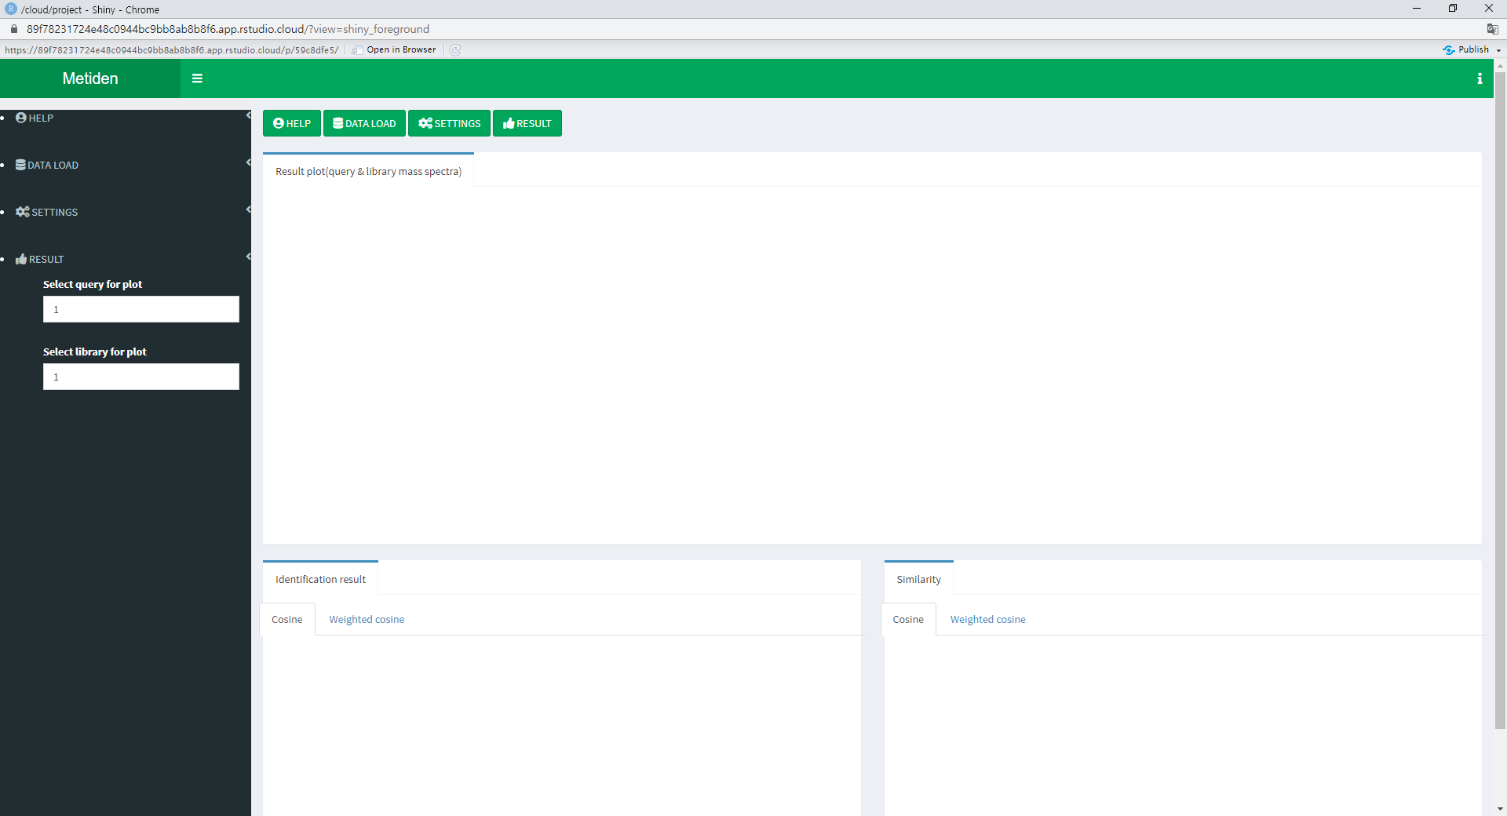
4. Result tab

Slide 19
4. Result tab
Given matching results, you can graphically check the similarity
You can see table including identification (top k) results
You can see table including similarity scores

Slide 20
4.1. Graphical representation of identification

Slide 21
4.1. Graphical representation of identification
Provide indices for matched query and library
Given indices, two bar graphs corresponding to the query and the library are provided.
The graph can be downloaded as a file in png format.

Slide 22
4.2. Table of Top k matching results

Slide 23
4.2. Table of Top k matching results
For each metabolite in query, table including names for the top k matched metabolites in library are provided.
Table including corresponding Top k matching similarity score is also provided.
Each table can be downloaded in csv, excel or pdf format.

Slide 24
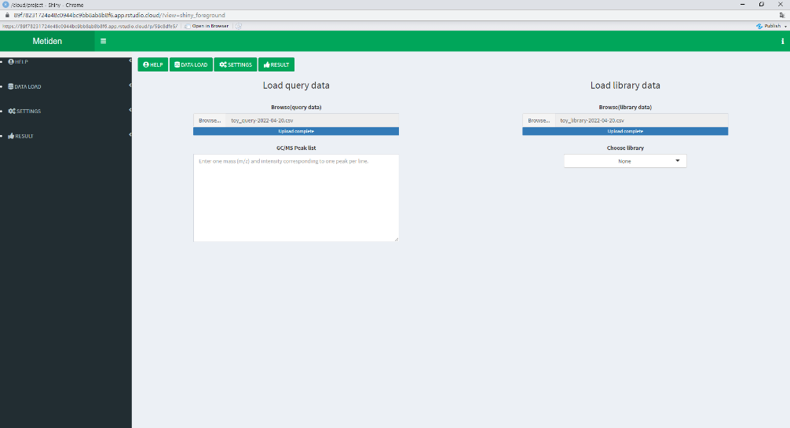
5. Toy example: loading query and library
DATALOAD tab
Choose the toy query (Query example) and toy library (Library example)

Slide 25
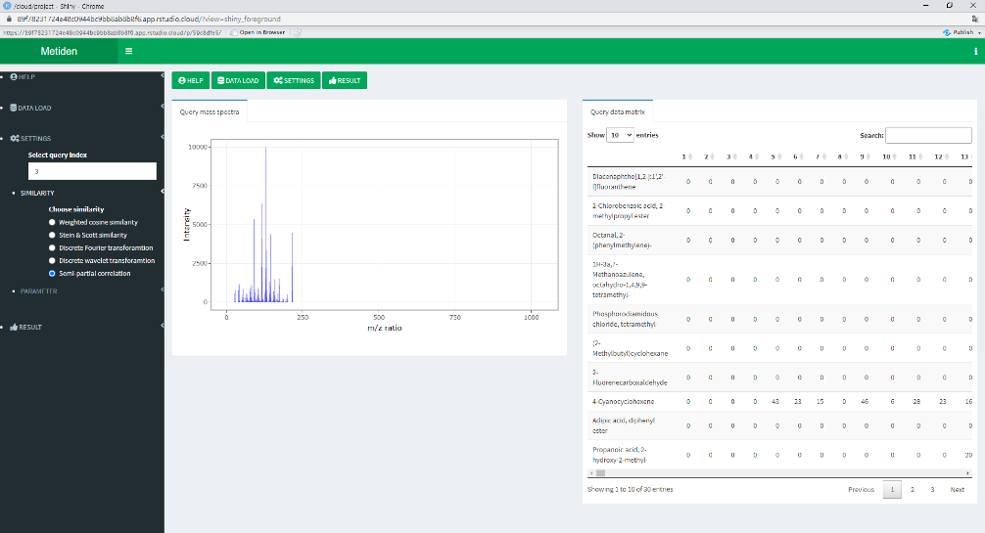
5. Toy example: data visualization
SETTINGS tab
Bar graph of the third metabolite in toy query
Data matrix of the loaded toy query

Slide 26
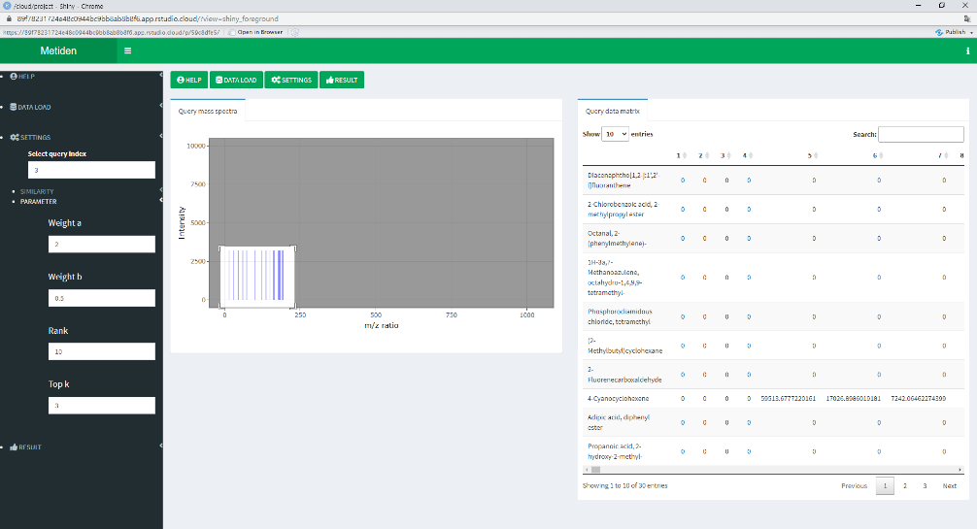
5. Toy example: similarity & parameter
SETTINGS side bar
Select similarity
Change weight ‘a’ and ‘b’
Transformed data and graph of the transformed data

Slide 27
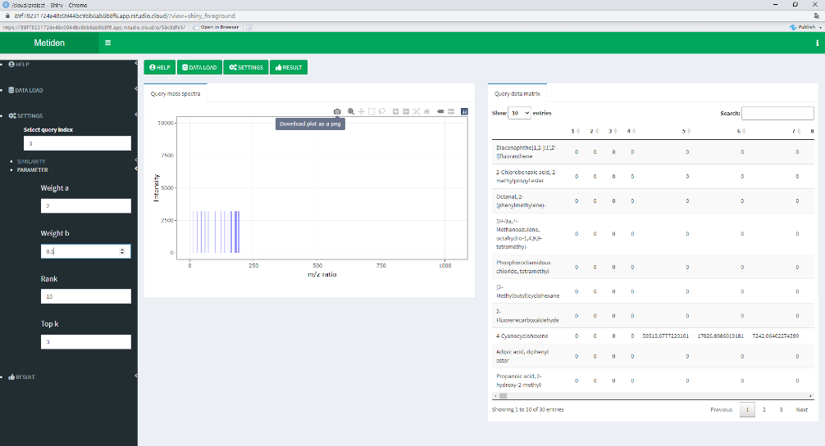
5. Toy example: transf. data visualization
There are many options in the graph
You can download the graph

Slide 28
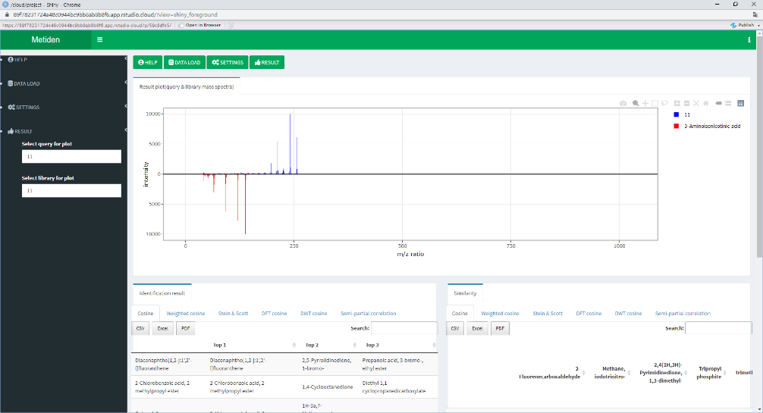
5. Toy example: identification results1
RESULT tab
Compare the 11th data in the query with the 11th data in the library

Slide 29
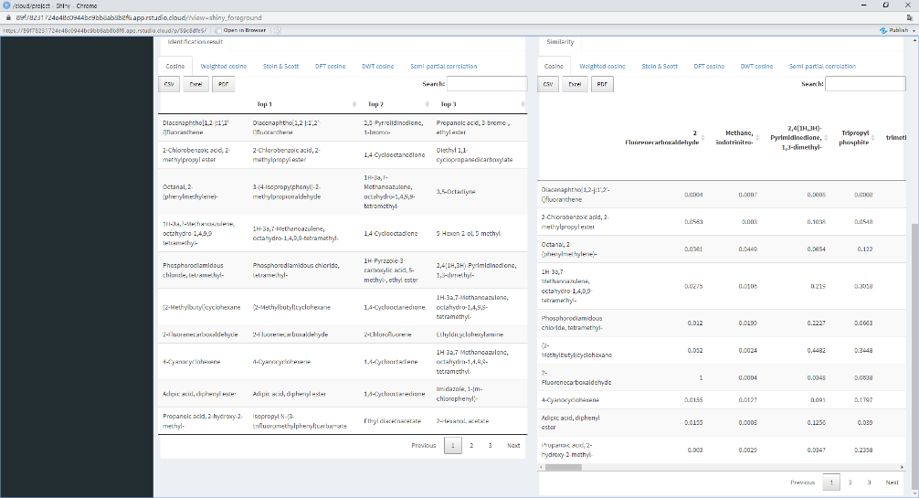
5. Toy example: identification results2
Result table and similarity table
For each metabolite in query, table including metabolite names on top (the best three) in library are provided
Table including corresponding matching similarity score is provided

