Slide 2
Timeline
2015: OpenAI is founded by Elon Musk, Sam Altman, Greg Brockman, Ilya Sutskever, and Wojciech Zaremba.
2016: OpenAI releases the first version of its GPT (Generative Pretrained Transformer) language model, GPT-1.
2018: OpenAI releases GPT-2, a more advanced version of GPT-1 with over 1.5 billion parameters.
2019: OpenAI launches its first commercial product, OpenAI API, which allows developers to access the GPT-3 language model to build AI applications.
May/2020: OpenAI releases GPT-3, the largest language model to date with over 175 billion parameters. Reinforcement Learning with Human Feedback (RLHF)
2021: OpenAI releases "API 2.0," which includes new capabilities like natural language generation, language translation, and summarization.
2022: OpenAI launches a new conversational AI model, ChatGPT, which is capable of generating human-like text in response to user inputs.
August/2021: OpenAI Codex Live Demo on Youtube (https://www.youtube.com/watch?v=SGUCcjHTmGY)
November/2022: OpenAI releases GTP-3.5
Notes:
Competitors:
- DeepMind (poduct: Chinchilla)

Slide 3







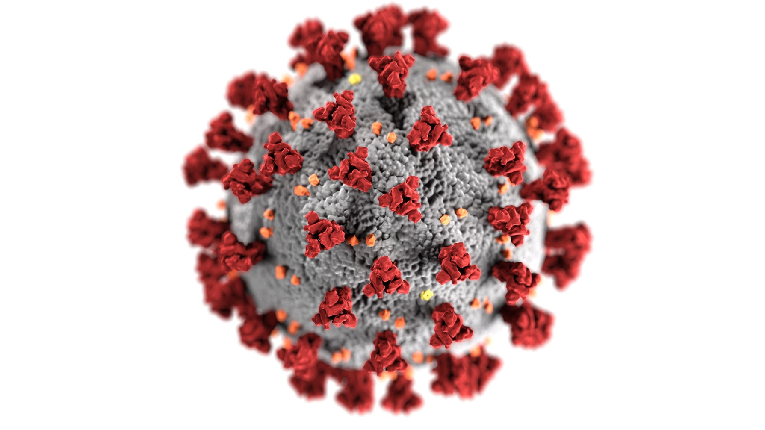
Explaining ChatGPT*
To my daughter
To programmers
To teachers
*CODEX
Notes:
Build a game with codex:
https://www.youtube.com/watch?v=SGUCcjHTmGY

Slide 4
What a time to be alive!
We are just scratching the surface!

Slide 5
chat.openai.com == ChatGPT
labs.openai.com == DALL-E
beta.openai.com == platform.openai.com -> /playground
https://platform.openai.com/examples

Slide 6


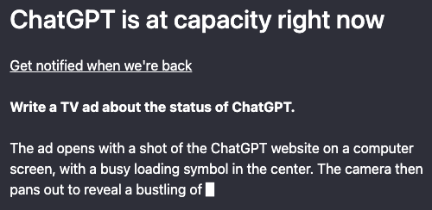


Errors and warnings

Slide 7
Model with lower latency and low costs

Slide 8
Natural language generation: ChatGPT can generate text that is similar to human writing based on a prompt or context.
Question-answering: ChatGPT can provide answers to questions by analyzing the input and retrieving relevant information from its training data.
Conversational response generation: ChatGPT can generate human-like responses in a conversational context, making it useful for chatbots and virtual assistants.
Text summarization: ChatGPT can generate short and concise summaries of longer texts.
Text completion: ChatGPT can suggest and complete sentences or paragraphs based on a partial input.
Sentiment analysis: ChatGPT can determine the sentiment or emotion expressed in a given text.
Translation: ChatGPT can translate text from one language to another.
1
Brainstorm some ideas combining VR and fitness:
import React from 'react’;
const HeaderComponent = () => (

Slide 9
Natural language generation: ChatGPT can generate text that is similar to human writing based on a prompt or context.
Question-answering: ChatGPT can provide answers to questions by analyzing the input and retrieving relevant information from its training data.
Conversational response generation: ChatGPT can generate human-like responses in a conversational context, making it useful for chatbots and virtual assistants.
Text summarization: ChatGPT can generate short and concise summaries of longer texts.
Text completion: ChatGPT can suggest and complete sentences or paragraphs based on a partial input.
Sentiment analysis: ChatGPT can determine the sentiment or emotion expressed in a given text.
Translation: ChatGPT can translate text from one language to another.
2
Q: Who is Batman?
Q: Who is George Lucas?

Slide 10
Natural language generation: ChatGPT can generate text that is similar to human writing based on a prompt or context.
Question-answering: ChatGPT can provide answers to questions by analyzing the input and retrieving relevant information from its training data.
Conversational response generation: ChatGPT can generate human-like responses in a conversational context, making it useful for chatbots and virtual assistants.
Text summarization: ChatGPT can generate short and concise summaries of longer texts.
Text completion: ChatGPT can suggest and complete sentences or paragraphs based on a partial input.
Sentiment analysis: ChatGPT can determine the sentiment or emotion expressed in a given text.
Translation: ChatGPT can translate text from one language to another.
3
The following is a conversation with an AI assistant. The assistant is helpful, creative, clever, and very friendly.
Human: Hello, who are you?
Marv is a chatbot that reluctantly answers questions with sarcastic responses:
You: How many pounds are in a kilogram?

Slide 11
Natural language generation: ChatGPT can generate text that is similar to human writing based on a prompt or context.
Question-answering: ChatGPT can provide answers to questions by analyzing the input and retrieving relevant information from its training data.
Conversational response generation: ChatGPT can generate human-like responses in a conversational context, making it useful for chatbots and virtual assistants.
Text summarization: ChatGPT can generate short and concise summaries of longer texts.
Text completion: ChatGPT can suggest and complete sentences or paragraphs based on a partial input.
Sentiment analysis: ChatGPT can determine the sentiment or emotion expressed in a given text.
Translation: ChatGPT can translate text from one language to another.
Summarize this for a second-grade student:
Jupiter is the fifth planet from the Sun and the largest in the Solar System. It is a gas giant with a mass one-thousandth that of the Sun, but two-and-a-half times that of all the other planets in the Solar System combined. Jupiter is one of the brightest objects visible to the naked eye in the night sky, and has been known to ancient civilizations since before recorded history. It is named after the Roman god Jupiter.[19] When viewed from Earth, Jupiter can be bright enough for its reflected light to cast visible shadows,[20] and is on average the third-brightest natural object in the night sky after the Moon and Venus.
4

Slide 12
Natural language generation: ChatGPT can generate text that is similar to human writing based on a prompt or context.
Question-answering: ChatGPT can provide answers to questions by analyzing the input and retrieving relevant information from its training data.
Conversational response generation: ChatGPT can generate human-like responses in a conversational context, making it useful for chatbots and virtual assistants.
Text summarization: ChatGPT can generate short and concise summaries of longer texts.
Text completion: ChatGPT can suggest and complete sentences or paragraphs based on a partial input.
Sentiment analysis: ChatGPT can determine the sentiment or emotion expressed in a given text.
Translation: ChatGPT can translate text from one language to another.
5
Vertical farming provides a novel solution for producing food locally, reducing transportation costs and

Slide 13
Natural language generation: ChatGPT can generate text that is similar to human writing based on a prompt or context.
Question-answering: ChatGPT can provide answers to questions by analyzing the input and retrieving relevant information from its training data.
Conversational response generation: ChatGPT can generate human-like responses in a conversational context, making it useful for chatbots and virtual assistants.
Text summarization: ChatGPT can generate short and concise summaries of longer texts.
Text completion: ChatGPT can suggest and complete sentences or paragraphs based on a partial input.
Sentiment analysis: ChatGPT can determine the sentiment or emotion expressed in a given text.
Translation: ChatGPT can translate text from one language to another.
6
Decide whether a Tweet's sentiment is positive, neutral, or negative.
Tweet: I loved the new Batman movie! Sentiment:
Classify the sentiment in these tweets:
"I can't stand homework"
"This sucks. I'm bored 😠"
"I can't wait for Halloween!!!"

Slide 14
Natural language generation: ChatGPT can generate text that is similar to human writing based on a prompt or context.
Question-answering: ChatGPT can provide answers to questions by analyzing the input and retrieving relevant information from its training data.
Conversational response generation: ChatGPT can generate human-like responses in a conversational context, making it useful for chatbots and virtual assistants.
Text summarization: ChatGPT can generate short and concise summaries of longer texts.
Text completion: ChatGPT can suggest and complete sentences or paragraphs based on a partial input.
Sentiment analysis: ChatGPT can determine the sentiment or emotion expressed in a given text.
Translation: ChatGPT can translate text from one language to another.
7
Convert movie titles into emoji.
Back to the Future: 👨👴🚗🕒
Batman:
Translate this into French, Spanish and Japanese: What rooms do you have available?

Slide 15
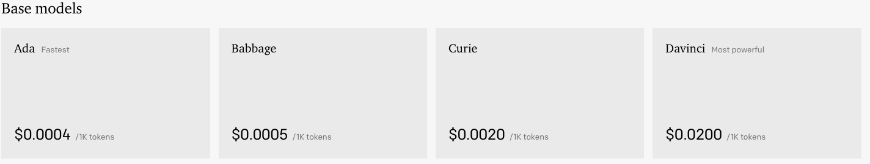
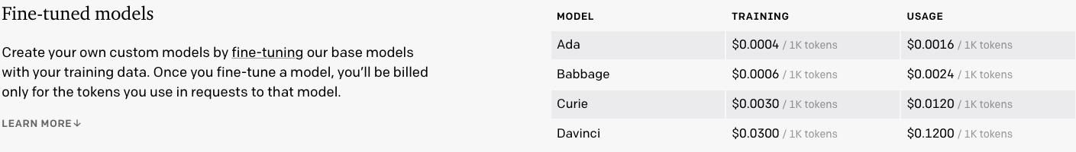
https://openai.com/api/pricing/

