Slide 1
Writing Modular Javascript with AMD and RequireJS
http://bit.ly/12Lf9qy
Josh Schlesinger
Josh Rack

Slide 2
SO HERE’S THE PROBLEM…
As your web “site” grows, so does your code complexity
As developers, we want modularized source files
…but in production, we want optimized code that is downloaded in a few HTTP calls
And then there’s this…
Notes:
I say “site” because we are now building applications in the browser. We are no longer just sprinkling in some javascript to do validations, etc. but our full presentation tier is built in javascript.
We want to be able to create discrete js files that encapsulate our modules just like we do on the server-side
But unlike our server code that gets compiled down to optimized binaries—we need a way for our js to be optimized in the browser

Slide 3
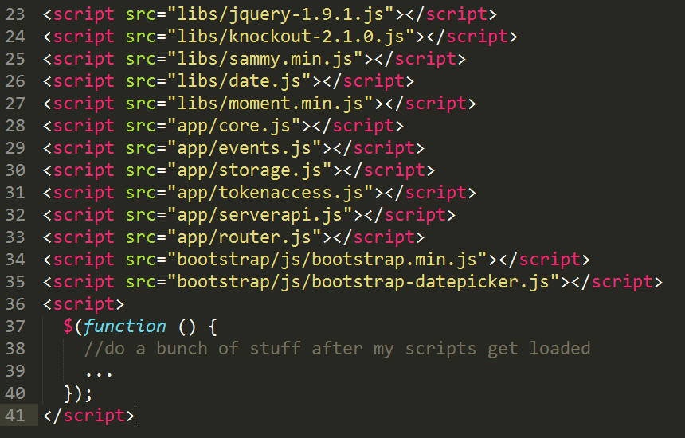
…if you’re lucky
Notes:
Now that we know the problem, what can we do to make our lives easier?

Slide 4
AMD - ASYNCHRONOUS MODULE DEFINITION
What is AMD?
A module format designed specifically for the web browser to overcome the problem of managing a bunch of script tags and their order
What is a module?
A reusable “unit of code”--in the context of building web apps, this can be a combination of js, css, and html
Asynchronicity
Scripts are loaded asynchronously
Notes:
Async: Later on, I will do a demo that shows the different ways the browser can load scripts and see why loading our scripts asynchronously is important. But don’t worry, by the time we are done, you won’t actually have think about it all!

Slide 5
REQUIREJS – AN AMD SCRIPT LOADER
Manages script loading
All of those script tags in your html go away, along with having to manage their order
Manages module dependencies
When you define your module with require, you also register it’s dependencies
Cleans up the global namespace
By encapsulating our code in modules, require is able to keep our code isolated

Slide 6
THE BASICS OF SCRIPT LOADING
<script src=”...”></script>
blocks everything (including rendering) until the script is loading and executes immediately when loaded
<script src=”...” defer></script>
Defers script execution until everything is loaded and rendered
<script src=”...” async></script>
Script executes immediately when loaded, but doesn’t block rendering or other script loading/execution
SYNC
DEFER
ASYNC
Notes:
Show sync example demo

Slide 7
DEMO

Slide 8
CONTACT
Josh Schlesinger
josh@jschlesinger.net
Josh Rack
joshuarack@gmail.com

Slide 9
RESOURCES
Sample Code & Deck
https://github.com/jjschlesinger/CCCRequireJS/
Project Home
http://requirejs.org/

