Slide 1


Data-Driven
Real Estate Investing
Jenny Shang
Wanyi (Evelyn) Dong
Shih-Hung (Angela) Ma
Yi ran (Jenny) Wang
Kai ping (Rory) Wang

Slide 2
Agenda
01
Recommendations
Data Cleaning & Analysis
02
Conclusion
03
04
Future Work
04

Slide 3

Recommendations

Slide 4


Recommendations
Allocate budget according to changes in 10-year US Treasury rate and demographics
Select properties that contain amenities that positively contribute to price per sqft
Invest more into buildings that are either mainly four bedrooms or a mix of different units
Notes:
Our analysis of the data provided by Centro yielded 3 recommendations, which are summarized here. We propose to #1) Allocate budget according to changes in the 10-year US Treasury rate #2) select properties that include fitness centers and business center amenities; and #3) invest in properties that have either over 45% in 4-bedroom units, or have a fair mix of all kinds of units.

Slide 5

Data Cleaning & Analysis

Slide 6
Data Cleaning
Step 1
Create new dataset by extracting useful columns
Step 4
Raw Data
Add in external data
(e.g. 10-Year US Treasury rate)
Properties file:
20,363 x 212
Sales file:
24,527 x 200
Step 2
Merge the two separate datasets together
Step 3
Split the dataset by State

Slide 7
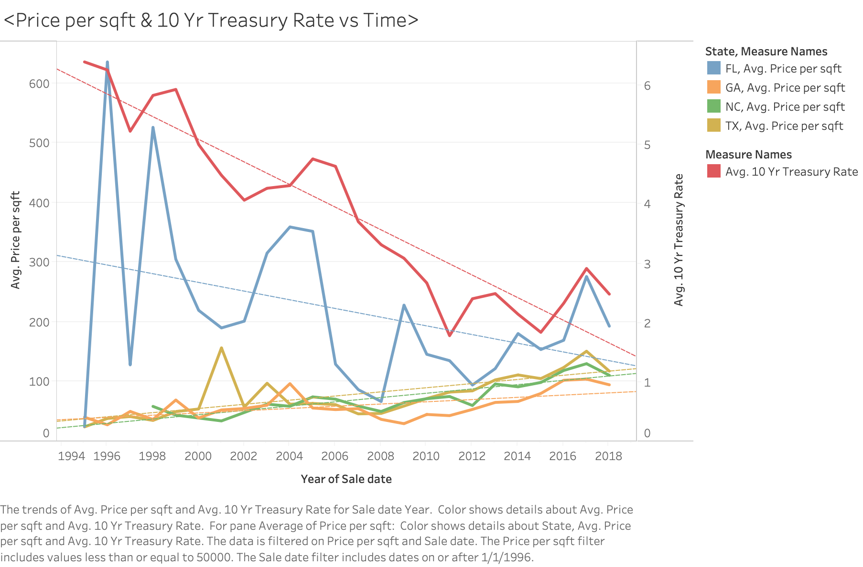
Geographic Analysis - Recommendation 1
Allocate budget to different locations according to 10-year Treasury Rate and demographic information
10-year Treasury Rate
Trend from 1996 to 2018
Florida
Texas, North Carolina, Georgia
10-year Treasury Rate - highly correlated with Florida’s building price

Slide 8
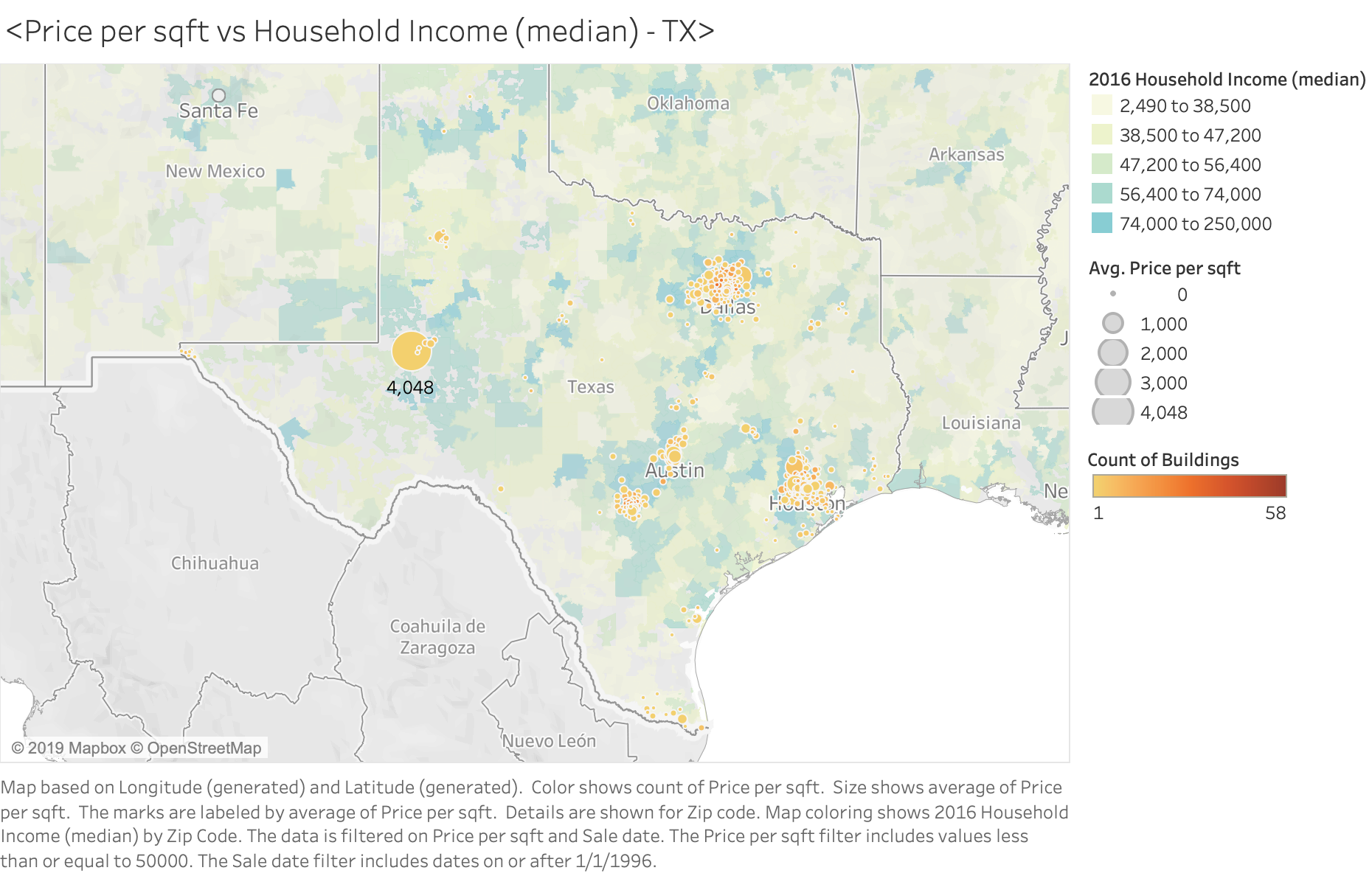
Demographic Analysis - Recommendation 1
Allocate budget to different locations according to 10-year Treasury Rate and demographic information
Demographic
Eight heatmaps
Four states
Household income
Per capita income
Positive relationship between building’s price per sqft and median household income
Example: Ector at Texas

Slide 9
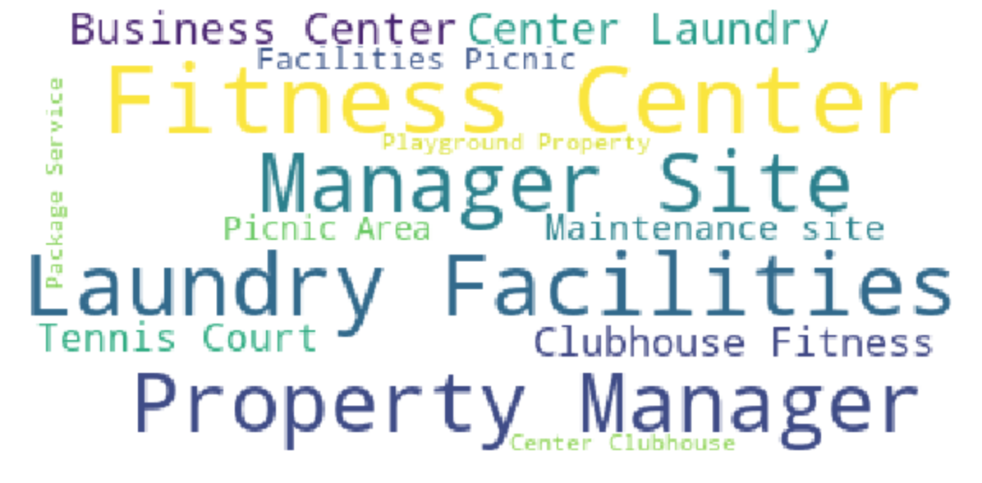

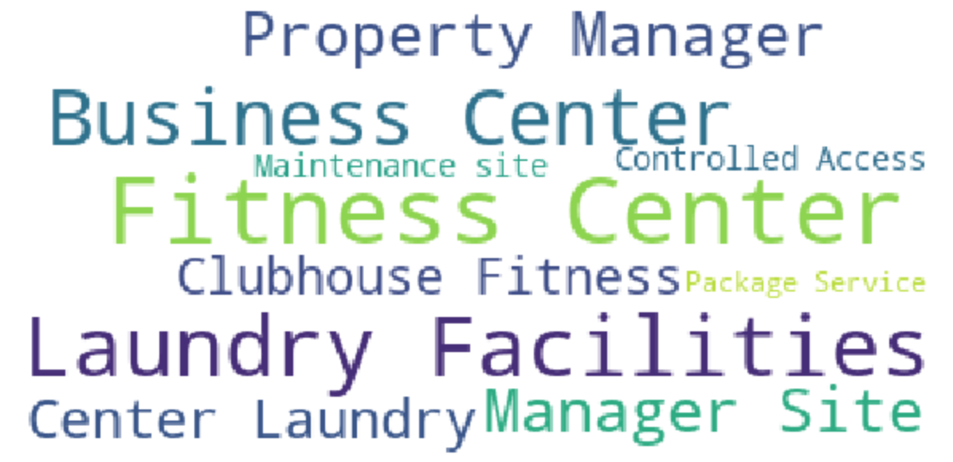

Word Cloud - Recommendation 2
Florida
North Carolina
Texas
Georgia

Slide 10
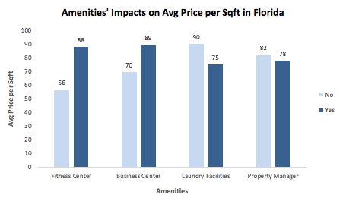
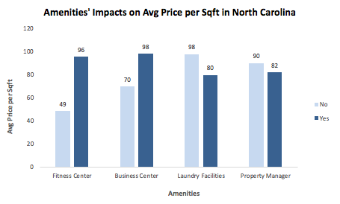
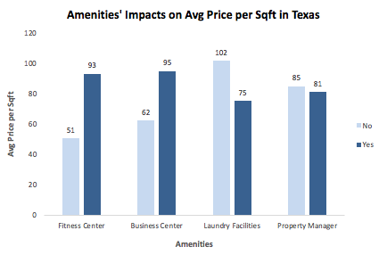
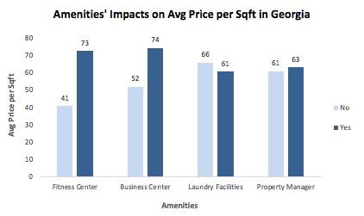
Amenities Analysis - Recommendation 2
Florida
North Carolina
Texas
Georgia

Slide 11
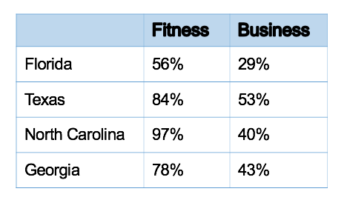
Amenities Analysis - Recommendation 2
Insight
% difference
Fitness center increases price per sqft by $38 on average
Business center increases price per sqft by $26 on average
Recommendation
Investing more heavily on buildings with fitness center and business center

Slide 12

Unit Mixes Analysis - Recommendation 3
> 45%
Classify as “Mainly”
6 Unit Mixes
Mainly 1,2,3,4 Bedroom, Studios, Mixed
Standard Deviation & Average of
Price per Sqft

Slide 13
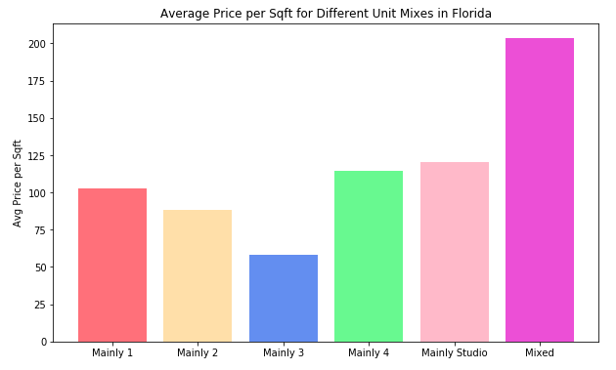
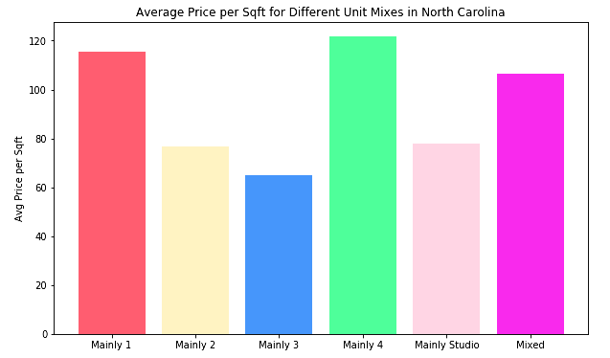
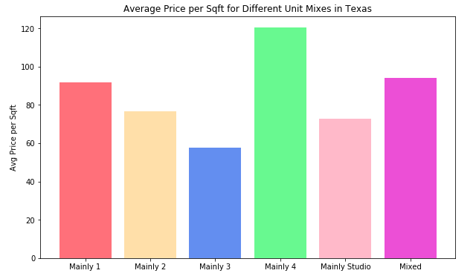
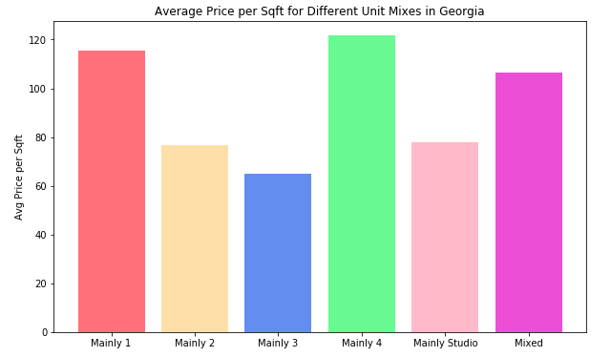
Unit Mixes Analysis - Recommendation 3
Florida
North Carolina
Texas
Georgia

Slide 14
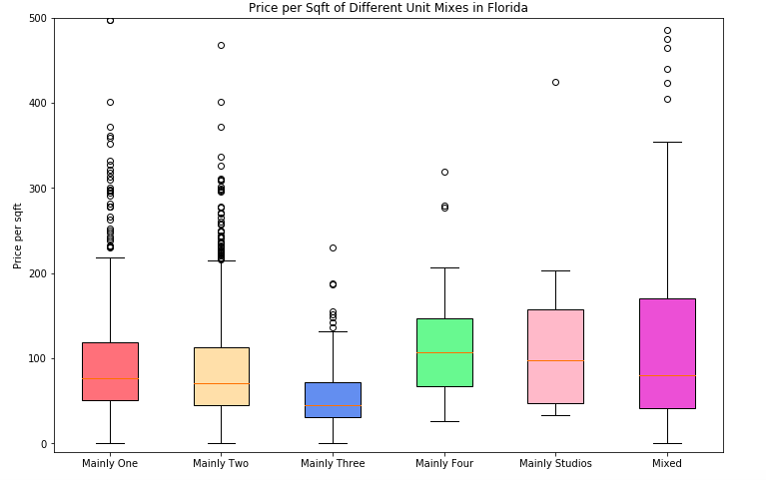
Unit Mixes Analysis - Recommendation 3
Recommendation
Mainly 4 Bedroom Buildings:
Georgia
Texas
North Carolina
Mixed Buildings:
Florida

Slide 15
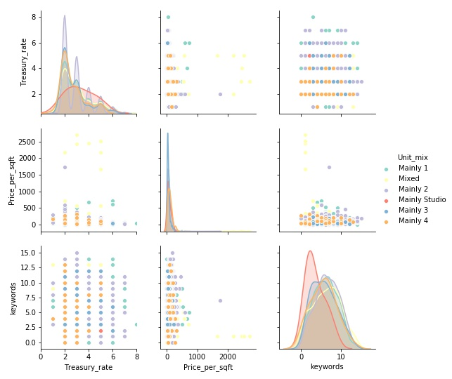
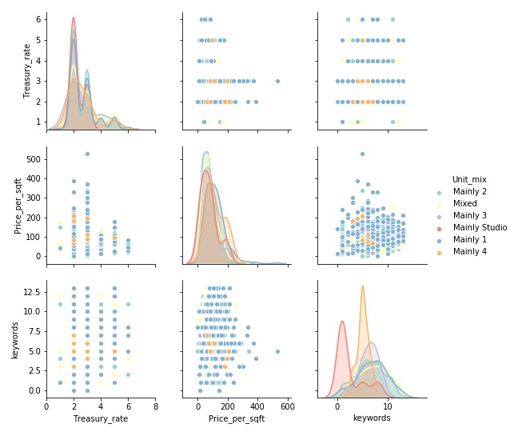
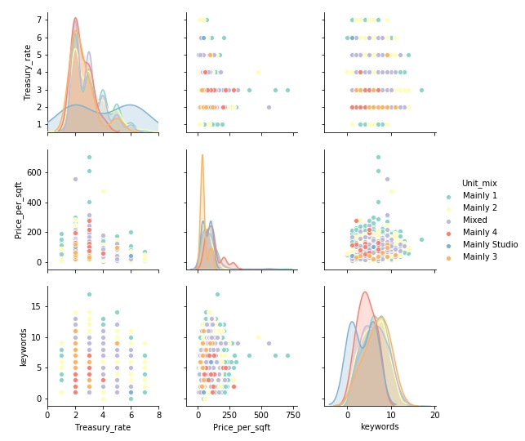
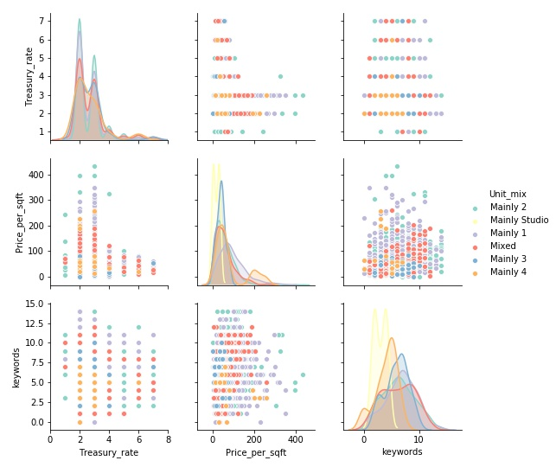
Pair Plot Analysis
Recommendation
Florida
North Carolina
Highest price in each region happened when 10-year treasury rate is around 2-3%
Buildings with equal to or more than one amenities have relatively higher price
Texas
Georgia

Slide 16

Conclusion

Slide 17
Conclusion
Exploratory Data Analysis
Data Visualization
Data
Cleaning
Insights

Slide 18
Insights
Treasury rate decrease :
Invest in GA, NC and TX
Treasury rate increase :
Invest in FL
Invest in properties with profit-
generating amenities
In GA, NC and TX :
Invest in buildings with mainly 4 bedrooms
In FL :
Invest in buildings with mixed units
Notes:
Our analysis of the data provided by Centro yielded 3 recommendations, which are summarized here. We propose to #1) Allocate budget according to changes in the 10-year US Treasury rate #2) select properties that include fitness centers and business center amenities; and #3) invest in properties that have either over 45% in 4-bedroom units, or have a fair mix of all kinds of units.

Slide 19

Future Work

Slide 20
Future Work
01
02
Continue to record the percentage of unit type
Continue to record amenities & survey residents
03
04
Use external variables to select optimal locations
Use machine learning to select locations

Slide 21
Thank you!
Questions?

Slide 22

Appendix

Slide 23
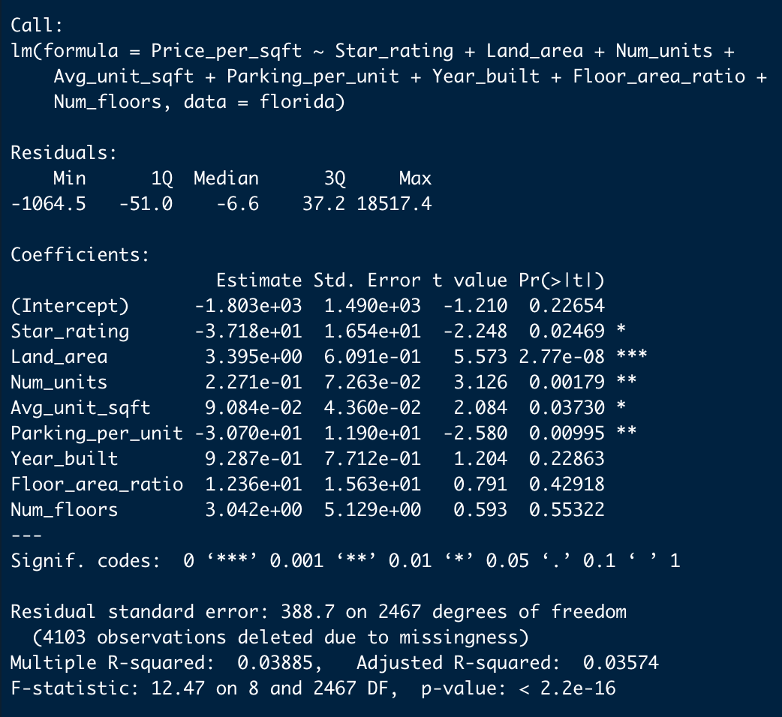
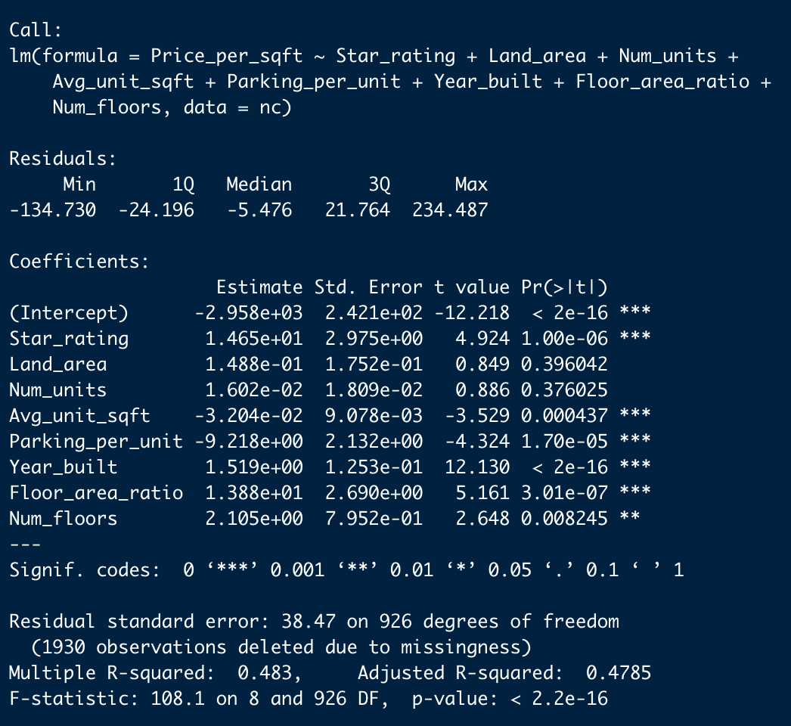
Regression Model
Florida
North Carolina
Georgia

Slide 24
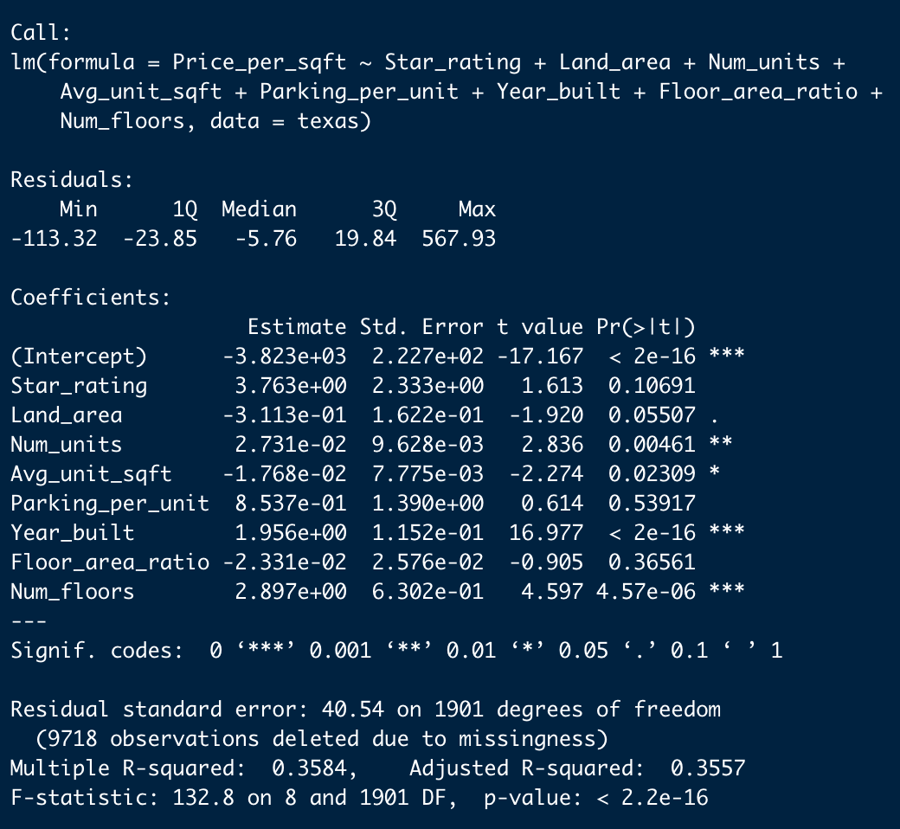
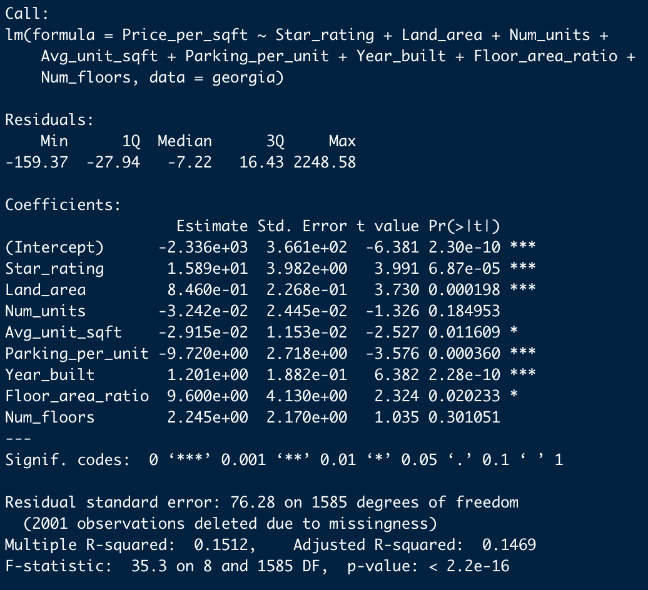
Regression Model
Texas
Georgia

