Slide 1
Centre Court: Baseline
Instant tennis coaching, computed on the court
2026 ASUS UGen AI League Innovation Hackathon
Battlefield Lightning (Lightweight Computing Track) ASUS UGen300 AI Accelerator (M.2 or USB)
Jefferson Tse-Wei Lee | Senior Data Scientist | Aurecon
Ben Wylie | Senior Asset Management | Aurecon
Notes:
Ben (0:00-0:14)
Hi everyone, I'm Ben Wylie, and this is Jefferson Lee. We're from Brisbane, and this is Centre Court: Baseline - instant tennis coaching, computed right on the court, on an Android phone and the ASUS UGen300.

Slide 2
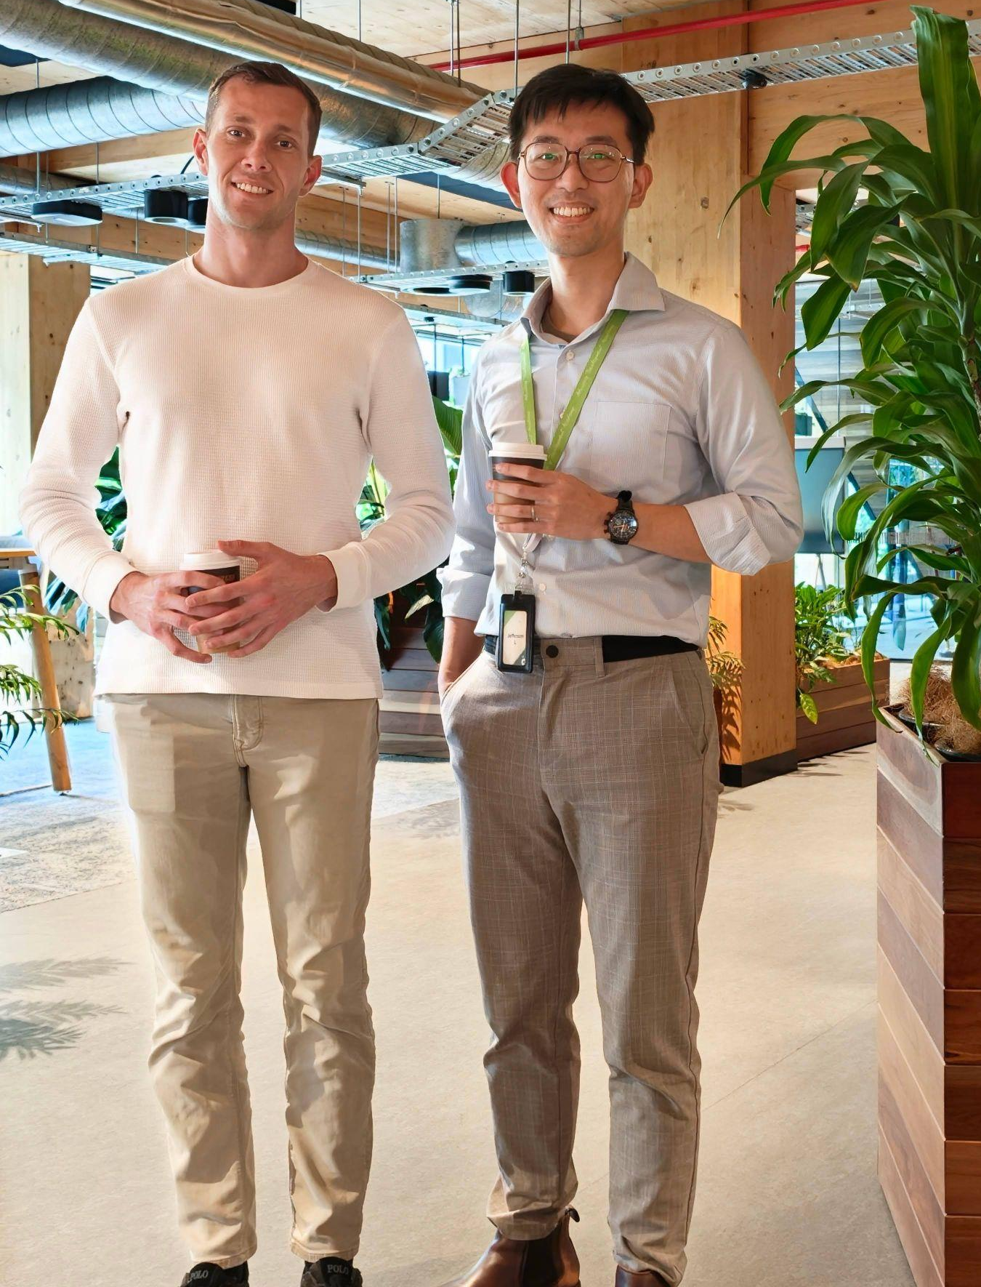


The Team:
Jefferson Tse-Wei Lee & Ben Wylie
PROBLEM AND WHY EDGE
Meet the team:
Jefferson Tse-Wei Lee
Born and raised in Taiwan, started his career as intern in ASUS Taiwan
Senior Data Scientist in Asset Performance at Aurecon
Ben Wylie
Twenty years+ of tennis experience and currently the club level player in Brisbane.
Senior Asset Consultant in Infrastructure Advisory at Aurecon
Location & Disclosure:
Both Ben and Jefferson are based in Brisbane Australia
Aurecon is a 7000+ people Engineering consultancy from Australia. The projects are across APAC region, including HK international Aireport and tallest building in Mainland China.
Disclosure: Although both Ben and Jefferson work for Aurecon, but this project is independent and has no commercial relationship with, or endorsement from, Aurecon.
Notes:
Ben (0:14-0:54)
We both work at Aurecon, a 7,000-person Australian engineering consultancy with projects across Asia-Pacific, from Hong Kong International Airport to the tallest building in mainland China. I'm a senior asset consultant in infrastructure advisory, and Jefferson is a senior data scientist in asset performance. Jefferson grew up in Taiwan and started his career as an intern at ASUS, so this is a bit of a homecoming for him. Our day jobs use data to understand how physical assets perform; Centre Court does the same for a tennis stroke. To be clear, this is our own independent project, not an Aurecon one.

Slide 3

Players cannot see their own technique, and the fix has to be instant, private and offline - a natural edge problem
PROBLEM AND WHY EDGE
The problem
Why edge computing
Invisible
Foot order, toss height and the hitting point happen in a fraction of a second.
Offline
Courts often have weak or no Wi-Fi; every step runs on the phone and the UGen300.
Delayed
Private
Video review happens after the session, when the feel of the stroke is gone.
Video of players (often juniors) never leaves the court.
Coach-dependent
Instant
Frame-by-frame analysis needs a coach's time for every stroke.
Feedback between points, while the player can still feel the stroke.
Our hypothesis, to be validated with players and coaches
Notes:
Ben (0:54-1:53)
Now the problem - and for me it's personal. I've played tennis for over twenty years, I still play at club level, and I still can't see my own technique. Is my right foot in front at contact? Is my toss too low? Am I hitting the ball above my head? It all happens in a fraction of a second. Today you either film yourself and watch it at home, when the feel of the stroke is gone, or pay a coach to watch every ball, which most club players can't do every week. And the court itself makes it hard: weak or no Wi-Fi, and lots of junior players whose video shouldn't be uploaded anywhere. So the answer has to be instant, private and offline. That's an edge-computing problem, and that's why we built it for the UGen300. Jefferson will show you how it works.

Slide 4

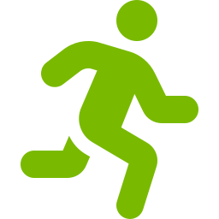
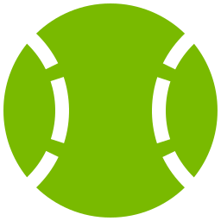


Five stages turn a phone clip into coaching; the phone does capture and logic, the UGen300's NPU runs the neural models
SOLUTION AND EDGE ARCHITECTURE
1 Frames
2 Skeleton
3 Ball
4 Judge
5 Coach
Video split into one image per frame (120 per second)
Player box + 33-point skeleton on a zoomed crop
Racquet, full-screen ball path, bounce, hitting point
18 forehand / 15 serve coaching checks
Every result as plain-language feedback
Runs on: Phone
Runs on: UGen300
Runs on: UGen300 + phone
Runs on: Phone
Runs on: Phone or UGen300
Android phone
ASUS UGen300 (Hailo NPU)
120 fps camera, frame splitting, ball maths (OpenCV), coaching logic, results screen
Player and racquet detection (YOLOX), skeleton model; optional small local LLM coach
Hackathon demo runs the same pipeline as a web app on a laptop; YOLOX is in the Hailo Model Zoo, the pose model still has to be converted and benchmarked
Notes:
Jefferson (1:53-2:22)
Thanks, Ben. The phone films at 120 frames a second, and then there are five stages. One: split the video into frames. Two: find the player and fit a 33-point skeleton. Three: find the racquet, the ball, the bounce and the exact hitting point. Four: judge the stroke against coaching rules. Five: turn it into plain-language coaching. The phone does the camera and the light maths; the UGen300's Hailo NPU runs the neural networks.

Slide 5
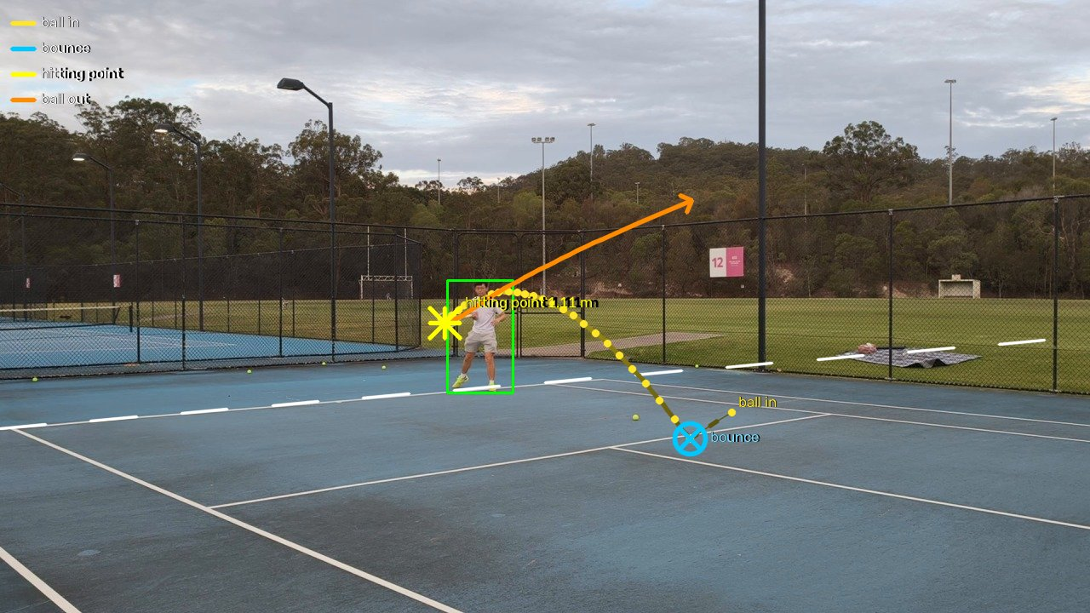
Every frame is kept, the skeleton is fitted on a zoom, and the ball is tracked across the whole screen
STAGES 1-3: SEE THE STROKE
1 Frames
120 images per second, written once to disk, so a 1080p clip never fills memory.
2 Skeleton
33 joints on a zoomed crop, smoothed over ~33 ms and converted to metres from the player's height.
3 Ball and racquet
Yellow moving blobs anywhere on screen are chained frame to frame; the hitting point is the midpoint of the two frames closest to the racquet head.
Full-frame ball path: incoming ball, bounce (cross), hitting point (star) and the ball leaving (arrow)
Forehand 1 of the 120 fps clip. Skeleton: MediaPipe BlazePose; player and racquet: YOLOX-tiny (both Apache-2.0)
Notes:
Jefferson (2:22-2:56)
Here's what stages one to three see. We keep every frame, because at 120 frames a second we catch the few milliseconds around contact. The skeleton is fitted on a zoomed crop and converted into metres from the player's height. And the ball is tracked across the whole screen: you can see it come in, bounce, and the star is the hitting point - the midpoint of the two frames where the ball is closest to the racquet head. The arrow is the ball leaving.

Slide 6
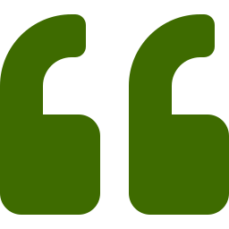
Plain coaching logic - 18 forehand and 15 serve checks - and the coach reports every one of them
STAGES 4-5: JUDGE AND COACH
Top-priority forehand rules
Coach, forehand 4
1
Hitting point above your head
Behind the baseline: move forward. Inside the court: leave no-man's land and let the ball drop.
Good (12): Contact not above your head; Ball bounced close enough; Body sideways in preparation; Contact in front of the body; Early preparation; Left arm tracks the ball; Load the legs (squat); Stable base; Racquet drops below the ball; Low-to-high swing (topspin); Legs drive up into the ball; Finish over the left shoulder.
To improve on your next forehands (5, most important first):
1. [Footwork] At contact your right foot is in front of your left. Step in with the LEFT foot so your weight transfers forward through the ball.
2. [Contact] You are hitting the ball too low - bend your knees to get down to it or take it a little earlier.
3. [Contact] Give yourself room: meet the ball about an arm's length to your right, not jammed into the body or at full stretch.
4. [Contact] Keep your head still and your eyes on the contact point until the ball has left the strings.
5. [Finish] Stay balanced: at the finish your head should be over your feet, not falling away.
Could not measure (1): Arm not cramped at contact (film a little closer, steady, with the ball in view).
2
Ball bounced too far in front
Ball took longer than 0.8 s from bounce to racquet: move forward to meet it.
3
Not sideways in preparation
Turn shoulders and hips sideways before the swing.
Also checked: contact in front, left foot in front, contact height, spacing, arm, head still, early preparation, left arm, knees, base, racquet drop, low-to-high, leg drive, finish, balance.
Targets are general club-coaching ranges for a right-handed player; a check shows 'not measurable' when the clip cannot support it
Notes:
Jefferson (2:56-3:28)
Stage four is deliberately not a black box. It's coaching logic: 18 forehand checks and 15 serve checks, each a rule on a measured number, in the order a coach would fix them. Top priority: if you hit the ball above your head, move forward - or, if you're already inside the court, get out of no-man's land and let it drop. Then the coach reports everything: what's good, every fix in priority order, and what it couldn't measure.

Slide 7
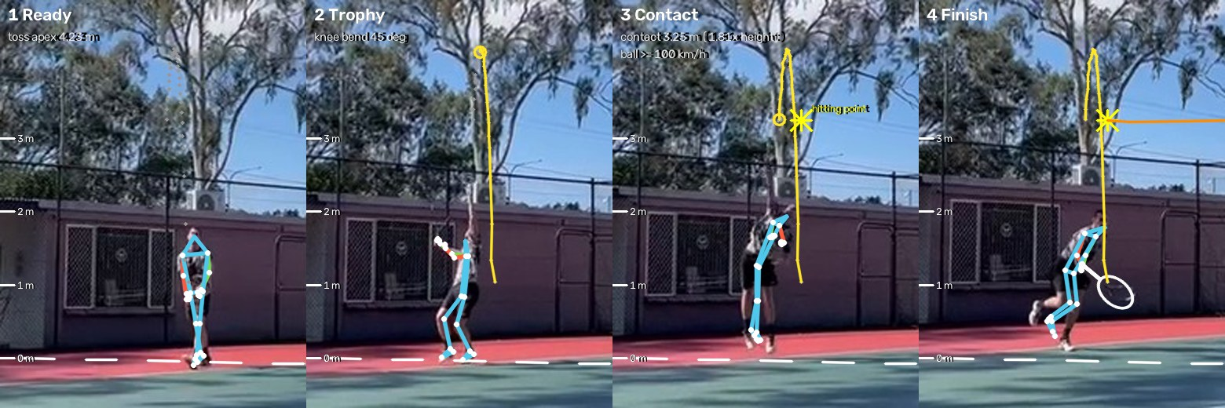
Serve: the toss, the exact contact moment and the heights that matter, from a low-resolution phone clip
DEMO RESULT: SERVE
3.25 m
contact height, with a jump
4.23 m
toss peak
≥ 100 km/h
ball speed off the racquet
Frame 50.5
contact, same as the manual check
What the coach says: 10 of 15 checks good; 3 fixes in priority order - shoulders tilted up to the ball; toss arm stays up; land inside the court.
Clip IMG_3025: phone, 30 fps, player about 86 px tall. Heights scaled from the player's entered height (1.80 m); ball speed is a lower bound
Notes:
Jefferson (3:28-3:53)
Here's a serve from an ordinary phone clip: 30 frames a second, with the player only 86 pixels tall. It fits the toss to a gravity curve and finds the contact at frame 50.5 - exactly what we found checking frame by frame. Contact at 3.25 metres, and three fixes: tilt the shoulders, keep the toss arm up, and land inside the court.

Slide 8
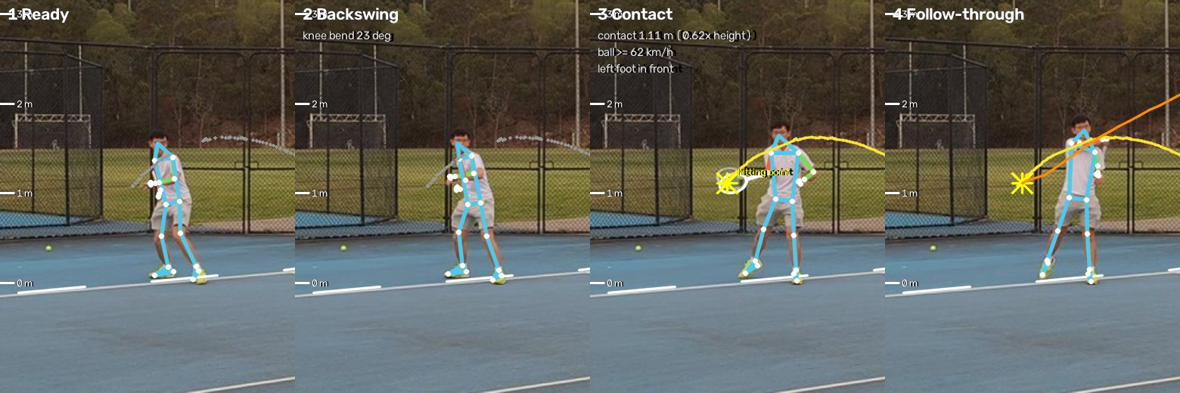
Forehand: 4 forehands in one 15 s clip, each fully checked - and the one backhand is recognised and skipped
DEMO RESULT: FOREHAND
# | Hitting point | Bounce to hit | Fixes
1 | 1.11 m | 0.86 s | 1
2 | 0.52 m | not seen | 3
3 | 0.95 m | not seen | 1
4 | 0.54 m | 0.55 s | 5
Forehand 1: white = racquet, star = hitting point, yellow = incoming ball, orange = ball leaving
Read-out: hitting point at 1.11 m, in front of the body, left foot in front, 16 of 18 checks good; one fix - the ball took 0.86 s from bounce to racquet, so move forward to meet it.
Clip forehand_120fps.mp4: 1080p at 120 fps. A stroke counts only when the ball leaves a fast-moving racquet in the swing direction; unclear strokes and backhands are skipped
Notes:
Jefferson (3:53-4:20)
On a 15-second forehand clip at 120 frames a second, it found four forehands. It also recognised the one backhand in the clip and skipped it - we'd rather miss a stroke than coach the wrong one. Forehand one: hit at 1.1 metres, in front of the body, left foot forward. One fix: the ball took almost 0.9 seconds after the bounce, so move forward to meet it.

Slide 9
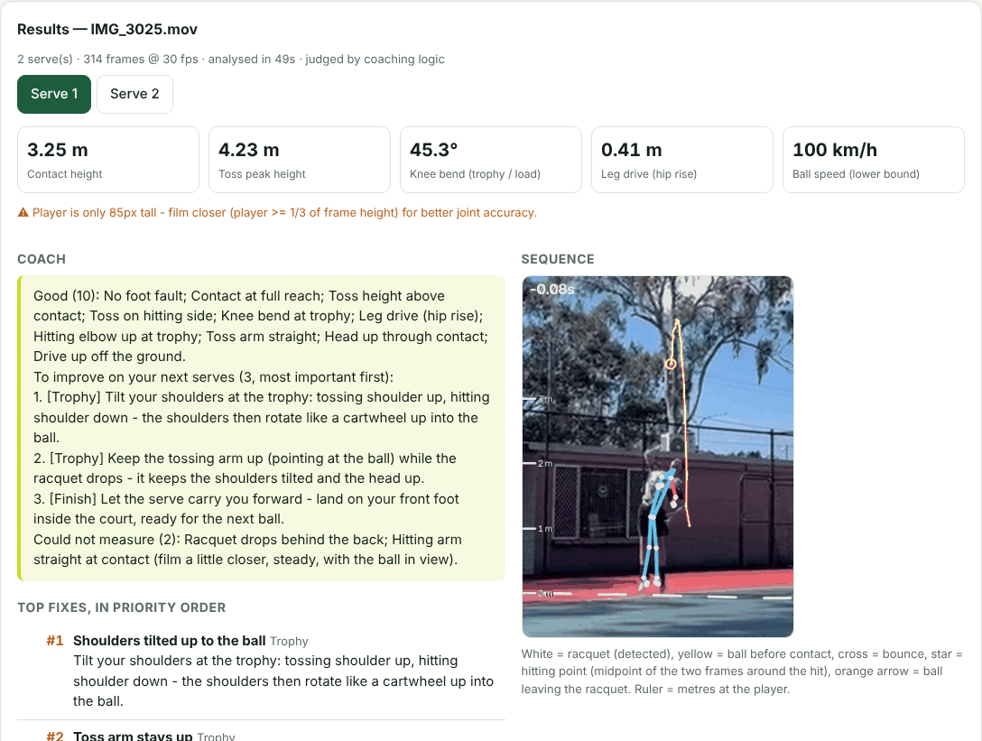
The player gets the answer first - the coach's note - and the visual evidence underneath
DEMO EXPERIENCE
1
Coach's note
everything that is good, every fix in priority order, what could not be measured
2
Ball trajectory
full-screen path: incoming ball, bounce, hitting point, ball leaving
3
Slow motion
annotated sequence with skeleton and racquet, key moments, joint heights
4
Checklist
every check: good, improve or not measurable, with the measured value
Screenshot of the Serve Lab web demo (serve mode, clip IMG_3025)
Notes:
Jefferson (4:20-4:46)
This is what the player sees. [DEMO: switch to the web app with IMG_3025 already analysed.] The coach's note comes first, then the evidence: the ball trajectory, slow motion with skeleton and racquet, and the checklist with every measured value.

Slide 10
The heavy part is exactly what the NPU accelerates, and the whole stack is licensed for commercial use
EDGE READINESS
Speed-ups already in
Detector at 10 Hz, skeleton at 60 Hz with gaps filled, shake estimate on a small copy: the forehand clip went from 270-390 s to 199 s.
To the NPU
Detection, racquet and skeleton are standard networks - the work the Hailo NPU is built for.
Commercially clean
OpenCV, MediaPipe, YOLOX, ONNX Runtime: Apache / BSD / MIT. Ultralytics YOLO (AGPL) deliberately avoided.
CPU time on a 2-core cloud machine, forehand clip (1818 frames, 1280x720 at 120 fps). Not yet benchmarked on the UGen300
Notes:
Jefferson (4:46-5:08)
Today this runs on a CPU: about three minutes for that 15-second clip at 120 frames a second. Most of that time is detection, skeleton and racquet - standard neural networks, exactly what the Hailo NPU accelerates. And it's commercially clean: every component is Apache, BSD or MIT licensed. We deliberately avoided AGPL models.

Slide 11
Next: from web demo to an Android app with the UGen300 doing the heavy lifting
Now
Next
Then
Serve and forehand working end to end; web demo
YOLOX + pose on the Hailo NPU; Android app with filming guide
Coaches validate thresholds; backhand; club trials
Thank you - Jefferson & Ben
Notes:
Ben (5:08-5:25)
Next, we put the models on the UGen300, build the Android app with a filming guide, and get coaches to validate the thresholds on real courts - then we add the backhand. Every club player deserves a coach on the court. Thank you.

