Slide 1
Centre Court: Baseline
Instant tennis coaching, computed on the court
2026 ASUS UGen AI League Innovation Hackathon
Battlefield Lightning: ASUS UGen300 AI Accelerator
Jefferson Tse-Wei Lee, Senior Data Scientist, Aurecon
Ben Wylie, Senior Asset Consultant, Aurecon
Notes:
Presenter: Ben. Hi everyone, I'm Ben Wylie, and this is Jefferson Lee. We're from Brisbane, and this is Centre Court: Baseline - instant tennis coaching, computed right on the court, on an Android phone and the ASUS UGen300.

Slide 2
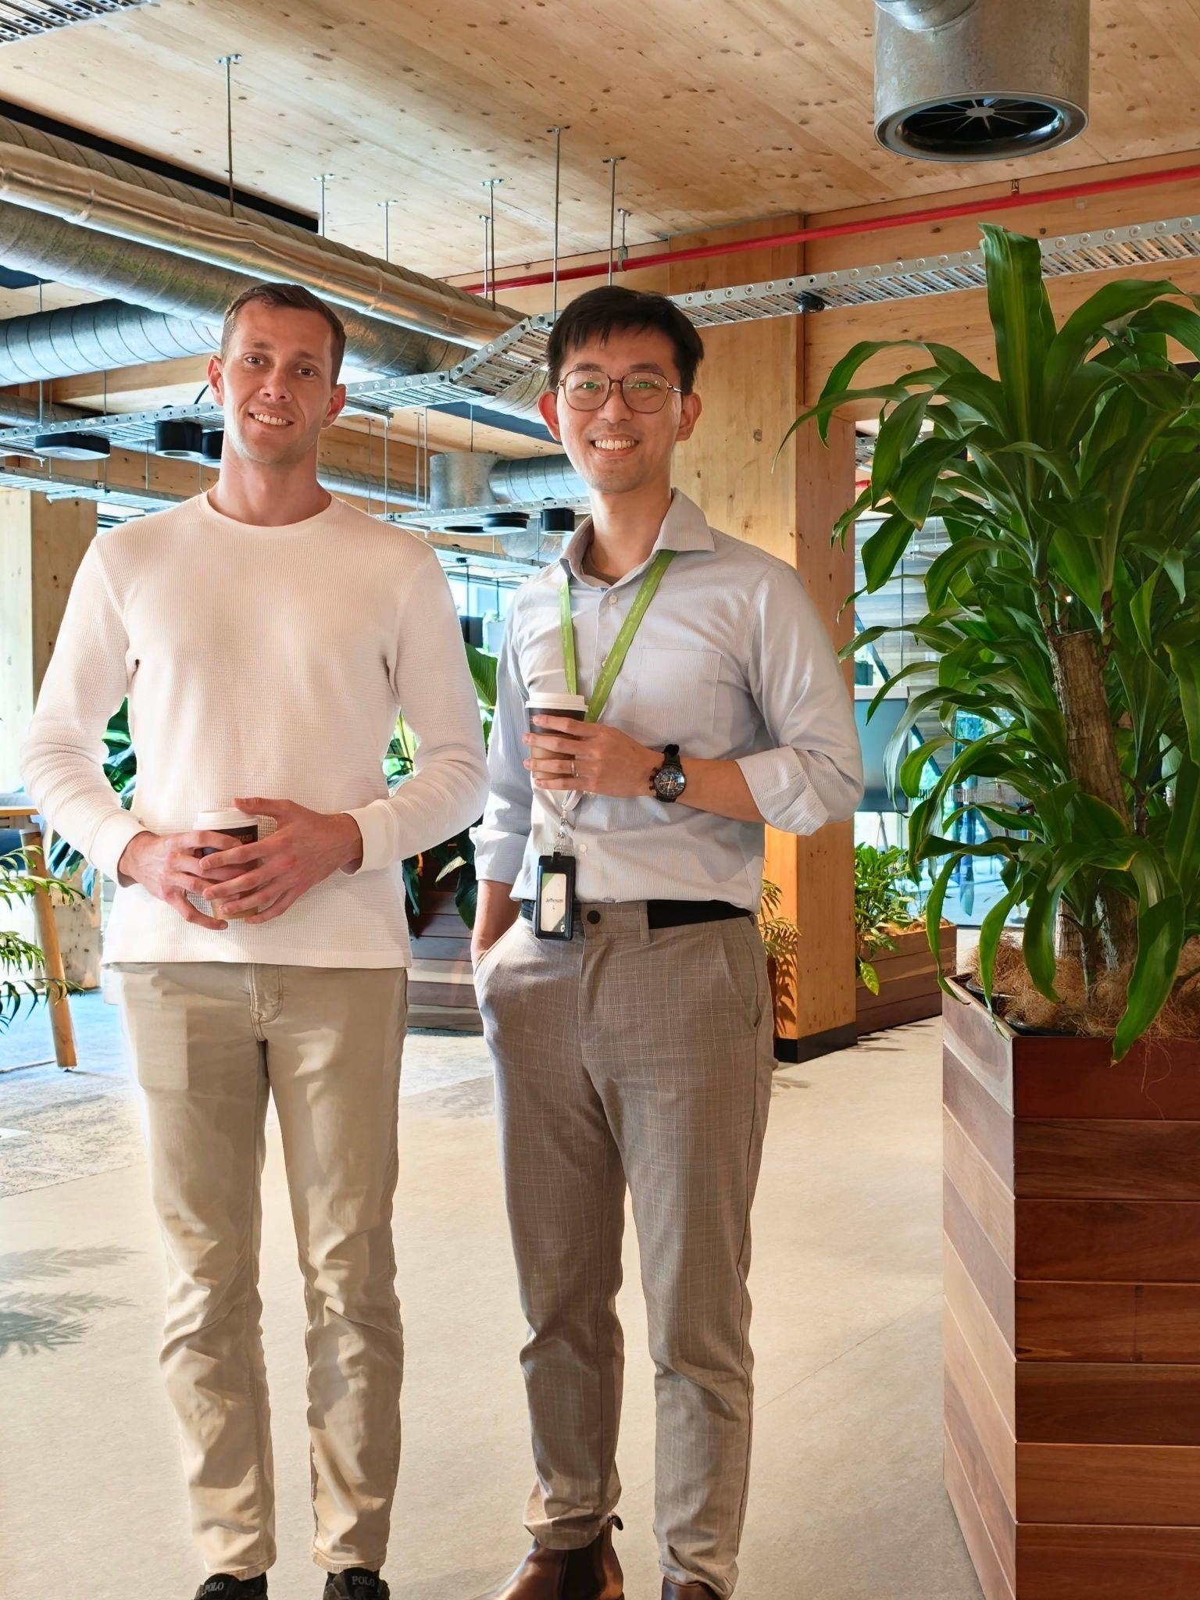
Two tennis players from Aurecon, both based in Brisbane
The team
Jefferson Tse-Wei Lee
Born and raised in Taiwan; started his career as an intern at ASUS Taiwan. Senior Data Scientist in Asset Performance at Aurecon.
Ben Wylie
Twenty-plus years of tennis; plays club level in Brisbane. Senior Asset Consultant in Infrastructure Advisory at Aurecon.
Aurecon is a 7,000-person engineering consultancy from Australia, with projects across Asia-Pacific including Hong Kong International Airport and the tallest building in mainland China.
Disclosure: this is an independent project, with no commercial relationship with, or endorsement from, Aurecon.
Notes:
Presenter: Ben. We both work at Aurecon, a 7,000-person Australian engineering consultancy with projects across Asia-Pacific, from Hong Kong International Airport to the tallest building in mainland China. I'm a senior asset consultant in infrastructure advisory, and Jefferson is a senior data scientist in asset performance. Jefferson grew up in Taiwan and started his career as an intern at ASUS, so this is a bit of a homecoming for him. Our day jobs use data to understand how physical assets perform; Centre Court does the same for a tennis stroke. To be clear, this is our own independent project, not an Aurecon one.

Slide 3
Players cannot see their own technique, and the fix has to be instant, private and offline
Problem and why edge
The problem
Why edge computing
Invisible
Foot order, toss height and the hitting point happen in a fraction of a second.
Offline
Courts often have weak or no Wi-Fi; every step runs on the phone and the UGen300.
Delayed
Private
Video review happens after the session, when the feel of the stroke is gone.
Video of players, often juniors, never leaves the court.
Coach-dependent
Instant
Frame-by-frame analysis needs a coach's time for every stroke.
Feedback between points, while the player can still feel the stroke.
Our hypothesis, to be validated with players and coaches
Notes:
Presenter: Ben. Now the problem - and for me it's personal. I've played tennis for over twenty years, I still play at club level, and I still can't see my own technique. Is my right foot in front at contact? Is my toss too low? Am I hitting the ball above my head? It all happens in a fraction of a second. Today you either film yourself and watch it at home, when the feel of the stroke is gone, or pay a coach to watch every ball, which most club players can't do every week. And the court itself makes it hard: weak or no Wi-Fi, and lots of junior players whose video shouldn't be uploaded anywhere. So the answer has to be instant, private and offline. That's an edge-computing problem, and that's why we built it for the UGen300. Jefferson will show you how it works.

Slide 4
Five stages turn a phone clip into coaching; the UGen300's NPU runs the neural models
Solution and edge architecture
1
2
3
4
5
Frames
Skeleton
Ball
Judge
Coach
Video split into one image per frame, 120 per second
Player box and a 33-point skeleton on a zoomed crop
Racquet, ball path, bounce and hitting point
26 forehand and 20 serve checks, at three player levels
Every result in plain words, worded for the player's level
Runs on: Phone
Runs on: UGen300
Runs on: UGen300 + phone
Runs on: Phone
Runs on: Phone or UGen300
Android phone
ASUS UGen300 (Hailo NPU)
120 fps camera, frame splitting, ball maths (OpenCV), coaching logic, results screen
Player and racquet detection (YOLOX), the skeleton model; optional small local language-model coach
The demo runs the same pipeline as a web app on a laptop. YOLOX is in the Hailo Model Zoo; the pose model still has to be converted and benchmarked
Notes:
Presenter: Jefferson. Thanks, Ben. The phone films at 120 frames a second, and then there are five stages. One: split the video into frames. Two: find the player and fit a 33-point skeleton. Three: find the racquet, the ball, the bounce and the exact hitting point. Four: judge the stroke against coaching rules. Five: turn it into plain-language coaching. The phone does the camera and the light maths; the UGen300's Hailo NPU runs the neural networks.

Slide 5
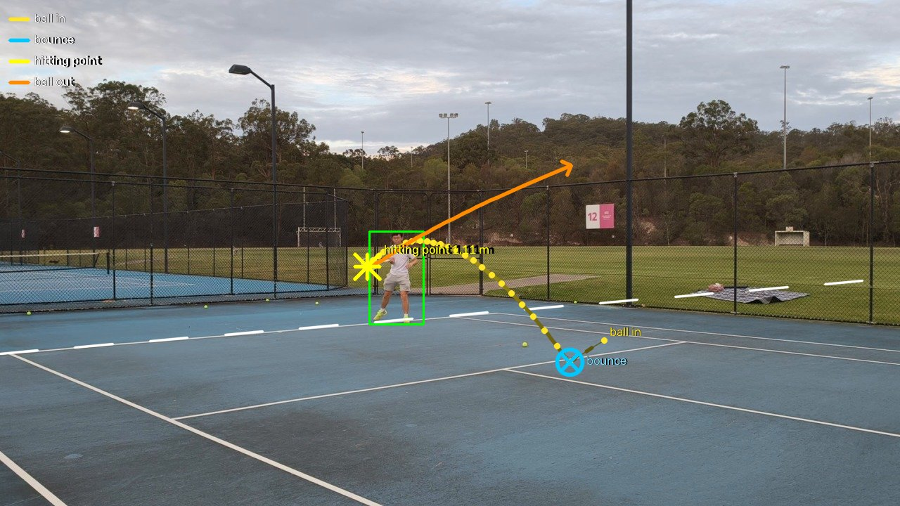
Every frame is kept, the skeleton is fitted on a zoom, and the ball is tracked across the whole screen
Stages 1 to 3: see the stroke
Frames
120 images per second, written once to disk, so a 1080p clip never fills memory.
Skeleton
33 joints on a zoomed crop, smoothed over about 33 ms and converted to metres from the player's height.
Ball and racquet
Moving yellow blobs are chained frame to frame; the hitting point is the midpoint of the two frames closest to the racquet head. A hit on the left side is a backhand and is skipped.
Ball in, bounce (cross), hitting point (star) and ball out (arrow), found anywhere on screen
Forehand 1 of the 120 fps clip. Skeleton: MediaPipe BlazePose; player and racquet: YOLOX-tiny (both Apache-2.0)
Notes:
Presenter: Jefferson. Here's what stages one to three see. We keep every frame, because at 120 frames a second we catch the few milliseconds around contact. The skeleton is fitted on a zoomed crop and converted into metres from the player's height. And the ball is tracked across the whole screen: you can see it come in, bounce, and the star is the hitting point - the midpoint of the two frames where the ball is closest to the racquet head. The arrow is the ball leaving.

Slide 6
One ladder from Beginner to Club: the checks, the targets and the coach's words follow the player's level
Stages 4 and 5: judge and coach
Check | Value | Beginner | Intermed. | Club | Reaches
Contact in front of the body | 0.97 | ≥ 0.45 | ≥ 0.55 | ≥ 0.60 | Club
Ball reaches you after the bounce | 0.86 s | ≤ 1.2 s | ≤ 1.0 s | ≤ 0.8 s | Intermediate
Head stays level through the swing | 0.13 m | ≤ 0.18 m | ≤ 0.12 m | ≤ 0.07 m | Beginner
Still in your legs at contact | 4° | ≥ 3° | ≥ 6° | ≥ 10° | Beginner
Shoulders coil past the hips | 0.31 | ≥ 0 | ≥ 0.05 | ≥ 0.12 | Club
What the coach says
Beginner
Well done: contact in front, ball not above your head, turned sideways, finish over the shoulder, balanced.
Intermediate
Keep your head at the same height from the backswing through contact.
Club
Scores for this forehand: 91 Beginner, 68 Intermediate, 56 Club.
Move forward to meet the ball (0.86 s; club ≤ 0.8 s). Head level (0.13 m; club ≤ 0.07 m). Stay down through the ball (4°; club ≥ 10°). Hips before arm.
Club level adds joint analysis: hip-shoulder coil, kinetic chain, steady spine and head, split step, weight transfer, left-arm tuck, knee bend at contact.
Forehand 1 of the 120 fps clip. Score: 40% for just meeting a target, full marks only near excellent; priority-weighted, then raised to the power 1.5
Notes:
Presenter: Jefferson. Stage four is deliberately not a black box. Every check is a rule on a measured number, and every check has a ladder: a Beginner, an Intermediate and a Club target. Pick your level and the checks, the targets and the coach's words change with it. A beginner hears 'hit the ball in front of you'. A club player gets the measured value against the club target, including joint analysis such as hip-shoulder separation, the kinetic chain and a steady head. And the score is strict: just meeting a target earns 40 percent; full marks only come close to excellent.

Slide 7
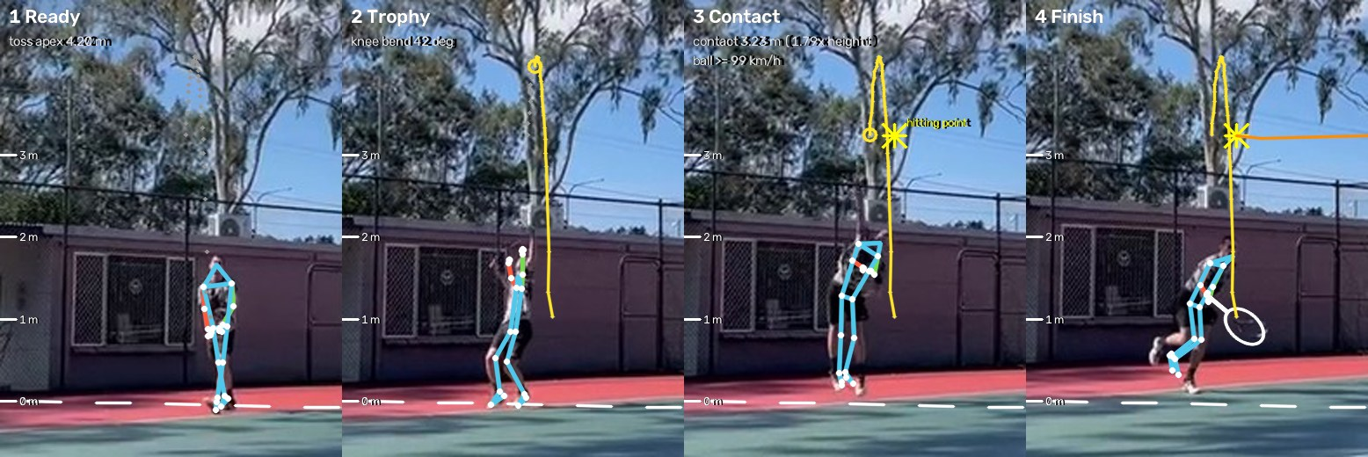
Serve: the toss, the exact contact moment and the heights that matter, from a low-resolution phone clip
Demo result: serve
3.2 m
contact height, with a jump
4.2 m
toss peak
≥ 99 km/h
ball speed off the racquet
Frame 50.5
contact, same as the manual check
68
67
62
Club-level fixes: toss a little lower and more to the hitting side, lean up and into the court at the trophy, land inside the court.
Beginner score
Intermediate score
Club level score
Clip IMG_3025: phone, 30 fps, player about 86 px tall. Heights scaled from the entered height (1.80 m); ball speed is a lower bound
Notes:
Presenter: Jefferson. Here's a serve from an ordinary phone clip: 30 frames a second, with the player only 86 pixels tall. It fits the toss to a gravity curve and finds the contact at frame 50.5, exactly what we found checking frame by frame. Contact at 3.2 metres. It scores 68 at Beginner, 67 at Intermediate and 62 at Club level, where the toss placement, the trophy lean and the landing are what to work on.

Slide 8
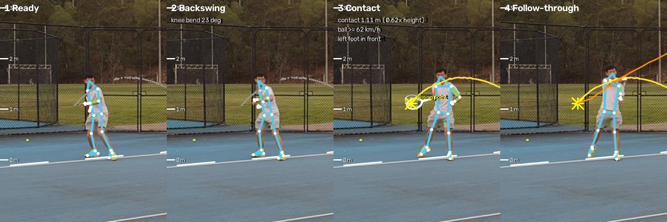
Forehand: four forehands found in one 15-second clip, the backhand skipped, each scored at every level
Demo result: forehand
Forehand 1: white = racquet, star = hitting point, yellow = ball in, orange = ball out
What separates the levels: all four forehands pass the Beginner basics. At Club level the head moves 12-16 cm in the swing and the knees are almost straight at contact - typical of an intermediate player.
Clip forehand_120fps.mp4: 1080p at 120 fps. A stroke counts only when the ball leaves a fast-moving racquet in the swing direction; backhands are recognised and skipped
Notes:
Presenter: Jefferson. On a 15-second forehand clip at 120 frames a second, it found four forehands, and it recognised the one backhand and skipped it - we'd rather miss a stroke than coach the wrong one. The same forehand scores in the nineties at Beginner, about 65 to 73 at Intermediate and 50 to 61 at Club. The club checks catch what an intermediate player still does: the head moving 13 centimetres in the swing and the knees straightening before contact.

Slide 9
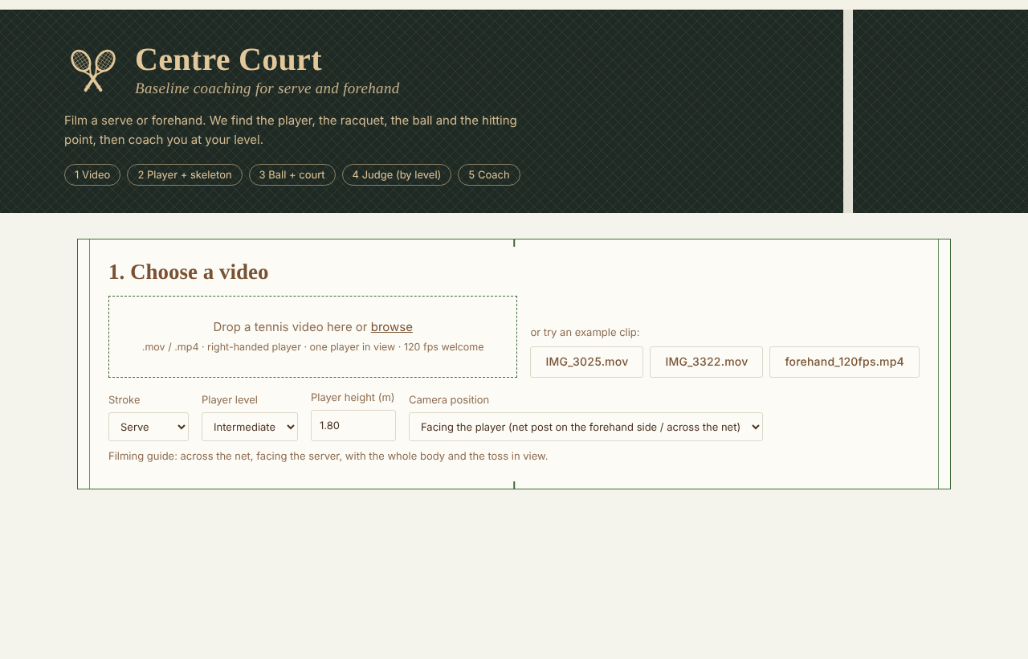
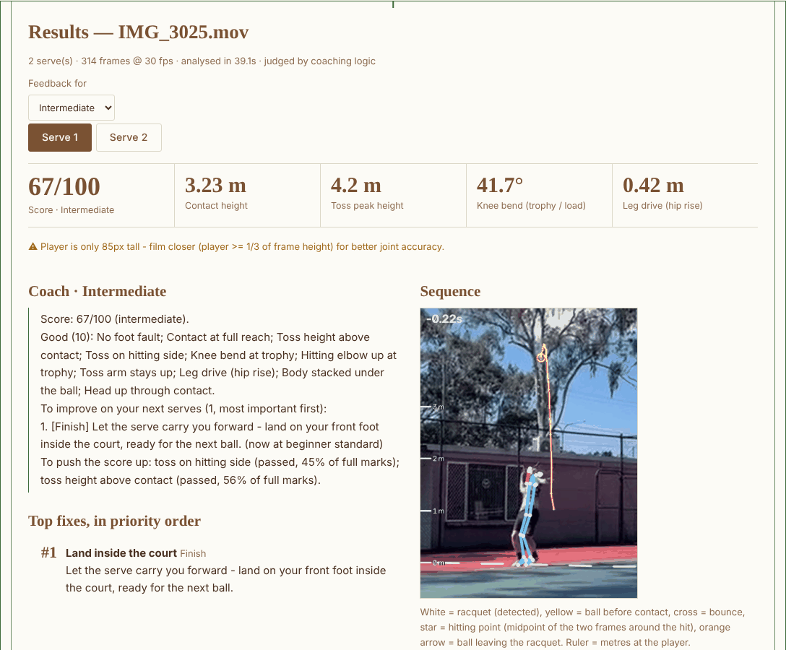
Pick your level, film, and get the coach's note first, with the evidence underneath
Demo experience
Coach's note, score and key numbers, ball trajectory, slow motion, and every check with the level it reaches.
Screenshots of the Centre Court web demo: start page, and a serve analysed at Intermediate level
Notes:
Presenter: Jefferson. This is what the player sees. [DEMO: switch to the web app with IMG_3025 already analysed.] Choose your level, film, and the coach's note comes first, then the evidence: the ball trajectory, slow motion with skeleton and racquet, and every check with the level it reaches.

Slide 10
The heavy part is exactly what the NPU accelerates, and the whole stack is licensed for commercial use
Edge readiness
Speed-ups already in
Detector at 10 Hz, skeleton at 60 Hz with gaps filled, shake estimate on a smaller copy: the forehand clip went from 270-390 s to 199 s.
To the NPU
Detection, racquet and skeleton are standard neural networks - the work the Hailo NPU is built for.
Commercially clean
OpenCV, MediaPipe, YOLOX, ONNX Runtime: Apache, BSD and MIT licences. Ultralytics YOLO (AGPL) deliberately avoided.
CPU time on a 2-core cloud machine, forehand clip (1,818 frames, 1280x720 at 120 fps). Not yet benchmarked on the UGen300
Notes:
Presenter: Jefferson. Today this runs on a CPU: about three minutes for that 15-second clip at 120 frames a second. Most of that time is detection, skeleton and racquet - standard neural networks, exactly what the Hailo NPU accelerates. And it's commercially clean: every component is Apache, BSD or MIT licensed. We deliberately avoided AGPL models.

Slide 11
Next: an Android app, with the UGen300 doing the heavy lifting
Now: serve and forehand working end to end, three player levels, web demo
Next: YOLOX and pose on the Hailo NPU; Android app with a filming guide
Then: coaches validate the ladders; backhand mode; club trials
Thank you - Jefferson and Ben
Notes:
Presenter: Ben. Next, we put the models on the UGen300, build the Android app with a filming guide, and get coaches to validate the thresholds on real courts - then we add the backhand. Every club player deserves a coach on the court. Thank you.

