Slide 1

Serve Lab: instant tennis coaching, computed on the court
ASUS Hackathon 2026 | Android phone + ASUS UGen300 (Hailo NPU) | Jefferson & Ben
Notes:
Presenter: Jefferson. A phone films a serve or forehand; the AI runs at the edge - phone plus ASUS UGen300 - and coaches the player right there on court, with no cloud. Jefferson covers the product and the forehand; Ben covers the serve, the demo and edge readiness.

Slide 2



Players cannot see their own technique, and the fix has to be instant, private and offline - a natural edge problem
PROBLEM AND WHY EDGE
The problem
Why edge computing
Invisible
Foot order, toss height and the hitting point happen in a fraction of a second.
Offline
Courts often have weak or no Wi-Fi; every step runs on the phone and the UGen300.
Delayed
Private
Video review happens after the session, when the feel of the stroke is gone.
Video of players (often juniors) never leaves the court.
Coach-dependent
Instant
Frame-by-frame analysis needs a coach's time for every stroke.
Feedback between points, while the player can still feel the stroke.
Our hypothesis, to be validated with players and coaches
Notes:
Presenter: Jefferson. Frame the problem as a hypothesis; the edge is not a gimmick here - network, privacy and speed all point to on-device processing.

Slide 3

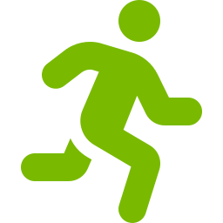



Five stages turn a phone clip into coaching; the phone does capture and logic, the UGen300's NPU runs the neural models
SOLUTION AND EDGE ARCHITECTURE
1 Frames
2 Skeleton
3 Ball
4 Judge
5 Coach
Video split into one image per frame (120 per second)
Player box + 33-point skeleton on a zoomed crop
Racquet, full-screen ball path, bounce, hitting point
18 forehand / 15 serve coaching checks
Every result as plain-language feedback
Runs on: Phone
Runs on: UGen300
Runs on: UGen300 + phone
Runs on: Phone
Runs on: Phone or UGen300
Android phone
ASUS UGen300 (Hailo NPU)
120 fps camera, frame splitting, ball maths (OpenCV), coaching logic, results screen
Player and racquet detection (YOLOX), skeleton model; optional small local LLM coach
Hackathon demo runs the same pipeline as a web app on a laptop; YOLOX is in the Hailo Model Zoo, the pose model still has to be converted and benchmarked
Notes:
Presenter: Jefferson. Frames go from the phone to the UGen300 over USB-C; boxes and skeletons come back; the light logic runs on the phone.

Slide 4
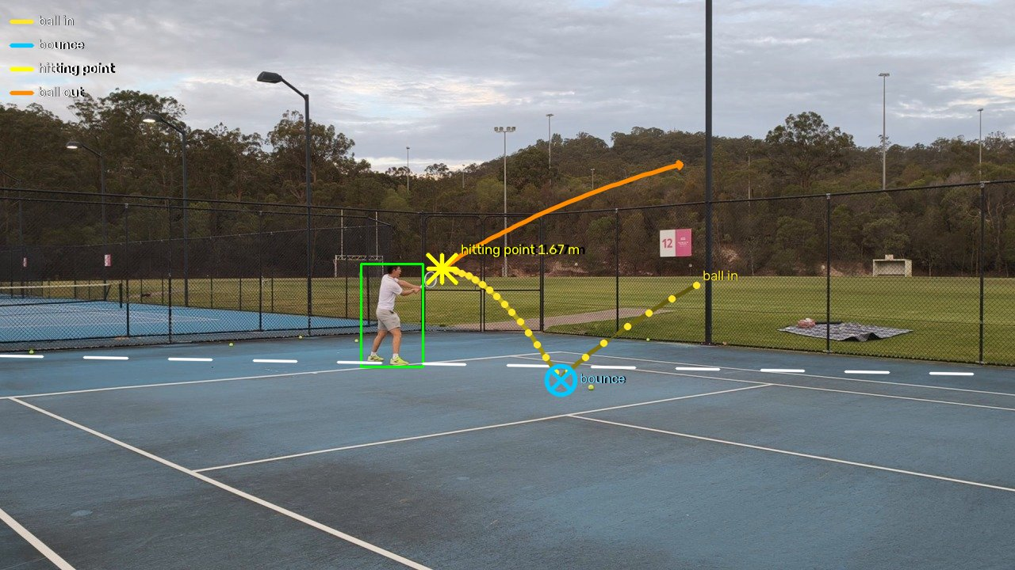
Every frame is kept, the skeleton is fitted on a zoom, and the ball is tracked across the whole screen to find the bounce and the hitting point
STAGES 1-3: SEE THE STROKE
1 Frames
120 images per second, written once to disk, so a 1080p clip never fills memory.
2 Skeleton
33 joints on a zoomed crop, smoothed over ~33 ms and converted to metres from the player's height.
3 Ball and racquet
Yellow moving blobs anywhere on screen are chained frame to frame; the hitting point is the midpoint of the two frames closest to the racquet head.
Full-frame ball path: incoming ball, bounce (cross), hitting point (star) and the ball leaving (arrow)
Forehand 2 of the 120 fps clip. Skeleton: MediaPipe BlazePose; player and racquet: YOLOX-tiny (both Apache-2.0)
Notes:
Presenter: Jefferson. The ball is now searched on the full screen, which is what makes the bounce visible. A stroke only counts when the ball is followed out of a fast-moving racquet.

Slide 5
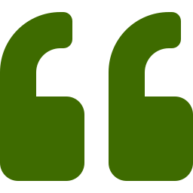
Plain coaching logic - 18 forehand and 15 serve checks - and the coach reports every one of them
STAGES 4-5: JUDGE AND COACH
Top-priority forehand rules
Coach, forehand 5
1
Hitting point above your head
Behind the baseline: move forward. Inside the court: leave no-man's land and let the ball drop.
Good (12): Contact not above your head; Ball bounced close enough; Body sideways in preparation; Contact in front of the body; Early preparation; Left arm tracks the ball; Load the legs (squat); Stable base; Racquet drops below the ball; Low-to-high swing (topspin); Legs drive up into the ball; Finish over the left shoulder.
To improve on your next forehands (5, most important first):
1. [Footwork] At contact your right foot is in front of your left. Step in with the LEFT foot so your weight transfers forward through the ball.
2. [Contact] You are hitting the ball too low - bend your knees to get down to it or take it a little earlier.
3. [Contact] Give yourself room: meet the ball about an arm's length to your right, not jammed into the body or at full stretch.
4. [Contact] Keep your head still and your eyes on the contact point until the ball has left the strings.
5. [Finish] Stay balanced: at the finish your head should be over your feet, not falling away.
Could not measure (1): Arm not cramped at contact (film a little closer, steady, with the ball in view).
2
Ball bounced too far in front
Ball took longer than 0.8 s from bounce to racquet: move forward to meet it.
3
Not sideways in preparation
Turn shoulders and hips sideways before the swing.
Also checked: contact in front, left foot in front, contact height, spacing, arm, head still, early preparation, left arm, knees, base, racquet drop, low-to-high, leg drive, finish, balance.
Targets are general club-coaching ranges for a right-handed player; a check shows 'not measurable' when the clip cannot support it
Notes:
Presenter: Jefferson. No machine learning in the judgement: each check is an explainable rule on a measured number. The coach lists everything: what is good, every fix in priority order, and what could not be measured. The template runs offline; a local LLM or Claude can reword it.

Slide 6
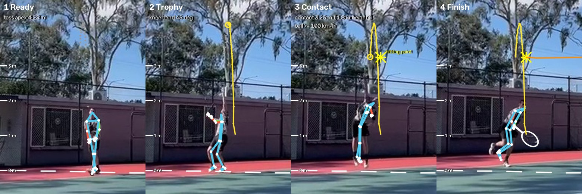
Serve: the toss, the exact contact moment and the heights that matter, from a low-resolution phone clip
DEMO RESULT: SERVE
3.25 m
contact height, with a jump
4.23 m
toss peak
≥ 100 km/h
ball speed off the racquet
Frame 50.5
contact, same as the manual check
What the coach says: 10 of 15 checks good; 3 fixes in priority order - shoulders tilted up to the ball; toss arm stays up; land inside the court.
Clip IMG_3025: phone, 30 fps, player about 86 px tall. Heights scaled from the player's entered height (1.80 m); ball speed is a lower bound
Notes:
Presenter: Ben. Yellow = toss fitted to a gravity curve; star = contact (midpoint between the last toss frame and the first frame of the hit ball); orange = ball leaving. Contact frame 50.5 matches the manual frame-by-frame check.

Slide 7
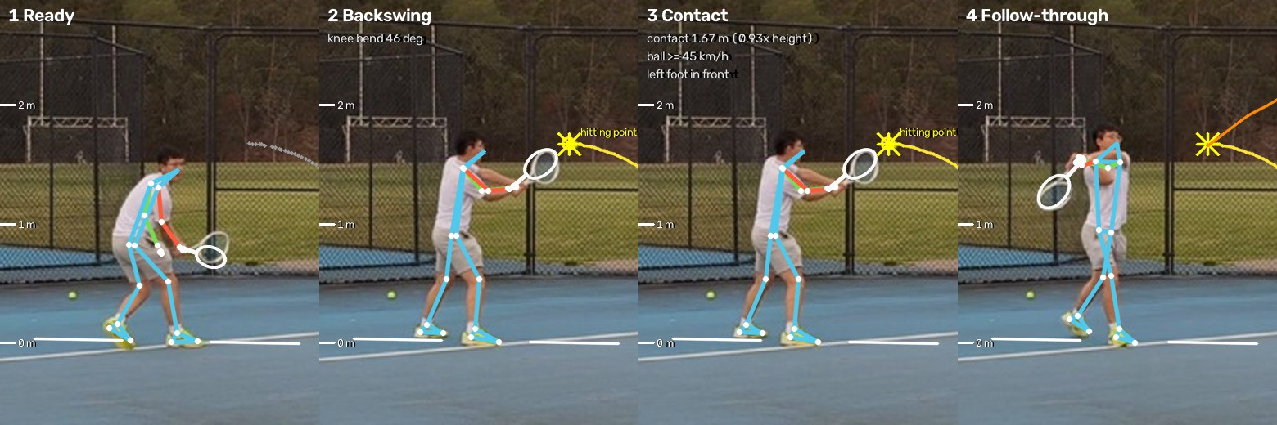
Forehand: 5 strokes found in one 15 s clip, each with racquet, hitting point and a full list of checks
DEMO RESULT: FOREHAND
# | Hitting point | Bounce to hit | Fixes
1 | 1.11 m | 0.86 s | 1
2 | 1.67 m | 0.52 s | 4
3 | 0.52 m | not seen | 3
4 | 0.95 m | not seen | 1
5 | 0.54 m | 0.55 s | 5
Forehand 2: white = racquet, star = hitting point, yellow = incoming ball, orange = ball leaving
Read-out: hitting point at 1.67 m, 13 of 18 checks good; fix: contact in front of the body; room between body and ball; early preparation; stable base.
Clip forehand_120fps.mp4: 1080p at 120 fps. A stroke counts only when the ball leaves a fast-moving racquet in the swing direction; unclear strokes are skipped
Notes:
Presenter: Jefferson. Each row is one forehand; 'Fixes' counts the failed checks, all of which the coach reports in priority order.

Slide 8
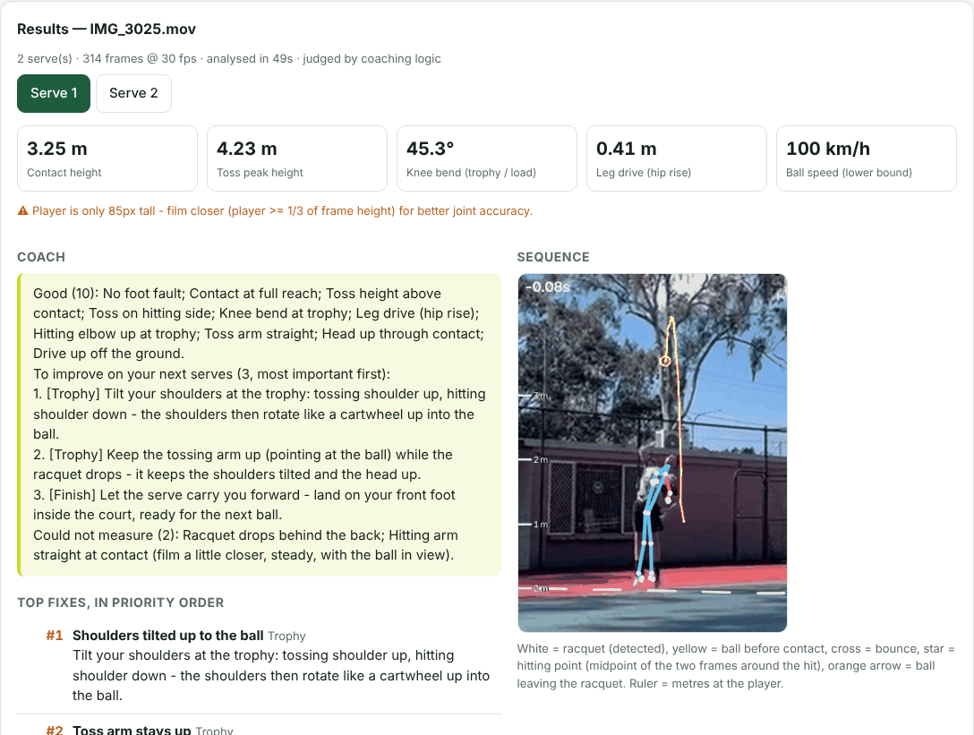
The player gets the answer first - the coach's note - and the visual evidence underneath
DEMO EXPERIENCE
1
Coach's note
everything that is good, every fix in priority order, what could not be measured
2
Ball trajectory
full-screen path: incoming ball, bounce, hitting point, ball leaving
3
Slow motion
annotated sequence with skeleton and racquet, key moments, joint heights
4
Checklist
every check: good, improve or not measurable, with the measured value
Screenshot of the Serve Lab web demo (serve mode, clip IMG_3025)
Notes:
Presenter: Ben. Live demo: python app/server.py, then analyse IMG_3025.mov (serve, about 45 s) or forehand_120fps.mp4 (about 3.3 min on a laptop CPU).

Slide 9
The heavy part is exactly what the NPU accelerates, and the whole stack is licensed for commercial use
EDGE READINESS
Speed-ups already in
Detector at 10 Hz, skeleton at 60 Hz with gaps filled, shake estimate on a small copy: the forehand clip went from 270-390 s to 199 s.
To the NPU
Detection, racquet and skeleton are standard networks - the work the Hailo NPU is built for.
Commercially clean
OpenCV, MediaPipe, YOLOX, ONNX Runtime: Apache / BSD / MIT. Ultralytics YOLO (AGPL) deliberately avoided.
CPU time on a 2-core cloud machine, forehand clip (1818 frames, 1280x720 at 120 fps). Not yet benchmarked on the UGen300
Notes:
Presenter: Ben. Today's numbers are CPU-only. First step at the hackathon: compile YOLOX-tiny for Hailo and measure per-frame latency on the UGen300. On a Mac, ONNX Runtime uses CoreML automatically when available.

Slide 10
Next: from web demo to an Android app with the UGen300 doing the heavy lifting
Now
Next
Then
Serve and forehand working end to end; web demo
YOLOX + pose on the Hailo NPU; Android app with filming guide
Coaches validate thresholds; backhand; club trials
Thank you - Jefferson & Ben
Notes:
Presenter: Jefferson. Close and hand over to the live demo if time allows.

