Slide 1

Case Study on Attrition
DDS Analytics

Slide 2

Case Study Objectives
Provide interesting trends and observations
Identify job role specific trends
Identify key factors leading to attrition
Build a AIML model to predict attrition

Slide 3

Company Snapshot
Trends & Observations

Slide 4
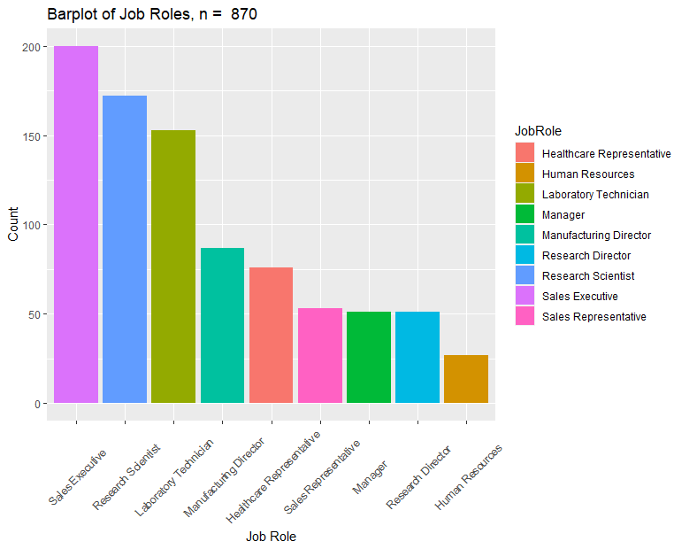
Frequency Distribution

Slide 5
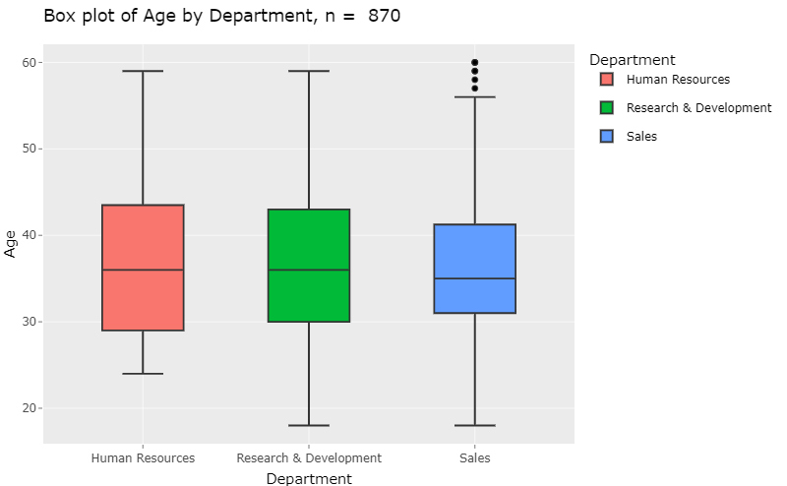
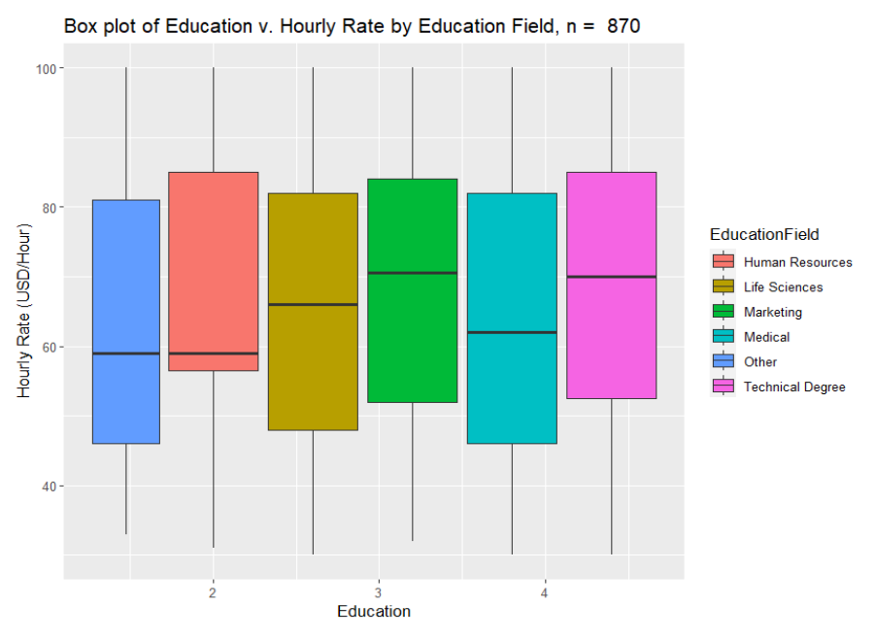
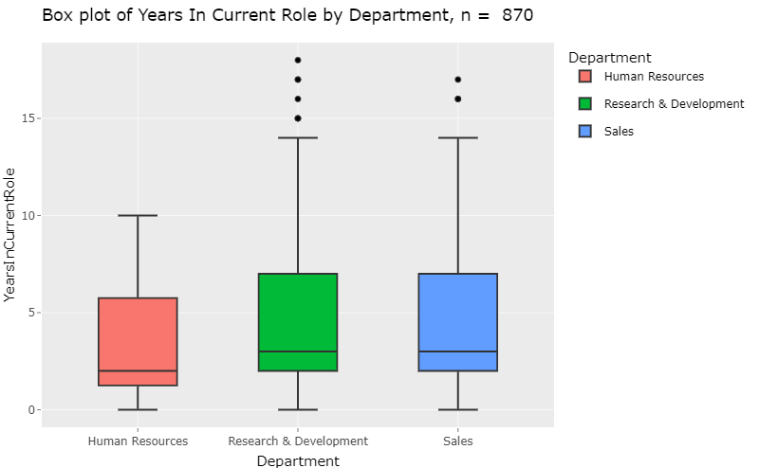
Range and Variability

Slide 6

Job Specific Trends
Exploratory Data Analysis

Slide 7
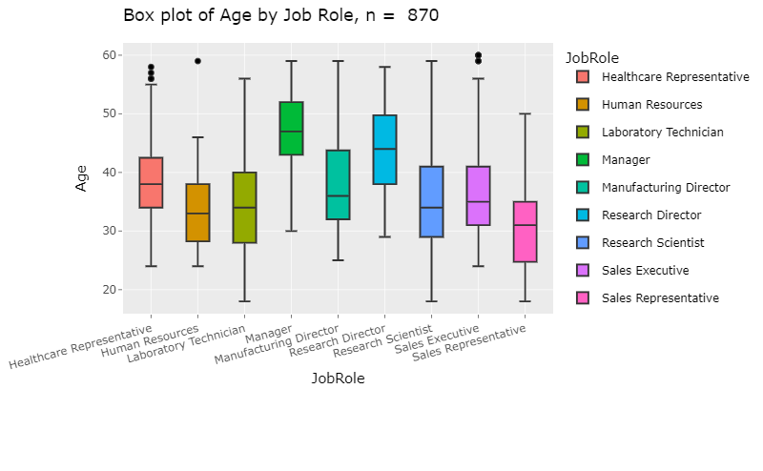
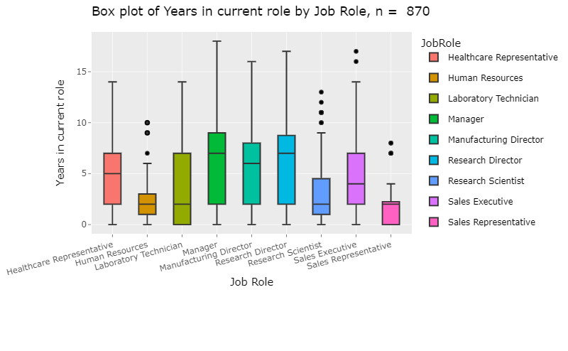
Age and Tenure

Slide 8
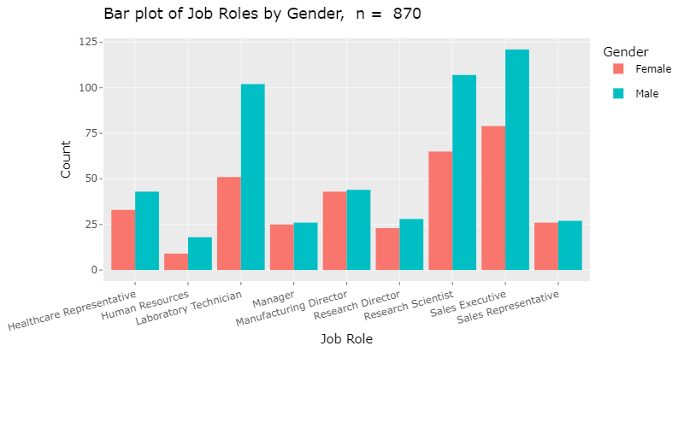
Gender Distribution

Slide 9
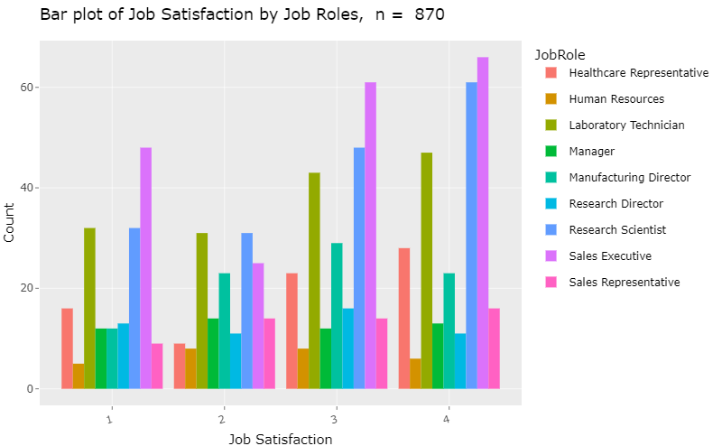
Employee Job Satisfaction

Slide 10
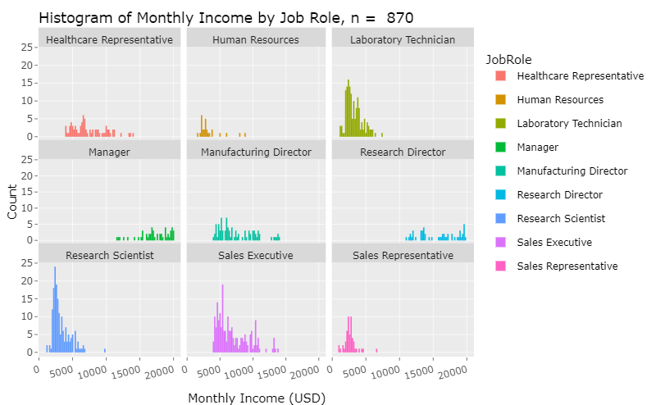
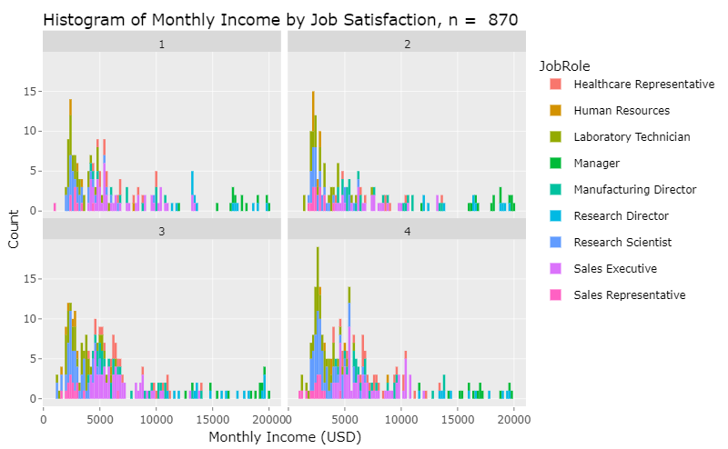
Income Distribution

Slide 11
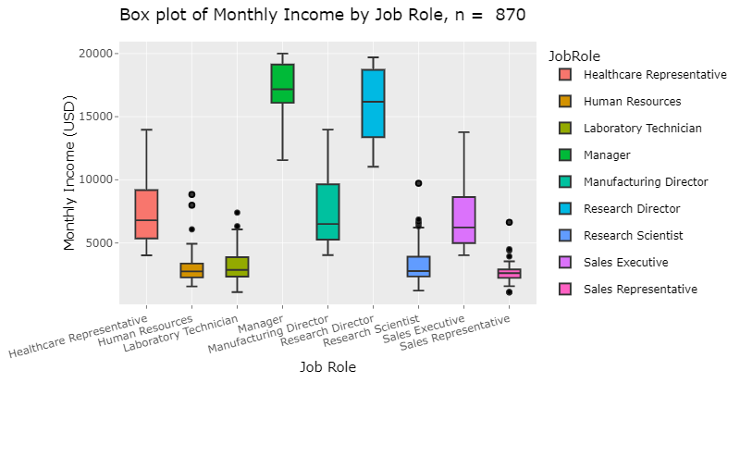
Income Variability & Spread

Slide 12

Attrition
Contributing Factors

Slide 13
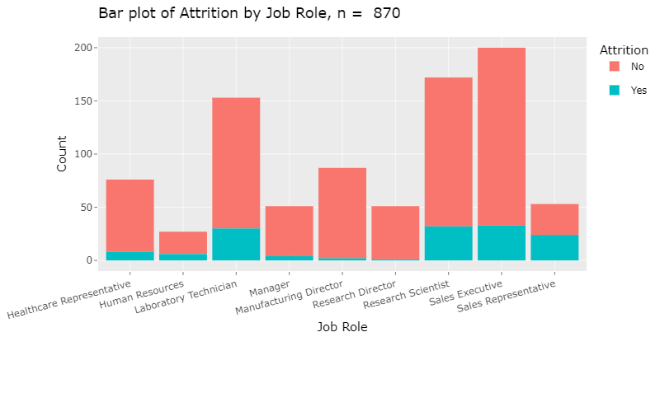
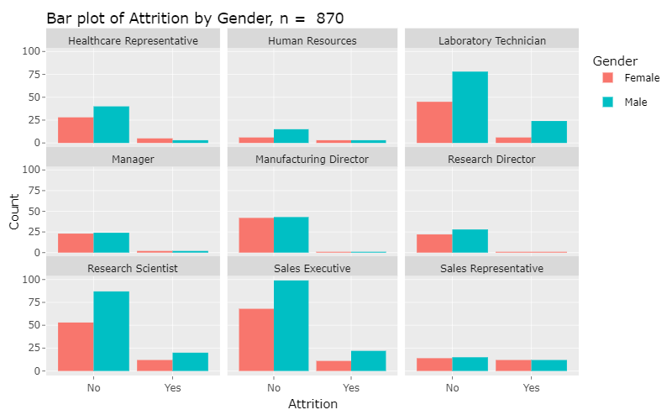
Job Role
Attrition

Slide 14
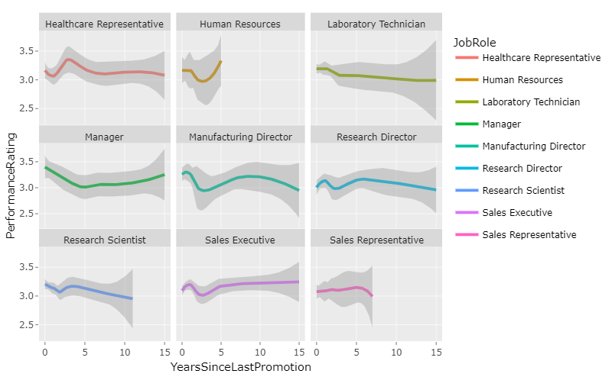
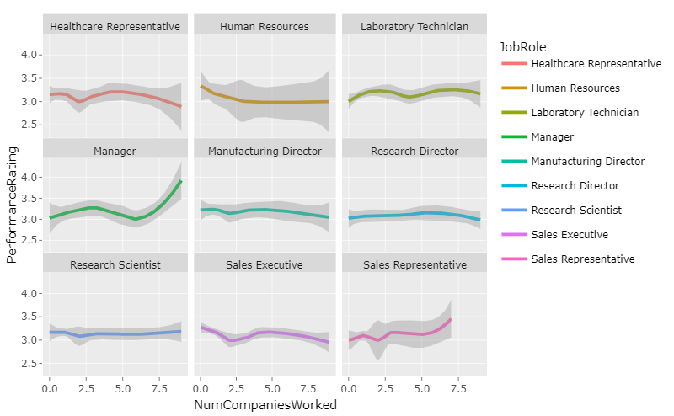
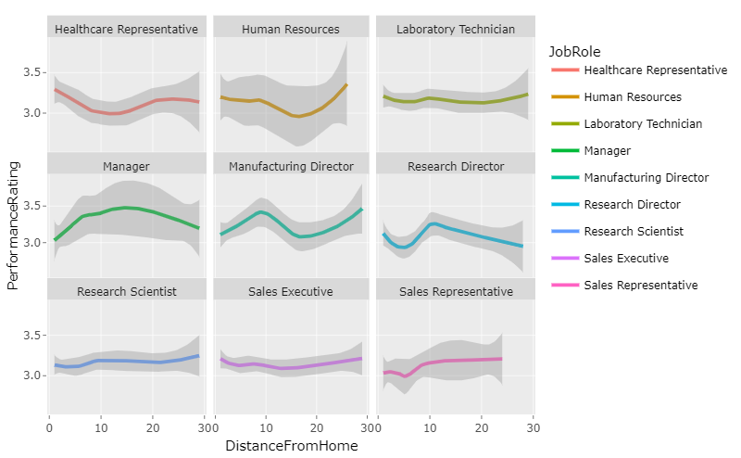
Performance Metrics

Slide 15

Predictors of Attrition
Naive Bayes Classification

Slide 16
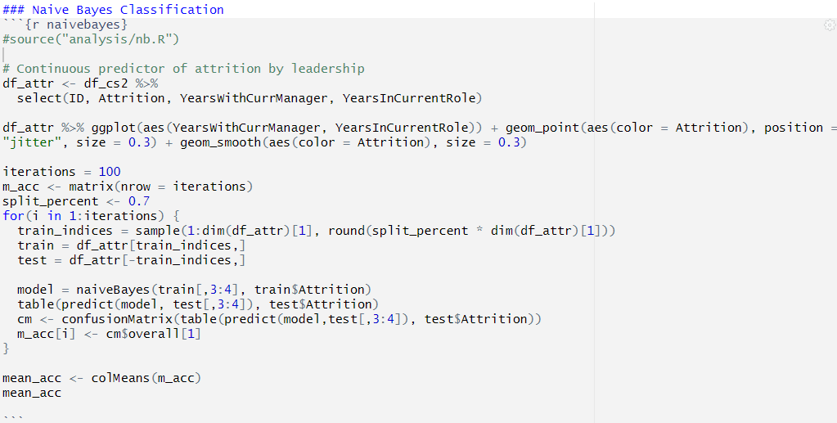
70/30
81.6%

Slide 17
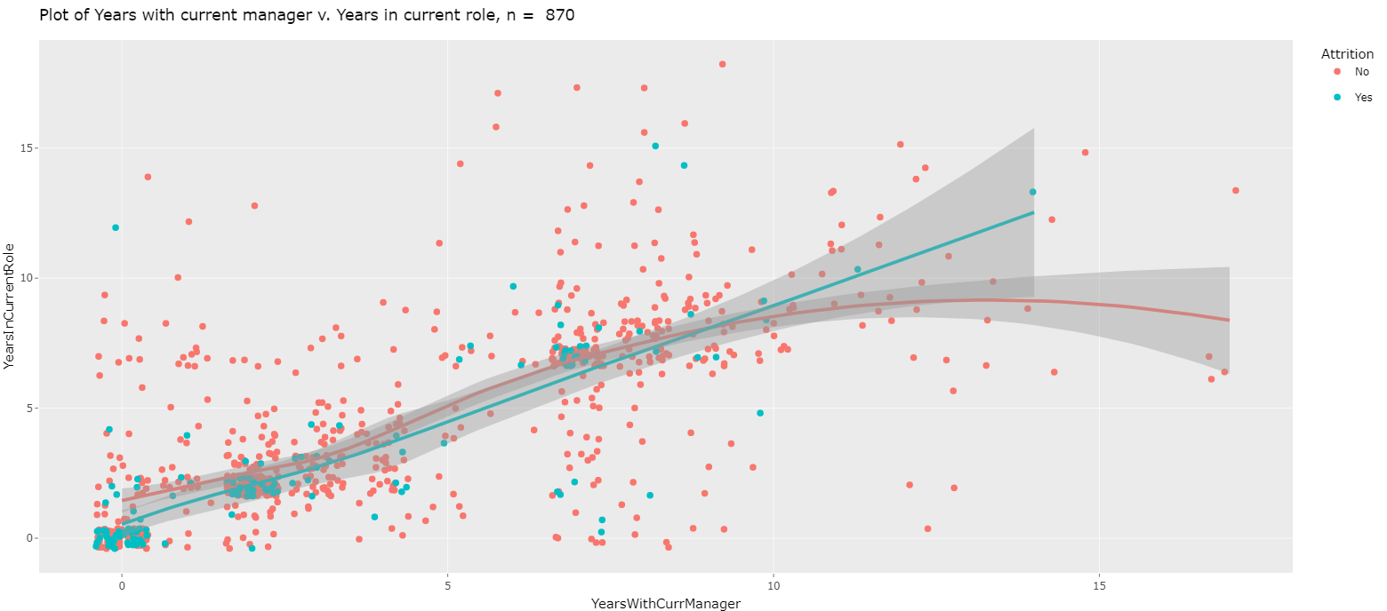

Slide 18

Questions or Comments? Thank you!

Slide 19
APA Citation
FactSet.(2023). Merrill Edge – Profile: PEP – PEPSICO, INC. – Stock Story, Merrill Edge. Accessed 8 December 2023. olui2.fs.ml.com/RIStocksUI/RIStocksStory.aspx?Symbol=PEP#/stock-story/PEP/0.
OpenAI.(2023). ChatGPT response to query on Frito-Lay. ChatGPT.
FritoLay Logo [Online Image]. (2023). Logos | FritoLay. fritolay.com/logos
pep+ logo [Online Image]. (2023). Media | pep+ logo. pepsico.com/mediadownload-item/pep-logo
PepsiCo, Inc. (PEP) (2023). Profile, Summary. Yahoo!Finance. finance.yahoo.com/quote/PEP?p=PEP

