Slide 1
CATSMAT
Periodic Segmentation Results
17-Feb-2017
Derrick Hill

Slide 2
“Periodic Cannon”
Some works in the repertoire have a clear “periodic cannon” structure.
One fixed duration phrase length used through entire work
Each phrase repeated identically in a different part
Phrases are “tail to head”, i.e. repetition of a phrase begins immediately after the end of the previous sounding of the phrase
Parts have rests if they are not sounding a phrase

Slide 3
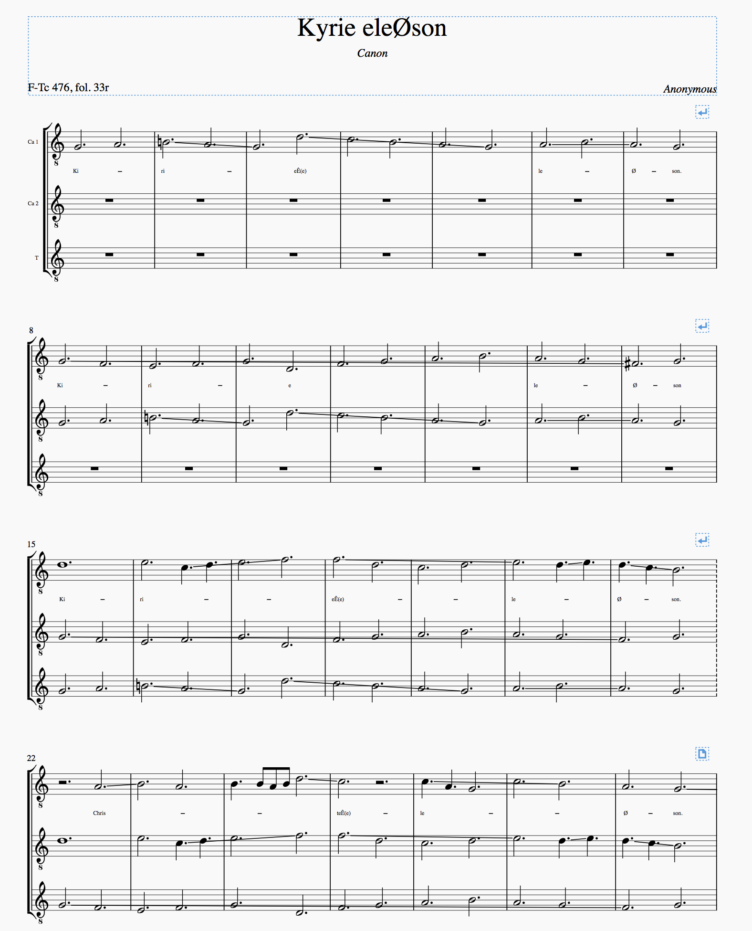
Phrase in one part echoed in the next
Parts enter in sequence.
Fixed 7 bar phrase length

Slide 4
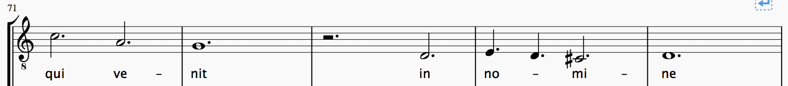
“Periodic Cannon”
Sometimes the repetition of a phrase is not exact with respect to pitch (e,g, introduced accidentals)
Sanctus
Ca 1 @ 71
Ca 2 @ 76
T @ 81

Slide 5
Segmentation Algorithm
The implemented algorithm does the following:
Accepts as input an IMUSANT_Score
Identifies parts that enter in sequence
Calculates the duration of the “period”
Attempts to segment according to the period length
Implements a “tolerance” for pitch differences between phrase repetitions
Creates a set of IMUSANT_segment

Slide 6
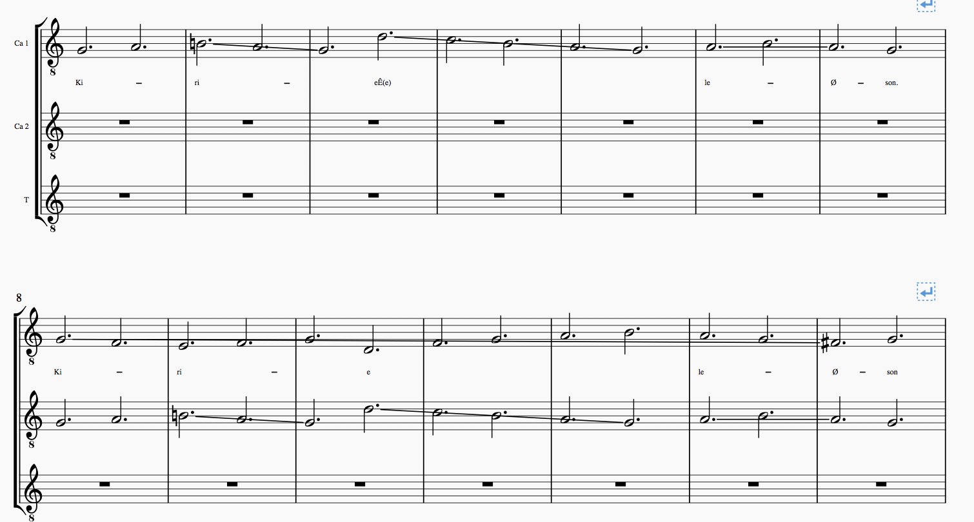
Segmentation Algorithm
The duration of the “period” is calculated based on the length of the rest before the second part enters:
7 bar rest prior to second part entering with a repetition of the first phrase, therefore the “period length” is seven bars*.
* To be technically correct, I have used “duration” rather than “bars” as the measure because there is no real reason why the period should be a integral number of bars.

Slide 7
Segmentation Algorithm
The period length is used to calculate an offset between parts. E.g:
Ca 2 is offset +7 from Ca 1
T is offset +14 from Ca 1
T is offset +7 from Ca 2

Slide 8
Segmentation Algorithm
Using the period length and the offsets, the algorithm tries to decide if a phrase in one Part is repeated at the offset in another Part by doing a note-for-note comparison
Candidate segments are only considered to have the length of the period.
…
First note + offset is the start of the next “candidate” segment in Ca 2.

Slide 9
Segmentation Algorithm
One phrase “matches” the phrase it is being compared against if each note in the first phrase is repeated in the second phrase.
The algorithm implements a “tolerance” for pitch differences. If the differences are within tolerance then the phrases will match and both will be identifier as Segments.
Note that there is no tolerance or recovery mechanism for rhythmic differences. The introduction of a passing note in one part, for example, will (probably) cause the algorithm to fail because each note-for-note comparison from that point on will be matching different notes. This could be solved simply by adding a recovery mechanism into the algorithm.

Slide 10
“Periodic Cannon”
Sometimes the repetition of a phrase is not exact with respect to pitch (e,g, introduced accidentals)
Sanctus
Ca 1 @ 71
Ca 2 @ 76
T @ 81

Slide 11
Segmentation Algorithm
The algorithm does a cross-product comparison of all the parts in a work to identify segments. So for the Kyrie shown earlier we have:
Ca 1 <-> Ca 2
Ca 1 <-> T
Ca 2 <-> T

Slide 12
IMUSANT_segment
We have an IMUSANT_segment object
Encapsulates the notes in the identified segment
Provides traceability of segments back to the Score, Part, and start location within the Part
Provides some metadata about the segment in a format useful for subsequent analysis
Identifies which algorithm was used to generate the segment.

Slide 13
No Duplicates in Result
Segments A, B, and C all contain identical musical material, but they are represented in the segmentation results as different segments.
Segment A
Each Segment appears once in the result, regardless of how many other Segments it matches.
Segment B
Segments are not associated with each other in the results. This is left to subsequent analysis
Segment C

Slide 14
Example CATSMAT Output
Segment:Num notes:Num measures:First duration:First pitch:Last duration:Last pitch
Kyrie eleØson.Ca 1.8.1.14.2:14:6:768.000000:55:768.000000:55
Kyrie eleØson.Ca 1.43.1.49.2:32:6:768.000000:62:768.000000:55
Kyrie eleØson.Ca 1.15.1.21.3:16:6:1536.000000:62:768.000000:59
Kyrie eleØson.Ca 2.36.1.42.2:14:6:768.000000:50:768.000000:52
Kyrie eleØson.T.57.1.63.2:32:6:768.000000:62:768.000000:55
Kyrie eleØson.Ca 2.8.1.14.2:14:6:768.000000:55:768.000000:55
Kyrie eleØson.Ca 1.1.1.7.2:14:6:768.000000:55:768.000000:55
Kyrie eleØson.Ca 2.57.1.63.3:25:6:768.000000:50:768.000000:62
…
Kyrie eleØson.Ca 2.50.1.56.2:32:6:768.000000:62:768.000000:55
Kyrie eleØson.Ca 1.50.1.56.3:25:6:768.000000:50:768.000000:62
Kyrie eleØson.T.36.1.42.2:18:6:768.000000:-1:768.000000:55
Kyrie eleØson.T.50.1.56.3:14:6:1536.000000:57:768.000000:59
Sanctus.T.111.1.115.1:10:4:1536.000000:53:1536.000000:62
Sanctus.T.91.1.95.2:9:4:768.000000:64:768.000000:-1
Sanctus.T.86.1.90.1:11:4:768.000000:57:1536.000000:62
Sanctus.T.71.1.75.1:10:4:1536.000000:-1:1536.000000:50
Sanctus.T.56.1.60.1:6:4:768.000000:55:1536.000000:50
Sanctus.T.46.1.50.1:9:4:768.000000:55:1536.000000:62
Sanctus.T.41.1.45.1:7:4:768.000000:52:1536.000000:50
Sanctus.T.31.1.35.1:6:4:768.000000:55:1536.000000:57
Sanctus.T.26.1.30.1:7:4:768.000000:55:1536.000000:50
Sanctus.Ca 2.61.1.65.1:7:4:1536.000000:-1:1536.000000:62
Sanctus.T.21.1.25.1:7:4:1536.000000:62:1536.000000:62
...
Sanctus.Ca 2.21.1.25.1:7:4:768.000000:55:1536.000000:50
Sanctus.Ca 1.46.1.50.1:6:4:768.000000:55:1536.000000:50
Sanctus.Ca 1.11.1.15.1:7:4:1536.000000:62:1536.000000:62
Sanctus.T.101.1.105.2:7:4:1536.000000:-1:768.000000:62
Sanctus.Ca 1.6.1.10.2:8:4:768.000000:-1:768.000000:-1
Sanctus.Ca 1.1.1.5.1:5:4:1536.000000:50:1536.000000:50
Sanctus.Ca 2.6.1.10.1:5:4:1536.000000:50:1536.000000:50
Sanctus.Ca 2.11.1.15.2:8:4:768.000000:-1:768.000000:-1
Segments are identified using a “.” delimited string of:
Movement Title
Part Name
First Measure
First Note Index
Last Measure
Last Note Index
Sanctus.Ca 2.11.1.15.2

Slide 15
Analyzing the Data
The theory is that, if we can generate a reasonable set of segments, then we can use a clustering algorithm to group segments that are related.
The difficulty with most standard statistical algorithms in this area is that they rely on a fixed set of attributes (“features”) of the data elements being analyzed).
E.g. Cars have features (such as engine size, horsepower, number of doors, presence of air conditioning) that can be used to cluster cars into similar groups. Every car has every feature in the dataset.
However, we are dealing with variable features in a musical phrase.
So I have simplified this and conducted analysis using fixed attributes of Segments:
First and Last note pitch
First and Last note duration
Number of notes
Number of measures
Other features could easily be added:
Duration
Pitch range
Number of occurrences of notes at each pitch
Number of occurrences of notes with specific rhythmic values (e.g. count of minims)
Etc, etc, etc

Slide 16
Results
See Word document.
In general, however:
For all the simple cases the algorithm performed as expected.
Where there are pitch differences the segment is missing in the result. I suspect that CATSMAT did not output that segment because the tolerance is too low.
There is a slightly unexpected cluster of 6 segments from Kyrie, but this is actually insightful, and indicates that the algorithm has the ability to discover things that are not immediately obvious.

Slide 17
Generalizations
We can use different segmentation algorithms to generate Segments into the result set. Every algorithm can populate a set of IMUSANT_Segment.
We can then apply the statistical algorithms over all of the elements in the set, regardless of which algorithm was used to perform the segmentation.
Segmentation algorithms include LBDM, but might also include finer grained algorithms that we have implemented for other purposes in the past.

