Slide 1
Autopilot Simulation For Efficient
Development Of Self Driving Cars
D. Parnitha 17911A1208
Manish Yadav 17911A1216
Jsvs Jogendra 17911A1218

Slide 2
ABSTRACT
An autonomous car (also known as a driverless car, self-driving car, and robotic car) is a vehicle that is capable of sensing its environment and navigating without human input. Autonomous cars combine a variety of techniques to perceive their surroundings, including radar, laser light, GPS, and computer vision. Advanced control systems interpret sensory information to identify appropriate navigation paths, as well as obstacles and relevant signage.
Development of a stimulation software that’s aided by Machine learning helps in the efficient development of self driving cars which require lot of real world testing that can be supplemented by a Autopilot stimulation software.

Slide 3
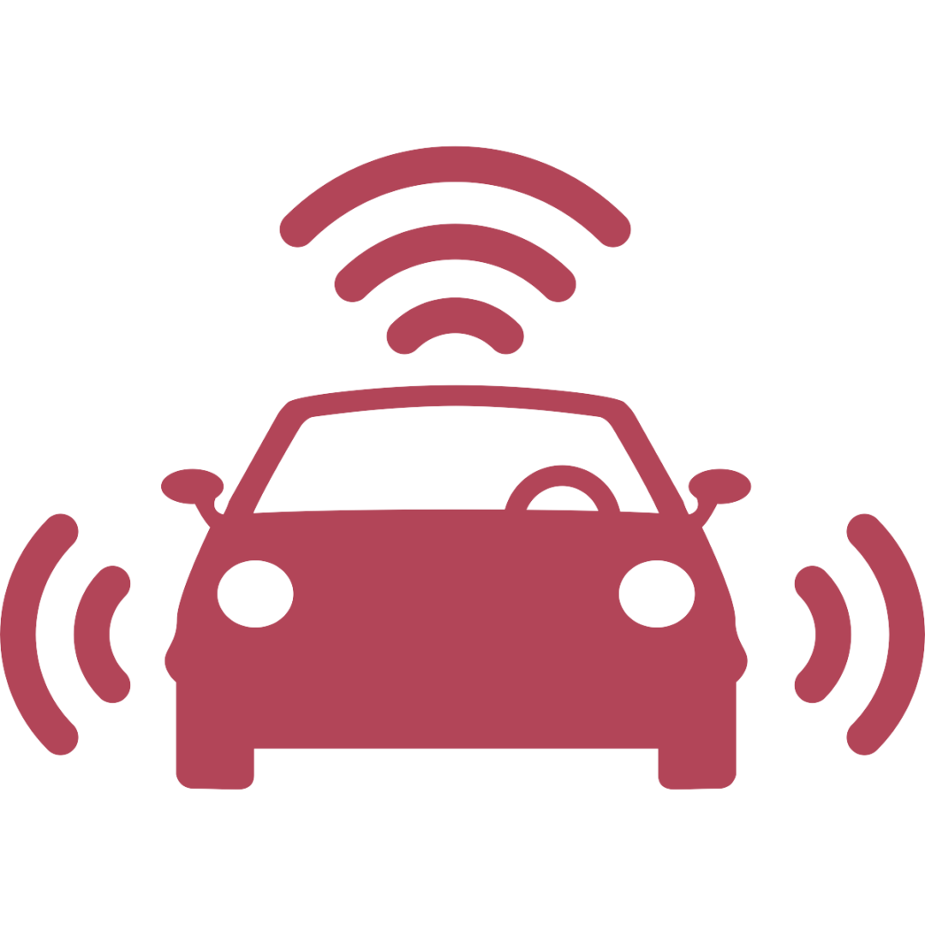
EXSISTINGSYSTEM
Existing system involve’s the use of LiDAR and sonar system which can sense the environment around it using light and sound waves.
The main drawback of this system is that it can only detect the surrounding for a few meters.
The system is incapable of processing various road signs and lacks the support for computer vision.
Lack of visual data makes it more challenging to train a model for such system.
Notes:
Stay as far away as possible from others when coughing or sneezing; better yet, face away from them. Sneeze into the crook of your arm or into a paper handkerchief that you then throw away immediately. Avoid touching other persons when greeting them and wash your hands regularly and thoroughly for at least 20 seconds with soap and water.

Slide 4
PROPOSED SYSTEM
Proposed system involves computer aided vision of the vehicle which is much more efficient and safer.
Capabilities of the vehicle can be improved constantly by collecting visual data and calibrating the vehicle according to the environment.
Presence of visual data makes it much easier to train and improve the model.
The system is capable of processing various road signs.
Notes:
Stay as far away as possible from others when coughing or sneezing; better yet, face away from them. Sneeze into the crook of your arm or into a paper handkerchief that you then throw away immediately. Avoid touching other persons when greeting them and wash your hands regularly and thoroughly for at least 20 seconds with soap and water.

Slide 5
MODULES OF THE SYSTEM
Camera
Visual input
Load data
Load data for training
Perform image conversion operations
Train Model
Train the loaded data using CNN
Simulator
Run simulation for the trained data
Notes:
Stay as far away as possible from others when coughing or sneezing; better yet, face away from them. Sneeze into the crook of your arm or into a paper handkerchief that you then throw away immediately. Avoid touching other persons when greeting them and wash your hands regularly and thoroughly for at least 20 seconds with soap and water.

Slide 6
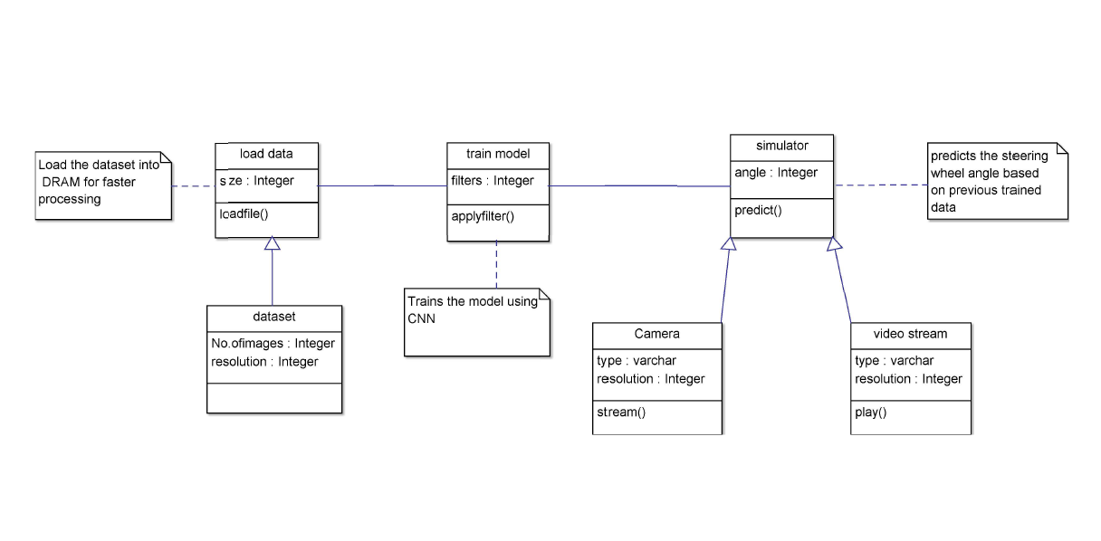
Class diagram
Notes:
Stay as far away as possible from others when coughing or sneezing; better yet, face away from them. Sneeze into the crook of your arm or into a paper handkerchief that you then throw away immediately. Avoid touching other persons when greeting them and wash your hands regularly and thoroughly for at least 20 seconds with soap and water.

Slide 7
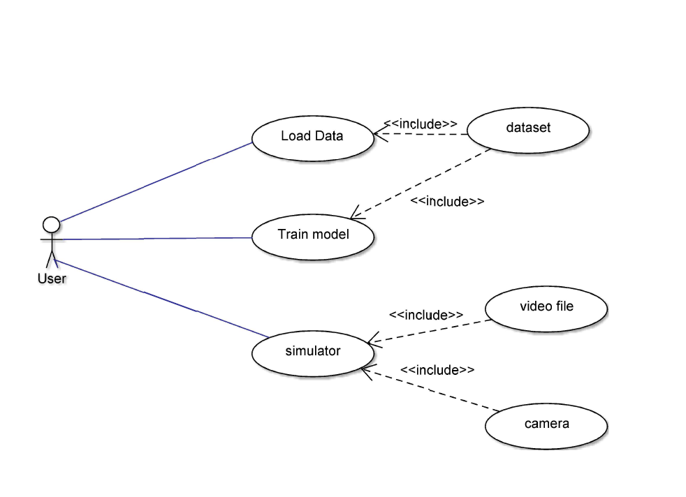
usecase diagram
Notes:
Stay as far away as possible from others when coughing or sneezing; better yet, face away from them. Sneeze into the crook of your arm or into a paper handkerchief that you then throw away immediately. Avoid touching other persons when greeting them and wash your hands regularly and thoroughly for at least 20 seconds with soap and water.

Slide 8
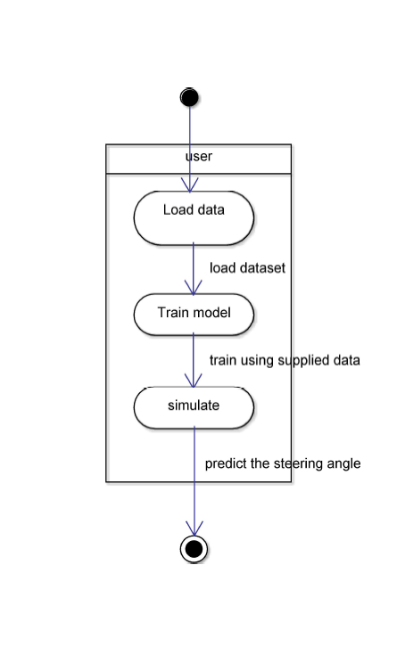
activity diagram
Notes:
Stay as far away as possible from others when coughing or sneezing; better yet, face away from them. Sneeze into the crook of your arm or into a paper handkerchief that you then throw away immediately. Avoid touching other persons when greeting them and wash your hands regularly and thoroughly for at least 20 seconds with soap and water.

Slide 9
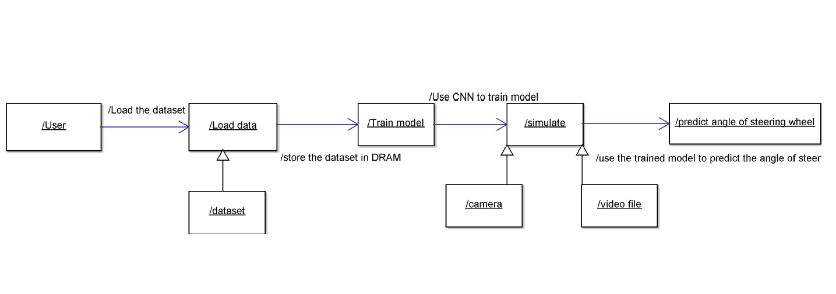
collaboration diagram
Notes:
Stay as far away as possible from others when coughing or sneezing; better yet, face away from them. Sneeze into the crook of your arm or into a paper handkerchief that you then throw away immediately. Avoid touching other persons when greeting them and wash your hands regularly and thoroughly for at least 20 seconds with soap and water.

Slide 10
Limitations
A computer malfunction even just a minor glitch could easily cause a far worse accident than anything human error might typically incur.
Driverless cars would rely on the collection of location and user information, quite possibly triggering major privacy concerns.
Reading road signs is challenging for a robot.
Wider adaption of technology is needed to make it practical to use
It may not function in all environmental conditions
Training data model for a congested city is difficult

Slide 11
Conclusion
We have explained that CNNs are able to learn the entire task of lane and road following with supplied data and training the supplied data and running the simulation for further improvements in the system before running it on an actual vehicle.

Slide 12
THANK YOU
Notes:
Stay as far away as possible from others when coughing or sneezing; better yet, face away from them. Sneeze into the crook of your arm or into a paper handkerchief that you then throw away immediately. Avoid touching other persons when greeting them and wash your hands regularly and thoroughly for at least 20 seconds with soap and water.

