Slide 1
Airline yield management
Simulation & Optimization – Group 6

Slide 2
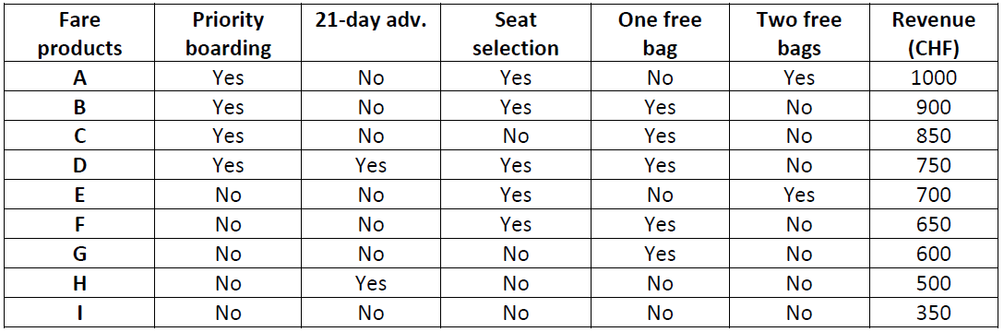



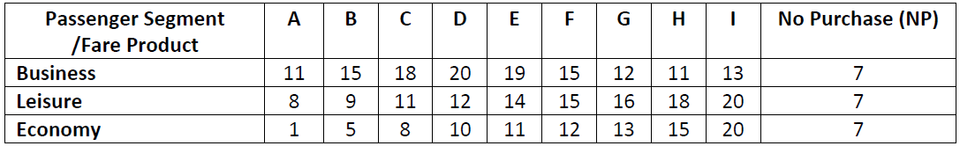



Introduction
Fare buckets
180 seats
Geneva
Washington DC
179
0
Passenger types with preferential weights
Booking time, t (days)
9 fare buckets (A to I) producing different revenues
3 different type of passengers with different arrival rates
Each passenger type has certain preferential weight to select the fare buckets
Passenger arrival rate
Inventory control
Business
$$λ\left(t\right)=1.2∗sin⁡(t)$$
Booking interval
Booking limit ( 20 seats per fare product)
Overbooking is not allowed
Each seat can be sold at any fare
Leisure
$$λ\left(t\right)=\frac{0.6}{179}t$$
Economy
$$λ\left(t\right)=0.8 ( 1 +sin(t+180))$$

Slide 3
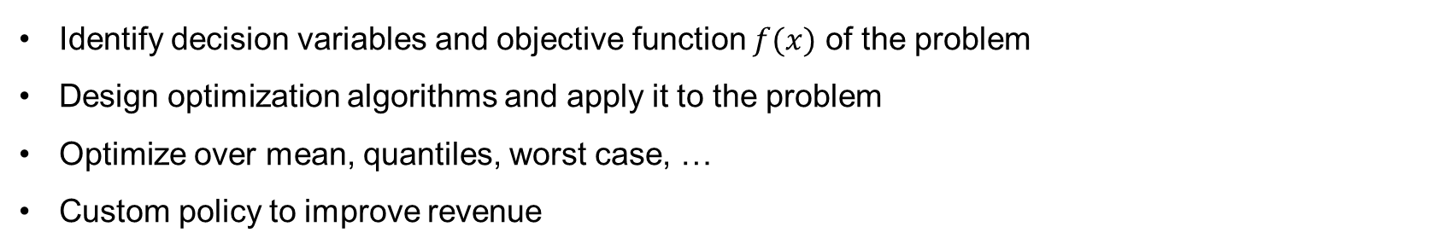
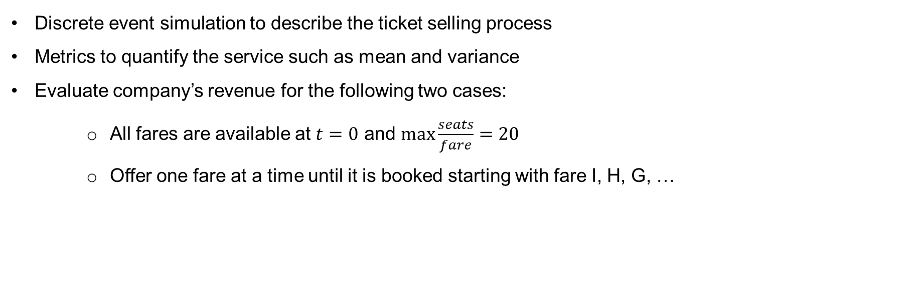
Problem statement
Simulation
Discrete event simulation to describe the ticket selling process
Metrics to quantify the service such as mean and variance
Evaluate company’s revenue for the following two cases:
All fares are available at $t=0$ and $\max_{}{\frac{seats}{fare}=20}$
Offer one fare at a time until it is booked starting with fare I, H, G, …
Optimization
Identify decision variables and objective function $f(x)$ of the problem
Design optimization algorithms and apply it to the problem
Optimize over mean, quantiles, worst case, …
Custom policy to improve revenue

Slide 4
Simulation

Slide 5
Simulation
State variables
Events
Time (days)
Seat availability (availabilities)
List of future events sorted in chronological order.
Initialization of the simulation: first event (Generation).
Process the next event:
Update the variables.
Collect statistics.
Generate and add new events to the list.
Remove the processed event from the list.
Finish the simulation if the list is empty, go to next event otherwise.
Parameters (Scenario)
Total booking days
Different passenger arrival rate
Total revenue
Choices

Slide 6
Simulation workflow
Choices
Simulator
Passengers
Ideal choices
Arrivals
Offered fares
Revenue
Scenario
Duration
Seats sold
Fare selection
Late passengers
Policy
Satisfaction

Slide 7
Code implemention

Slide 8
Auxiliary functions
exponential_rng(lam = 1.0)
generates exponential random number
homogeneous_poisson_process(lam, T)
generates arrivals according to a Poisson process
non_homogeneous_poisson_process(lam_t, lam_max, T)
generates arrivals according to non-homogeneous Poisson process with time-dependent rate lam_t
non_homogeneous_poisson_process_piecewise(lam_t, lam_max, T)
generates Business Passenger arrivals according to non-homogeneous Poisson process with time-dependent rate lam_t

Slide 9
Discrete event simulator
class Scenario
airline yield management scenario
class Passenger
generic airline passenger (subclasses: Business, Leisure, Economy)
totalRevenue(choices)
computes the revenue of the airline company starting from the list of passenger choices
seatsSold(choices)
computes the number of fares sold from the list of passenger choices
simulate(scenario)
implements the simulation procedure

Slide 10
Statistical analysis
moving_mean_var(new_data, old_mean, old_var, t)
Calculates moving sample mean and variance at time t
bootstrap(data, f_statistic, draws)
Calculates the bootstrap mse of a statistic of choice

Slide 11
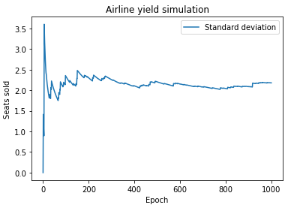
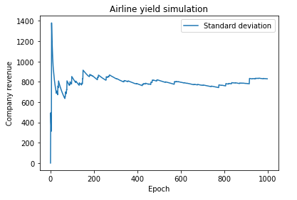
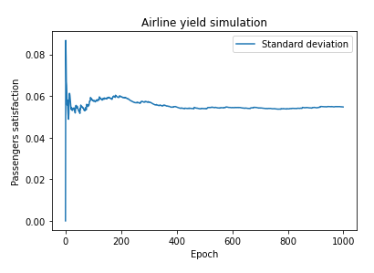
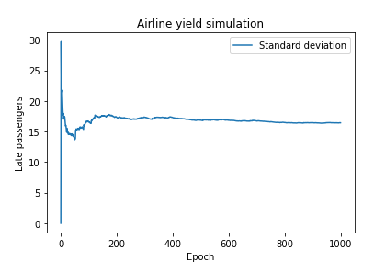
Scenario 1: Statistical analysis (Moving mean variance)

Slide 12
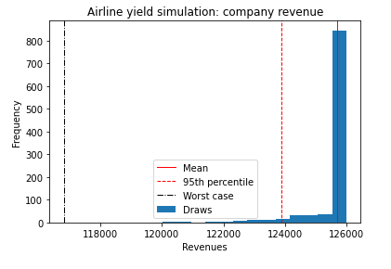
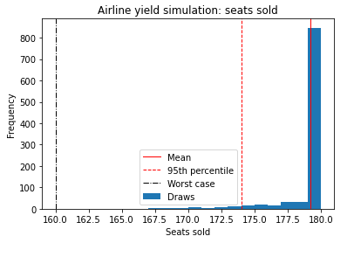
Scenario 1: Bootstrapping (Revenue & Seats sold)
Mean: 125702.65
Bootstrapped MSE: 654.4638750000075
Theoretical MSE: 687.4404775
95% percentile: 123900.0
Bootstrapped MSE: 0.0
Mean: 179.188
Bootstrapped MSE: 0.004356262000000078
Theoretical MSE: 0.004738656000000001
95% percentile: 174.0
Bootstrapped MSE: 0.0

Slide 13
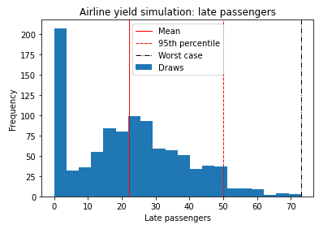
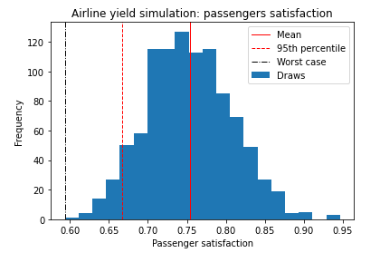
Scenario 1: Bootstrapping (Late passengers and Satisfication)
Mean: 22.097
Bootstrapped MSE: 0.28112021399999976
Theoretical MSE: 0.26936359100000007
95% percentile: 50.0
Bootstrapped MSE:
0.7666399999999994
Worst case: 73
Bootstrapped MSE: 1.258
Mean: 0.7534550742300916
Bootstrapped MSE: 2.9248368148026313e-06
Theoretical MSE: 2.995066914075187e-06
95% percentile: 0.6666025641025641
Bootstrapped MSE: 1.0126182173112962e-05
Worst case: 0.5931558935361216
Bootstrapped MSE: 0.00022041730189332822

Slide 14
Scenario 2: Statistical analysis (Moving mean variance)

Slide 15
Scenario 2: Bootstrapping (Revenue & Seats sold)

Slide 16
Scenario 2: Bootstrapping (Late passengers and Satisfication)

Slide 17
Comparison between scenario 1 and 2
 |  | Scenario 1 | Scenario 2
Company revenue | Mean
 | Bootstrapped MSE
 | 95%
 | Bootstrapped MSE
Seats sold | Mean
 | Bootstrapped MSE
 | 95%
 | Bootstrapped MSE
Late passengers | Mean
 | Bootstrapped MSE
 | 95%
 | Bootstrapped MSE
Passenger satisfcation | Mean
 | Bootstrapped MSE
 | 95%
 | Bootstrapped MSE

Slide 18
Observations
Which scenario provides better revenue?
Which data makes sense and which not?

Slide 19
Optimization

Slide 20
Optimization
Objective functions
Multi-Objectives
Mean revenue
Passenger satisfaction
Maximizing mean revenue
Maximizing passenger satisfaction
Algorithms used
Full enumeration
Local search
Variable neighborhood search
Simulated annealing

Slide 21
Code implementation
Creating availability vector and cut off vector for (a) mean and std of revenue and (b) mean and std dev for passenger satisfaction
→ def evaluate(startAvail,startCutoffs, numIter = 10):
def evaluateSat(startAvail,startCutoffs, numIter = 10):
Creating availability vectors for different search methods
→ def generateAvailabilities(rg,availabilities,mode='ls',neighborhoodSize=None):
→ def generateAvailabilities_LS(rg,availabilities, neighborhoodSize=q):
→ def generateAvailabilities_FE(rg,availabilities):
Creating cut-off vectors for different search methods
→ def generateCutoffs(rg,cutoffs,mode='ls',neighborhoodSize=None):
→ def generateCutoffs_LS(rg,cutoffs,neighborhoodSize=1):
→ def generateCutoffs_FE(rg,cutoffs):
Checking dominance for higher mean and lower std, temperature
→ def dominates(test,testScore,pList,listScores):
→ def dominatesSat(test,testScore,pList,listScores):
→ def temperature_linear(init, i, iterations):
→ def temperature_nonlinear(init, i, iterations):

Slide 22
Local search
Consider a list of candidates and scores
Select a random candidate and generate a new solution from the list
Check dominance
Add new candidate to Pareto front
if it is not dominated by any other candidate
Remove dominated solutions from Pareto front
Insert the plot of local search algorithm

Slide 23
Variable Neighbourhood search
Consider a list of candidates and scores
Select the last candidate, and generates a new solution from it
Check dominance, and add new candidate to Pareto front
if it is not dominated by any other candidate
Reset neighborhood size to 1
Else, increase the size of the neighborhood and repeat
Remove dominated solutions from Pareto front
Insert the plot of VNS

Slide 24
Simulated Annealing
Consider a list of candidate solutions and their scores
Select the last candidate, and generates a new solution from it
Check dominance, and add a new candidate to Pareto front
if it is not dominated by any other candidate
Else, use the candidate as the start point for the generator probabilistically, based on temperature
Remove dominated solutions from Pareto front
Insert the plot of SA

Slide 25
Comparison of different methods
 | Local search | VNS | SA
Mean revenue
Customer satisfication score
Computational time

Slide 26
Conclusion

Slide 27
Queries?
Thank you

