Slide 1

Joseph Taied Data Bootcamp Final Project Graphs
President Trump's Twitter Activity and Engagement with President Trump's Tweets as a Function of Time

Slide 2
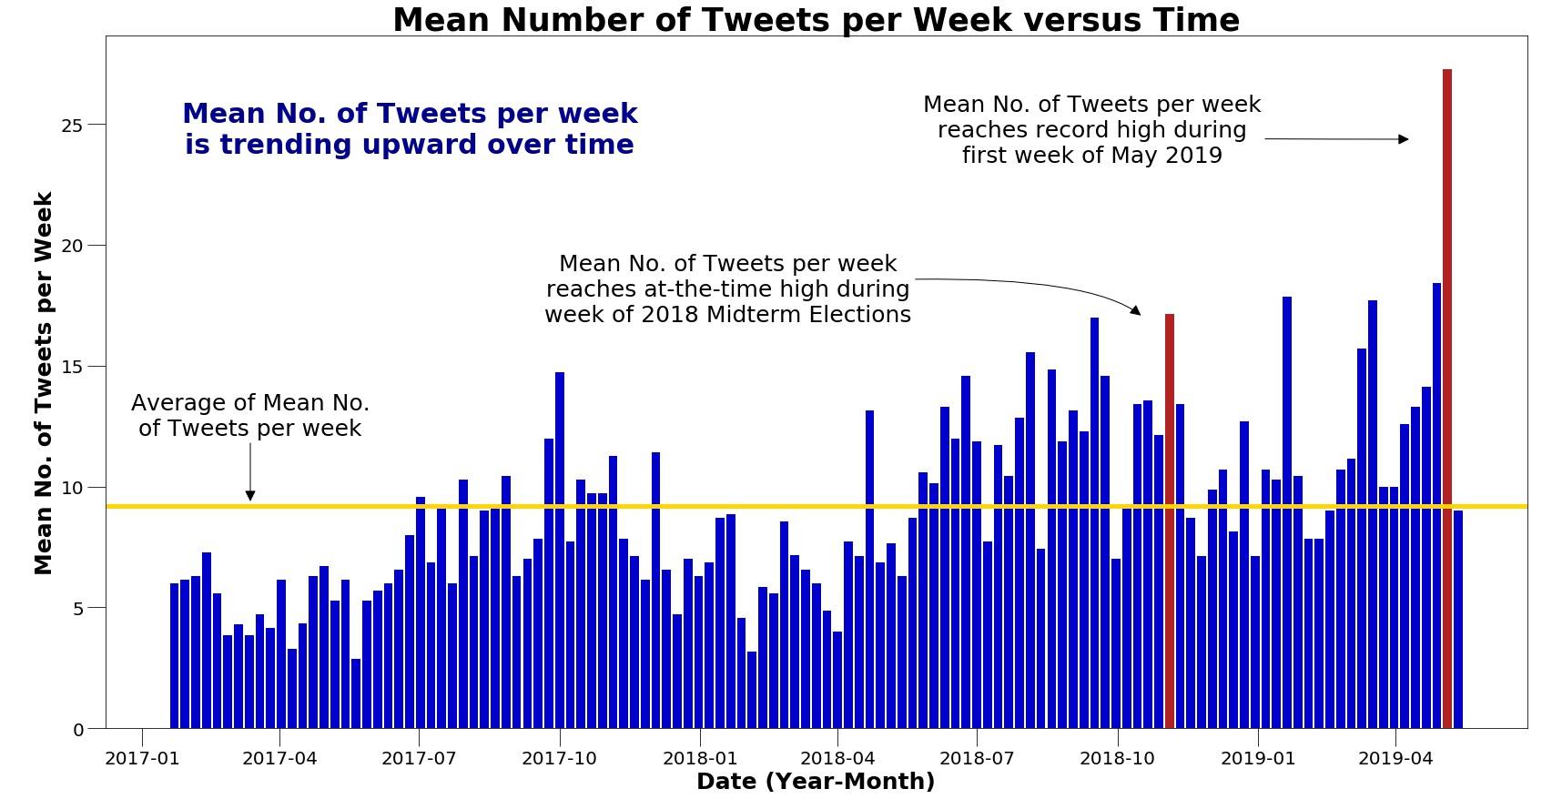

Slide 3
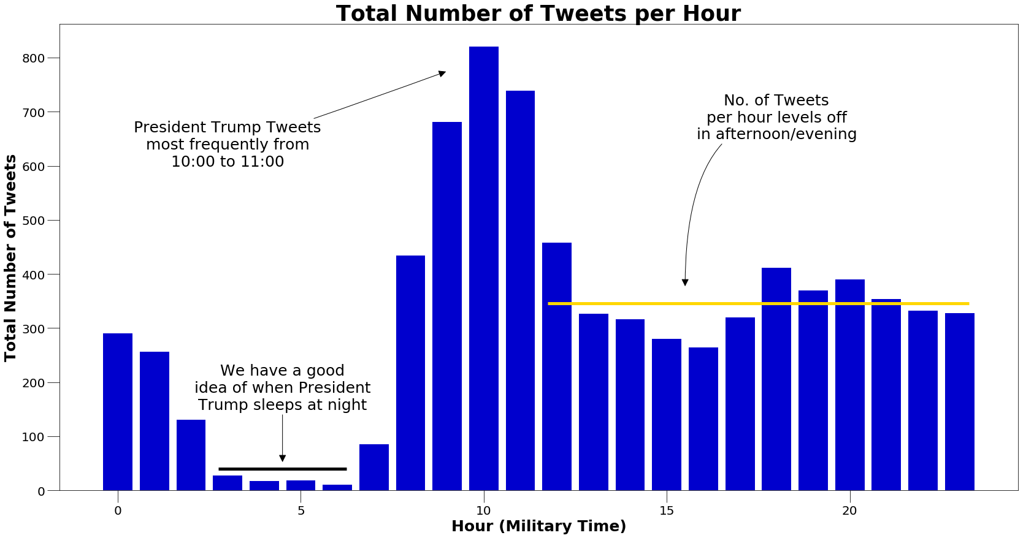

Slide 4
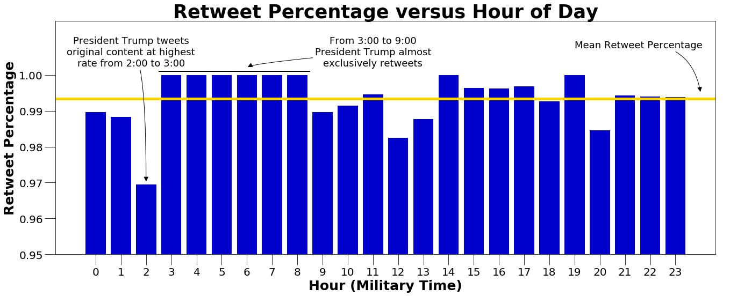

Slide 5
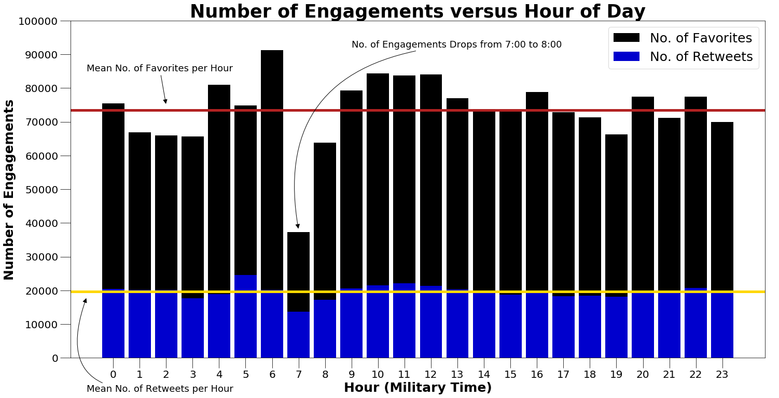

Slide 6
