Slide 1
Algorithm to detect collisions
with the spatial hash algorithm
Omar Alexis Becerra
Juan José Tamayo
Medellín, May 21

Slide 2
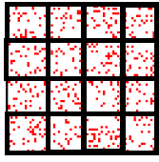
Data structure designed
Figure 1: Representation of a spatial hash where each red dot is a bee and each square is a quadrant

Slide 3
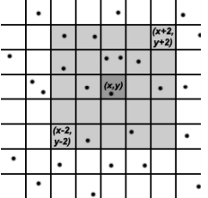
Data Structure Operations
Figure 2: Representation of a spatial hash where each black dot is a bee and each frame is a quadrant
Table 1: Complexity algorithm methods

Slide 4
Design Criteria of the Data Structure
This structure was designed in this way thanks to the efficiency in the identification of collisions and its low algorithmic complexity, the efficiency in the time of execution, this idea was granted thanks to a suggestion from our teacher.
The delete operation in a Linked List, for the first and last element, has a time complexity of O(1).
The delete operation has a memory complexity of O(1).
The delete operation of a linked list is, therefore, efficient to solve the problem.

Slide 5
Time and Memory Consumption
Table 4: Analysis of the results obtained with the implementation of a special hash and two cycles with complexity n²

