Slide 1
ENGI 301
Safe and Sound Vault
</
/>
By: JJ Tellez

Slide 2
</ Table of contents
{01}
{03}
Background Information
Power Block Diagram
{02}
{04}
System Block Diagram
Components and Budget

Slide 3
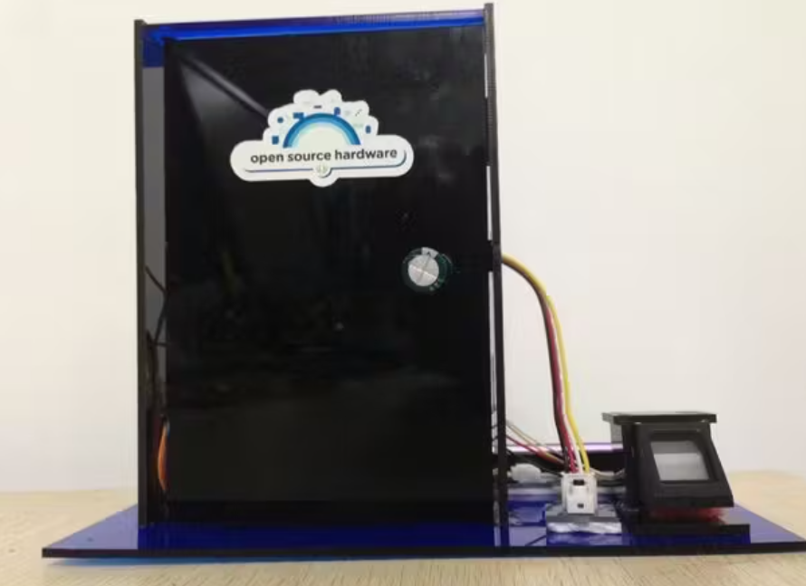
</ Background Information
I’ve always wanted to have a place where I can store all my valuables in, but have never wanted to buy a vault.
Therefore, I decided to create a vault that can only be accessed by fingerprint and face recognition.
This project will be an addition of the project linked below, a fingerprint lock. However, this project will also include a face recognition aspect to it and will be able to accessed by 3 people so it will be able to store 3 users.
Fingerprint Lock

Slide 4
</ System Block Diagram
Fingerprint Sensor
Pocket Beagle
Servo that opens/locks vault
USB Camera

Slide 5
</ Power Block Diagram
Fingerprint Sensor
Pocket Beagle
AA Battery
USB Camera
Servo that opens/locks vault

Slide 6
</ Components and Budget
Component | Need to Buy | Cost
Fingerprint Sensor | To read fingerprint and open vault | $20.99
USB Camera | To scan face and open vault | $19.99
Standard LCD | To display status of opening vault | $9.95
Micro Servo | To open and close vault | $11.95
AA Battery | To power up the PocketBeagle | $12.49

Slide 7
Thanks!
</
} /> [
/>
Please keep this slide for attribution

