Slide 1
Delta Processing for Social Analytics
James Thomas et. al.
Notes:
We have a domain-specific storage layer, now what about the computation layer? How can we build a computation layer optimized for social analytics?

Slide 2
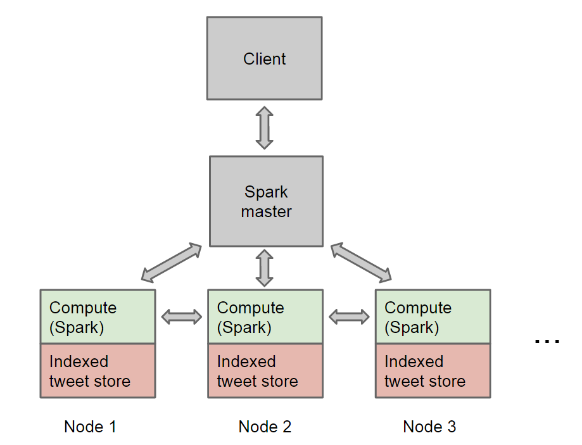
DSoAP System Architecture (from before)
Retrieve tweets with plain text search and perform some analysis on them
Notes:
Support distributed computation on indexed tweet data – faster retrieval and computation phases (vs. COSMOS to single node)

Slide 3
Common Social Analytics Workflow
Plain text search to get target tweet set
Analysis within groups of tweets
e.g. each group has all tweets with a certain pair of words co-occurring
Finally global analysis (e.g. sort the groups by some field)
e.g. sort co-occurrence pairs by # of tweets
Refine search query if irrelevant results observed and repeat steps 1-3
Make this process faster, assuming fixed analysis

Slide 4
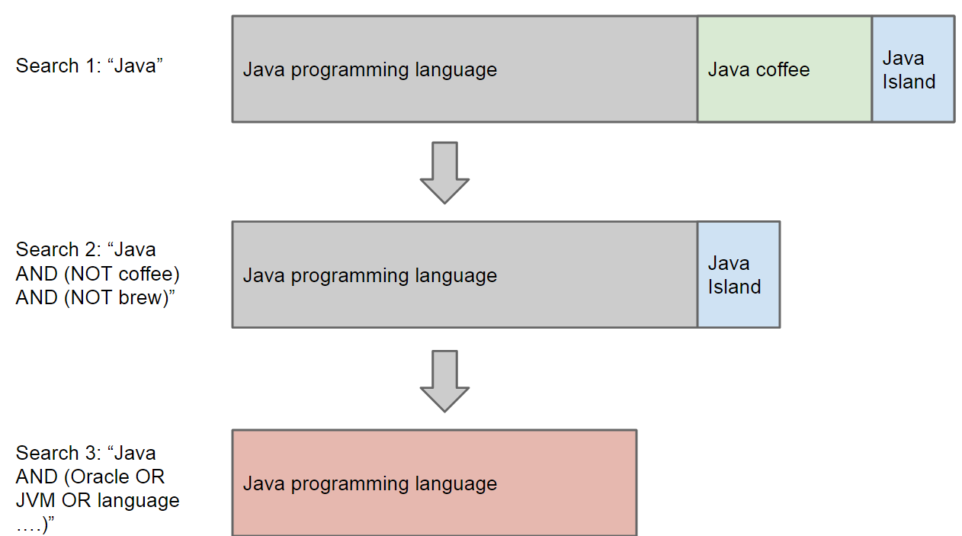
Motivation
Honing in on target tweet set with plain text search
Notes:
Social media analysts have a target tweet set in mind – the problem is extracting this tweet set from the full dataset, where the important data is all in plain text
Rely on full text search, inherently fuzzy
Repeated refinement to get the right precision/recall

Slide 5
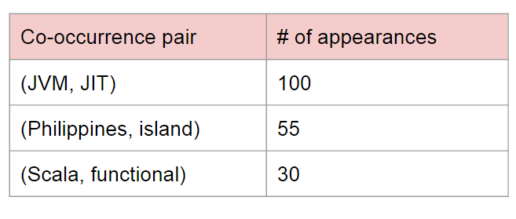
Problem
Only realize tweet set is bad at end of computation pipeline
Must rerun whole computation pipeline on updated tweet set, even though many tweets shared
Oh no…
Notes:
We may do extensive computations on the returned results to determine whether we got the right result set
Scott famous song example, “I lost my job”, “I got laid off”
Redo these computations from scratch for every search query refinement, even though many returned records are the same
Can we reuse results from the old computation?

Slide 6
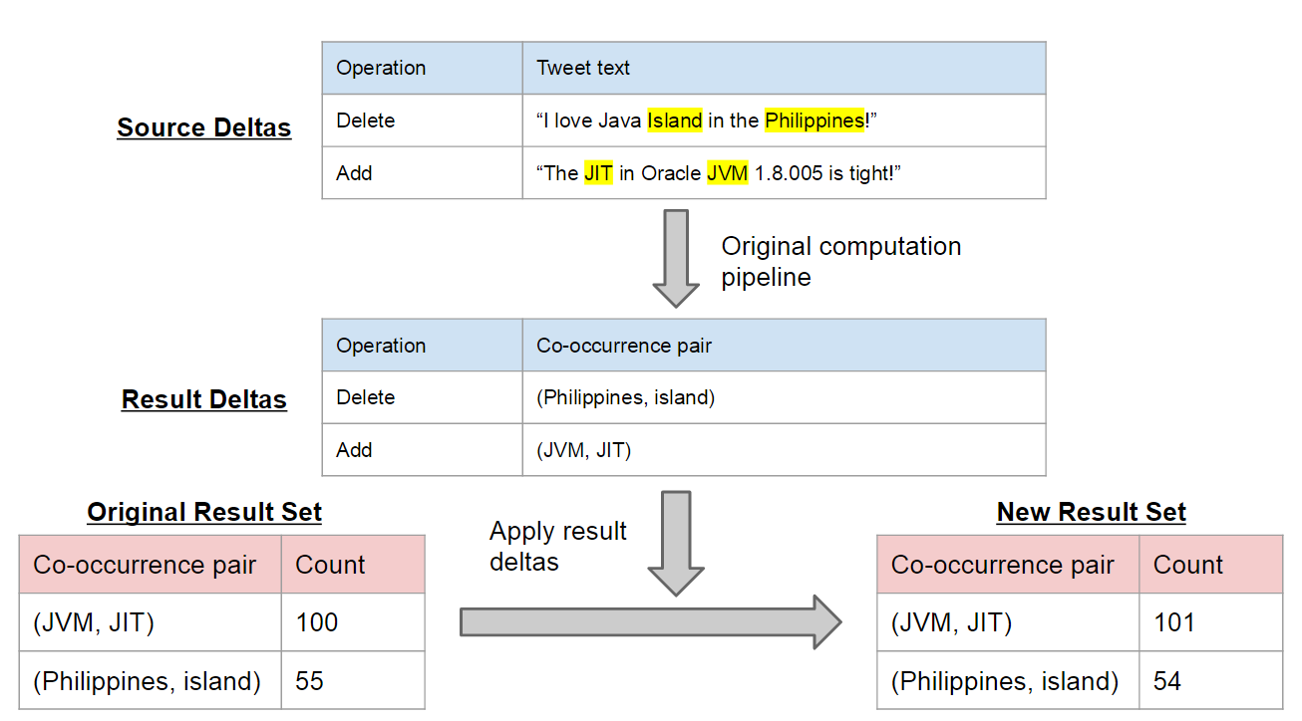
Solution
Keep previous results, pass only deltas through computation pipeline and update previous results

Slide 7
Design Goals / Limits of Prior Work
Have good distributed computation characteristics, like fault/straggler tolerance, communication avoidance
Modify Spark without losing these properties
Efficient fine-grained updates to prior results
Notes:
Easier than adapting single-node delta solutions to distributed?

Slide 8
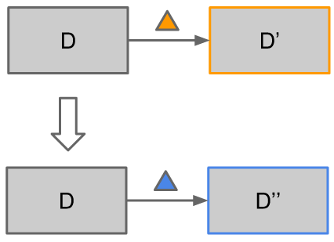
Design Goals Cont’d
Mix non-incrementalizable computations with incrementalizable in general-purpose computation framework
Easy to roll back to and apply deltas to previous result sets
Not the desired result

Slide 9
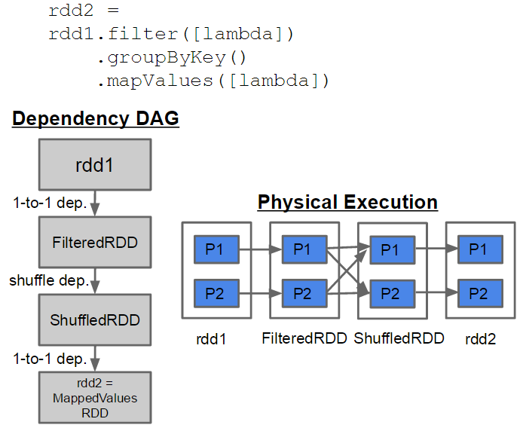
Spark Review
Partitioned datasets (RDDs)
One-to-one and shuffle dependencies (narrow and wide)
DAG of dependencies
Programmer-specified caching of datasets in memory

Slide 10
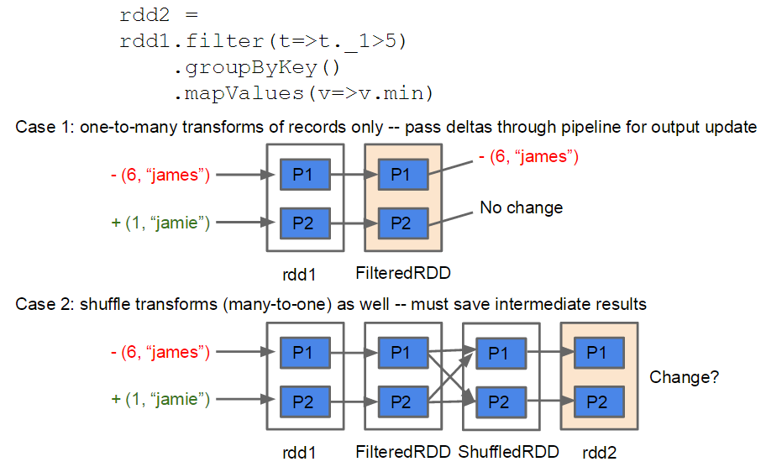
Feeding Deltas through Computation
Don’t know other keys in group 6, so can’t pass deltas through this stage without saving ShuffledRDD
Notes:
Make point that we must save after groupBy

Slide 11
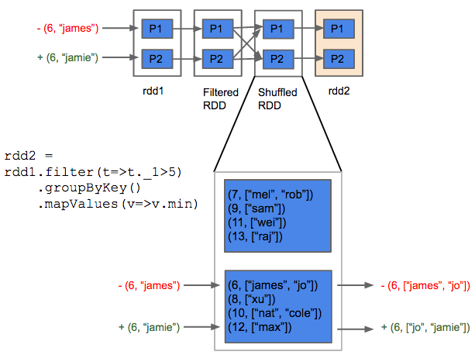
Feeding Deltas through Shuffle
Arbitrary map functions can be applied to groups, so we must pass entire old group as neg. delta and new group as pos. delta

Slide 12
Target API (Design Goals 3 & 4)
d = new DeltaComputation(rdd)
rdd can be any map-filter-groupby computation
newD = d.applyDeltas(pos, neg)
pos, neg are RDDs that are deltas to the source dataset in the computation in d
d is not mutated, so we still have a handle to it and can apply other deltas
result = newD.getResult()
result is an RDD on which any Spark transformations (incrementalizable or not) can be run

Slide 13
API Example
result = source.map(...).groupByKey().map(...)
.groupByKey().filter()...
d = new DeltaComputation(result)
top10 = d.getResult().topK(10)
// top10 has bad results, refine query
(pos, neg) = [submit new text filter to storage layer, obtain +/- deltas to source]
dUpdated = d.applyDeltas(pos, neg)
newTop10 = dUpdated.getResult().topK(10)
// realize new query was completely wrong, go back to original query and refine it
(newPos, newNeg) = ...
dUpdated2 = d.applyDeltas(newPos, newNeg)
...
Mixing in non-incremental computation
Handle to old version allows us to apply deltas to it
Notes:
High-level API
DeltaComputation code
Support arbitrarily long pipelines
Have some global analysis

Slide 14
Generality of map-filter-groupby
Our system can pass deltas through any map-filter-groupby computation
All single-dataset computations can be expressed with these operations (c.f. MapReduce)
Social analytics generally groups records and then performs map-like transformations on the groups, then groups again and repeats
Notes:
Design automatically falls back to redoing the entire computation if non-incrementalizable (e.g. a single key for the groupBy)

Slide 15
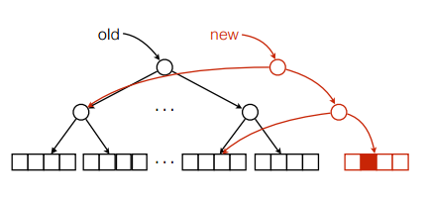
Fine-grained Updates to RDDs
Fast, space-efficient fine-grained updates required for deltas not easy in Spark due to dataset immutability
IndexedRDD (AMP Lab) uses functional data structure idea to solve problem
Space-efficiency means persisting old versions is cheap (design goal 4)
(fig. by Ankur Dave, AMP Lab)
Notes:
Immutability key also so we can roll back to prior versions

Slide 16
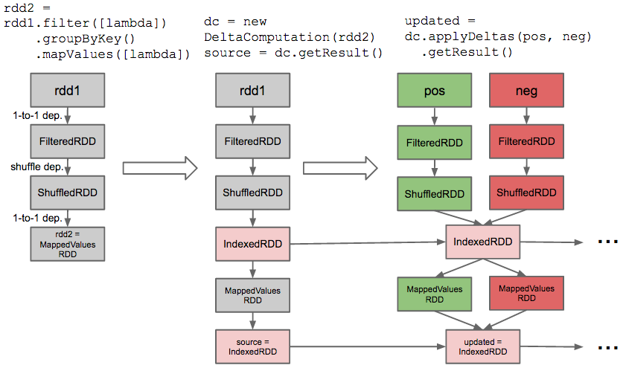
Computation DAG Rewriter (Design Goals 1 & 2)

Slide 17
Implementation Details
Just a library – no modifications to Spark core
~300 LOC (DAG rewriter and modifications to IndexedRDD)
Spark partitioners used to avoid shuffles for IndexedRDD state maintenance
Notes:
All good properties of Spark retained
Works within Spark’s existing scheduling and resource management framework (cache())

Slide 18
Evaluation Methodology
1e7 records, uniformly distributed over G keys
Computation: records.map(…).groupByKey().map(…)
Feed D deltas into the computation
Measure percentage improvement in runtime over redoing whole computation
Notes:
Good case when state is not evicted from cache and tasks are scheduled where cached state is
Carefully discuss impact of varying the two parameters
G varied over []
D varied over []

Slide 19
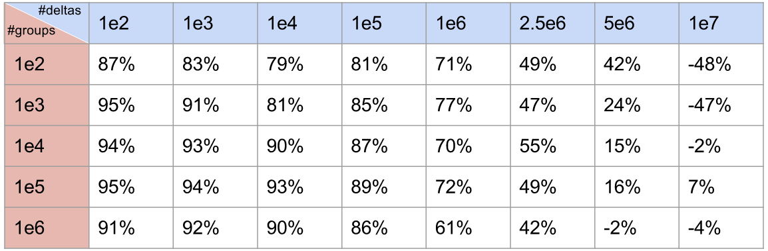
Results
Increasing because fewer deltas passed through computation pipeline
Good perf. even when most groups changed
Good perf. even at 25%-50% of dataset changed

Slide 20
General Applicability of Delta Engine
Can be used on top of any datastore that can return deltas
Can be used to improve performance of iterative computations where each iteration can work with deltas from previous iteration

Slide 21
Conclusion
General purpose delta processing system built on Spark, with applications in social analytics
Achieved design goals:
Retains good properties of Spark
Supports fine-grained updates to prior results
Supports mixing of incremental and non-incremental computation
Efficiently saves prior dataset versions for reuse

Slide 22
Future Work
Support wider class of Spark operators (joins, etc.)
Test performance when intermediate IndexedRDDs must be recomputed and when delta volume large for several stages
Decide intelligently in these cases whether full pipeline recomputation is faster
Support updating the computation as well as the dataset
Identifying common subcomputations and running the deltas through them
Notes:
Support updates to underlying datastore

