Slide 1
C++ and VC++ programming
C++ / VC+ 编程
Introduction

Slide 2
Sections 部分
Chp1/2: C/C++ review = C/C++ 温习
Chp 2/3: C++ datatypes and description = C++ 数据类型和描述
Chp 3/4: Visual Studio/CFree compile process = Visual Studio 编译过程
Chp 4: Windows functions = Windows 函数
Chp 4: Windows programming description = Windows programming 描述
Notes:
温

Slide 3
Sections 部分
(f) Chp 4/5: MFC foundations classes = MFC 基础类
(g) Chp 5/6: MFC Dialog controls, windows control classes.
(h) Chp 6: Document/View, frame windows.
CWinApp class

Slide 4
Visual Studio
.NET framework .NET 框架
Includes many languages: Visual C#, Visual F#, Visual Basic, Sharepoint, Crystal Reports, Visual C++
Visual Studio包括多种程序语言

Slide 5
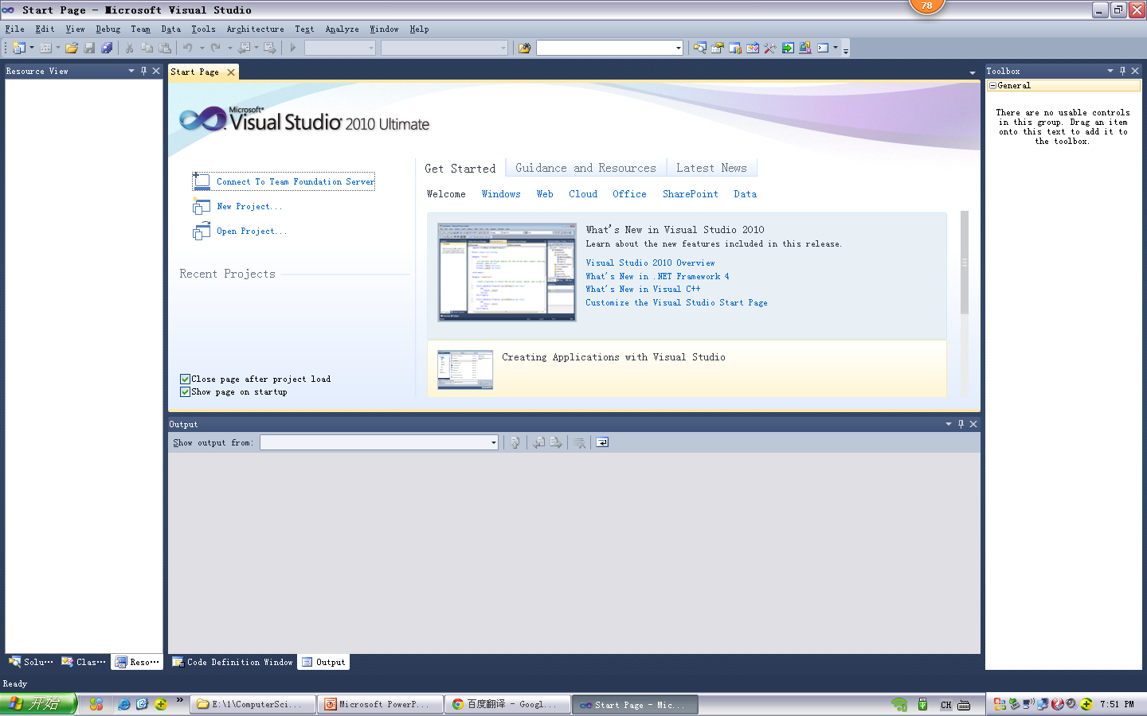
Visual Studio

Slide 6
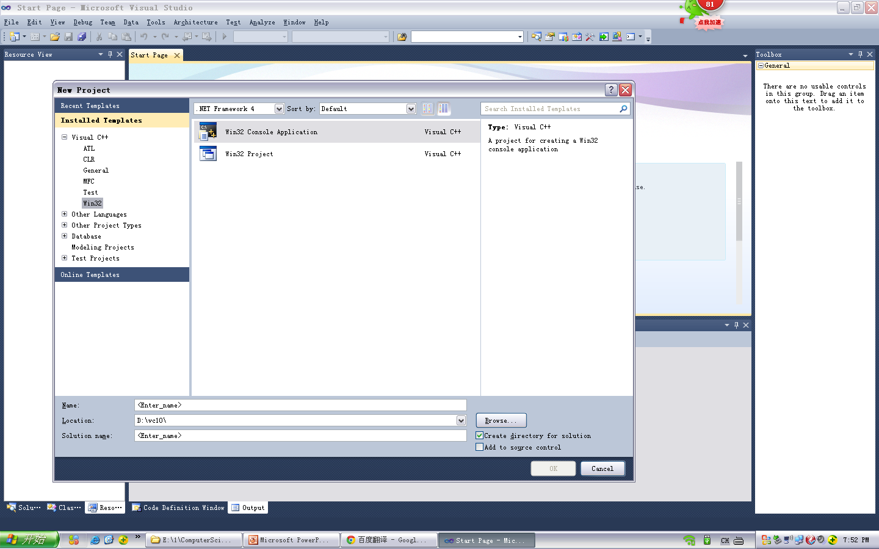
Visual Studio C++

Slide 7
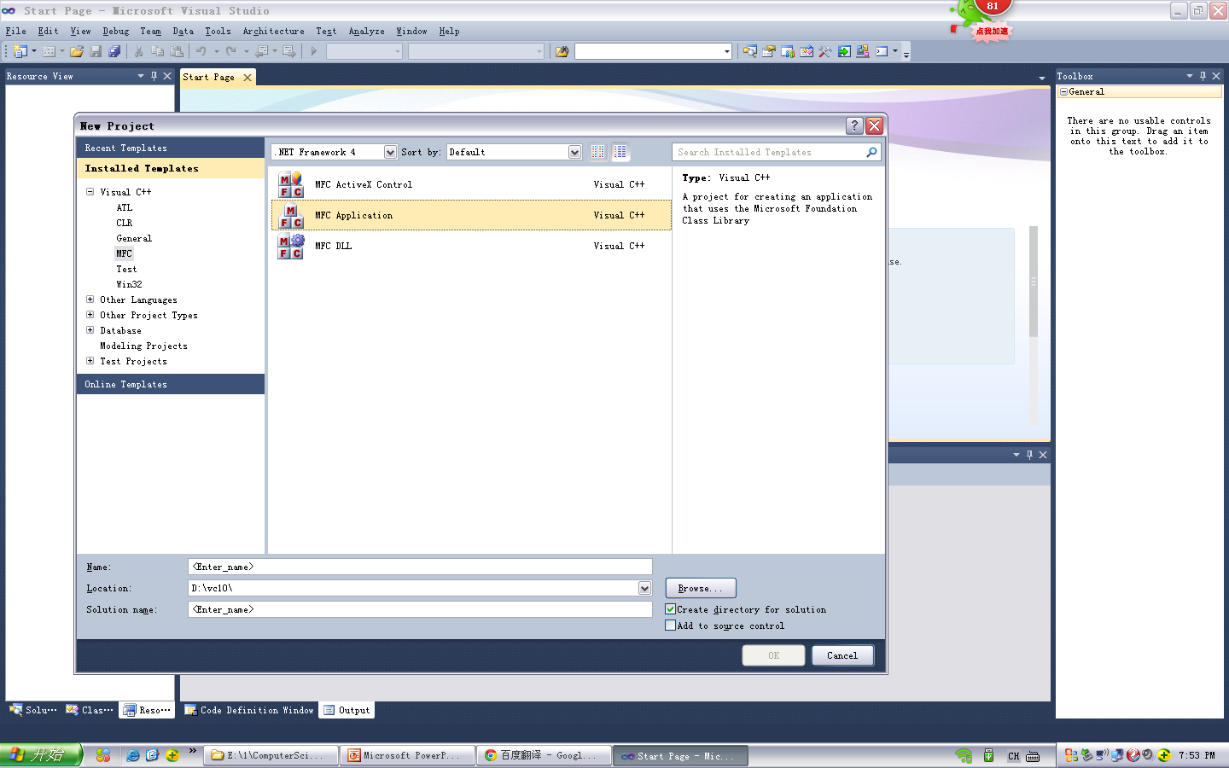
Visual Studio MFC

Slide 8
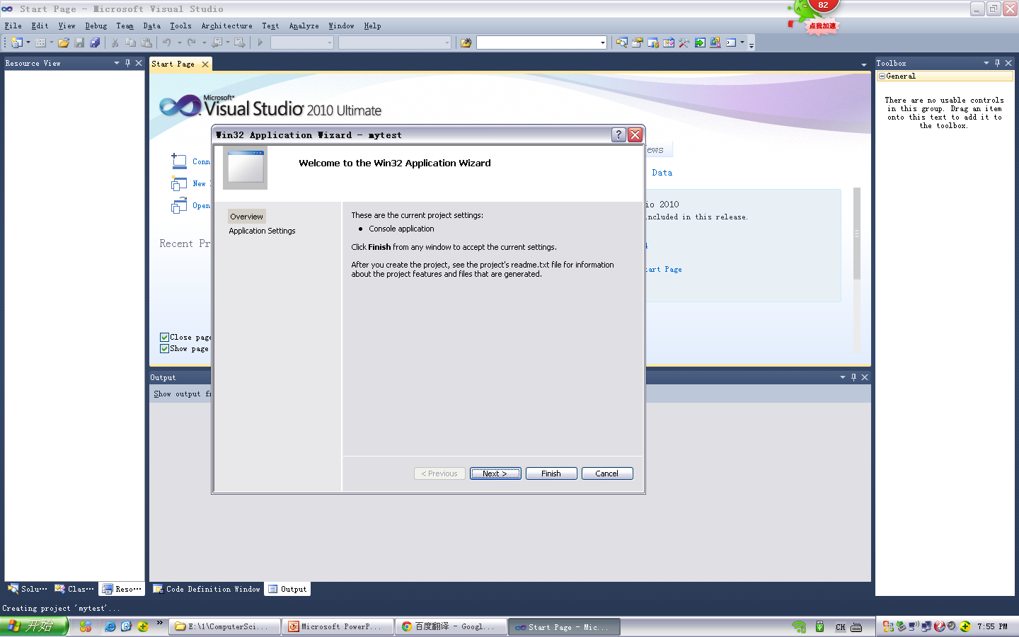
Visual Studio options

Slide 9
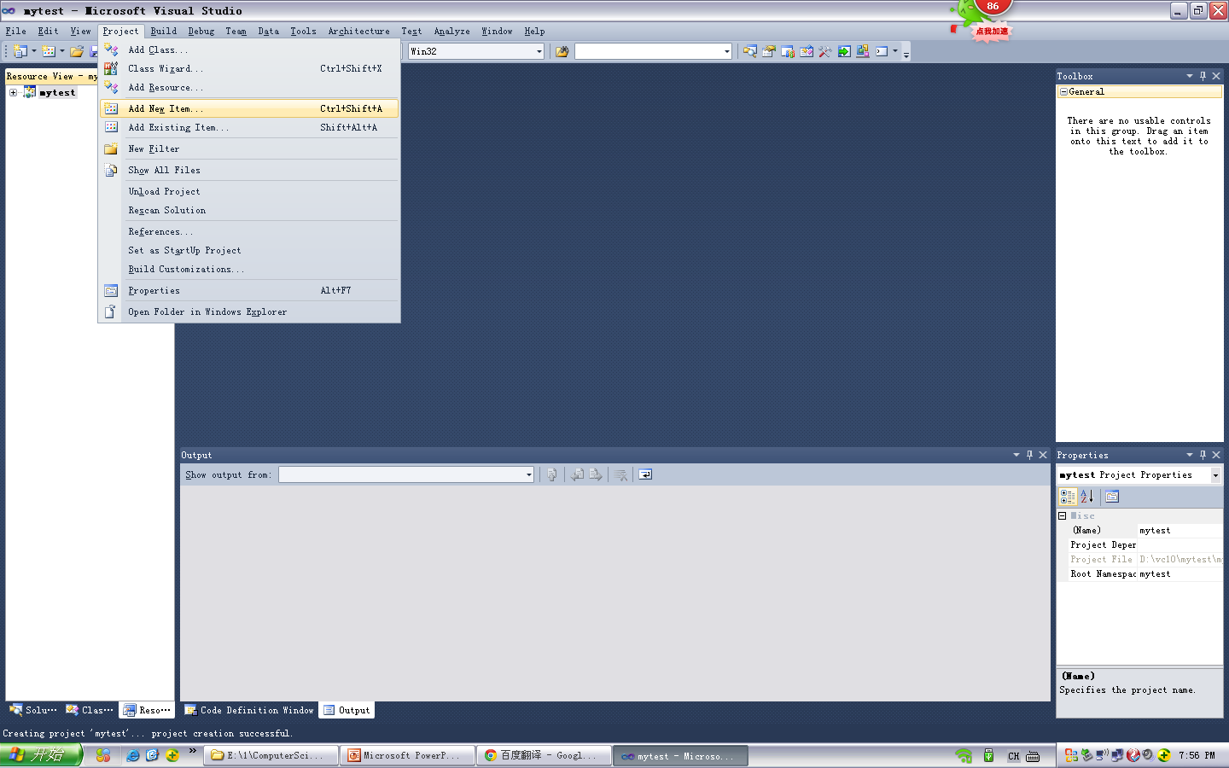
Visual Studio C++ console

Slide 10
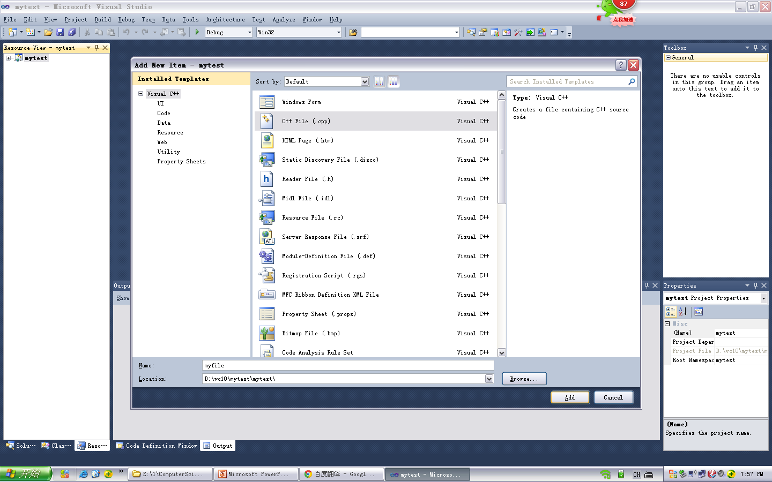
Visual Studio C++ console

Slide 11
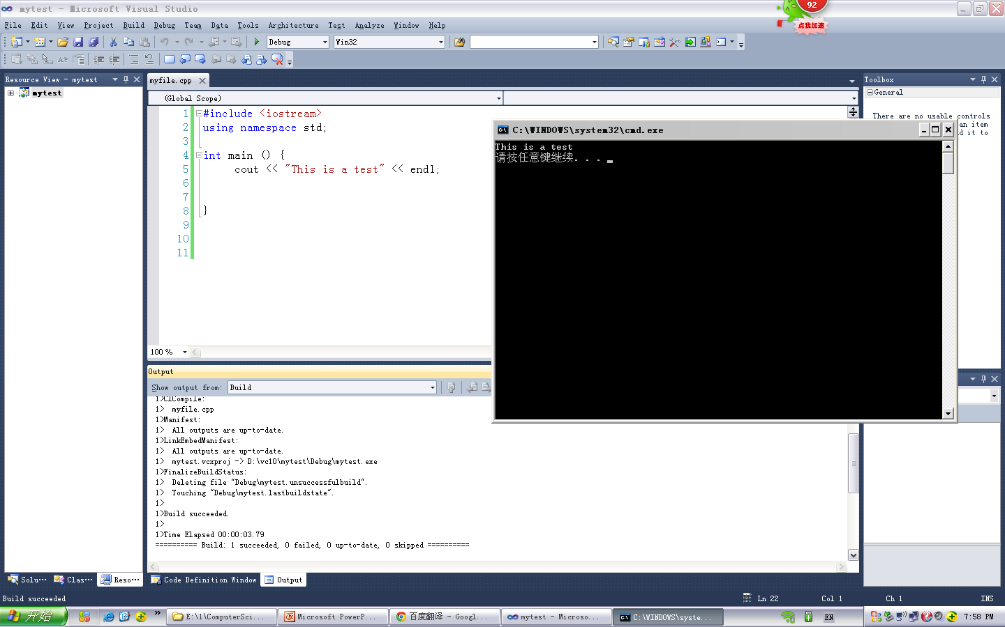
Visual Studio C++ console

Slide 12
Chapter 1: IOSTREAM (C++)
Use #include <iostream>
OR #include “iostream”
What is difference? “iostream” will search current directory first before searching standard locations.

Slide 13
Chapter 1: using
After #include, add the standard library by adding “using”.
Ex: #include <iostream>
using namespace std;
OR
#include <iostream>
using std::cout;
using std::endl;

Slide 14
(a) Chapter 1: C,C++ 温习
1.3 Datatypes = C++ 数据类型
变量类型 : Variable types: char, short, int, long, float, double
Signed, unsigned
1.3.5: Array = 数组 array, strings
1.3.6: Structures = 结构
1.3.8: Enum
1.3.9: Typedef

Slide 15
(a) Chapter 1: C,C++ 温习
1.4 Operators: ++, --, +, -, ==, =, &, &&, *, !=, *=, +=, %, /
1.4.3: Greater than, less than
1.4.4: AND, OR
1.4.6: if /else ( ? : )
1.4.7: Increment, decrement
1.4.8: bracket operations
1.4.9: sizeof - specifies size of variable in bytes
1.4.10: new, delete - C++ allocate and deallocate memory

Slide 16
(a) Chapter 1: C++ 温习
1.5 Basic statements: 基本语句
1.5.2 : if / else
1.5.3: while, do-while, for
1.5.4: break, continue
1.6: functions 函数,
1.6.4/1.6.5 function types: void, int, float
1.7 Pointers 指针
1.9 Preprocessor:预处理器

Slide 17
<string> vs <string.h>
<string.h> - strcpy, strcat, strlen, strcmp – used for char *, char [] strings.
<string> - part of std string library
string.append(), string.insert(), string.replace(), string.length()

Slide 18
(a) Chapter 2: C++ 温习
Object oriented programming has 3 main concepts:
Encapsulation (2.1) – hiding data
Inheritance (2.3) – ability to inherit from a base class instead of developing new classes from scratch.
Polymorphism (3.1/3.2) – ability to redefine functions in different ways. (virtual functions 3.1, operator overloading 3.2)

Slide 19
(a) Chapter 2: C++ 温习
(b) C++
2.1 Structures, classes and objects: 结构, 类和对象
2.1.2/2.1.3: Definition of a class,
Class – Blueprint of object.
Object – Instance of class.
Public member: 公有 – visible anywhere object is available, visible outside of class.
Private member:私有 – accessible only inside class and friend members.
Protected member: accessible only within class, friend members and derived classes.

Slide 20
(b) Chapter 2: C++ datatypes and description/ C++ 数据类型和描述
2.1:Members and features of a class
2.1.2 – Classname objectname declaration.
2.2.1: Constructors 构造函数, - initialize object members, responsible for creating new objects, if you don't supply a constuctor, the compiler will supply a default one.
NOTE: There is no return value for constructors.
2.2.2: Destructors 祈构 函数 – destroy object when finished. If you don't supply a destructor, the compiler will automatically supply a default one.
NOTE: There is no return value for destructors.
2.2.3: Object member initialization - multi-object initialization as example in book.

Slide 21
2.2.3 – example
top = 100
left = 10
right =80
bottom = 250
L = length = 80-10=70 W = width = 250-100=150

Slide 22
(b) Chapter 2: C++ datatypes and description/ C++ 数据类型和描述
2.2.4: Constant types – a) const declared after function means function not allowed to modify or change class members.
b) Constant variables can only be initialized through constructors in the class. Once the value is initialized it cannot be modified or changed.
c) Constant objects not allowed to modify data after initialized.
2.2.5: this pointer – return a pointer to current object, it is a constant pointer that holds memory address of current object. To be used as a pointer. See example 2.2.5 in book.
2.2.7: static members – a)single instance member shared between all objects of the class.
b) Static variables cannot be initialized within the class, must be initialized outside of the class.
c) Its value will continue to exist for all function calls and retain its value thoughout the program.
d) Can be used to keep track of how many times a function is called in the program.

Slide 23
(b) Chapter 2: C++ datatypes and description/ C++ 数据类型和描述
2.2.8: friend function – able to access private, protected members of class.
2.3 Derived class / Inheritance = 派生类 / 继承 – to create another class from the base class with similar characteristics. NOTE: Constructors and destructors are not inherited from the base class.
2.3.1 Single Inheritance: public 公有继承/ private 私有继承
2.3.3 Multiple inheritance 多继承

Slide 25
Templates:模板
Template – 模板
template <class T>
template <class T1, class T2>
1. Function template – 函数摸板
2. Class template – 类摸板
3. STL template – STL摸板
(standard template libraries) Example <vector>

Slide 26
Templates:模板
3.4 Template – 模板
template <class T>
template <class T1, class T2>
Templates are to allow multiple data types to run on the same function or the same class.
Example: int, char, float, double can all run on the same function.

Slide 27
Templates STL:模板
Chapter 10: STL Templates: part of Standard Template Library.
Used in C++ libraries, and available to a C++ compiler.
Example vector container:
#include <vector>

Slide 28
(b) Chapter 3: C++ datatypes and description/ C++ 数据类型和描述
3.1 Polymorphism / Virtual functions 蔼多态和虚函数
3.1.1 – Virtual functions – member function that can be redefined in a derived class. Provides the opportunity to call the methods in a derived class using the base class pointers.
3.1.2 – Pure virtual functions – no implementation provided. You cannot create an object from the base class.
The =0 means it is a pure virtual function.
3.2 Operator overloading 运算符重载
(Giving different meanings to basic operators)
3.2.1 – Operator overloading syntax
3.2.2 – Operator overloading assignment
3.3 Input/Output

Slide 29
3.2 operator overloading
Normal: 5 + 6 = 11 (int + int = int)
Example: int i=8, k;
k = i;
Not normal: object + object = ? (operator+)
Operator overload: object + object = object
Example: Person p2, Person p1(“me”,23);
p2 = p1; // operator overload operator=
Uses key word: operator

Slide 30
Operator overloading
Give extra functionality to +, - , *, =
int + int = int (normal)
Object + object = object (operator overload)
Or
int i = 5, j=7
int k = i + j (normal)
Person p1, p2, p3;
p2 + p3 (operator overload operator+)
p3 = p2; (operator overload operator=)

Slide 31
3.3 File Input output
C = FILE *fp // file pointer
C++ = fstream // part of iostream
OPEN C:
FILE *fp; fp = fopen(filename, “r”); //read
fp = fopen(filename, ”a”, “w”); //append , write
OPEN C++:
fstream fp; fp.open (filename, ios::in); //read
fp.open (filename, ios::out | ios::app); //write

Slide 32
(e) Chapter 4: Windows functions = Windows 函数
4.1 Windows programming - event driven programming
4.1.2 WinMain( ) function, windows messaging, event driven programming.
4.1.3 Windows basic datatypes. (LPCSTR, WPARAM, LPARAM)
4.1.4 MFC classes – Using AppWizard to create an MFC application.
4.1.5 Creating a MFC application framework. Document/view/dialog application creation using AppWizard.

Slide 33
(e) Chapter 4: Windows functions = Windows 函数
1. WinMain() function: main() function for Windows program
int WINAPI WinMain(HINSTANCE hInstance, HINSTANCE hPrevInstance, LPSTR lpCmdLine, int nCmdShow);
2. WinProc(): handle messages
LRESULT CALLBACK WndProc(HWND, UINT, WPARAM, LPARAM);
3. Register window:
if (!RegisterClassEx(&wcex)) {
MessageBox(NULL,
_T("Call to RegisterClassEx failed!"),
_T("Win32 Guided Tour"), NULL);
return 1;
}

Slide 34
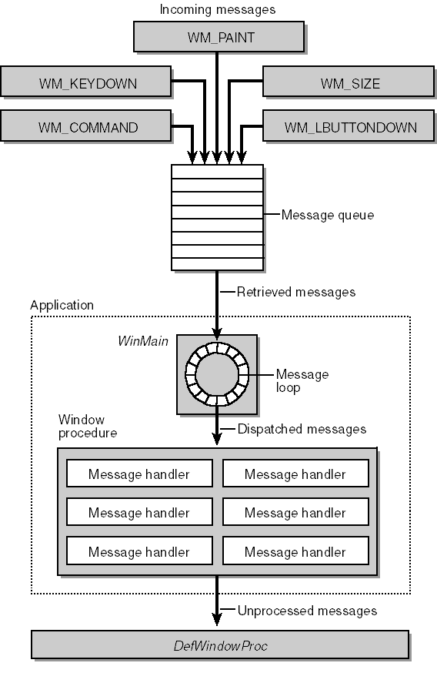
(d) Chapter 4: Windows program

Slide 35
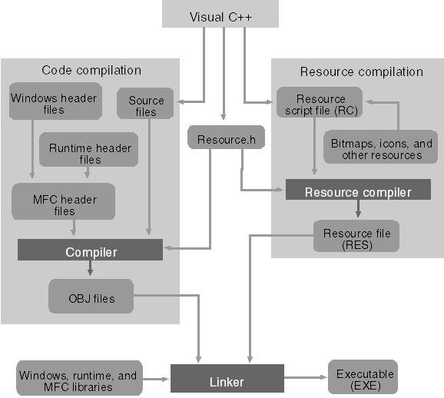
(d) Chapter 4: MFC program

Slide 36
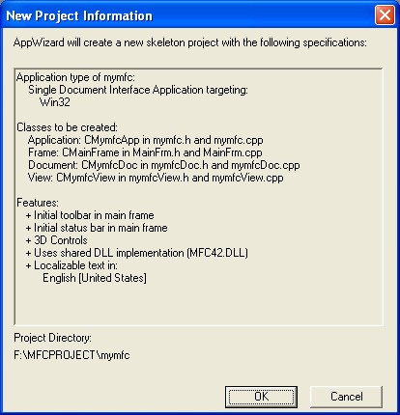
(d) Chapter 4: MFC program

Slide 37
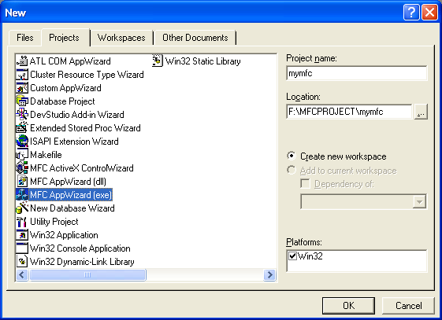
(d) Chapter 4: MFC program

Slide 38
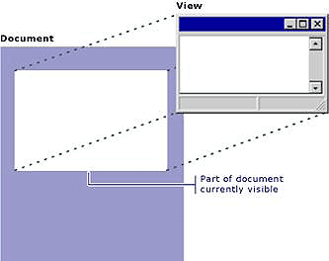
(d) Chapter 4: MFC program
The document/view implementation in the class library separates the data itself from its display and from user operations on the data. All changes to the data are managed through the document class.

Slide 39
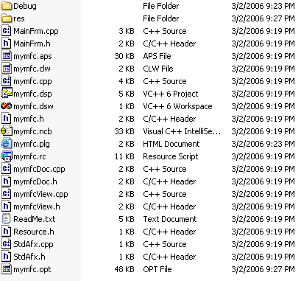
(d) Chapter 4: MFC program

Slide 40
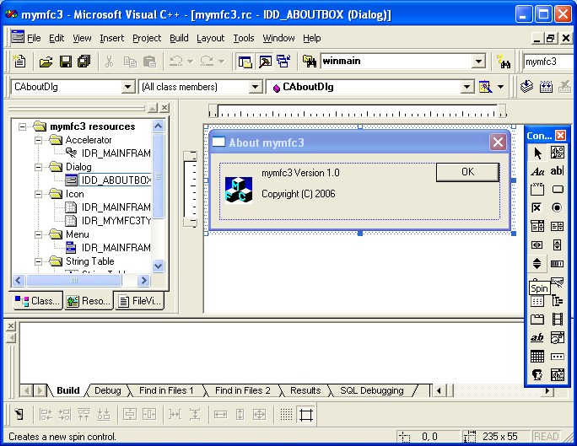
(d) Chapter 4: MFC program

Slide 41
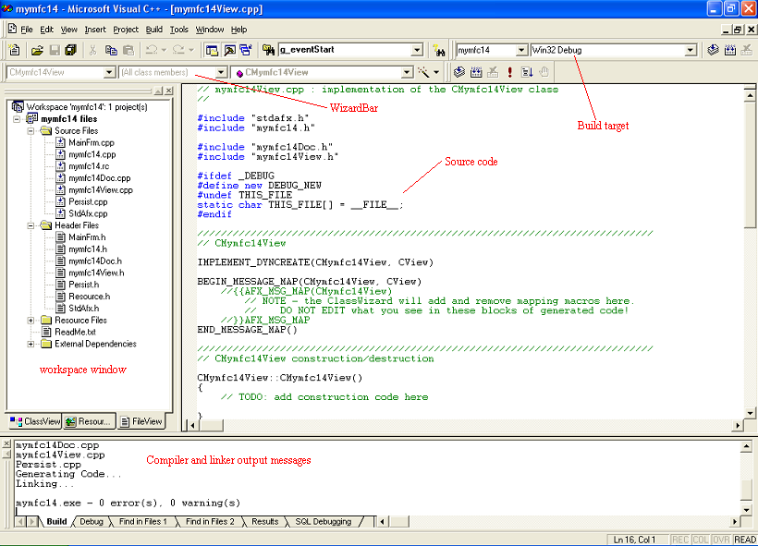
(d) Chapter 4: MFC program

Slide 42
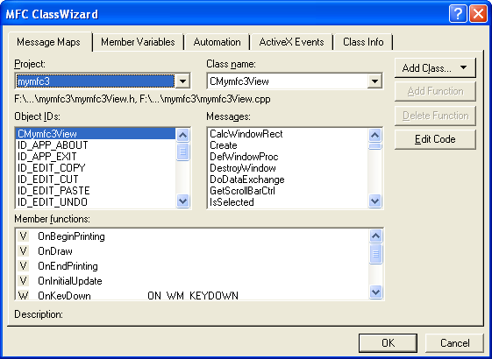
(d) Chapter 4: MFC program

Slide 43
(e) Chapter 4: MFC functions = MFC 函数
4.2 Adding a dialog application
4.2.1 – using the resource view, resource identifiers and types. (ID_, IDR_, IDD_, IDC_, IDI_)
4.2.2 – Adding a dialog resource, resource types using Visual Studio
4.2.3 – Dialog properties.
4.2.4 – Adding layout controls and control types. –Adding a static box
4.2.5 – Creating a new dialog class by adding a derived class of CDialog.
4.2.6 – OnInitDialog( ) – function description, adding some code to OnInitDialog( ) function.
OnInitDialog() is the result of WM_INITDIALOG windows message call. It is used to partially initialize a dialog box.

Slide 44
(e) Chapter 4: MFC functions = MFC 函数
4.2.7 – Using a dialog box, adding a modal dialog.
Application example: Adding a tab to the mainframe (IDR_MAINFRAME) resource view.
Adding a member function to the CMainFrame class. This class contains the frame bar in the document view. Adding a member function that responds to the windows COMMAND message to ID_TEST_DLG will allow the user to click and open a dialog. The function will be named CMainFrame::OnTestDlg().

Slide 45
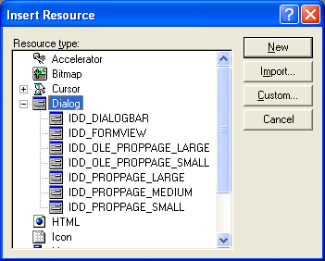
(e) Chapter 4: MFC functions = MFC 函数

Slide 46
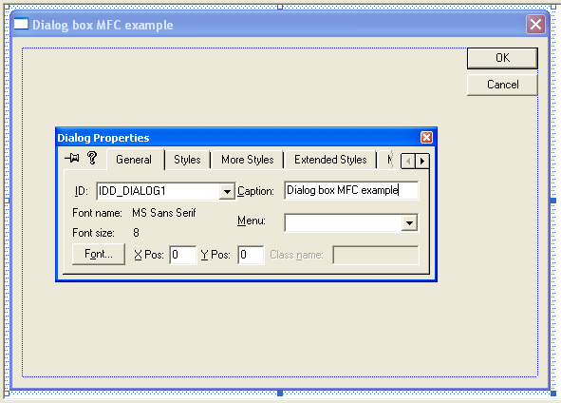
(e) Chapter 4: MFC functions = MFC 函数

Slide 47
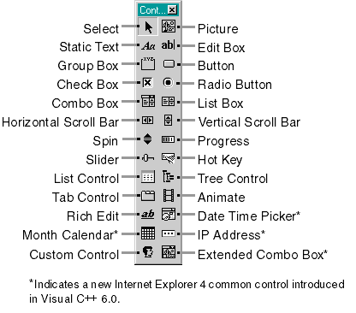
(e) Chapter 4: MFC functions = MFC 函数

Slide 48
Document/View example
Write in OnLButtonDown:
startpt.x = point.x;
startpt.y = point.y;
Write in OnMouseMove:
CClientDC dc(this);
endpt.x = point.x;
endpt.y = point.y;
if (startpt.x != -1)
{
dc.MoveTo(startpt.x, startpt.y);
dc.LineTo(endpt.x, endpt.y);
startpt.x = endpt.x;
startpt.y = endpt.y;
}
Write in OnLButtonUp:
startpt = -1;

Slide 49
(f) Chapter 4/5: MFC functions = MFC 函数
4.3 – Using AppWizard to create a basic dialog application
4.4 – Using a modeless dialog, replacing a modal dialog with a modeless dialog.
Adding a derived class from CDialog.
Using DestroyWindow() function to delete the modeless dialog. Modeless dialogs should be deleted using the DestroyWindow() function because we are creating a new object.
4.5 The Dialog box and the message box description
4.5.1 Description of CFileDialog and some other types of dialogs
Using CFileDialog derived from base class CCommonDialog.
Adding CFileDialog as a replacement for the modeless dialog.
4.5.2 – MessageBox description
MessageBox() – derived from base class CWnd.
AfxmessageBox() – from AFXAPI(afxwin.h) available regardless of parent class.

Slide 50
(f) Chapter 5: MFC functions = MFC 函数
5.1 – Creating controls
5.1.2 – Control messaging and mapping – how MFC maps Windows based messages.
Message handler functions and declaration of Message Map macros.
5.1.3 – DDV (data validation), DDX (data exchange) – initialization and validation of data in your application. Functions introduction: UpdateData(), SetWindowText()
Data member variables are initialized in the constructor class of the dialog class.
Moving data to and from controls in your application using DDX.
UpdateData() – initialize data in a dialog box / retrieve or validate data.
SetWindowText() – set text in specified window.
5.2 – Static controls and buttons (CStatic, CButton).
Button types – general buttons, radio buttons, check buttons. How to implement radio buttons, check buttons.

Slide 51
(f) Chapter 5: MFC functions = MFC 函数
Button types – general buttons, radio buttons, check buttons. How to implement radio buttons, check buttons.
5.3 – CEdit control (edit box control)
5.3.3 – Spin Button control – using spin button to link with edit box control, using the SetRange( ) function, using Auto Buddy.
5.3.4 – Example of a spin button control application.
Setting range, printout float variables.

Slide 52
(f) Chapter 5: MFC functions = MFC 函数
5.4 – List box control: CListBox base class – properties and messages.
5.4.2 – Using a list box controls and related functions: CListBox functions – AddString(), InsertString(), SetItemData(), SetItemDataPtr( ), GetItemData(), GetCurSel(), GetText().
5.4.3 – List box and edit box control example: City and Zip code application – adding cities and zip codes to list box.
Using UpdateData(), AddString(), FindStringExact(), GetText().
5.5 – Combo box control – CComboBox – a list box with edit controls attached.
5.5.3 – Application example – read files in a directory. Functions used: AddString(), ResetContent(), GetCurSel(), GetLBText(), Dir().

Slide 53
(f) Chapter 5: MFC functions = MFC 函数
5.6 – Progress bar controls
(CProgressCtrl – base class) and sliders – example adding a progress bar.
5.6.1 - Application of progress bar using functions: SetRange(), SetStep(), SetPos(), StepIt()
5.6.2 – Scroll bar – WM_HSCROLL – message sent to a window when a scroll event occurs in horizontal scroll bar.
5.6.3 – Sliders – CSliderCtrl base class
5.6.4 – Example application: Adjusting background color with slider and scroll bars. Functions used include: UpdateData(), SetScroll(), SetRange(), Invalidate(), WM_CTLCOLOR

Slide 54
(f) MFC functions = MFC 函数
6.1 Frame Windows – about the App, Document, View, MainFrame classes.
CWinApp is the central class derived from your application. There are also other classes such as CWinThread, CCmdTarget, CDocument, CView that make up your application framework.
6.1.2 – InitInstance() is called during the construction of CWinApp and all serious initialization occurs here.
The main window is initialized along with other standard load options and .ini files.
The PreCreateWindow() function defines initialization parameters passed to the window procedure of the application.
6.1.4: The SetWindowPos() changes the size, position of the pop-up and top windows.
6.2 Menus – the function LoadMenu() will load a new menu given the menu RESOURCE_ID.

Slide 55
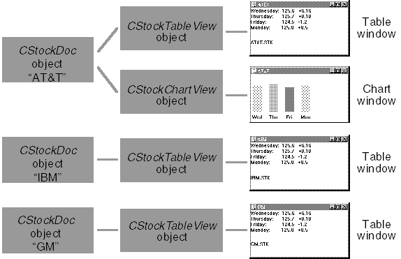
(f) MFC functions = MFC 函数
Document/View

