Slide 1
C sharp C# programming
编程
Introduction

Slide 2
Visual Studio
.NET framework .NET 框架
Includes many languages: Visual C#, Visual F#, Visual Basic, Sharepoint, Crystal Reports, Visual C++
Visual Studio包括多种程序语言

Slide 3
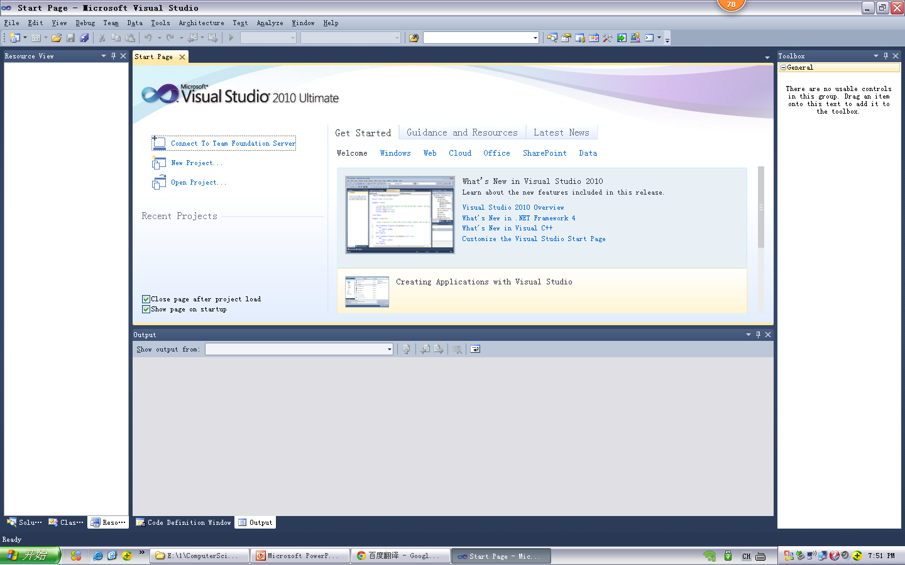
Visual Studio

Slide 4
Visual Studio C#
Console application, programming basics

Slide 5
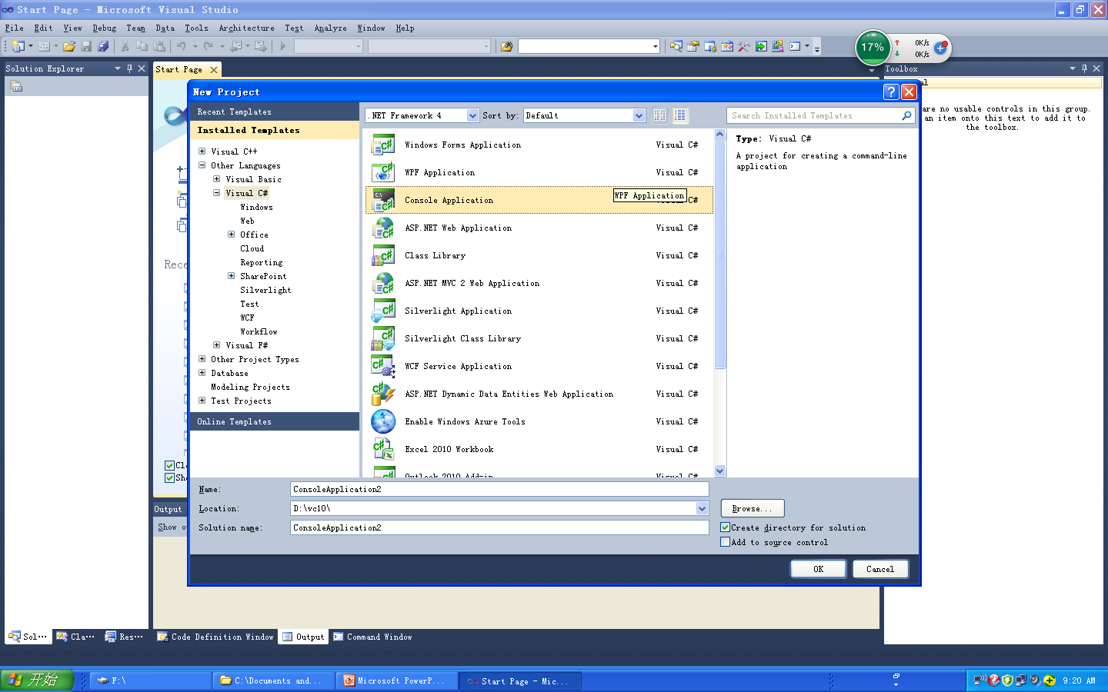
Visual Studio C#

Slide 6
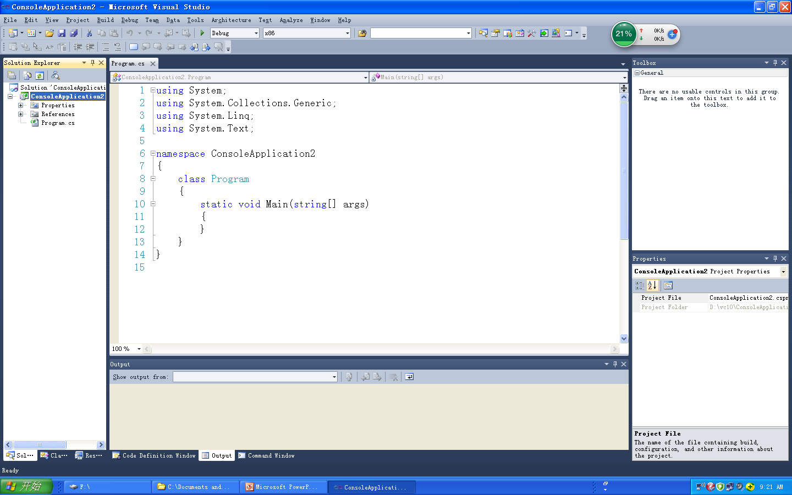
Visual Studio C# console

Slide 7
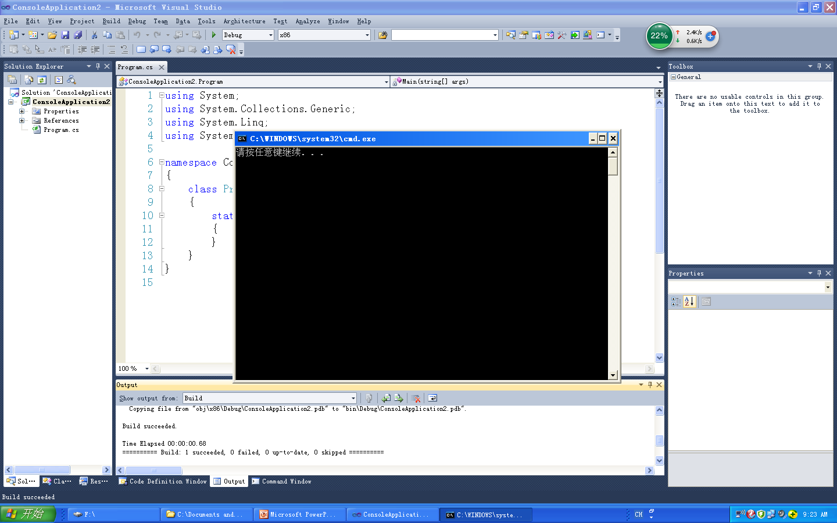
Visual Studio console

Slide 8
Visual Studio C# forms
Some visual forms, GUI interfaces.

Slide 9
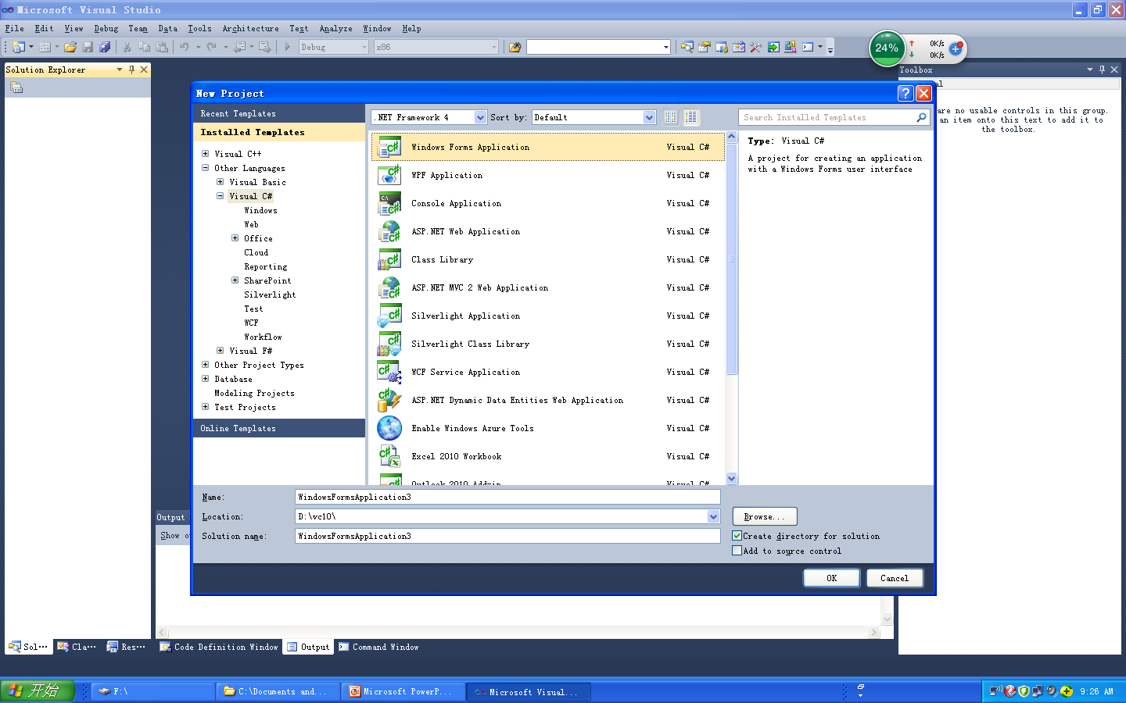
Visual Studio C# form

Slide 10
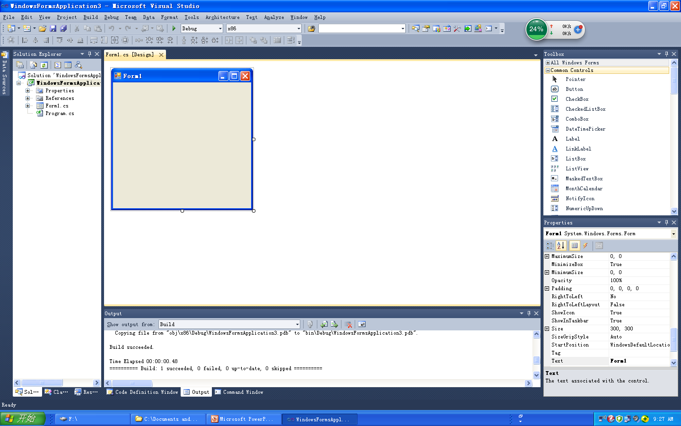
Visual Studio C# forms

Slide 11
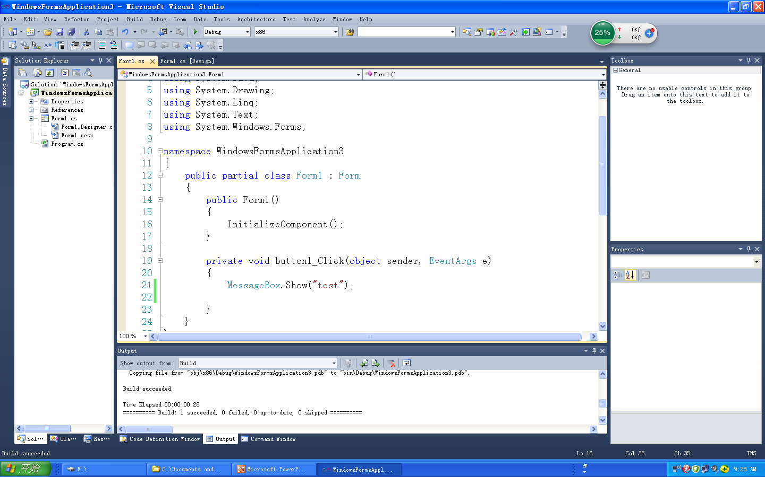
Visual Studio C# forms

Slide 12
Visual Studio C#
Web pages , forms

Slide 13
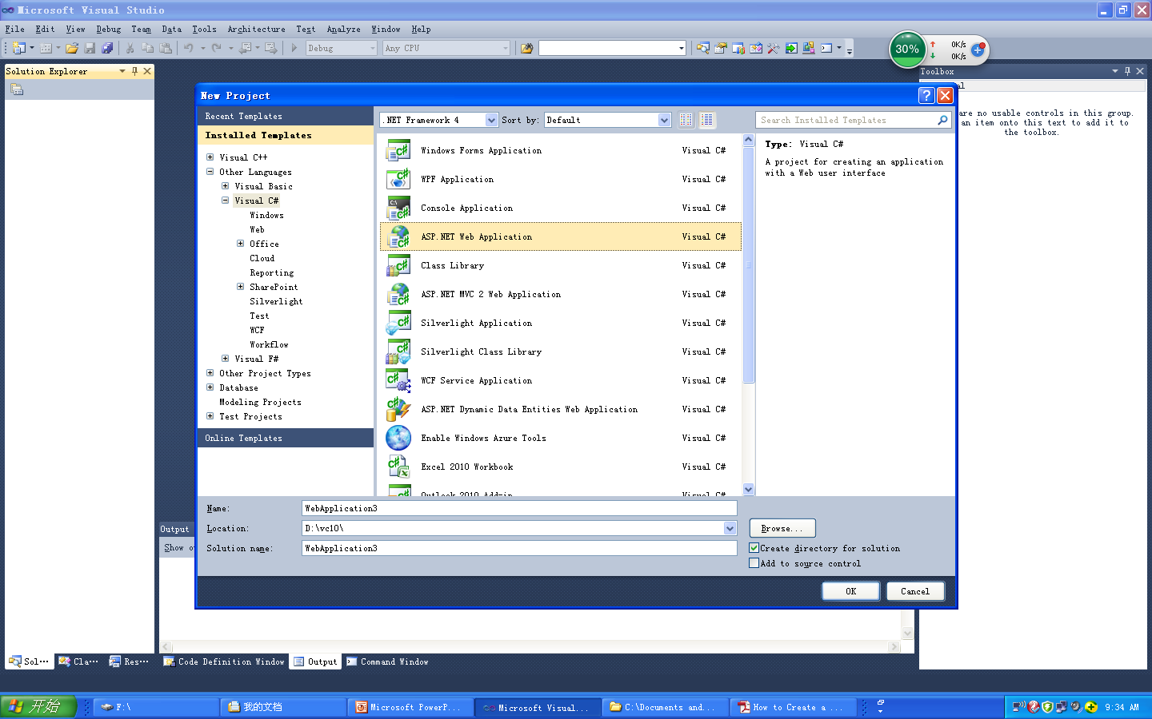
Visual Studio C# asp

Slide 14
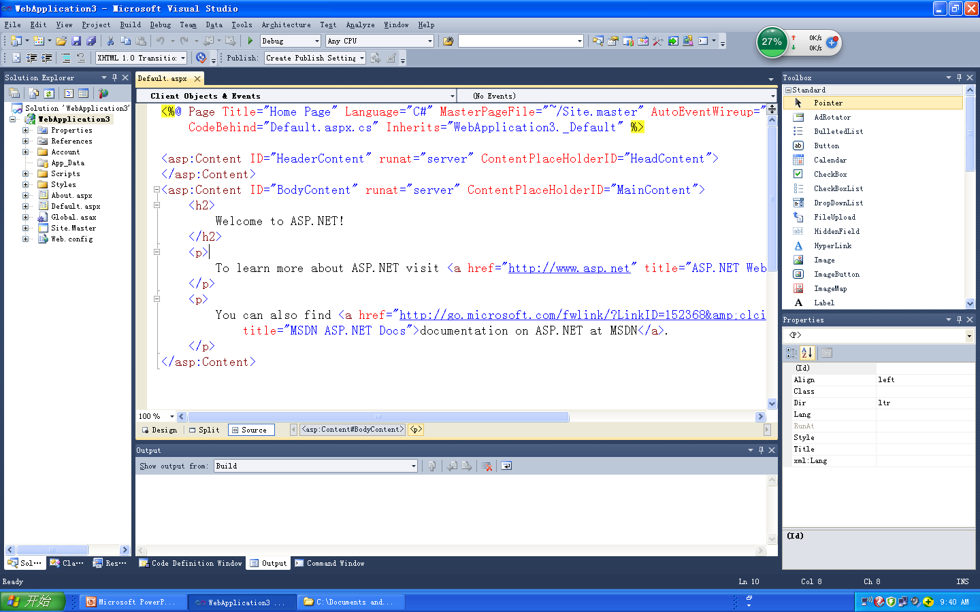
Visual Studio C# asp

Slide 15
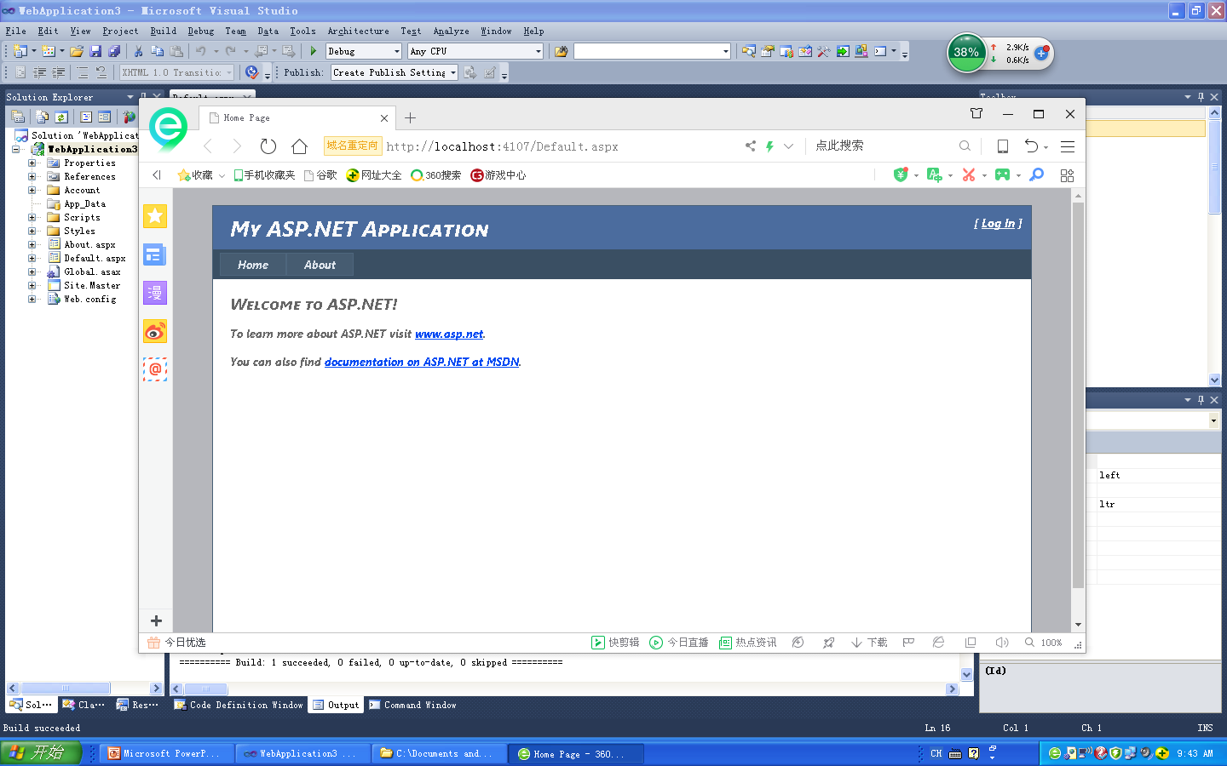
Visual Studio C# asp

Slide 16
Visual Studio C# - Console syntax

Slide 17
Visual Studio C# - syntax
DataTypes
int, float, double, char, String or string
Loops:
For, foreach, while
Input, output:
Console.WriteLine, Console.Write
Console.Read(), Console.ReadLine()

Slide 18
Visual Studio C# - ReadLine
DataTypes
Console.Read(), Console.ReadLine() using string only. For int or float must use
int.Parse(), float.Parse();
Ex:
float a = float.Parse(Console.ReadLine());
int b = int.Parse(Console.ReadLine());

Slide 19
Visual Studio C# - Parse
To check if int or float:
Use int.TryParse();
Ex.
string myage;
int age;
If (!int.TryParse(myage, out age)) {
Console.WriteLine(“only number allowed”);
}

Slide 21
Visual Studio C# - syntax
Struct, class
struct STUDENT{
string name;
int age;
string major
};

Slide 22
Visual Studio C# - syntax
Class:
class STUDENT {
public STUDENT ( ) { }
public string name;
public int age;
public string major;
}

Slide 23
Visual Studio C# - syntax
Main program:
static void Main(string[] args) {
// main driver code
}

Slide 24
Visual Studio C# - syntax
Function or method in class: (functions must be written in class, class must be called)
class mytest {
  public void test( ) {
  //contents
  }
}

Slide 25
Visual Studio C# - syntax
Namespace (project name, using to organize classes, define class scope, a namespace can have more than one class):
Example:
using System;
namespace {
// main program code
}

Slide 26
Visual Studio C# - operators
DataTypes:
int, float can use:
int a = 5;
a++;
++a;
a += 1;
a += 2;
a = a + 2;
Or use in Console.WriteLine();
Example:
Console.WriteLine(“{0} “, a++);
Console.WriteLine(“{0} “, ++a);
Console.WriteLine(“{0} “, a = a+3);

Slide 27
Visual Studio C# - string syntax
String, string – both derived from System.string
String aa = “abc”; //same
string aa = “abc”; //same
string.compare( )
string.replace( )
string.insert( );
string.concat( );
String.remove(0,2);
string.equals();

Slide 28
Visual Studio C# - example program
using System;
namespace exampleProject {
class Program
{
static void Main(string[] args)
{
// main program code
int a; string name;
Console.WriteLine("Enter age: ");
a = int.Parse(Console.ReadLine());
Console.WriteLine("Your age is: {0}", a);
Console.WriteLine("Enter name: ");
name = Console.ReadLine();
Console.WriteLine(“Your name is: {0}”,name);
}
}
}

Slide 29
Visual Studio C# - calling function
Calling a class must use “new”:
Ex: class Program {
public void test () {
Console.WriteLine(“test”);
}
}
To use: Program pp = new Program();
pp.test();

Slide 30
C sharp syntax – ArrayList, Lis
ArrayList ar = new ArrayList();
List <type> rr = new List<type>();
ar.Add();
ar.Insert(0, ar);
ar.Remove();
ar.Reverse();
ar.Sort();
ar.Clear();

