Slide 1
C++ programming
Inheritance
Introduction

Slide 2
What is inheritance?
Inheritance in C++ is a powerful feature. It allows code reusability and the ability to reuse features in the code that have already been written.
The basic concept of inheritance in C++ is the usage of the base class and derived class features.

Slide 3
How do we use inheritance?
Inheritance in C++ is implimented using
base class and derived classes.
What is a base class?
A Base Class in C++ is a user defined
datatype that is written as a generic
class which also allows the user to
expand or add functionality.

Slide 4
Types of inheritance
1. Single inheritance: a class will be derived from a single base class.
We will be concentrating on single inheritance.
2. Multiple inheritance: a class will be derived from a number of base classes.
We will touch on this briefly.

Slide 5
Base Class example
class Animal {
public:
Animal() { }
void move() {
cout << “The animal is moving” << endl;
}
private:
};
This base class has 1 public method and nothing in
the private section yet. Although we can add variables in the private section if we want.

Slide 6
Derived class
A derived class is another class that can
inherit the base class's public methods.
Base Class
Derived Class
Derived Class
Derived Class
There can be multiple derived classes that inherit a common base class.

Slide 7
Derived classes example
Animal
Cat
Dog
Horse
class Cat : public Animal {
public:
Cat() { }
};
We now declare a derived class named Cat that inherits the methods of the previous base class Animal.
This is the principle of inheritance.

Slide 8
Inheritance in action
Now lets see inheritance in action with a base class and a derived class:
int main() {
Animal a;
a.move(); // here we call the base class method
Cat c;
c.move(); //here we are able to call the method of
// the base class even though we don't
// declare it in the Cat class, this is the
// principle of inheritance
}

Slide 9
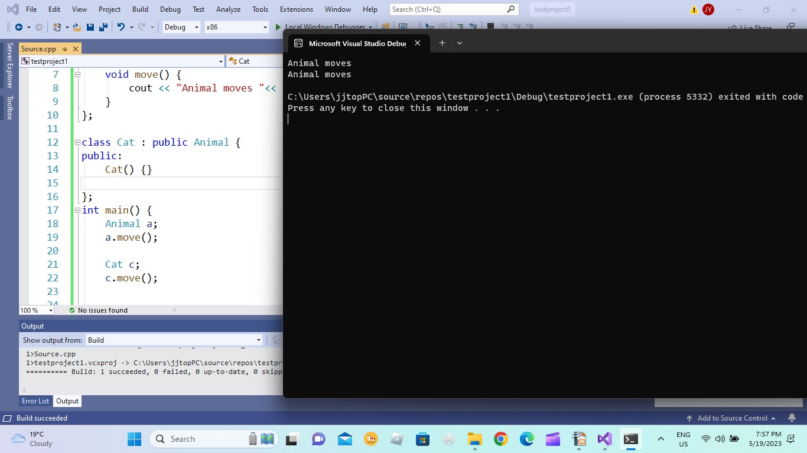
Inheritance in action
The result here shows that the derived class Cat is able to call the base class Animals method (called move()) in this case because the method is declared a public method. Therefore the derived class “inherits” the base classes public methods.

Slide 10
Derived class inheritance
We can also have a number of derived classes that inherit a single base class.
class Dog : public Animal {
public:
Dog() { }
void makesound() { cout << “Woof!” << endl; }
private:
};
The Dog derived class also inherits the Animal base class. The Dog class can call the move() method as well as utilize it's makesound() method.
We can call the Dog class like this:
Dog d;
d.move();
d.makesound();

Slide 11
Ways in C++ of calling base and derived classes.
Calling base and derived classes can be called via a simple declaration of the class through an normal object declaration or via a pointer call to declare the object.
We normally instantiate an object in the main function of the program. It is instantiated by declaring an object of the class like this:
int main () {
Base1 b; // declare an object b of class Base1
b.method(); //call the method of object b
Derived1 d //declare an object d of derived class Derived1
d.method() // call the method of object d (could be a method belonging // to base class)
Base1 *b1 = new Base1(); //declare a pointer to an object and allocate //enough memory for the class
b1->method(); //call the method through the pointer
}

Slide 12
Multiple inheritance
Although more complex, we can also have a derived class inherit from more than one base class. This is called multiple inheritance. This although powerful in some cases, could also cause ambiguity problems and confusion in other cases.
class Base1 {
public:
void test1() { cout << “test base1” << endl; }
};
class Base2 {
public:
void test2() { cout << “test base2” << endl; }
};
class Derived1 : public Base1, public Base2 {
public:
Derived1() { }
};

Slide 13
Multiple inheritance
Looks as follows:
Base1
Base2
Derived1
Here the derived class (Derived1) inherits from both base classes (Base1 and Base2)

Slide 14
Multiple inheritance – calling the object
When calling multiple base classes, there is not a big difference syntactically in C++ as in declaring the object when using single inheritance.
Inside the main() function we call the same way:
int main () {
Base1 b1; //create a Base1 object
Base2 b2; //create a Base2 object
Derived1 d1; //create Derived1 object
d1.test1(); //derived class uses Base1 method
d1.test2(); //derived class uses Base2 method
}

Slide 15
What cannot be inherited?
What cannot be inherited from a base class?
1. Constructors and Destructors
2. Private variables and methods.
1. Constructors and Destructors although declared in the public section of a class, cannot be inherited by a derived class. However derived class constructors and destructors can call base class constructors and destructors or base class methods.
2. Private variables and methods are not inherited though derived classes and are only visible in the base class.

Slide 16
What cannot be inherited continued
We cannot or do not inherit constructors or destructors for a number of reasons:
1. The derived class may need to complete further actions such as initializing more variables that the base class does not need to do.
2. The parameters of the derived class may be different than the base class.
3. The derived class will always call the base class constructor implicitly to initialize the derived class's base class members.

Slide 17
What is not inherited continued
Example:
class base {
public:
base(int i=0, string name=”none”) {
//do something
}
private:
int avar;
};
class derived : public base {
public:
derived(int i=0, string name1=”none”, string name2=”none”) {
//we can call a base class method here
}
};

Slide 18
Private variables cannot be inherited
Private variables in base classes also cannot be inherited for a number of reasons:
1. These variables are by default private and should only be used in that particular class and not viewed outside that class. This is the concept on encapsulation.
2. Some of the private variables are only suitable for usage in that particular class and would case confusion if made available to other classes.

Slide 19
Main advantages of inheritance
Inheritance is used in most object oriented languages and C++ is no exception. The main advantages include software reusability and the ability to reuse methods and functions without needing to rewrite specific code.
A base class can provide a common general purpose template or functionality and the derived classes can expand on that functionality and tailor it to be more specific to it's needs. Hence the power of inheritance and reusability.
A derived class will usually have more functionality than it's base class and be able to expand and generally becomes more specific than it's base class.

Slide 20
Other points to note
1. We can assign or create a base class object with another base class object.
2. We can assign or create a derived class object with another derived class object.
3. We can assign or create a derived class object with a base class object since a derived class object is also an object of its base class.
4. We cannot assign or create a base class object with a derived class object because the derived class object would have features that are not available to the base class.

Slide 21
Example:
1. Animal *a = new Animal(); // a valid assignment new base class //object
2. Dog *d = new Dog(); //a valid assignment, new derived class //object
3. Animal *dd = new Dog(); // a valid assignment a new derived class //object assigned to a base class
4. Dog *ddd = new Animal(); // invalid assignment, base class object // cannot be assigned to a derived class

Slide 22
Summary
Inheritance is a powerful concept used in object oriented programming and particularly in C++.
The ability to reuse code and methods inside a class is key to achieving software reusability.
A derived class is usually more specific and provides more features than its base class as the base class is more generic.
A derived class object can be assigned to a base class but not vice versa since all derived classes spawn from the base class.

