Slide 1
R – Programming Introduction
Spring 2025

Slide 2
Sections
Before textbook:
Part A: Introduction to R, R-Studio, R basics
Part B: Basic coding in R
Part C: Data Visualization in R
After textbook:
Chp 1, 2 – ggplot() usage
Chp 3 – Data Transformation
Chp 7 – Data Import
Chp 9 – Data Visualization more ggplot()

Slide 3
Part A
Introduction to R, R-Studio and R Basics

Slide 4
What is R?
R is a data centric programming language.
R is useful for finding out more information on datasets.
R is used mainly for statistical analysis and data visualization
R-studio is a software tool for programming in R.
There are many libraries and datasets for data analytics built-in with the R-studio.

Slide 5
Advantages of R
1. R is very useful to use on large datasets.
2. R has many built-in features for statistical analysis and data visualization.
3. R is open-source and freely able to download and install software

Slide 6
Getting R-Studio
Download the R-studio development environment at:
https://posit.co/products/open-source/rstudio
2. Download the free version of R – studio here for your own copy:

Slide 7
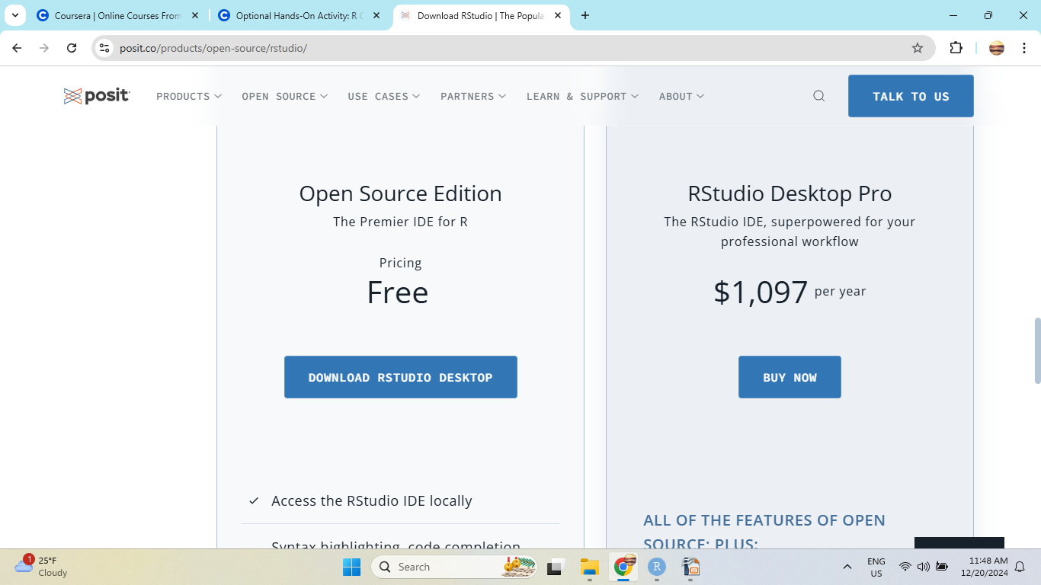
Getting R-Studio

Slide 8
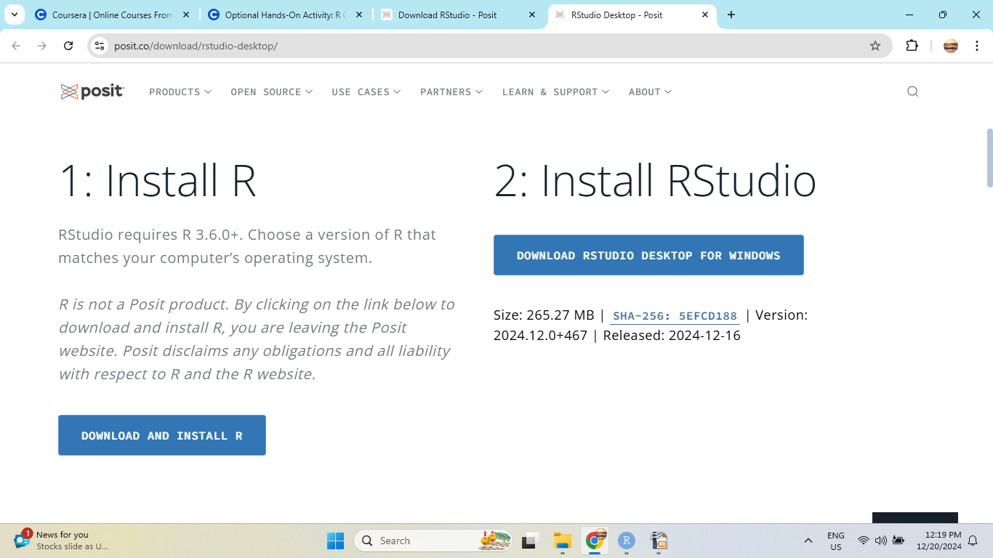
Getting R-Studio

Slide 9
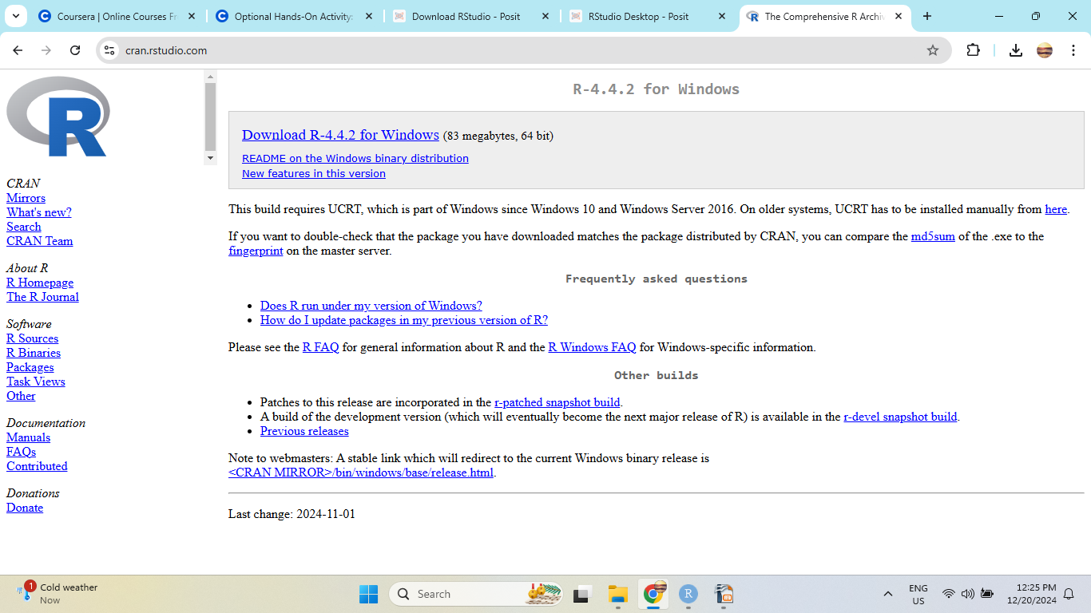
Install R

Slide 10
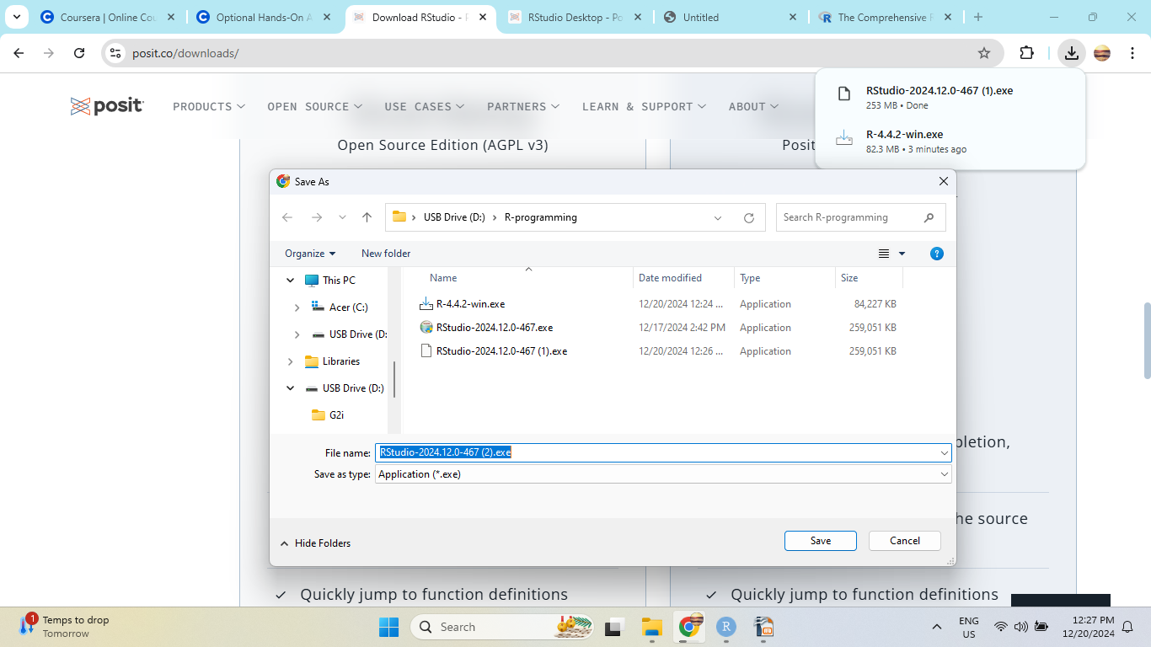
Install R-Studio

Slide 11
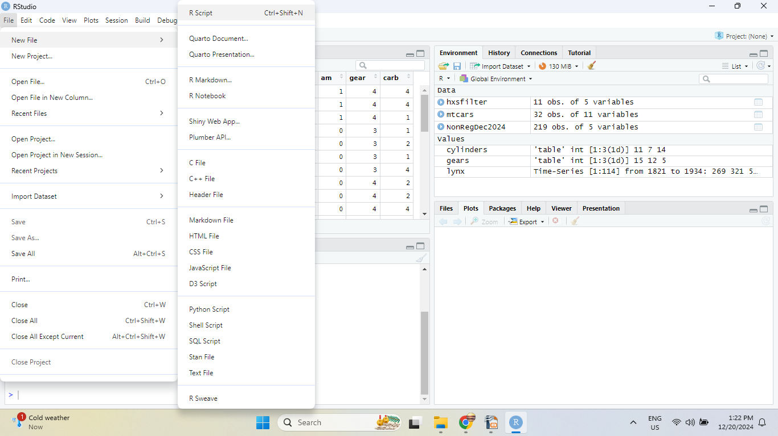
R – Studio tool

Slide 12
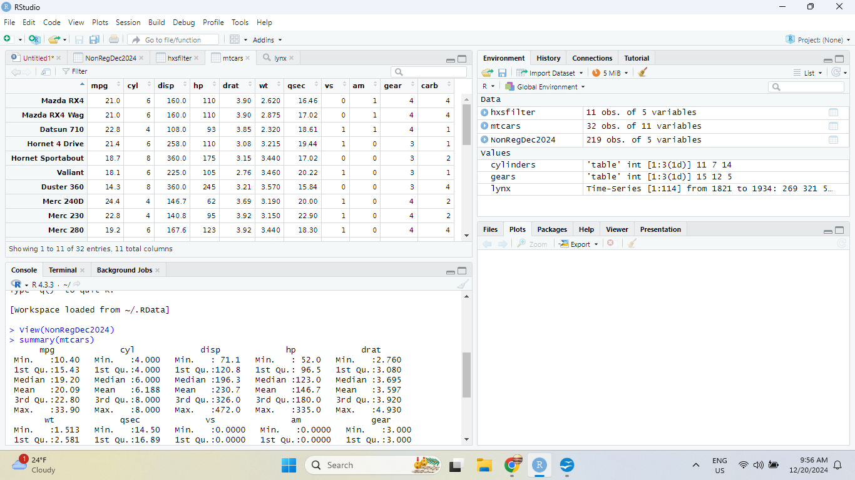
R – Studio Tool

Slide 13
R-Studio setup
First we must install some packages for the environment to run correctly:
>install.packages(“tidyverse”) # for usage of graphing, data analytics
>install.packages(“palmerpenguins”) #for dataset testing
>install.packages(“ggthemes”) #additional package for graphing
>install.packages(“tidymodels”) #additional package for graphing
>install.packages(“openxlsx”) #additional package for xlsx files

Slide 14
R Types and Basics
1. Functions – reusable code to perform certain tasks
2. Comments – Information written in a program not to be executed, describes information about the code.
3. Variables – Representation of values that can be used later in a program.
4. Data Types – Different types of data available to R for programming use. Includes string/character, floats/numeric, integers, logical, complex
5. Data Structures – Vectors / Lists – Group of data elements of the same type stored in a sequence in R. Matrices – 2 dimensional datasets with row and columns. Data Frames – Dictionary like datasets, foundations of csv files.
6. Pipes – Tool in R for expressing a sequence of multiple operations. Written like “%>%”

Slide 15
Part B
Basic Coding in R
Functions, Variables, Coding, Vectors, Lists, Matrices,
Data Frames

Slide 16
Examples of Functions in R
>print(“This is a test”)
>?print #this will give you more information about the function
>plot(1:10)
>?plot

Slide 17
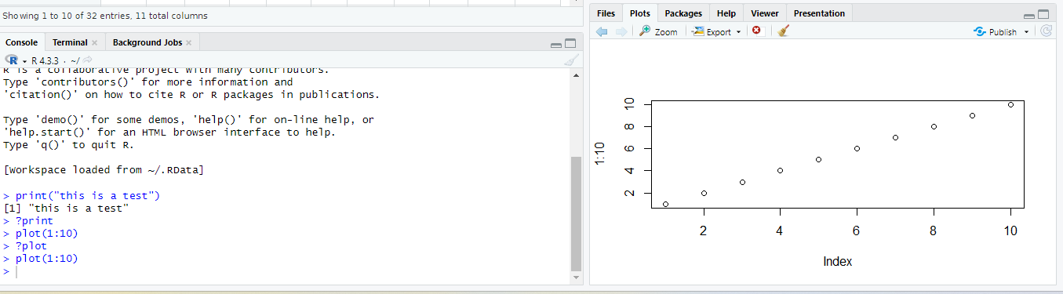
Examples of Functions in R
Using plot in R-Studio:

Slide 18
Examples of variables in R
> first_variable < - “This is a variable”
>second_variable < - 12.6
> i < - 1
Simple coding in R:
i <- 1
while (i < 6) {
print(i)
i <- i + 1
}

Slide 19
Examples of coding in R:
In R script write the following code:
i <- 1
while (i < 6) {
print(i)
i <- i + 1
if (i == 4) {
break
}
}
What is the output?

Slide 20
Example of creating a function in R
my_function <- function(x) {
return (5 * x)
}
print(my_function(3))
print(my_function(5))
print(my_function(9))
The output will be:
[1] 15
[1] 25
[1] 45

Slide 21
Examples of vectors in R
> c(x, y, z)
Example:
> vec1 < - c(2.1, 3.5, 56.7, 77.3, 5)
>vec1
[1] 2.1 3.5 56.7 77.3 5.0
> num1 <- 1.5:6.5
> num1
[1] 1.5 2.5 3.5 4.5 5.5 6.5

Slide 22
Examples of vectors in R
>numbers2 <- 1.5:6.3
>numbers2
[1] 1.5 2.5 3.5 4.5 5.5

Slide 23
Examples of lists in R
# List of strings
mylist <- list("apple", "banana", "cherry")
# Print the list
mylist

Slide 24
Example of a matrix in R
>mymatrix <- matrix(c(1,2,3,4,5,6), nrow = 3, ncol = 2)
# Print the matrix
>mymatrix
[,1] [,2]
[1,] 1 4
[2,] 2 5
[3,] 3 6

Slide 25
Example of Data Frames in R
Data_F <- data.frame (
Types = c("Able", "Bee", "Clis"),
Pulse = c(100, 150, 120),
Timing = c(60, 30, 45)
)
# Print the data frame
>Data_F
Types Pulse Timing
1 Able 100 60
2 Bee 150 30
3 Clis 120 45

Slide 26
Part C
Data Visualization in R
1. Creating Line Charts, Bar Charts, Scatterplots, Pie Charts, Histograms
2. Using datasets to graph charts.

Slide 27
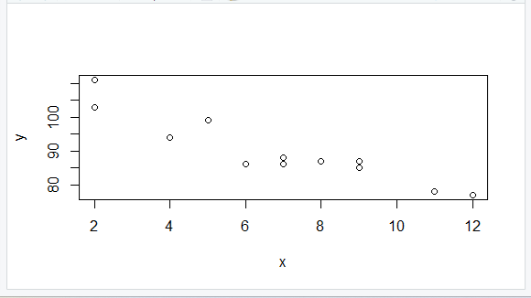
R - Scatterplot
In R-script, enter the following:
x <- c(5,7,8,7,2,2,9,4,11,12,9,6)
y <- c(99,86,87,88,111,103,87,94,78,77,85,86)
plot(x, y)
The result should show:

Slide 28
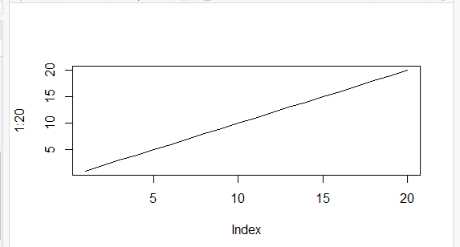
R – Line Charts
>plot(1:20, type="l") # “l” is for line graph
The results would show

Slide 29
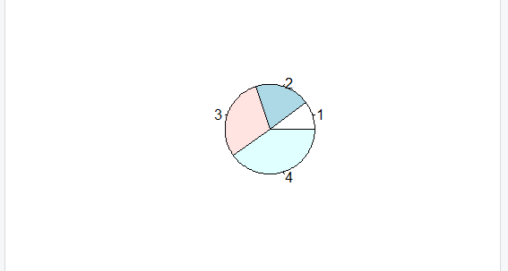
R – Pie charts
# Create a vector of pies
x <- c(10,20,30,40)
# Display the pie chart
pie(x)

Slide 30
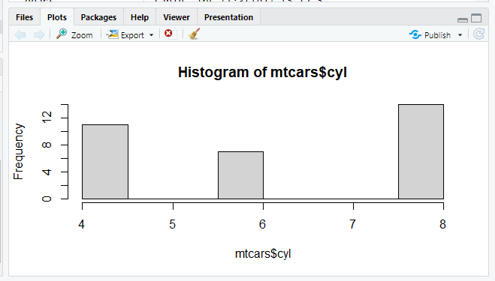
R-Histograms
> hist(mtcars$cyl) #mtcars is a dataset we will discuss later

Slide 31
Datasets in R
What is a dataset?
A dataset is a collection of data. In tabular structured data it corresponds to rows and columns of data.
R uses datasets by reading them in to Data frames, data tables and tibbles.
Conceptually they are similar and we will use all three as examples.

Slide 32
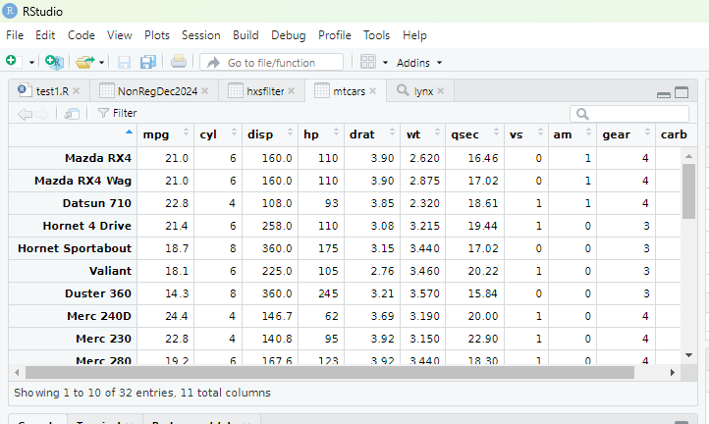
Datasets in R
Here is an example of a built in dataset in R:
>View(mtcars)

Slide 33
Datasets in R
1. Loading a dataset:
>library(datasets) #shows preloaded datasets from the datasets package
>data() #displays all available datasets in the datasets package
>data(mtcars) #loads a particular dataset named “mtcars” into R session
2. Getting information about a dataset:
>summary(mtcars) #gets statistics about the dataset
3. Check the dataset:
>head(mtcars) #gets top 6 rows of dataset

Slide 34
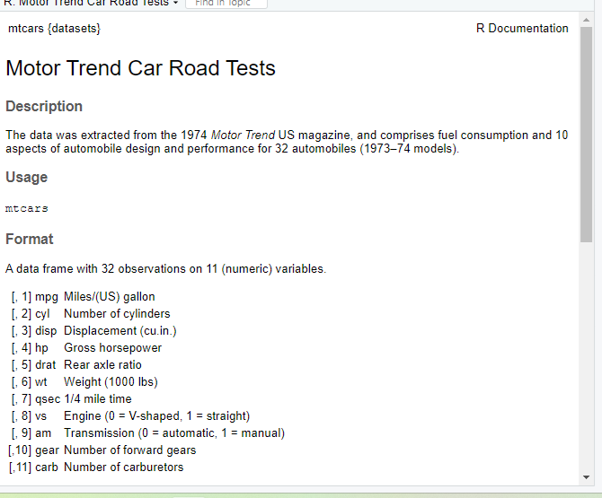
Datasets in R
First we should get some information about the dataset:
>mtcars? #this will get some basic information on the dataset

Slide 35
Datasets in R
Particularly we pay attention to the last section:
Format
A data frame with 32 observations on 11 (numeric) variables.
[, 1] mpg Miles/(US) gallon
[, 2] cyl Number of cylinders
[, 3] disp Displacement (cu.in.)
[, 4] hp Gross horsepower
[, 5] drat Rear axle ratio
[, 6] wt Weight (1000 lbs)
[, 7] qsec 1/4 mile time
[, 8] vs Engine (0 = V-shaped, 1 = straight)
[, 9] am Transmission (0 = automatic, 1 = manual)
[,10] gear Number of forward gears
[,11] carb Number of carburetors

Slide 36
Datasets in R
>summary(mtcars)
mpg cyl disp hp drat
Min. :10.40 Min. :4.000 Min. : 71.1 Min. : 52.0 Min. :2.760
1st Qu.:15.43 1st Qu.:4.000 1st Qu.:120.8 1st Qu.: 96.5 1st Qu.:3.080
Median :19.20 Median :6.000 Median :196.3 Median :123.0 Median :3.695
Mean :20.09 Mean :6.188 Mean :230.7 Mean :146.7 Mean :3.597
3rd Qu.:22.80 3rd Qu.:8.000 3rd Qu.:326.0 3rd Qu.:180.0 3rd Qu.:3.920
Max. :33.90 Max. :8.000 Max. :472.0 Max. :335.0 Max. :4.930
Statistics include:
Minimum, Maximum, Median, Mean, 1st Quartile, 3rd Quartile

Slide 37
Datasets in R
Peeking into the dataset:
>head(mtcars)
mpg cyl disp hp drat wt qsec vs am gear carb
Mazda RX4 21.0 6 160 110 3.90 2.620 16.46 0 1 4 4
Mazda RX4 Wag 21.0 6 160 110 3.90 2.875 17.02 0 1 4 4
Datsun 710 22.8 4 108 93 3.85 2.320 18.61 1 1 4 1
Hornet 4 Drive 21.4 6 258 110 3.08 3.215 19.44 1 0 3 1
Hornet Sportabout 18.7 8 360 175 3.15 3.440 17.02 0 0 3 2
Valiant 18.1 6 225 105 2.76 3.460 20.22 1 0 3 1
Here we see the top 6 rows

Slide 38
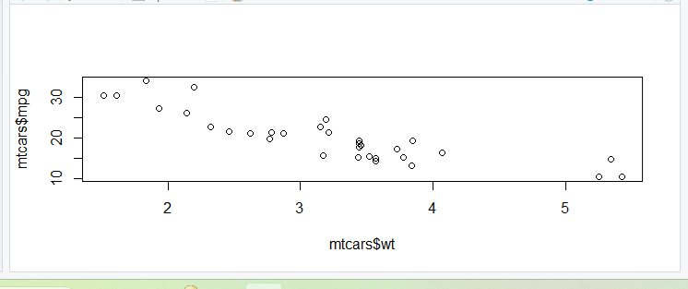
Datasets in R
Digging into the dataset.
1. Find some correlations in the data:
Ex. Mpg (miles per gallon) vs wt (weight)
Lets create a plot chart and check:
>plot(mtcars$wt, mtcars$mpg)

Slide 39
Datasets in R
We will now use some options available in plot():
>plot(mtcars$wt, mtcars$mpg,
Pch=19, #solid circle
Cex = 1.5, #make 150% size
Col='#cc0000', #red
Main = “Correlation of mpg vs weight”,
Xlab = “Weight”,
ylab=”mpg”)

Slide 40
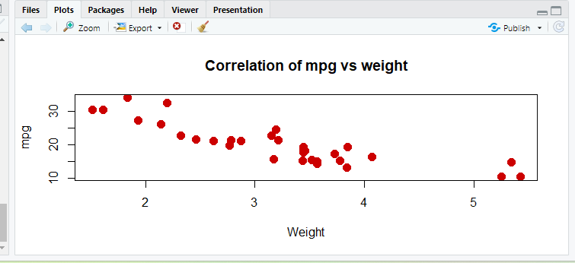
Datasets in R
Result is:

Slide 41
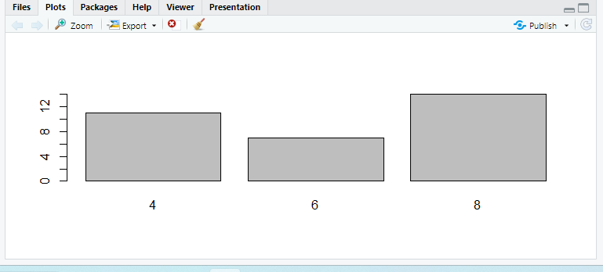
Creating visuals
We will create a barplot with the existing dataset:
>cylinders < - table(mtcars$cyl)
>barplot(cylinders)

Slide 42
R for Data Science – Import, Tidy, Transform, Visualize and Model Data – Chp 1

Slide 43
Creating visuals – Using ggplot()
A. ggplot2() is a tool for creating sophisticated and elegant graphs. It requires certain parameters such as the dataset, the mapping and the object type. (From R for Data Science – Import, Tidy, Transform, Visualize and Model Data – Chp 1 – Pg 6)
The dataset is given as the first parameter: data = dataset
The mapping is given as mapping = aes(x = length, y = length)
The call can be made as:
>ggplot(
data = penguins,
mapping = aes(x = flipper_length_mm, y = body_mass_g))
To get the penguins dataset: 1. >install.packages(“palmerpenguins”)
2. >library(palmerpenguins) 3. >penguins #check the dataframe penguins

Slide 44
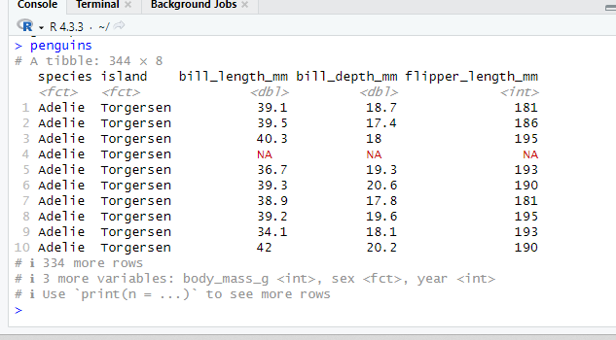
Creating visuals – Using ggplot()
B. Our penguins dataset looks like the following in R-Studio.

Slide 45
Creating visuals – Using ggplot()
C. This is not sufficient for a correct graph, we need to add a geometrical object to represent the data. We will need to add objects such as:
geom_line() : for line graphs
geom_bar(): for bar graphs
geom_boxplot(): for boxplot graphs
geom_point(): for point plots such as scatterplots
geom_histogram(): for histograms
Now our gglot() call can look like:
>ggplot(
data = penguins,
mapping = aes(x=flipper_length_mm, y=body_mass_g, color=species)
) + geom_point()

Slide 46
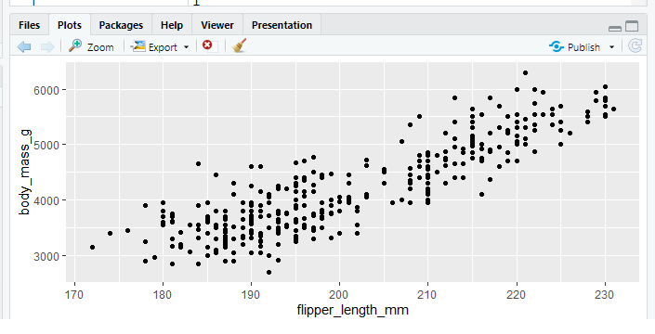
Creating visuals – Using ggplot()
You will have a scatterplot as follows:

Slide 47
Creating visuals – Using ggplot()
2. This is not sufficient for a correct graph, we need to add a geometrical object to represent the data. We will need to add objects such as:
geom_line() : for line graphs
geom_bar(): for bar graphs
geom_boxplot(): for boxplot graphs
geom_point(): for point plots such as scatterplots
Now our gglot() call can look like:
>ggplot(
data = penguins,
mapping = aes(x=flipper_length_mm, y=body_mass_g, color=species)
) + geom_point()

Slide 48
Creating visuals – Using ggplot()
We can also add another layer of graphing on top of another, also we can label our graphs by using labs(). Our call can now look like:
> ggplot(
data = penguins,
mapping = aes(x = flipper_length_mm, y = body_mass_g)) +
geom_point(aes(color = species, shape = species)) +
geom_smooth(method = “lm”) + labs(
title = “Body mass and flipper length”,
subtitle = “Dimensions for Adelie,Chinstrap,Gentoo Penguins”,
x = “Flipper length (mm), y = “Body mass (g)”,
color = “Species”, shape = “Species” ) + scale_color_colorblind()

Slide 49
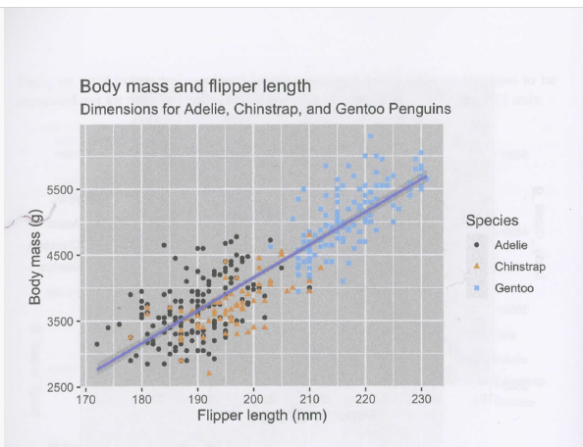
Creating visuals – Using ggplot()
Here we see the resulting plot from the ggplot() call: R for Data Science – Import, Tidy, Transform, Visualize and Model Data(Chp 1: pg. 12)

Slide 50
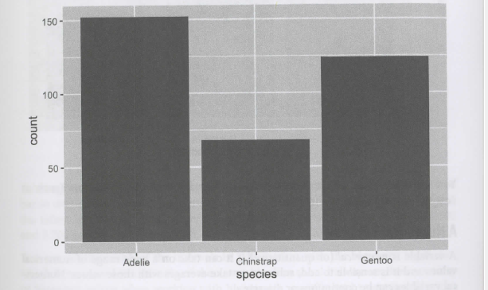
Visualizing Distributions
A Categorical Variable: Takes a small set of values. Here we can observe the distribution of a categorical variable. Bar heights shown will display how many observations occurred with each x value.
The following call >ggplot(penguins, aes(x = species)) + geom_bar() shows:

Slide 51
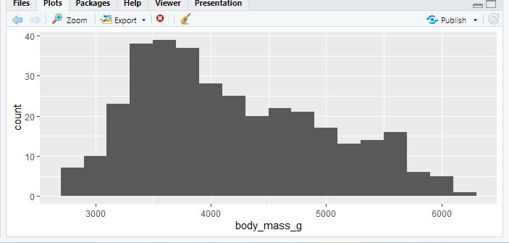
Visualizing Distributions
A Numerical variable can take on a wide range of numerical values. Numerical variables can be continuous or discrete. The following call uses histograms to show a continuous variable.
>ggplot(penguins, aes(x = body_mass_g)) + geom_histogram(binwidth = 200)

Slide 52
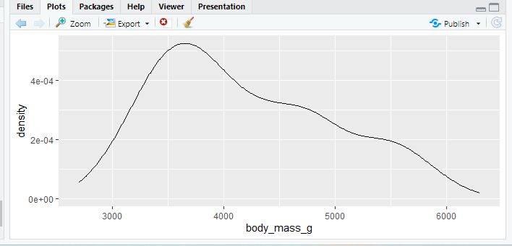
Visualizing Distributions
A density plot is a smoothed out version of a histogram. We use geom_density(). The call is as follows:
>ggplot(penguins, aes(x = body_mass_g)) + geom_density()

Slide 53
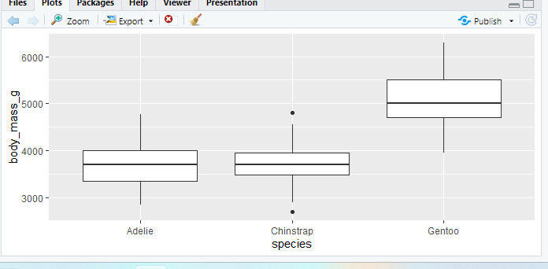
Visualizing Distributions
A boxplot shows the percentiles and the IQR (interquartile range) from the 25th percentile to the 75th percentile. The call is as follows:
>ggplot(penguins, aes(x = species, y = body_mass_g)) + geom_boxplot()

Slide 54
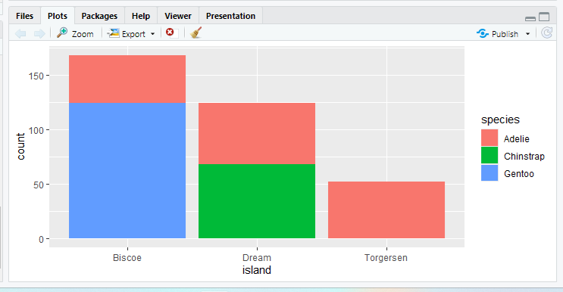
Visualizing Distributions
Now lets look at two categorical variables: we will look at the species and islands variables as a stacked bar plot. We write as such:
>ggplot(penguins, aes(x = island, fill = species)) + geom_bar()

Slide 55
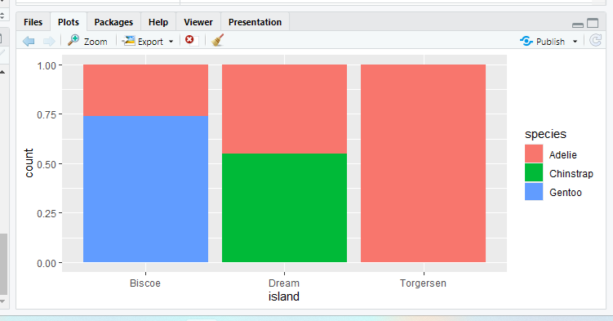
Visualizing Distributions
Now we can add position=”fill” in geom_bar() and the percentage of species will show for each island.
>ggplot(penguins, aes(x = island, fill = species)) + geom_bar(position = “fill”)

Slide 56
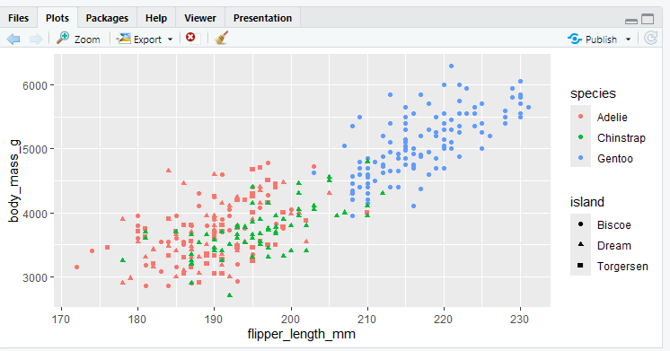
Visualizing Distributions
Here we add points and use geom_point() to show the distributions: shapes = island, color = species. The code is as follows:
>ggplot(penguins, aes(x = flipper_length_mm, y = body_mass_g)) + geom_point(aes(color = species, shape = island))

Slide 57
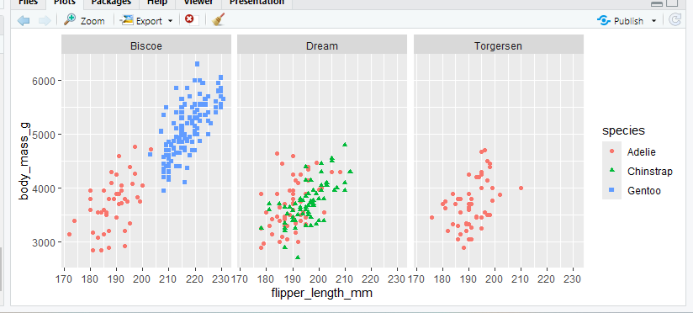
Visualizing Distributions
The use of facets or subplots can simplify your graphing. facet_wrap() will split the graph into subgraphs. We add as follows:
>ggplot(penguins, aes(x = flipper_length_mm, y = body_mass_g)) + geom_point(aes(color = species, shape = species)) + facet_wrap(~island)

Slide 58
Visualizing Distributions
Saving your plot: use ggsave():
>ggplot(penguins, aes(x = flipper_length_mm, y = body_mass_g)) + geom_point()
>ggsave(filename = “penguin-myplot.png”)
Saving 8.35 x 3.43 in image
This will be saved in your local directory.
Check your directory by using >getwd()

Slide 59
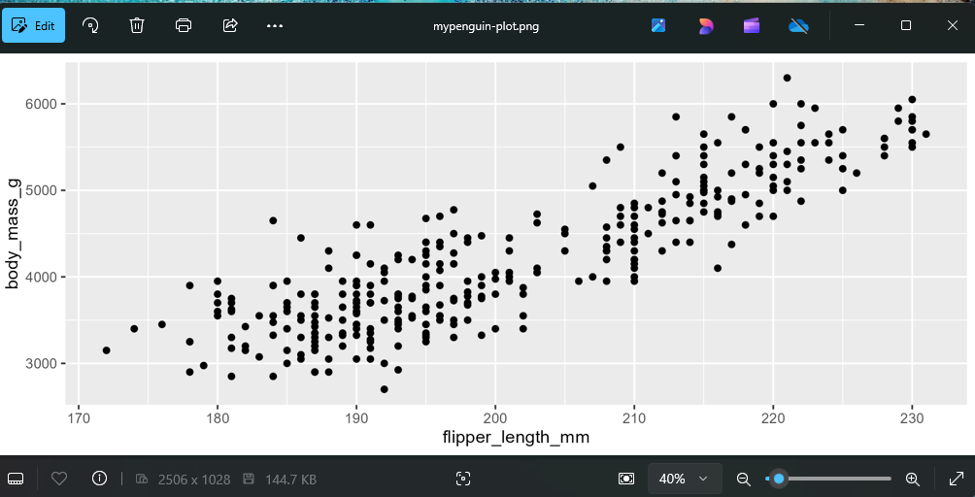
Visualizing Distributions

Slide 60
We have finished:
R for Data Science – Import, Tidy, Transform, Visualize and Model Data – Chp 1
NOTE: We will return to visualizations in Chp 9.

Slide 61
Data Transformation
From R for Data Science – Import, Tidy, Transform, Visualize and Model Data – Chp 3
We will now use the dataset: nycflights13.
You will install it by using:
>install.packages(“nycflights13”)
>library(nycflights13)
>flights #check the tibble
>View(flights) #see the dataset
To reload tidyverse: >library(tidyverse)

Slide 62
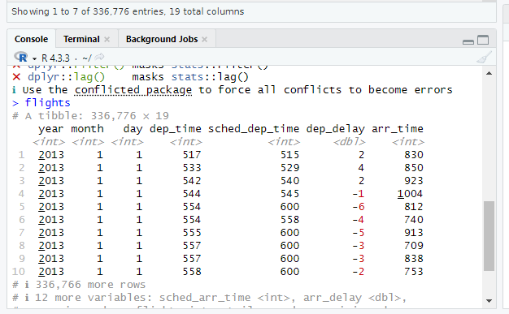
Data Transformation
Here is a snapshot of the flights tibble data: Note that not all columns ar available as in >View(flights)

Slide 63
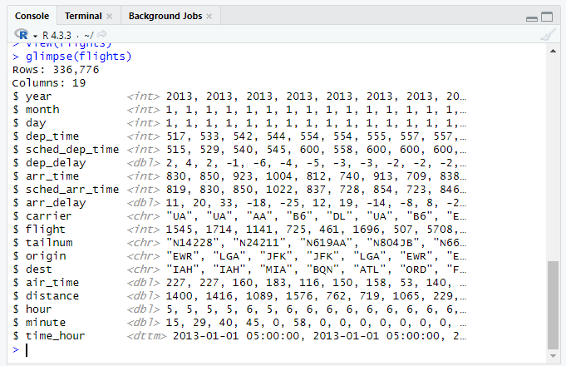
Data Transformation
To get more detailed information we can use glimpse(dataset).

Slide 64
Data Transformation - Rows
We will discuss four main functions to manipulate rows:
Filter() : change rows and show rows by condition
Arrange() : changes order of rows
Distinct() : find rows with unique values
Count() : show number of occurrences of rows

Slide 65
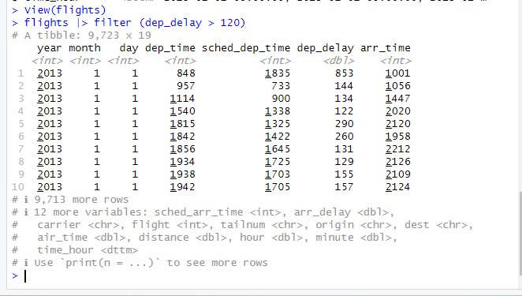
Data Transformation - Rows
To operate on rows of a dataset in R we will use the filter() function.
Example: To find all flights that departed more than 120 minutes late:
>flights |> filter (dep_delay > 120)

Slide 66
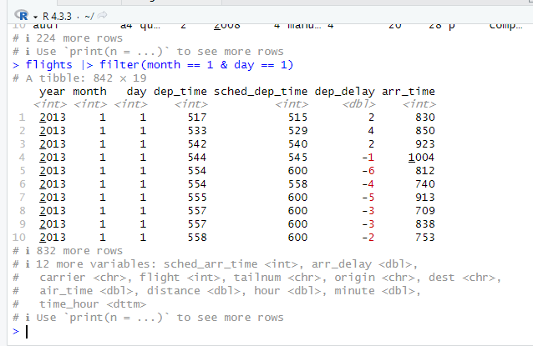
Data Transformation - Rows
Now we will find flights that departed on Jan 1. We use the following:
>flights |> filter(month == 1 & day == 1)

Slide 67
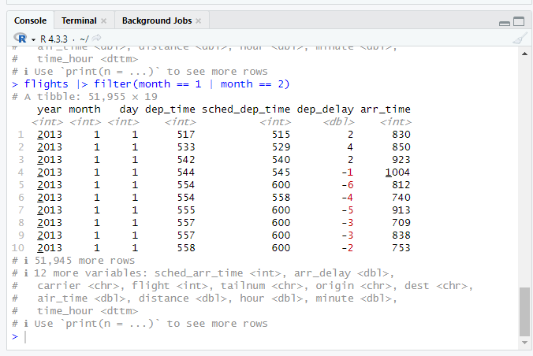
Data Transformation - Rows
To get flights that departed either Jan or Feb we use:
>flights |> filter(month == 1 | month == 2)

Slide 68
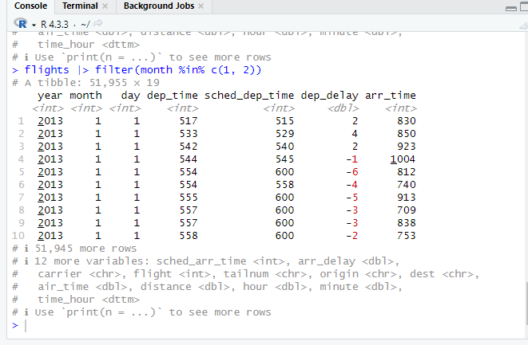
Data Transformation - Rows
Another way to write it is:
>flights |> filter(month %in% c(1, 2))

Slide 69
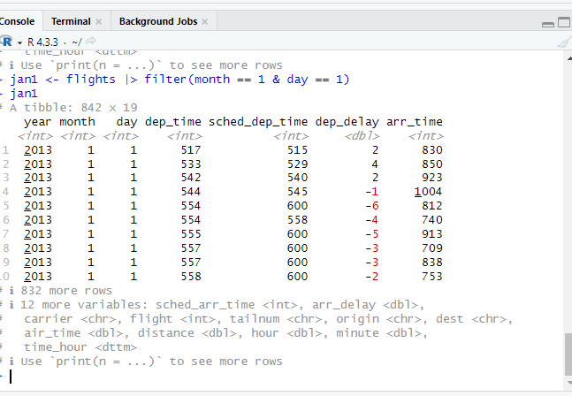
Data Transformation - Rows
You can assign a filtered dataset to another dataset like:
>jan1 <- flights |> filter(month == 1 & day == 1), now the jan1 dataset contains only flights on Jan 1.

Slide 70
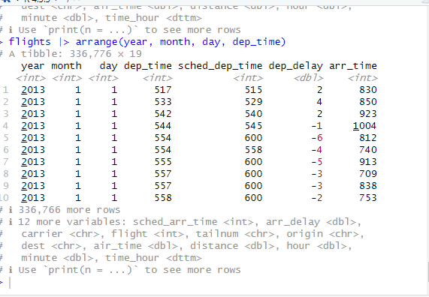
Data Transformation - Rows
We can use the arrange() function to order by rows depending on the value of the columns.
>flights |> arrange(year, month, day, dep_time) will get the earliest year, then month, then day, then dep_time. It will be ordered from smallest to largest.

Slide 71
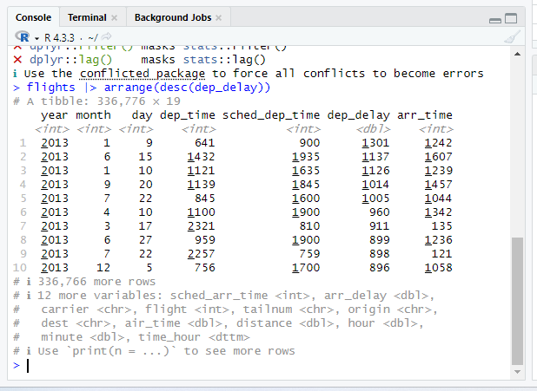
Data Transformation - Rows
We can also use arrange to order the data from largest to smallest using desc (descending). The code is as follows:
>flights |> arrange(desc(dep_delay))

Slide 72
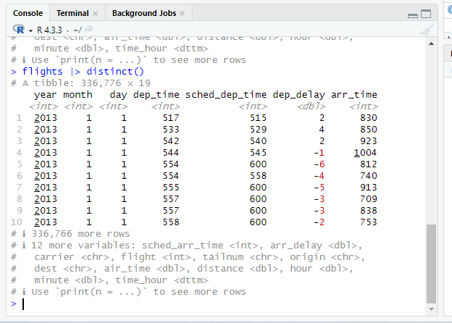
Data Transformation - Rows
Using distinct() will give us all the unique rows in a dataset. Without column names we will just get all unique rows as such:
>flights |> distinct()

Slide 73
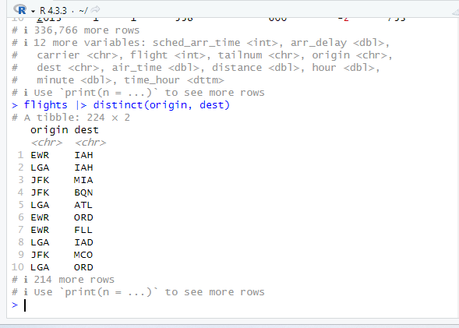
Data Transformation - Rows
We can also add parameters to distinct() as such:
>flights |> distinct(origin, dest) #we get all unique origin, dest, pairs.

Slide 74
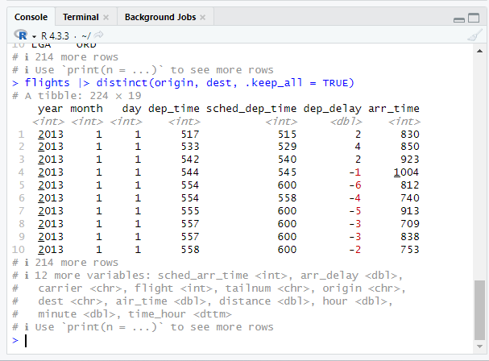
Data Transformation - Rows
Adding the .keep_all = TRUE option will keep all the other columns.
>flights |> distinct(origin, dest, .keep_all = TRUE)

Slide 75
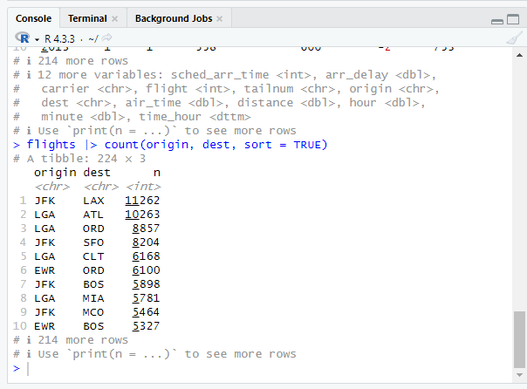
Data Transformation - Rows
If we want to find the number of occurrences, we can use the count() and
sort = TRUE option. We see it is listed from largest to smallest. The call is follows:
>flights |> count(origin, dest, sort = TRUE)

Slide 76
Data Transformation - Columns
There are four main functions that are used to manipulate columns:
Mutate() : add new columns from existing columns, can also modify existing columns
Select() : changes which columns are present
Rename() : changes names of columns
Relocate() : changes positions of columns

Slide 77
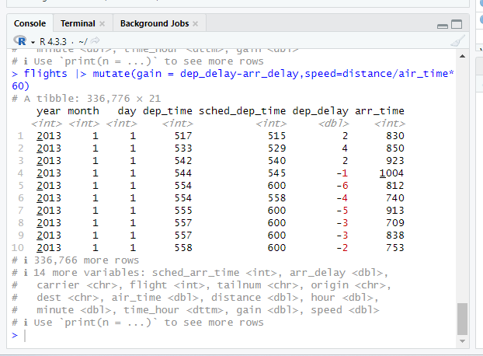
Data Transformation - Columns
Mutate() will add new columns from existing columns. From the flight dataset we will add 2 new columns, “gain” and “speed”.
>flights |> mutate (gain = dep_delay – arr_delay, speed = distance / air_time*60)
We don't see the 2 new columns below because columns are added to the right.

Slide 78
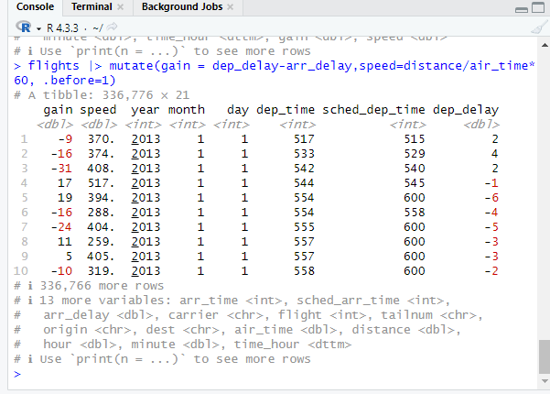
Data Transformation - Columns
To change the columns to the left side we add .before = 1
>flights |> mutate(gain = dep_delay-arr_delay,speed=distance/air_time*60, .before = 1)

Slide 79
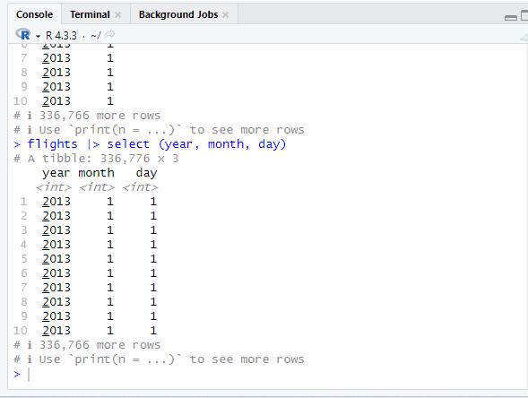
Data Transformation - Columns
To get only some columns we can use the select() function:
>flights |> select(year, month, day)

Slide 80
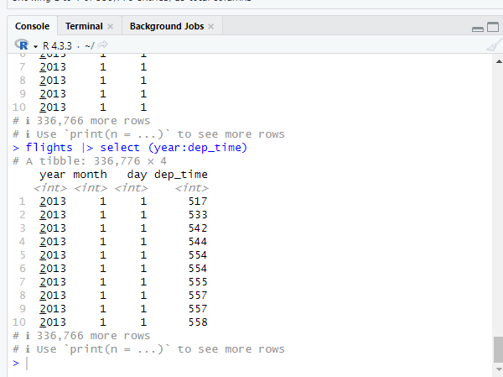
Data Transformation - Columns
To select from a column to another one: >flights |> select(year:dep_time)

Slide 81
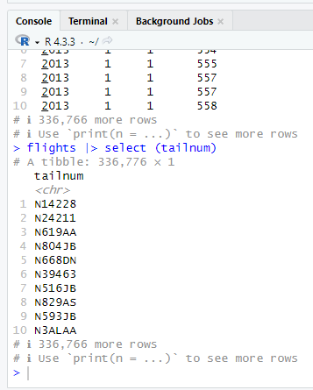
Data Transformation - Columns
To rename a column we use the rename() function. It requires the new column name first before the old column name as such rename(data, newname = oldname). Since we are giving data as a pipe, we just write like:
>flights |> rename(tail_num = tailnum)
The old flights dataset does not change, only if we copy to a new dataset.

Slide 82
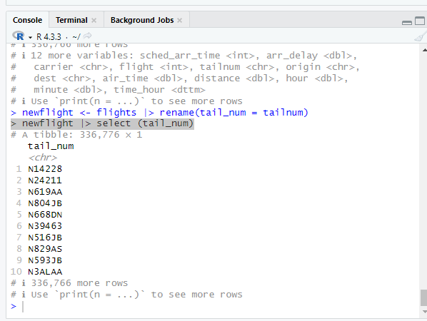
Data Transformation - Columns
Here we will copy to another dataset with the renamed column:
1. >newflight <- flights |> rename(tail_num = tailnum)
2. Now we check using select: > newflight |> select (tail_num)

Slide 83
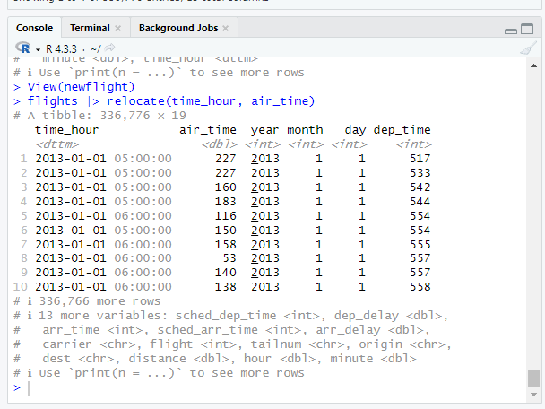
Data Transformation - Columns
The relocate() function moves the variables around. By default relocate() moves variables to the front.
>flights |> relocate(time_hour, air_time)

Slide 84
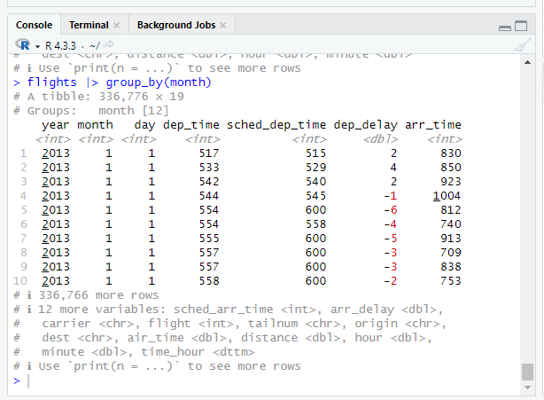
Data Transformation - Columns
Groups: group_by() will divide your dataset into groups for your analysis.
>flights |> group_by(month) #will not change data, by group by month.

Slide 85
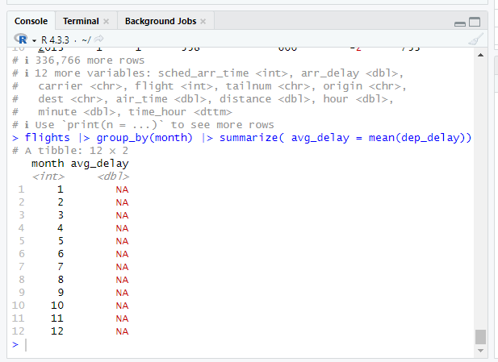
Data Transformation - Columns
Group_by() works well with summarize(). It is used as a summary statistic for a dataset. Here we summarize the mean departure delay by month.
>flights |> group_by(month) |> summarize( avg_delay = mean(dep_delay))

Slide 86

Data Transformation - Columns
We have run into a problem with the previous results. This is because there were missing values in our dataset. To ignore our missing values we will use the na.rm = TRUE option.
>flights |> group_by(month) |> summarize( delay = mean(dep_delay, na.rm = TRUE))

Slide 87

Data Transformation - Columns
We can add an option to summarize which is n(), this means it is the number of rows in each group.
>flights |> group_by(month) |> summarize(delay = mean(dep_delay, na.rm = TRUE), n = n())

Slide 88
Data Transformation – Data Import
Were now starting:
R for Data Science – Import, Tidy, Transform, Visualize and Model Data – Chp 7

Slide 89

Data Transformation – Data Import
We can import data to R by reading in CSV files. We have a sample CSV file called students.csv in both CSV and table form. We will read this into R-Studio.

Slide 90
Data Transformation – Data Import
We are going to do the following steps:
1. Read in the csv file using read_csv()
2. Change format of certain data “N/A” to R format “not available” using na= c( )
3. Change column names by reformatting the column names first using rename() then using janitor::clean_names()
4. Change column datatype from <chr> to <fct> using mutate()
5. Change another column data type by using parse_number()

Slide 91

Data Transformation – Data Import
1. First we will use >library(tidyverse) to attach our packages. Next we will read in our students.csv file. You will need to create this file locally on your computer. Read in as follows:
> students <- read_csv("C:\\Users\\jjtopPC\\Documents\\personal\\courses\\DataAnalysis-Rprog\\R-prog\\students.csv")

Slide 92

Data Transformation – Data Import
2. The next step is to transform the data. We will first change “N/A” to “not available” in R format.
>students < - read_csv(“/directory”, na = c(“N/A”, “”)) #use your directory of students.csv

Slide 93

Data Transformation – Data Import
3. Now we will reformat the column names as such:
>students |> rename(student_id = 'Student ID', full_name = 'Full Name')

Slide 94

Data Transformation – Data Import
4. There is another function to use: janitor::clean_names() which will correct all our column headings.
First install the package by using:
>install.packages(“janitor”)
>students |> janitor::clean_names()

Slide 95

Data Transformation – Data Import
5. (a) to a set vector of characters more suitable for categorical variables. The following will change the meal_plan column to factors.
>students |> janitor::clean_names() |> mutate(meal_plan = factor(meal_plan))

Slide 96
Data Transformation – Data Import
5. (b) Note from the previous slide we used mutate() to modify an existing column from one type to another.
>students |> janitor::clean_names() |> mutate(meal_plan = factor(meal_plan))
mutate() is used to change column type from <chr> to <fct>

Slide 97

Data Transformation – Data Import
6. Now we want to fix the column type for “age”. Here we will change the wording of “five” to the number 5.
>students < - students |> janitor::clean_names() |> mutate ( meal_plan = factor(meal_plan), age = parse_number(if_else(age == “five”, “5”, age)))

Slide 98

Data Transformation – Data Import
We will now discuss the read_csv() function where we can read in text.
To read everything on a single line: (First line is treated as a column name)
> read_csv("a,b,c\n1,2,3\n4,5,6") #Reads in a dataset manually.

Slide 99

Data Transformation – Data Import
Now we will write to a file using write_csv(). We will use the modified students dataset from the previous assignment to now write to a new csv file.
First check your current directory by using: >getwd()
Now use: >write_csv(students, "students2.csv")
This will write the students tibble to your current directory as students2.csv your file should look like this:

Slide 100
Data Transformation – Data Import
We are finished with Chp. 7 – Data Import
We will now move to Chp 9 – Back to Data Visualization – Layers

Slide 101

Data Visualization - Layers
We will now continue on with ggplot() and a dataset called mpg. This is a similar dataset to mtcars which we briefly discussed earlier but not the same.

Slide 102
Data Visualization - Layers
Aesthetic Mappings (using aes()):
We will call aes() first with color, then with shape:
1. >ggplot(mpg, aes(x = displ, y = hwy, color = class)) + geom_point()
Color is represented as class type of car.
2. >ggplot(mpg, aes(x = displ, y = hwy, shape = class)) + geom_point()
Shape is represented as class type of car.
3. >ggplot(mpg, aes(x = displ, y = hwy, size = class)) + geom_point()
Size is represented as class type of car.
4. >ggplot(mpg, aes(x = displ, y = hwy, alpha = class)) + geom_point()
Alpha is represented as class type of car.

Slide 103

Data Visualization - Layers
1. From the first call we have color = class:

Slide 104

Data Visualization - Layers
2. From the second call we have shape = class: Note the maximum number of shapes is six, as a result the suv datapoint is NOT plotted.

Slide 105

Data Visualization - Layers
3. From the third call we have size = class: (not recommended)

Slide 106

Data Visualization - Layers
From the fourth call we get alpha = class: (not recommended)

Slide 107

Data Visualization - Layers
Plot color can be selected, but in this case, it does not change the appearance of the variable. This is as follows:
>ggplot(mpg, aes(x = displ, y = hwy )) + geom_point(color = “blue”)

Slide 108
Data Visualization - Layers
Now we will discuss Geometric Objects, we look at two types of geom.
geom_point() and geom_smooth()
1. >ggplot(mpg, aes(x = displ, y = hwy)) + geom_point()
geom_point() uses scatterplot data
2. >ggplot(mpg, aes(x = displ, y = hwy)) + geom_smooth()
geom_smooth() uses a smooth line fitted to the data

Slide 109

Data Visualization - Layers
1. >ggplot(mpg, aes(x = displ, y = hwy)) + geom_point()

Slide 110

Data Visualization - Layers
2. >ggplot(mpg, aes(x = displ, y = hwy)) + geom_smooth()

Slide 111

Data Visualization - Layers
geom_smooth() will separate a variable such as “drv” into 3 different lines based on drivetrain. However you must use correct options. For instance “shape” will not work as seen here: (The following graph is not useful)
>ggplot(mpg, aes(x = displ, y =hwy, shape = drv))+geom_smooth()

Slide 112

Data Visualization - Layers
Now we implement the linetype = drv option, which will set the linetype instead of shape. This will separate three lines based on the drivetrain “drv” value.
>ggplot(mpg, aes(x = displ, y =hwy, linetype = drv))+geom_smooth()

Slide 113

Data Visualization - Layers
We can overlay the lines by using a combination of both geom_point() and geom_smooth(). We use the following: >ggplot(mpg, aes(x = displ, y = hwy, color = drv)) + geom_point() + geom_smooth(aes(linetype = drv))

Slide 114
Data Visualization - Layers
Chp 9: Pg 122: geom_smooth() can be used with aes() - aesthetic options.
The three calls are as follows:
1. >ggplot (mpg, aes(x = displ, y = hwy)) + geom_smooth()
2. >ggplot (mpg, aes(x = displ, y = hwy)) + geom_smooth(aes(group = drv))
3. >ggplot (mpg, aes(x = displ, y = hwy)) + geom_smooth(aes(color = drv), show.legend = FALSE)
The graphs are as follows:

Slide 115


Data Visualization - Layers
1. >ggplot (mpg, aes(x = displ, y = hwy)) + geom_smooth()
2. >ggplot (mpg, aes(x = displ, y = hwy)) + geom_smooth(aes(group = drv))

Slide 116

Data Visualization - Layers
3. >ggplot (mpg, aes(x = displ, y = hwy)) + geom_smooth(aes(color = drv), show.legend = FALSE)

Slide 117

Data Visualization - Layers
Here we add geom_point() and geom_smooth():
>ggplot(mpg, aes(x = displ, y = hwy)) + geom_point(aes(color = class)) + geom_smooth()

Slide 118
Data Visualization - Layers
Here we an highlight a specific set of datapoints using geom_point(). The following call will highlight all “2seater” class of cars in red and in circles.
geom_point() is called two times.
>ggplot(mpg, aes(x = displ, y = hwy)) + geom_point() + geom_point(
data = mpg |> filter(class == “2seater”), color = “red”) +
geom_point(data = mpg |> filter(class == “2seater”),
shape =”circle open”, size = 3, color = “red”)

Slide 119

Data Visualization - Layers

Slide 120
Data Visualization - Layers
ggplot() can use geom_histogram(), geom_density(), geom_boxplot().
geom_histogram() will show histogram, or geom_density() density plots.
1. >ggplot(mpg, aes(x = hwy)) + geom_histogram(binwidth = 2)
2. >ggplot(mpg, aes(x = hwy)) + geom_density()
3. >ggplot(mpg, aes(x = hwy)) + geom_boxplot()

Slide 121


Data Visualization - Layers
1. >ggplot(mpg, aes(x = hwy)) + geom_histogram(binwidth = 2)
2. >ggplot(mpg, aes(x = hwy)) + geom_density()

Slide 122

Data Visualization - Layers
3.>ggplot(mpg, aes(x = hwy)) + geom_boxplot().
The boxplot() shows two potential outliers.

