Slide 1

Asynchronous Audio Sample Rate Converter
IIEEC - Presentation
Pedro Teixeira - 84172

Slide 2
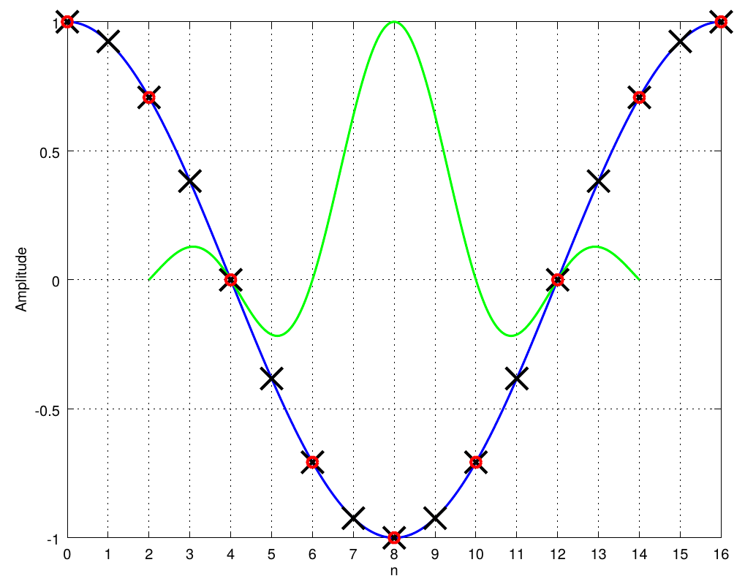
What Is A Sample Rate Converter?
Notes:
Um SRC é uma estrutura de hardware capaz de converter um sinal amostrado a uma frequência f1 num sinal semelhante, amostrado a uma frequência f2.
Explicar com imagem

Slide 3
Sample Rate Converter Applications
Film and television
Most movies are shot at 24 frames per second
Most televisions run at 50 (PAL) or 60 (NTSC) frames per second
Audio
Conversion from Compact Disc (44.1 kHz) to Digital Audio Tape (48 kHz)
Mixing consoles
Audio workstations
Audio broadcast equipment
Notes:
Um SRC é uma estrutura de hardware capaz de converter um sinal amostrado a uma frequência f1 num sinal semelhante, amostrado a uma frequência f2.
Explicar com imagem

Slide 4
Some Sample Rate Converters
AD1896 (IC)
SRC4194 (IC)
2 channel input
7.75:1 to 1:8 conversion ratio
Worst THD+N: -117 dB
4 channel input
16:1 to 1:16 conversion ratio
Worst THD+N: -137 dB
CWda52 (IP)
8 channel input
7:1 to 1:7 conversion ratio
Worst THD+N: -118 dB

Slide 5
Motivation
Few IP implementations, with limited specifications.
No cheaper access to sample rate converters.
Growth of the market leads to the need of better IP cores.

Slide 6
Objectives
Design an asynchronous sample rate converter IP core, using Verilog.
Specifications should be competitive to IC counterparts.
Core should be implemented in a system-on-chip.

Slide 7
Proposed Specifications
Up to 24 bit samples
Support to signals sampled from 8 kHz to 192 kHz
24:1 to 1:24 conversion ratio
Worst THD+N: -130 dB
Multi-channel support

Slide 8
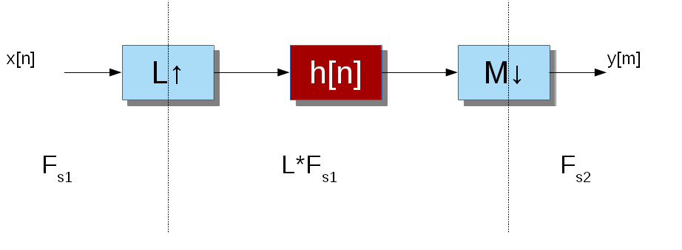
Sample Rate Converter Structure

Slide 9

Low Pass Filter – Digital Case
$\left|H_{d}\left(e^{jΩ}\right)\right| = \left\{\begin{aligned}1, \left|Ω\right|<Ω_{c} \\ 0, otherwise\end{aligned}\right.$
$Ω_{c}=\min\left(\frac{π}{2L},\frac{π}{2M}\right)[rad]$
$h_{d}\left[n\right]=\frac{Ω_{c}}{π}sinc\left[\frac{Ω_{c}}{π}\left(n−τ_{d}\right)\right]$
Normalization:
$Ω=\frac{2πf}{L f_{s1}} [rad]$

Slide 10
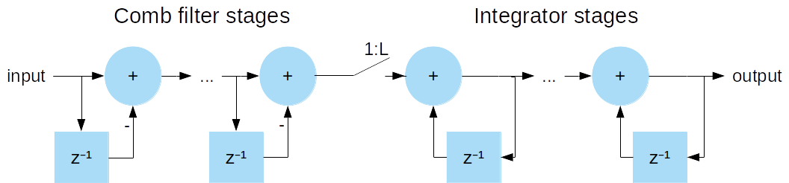
Cascaded Integrator Comb Filters

Slide 11
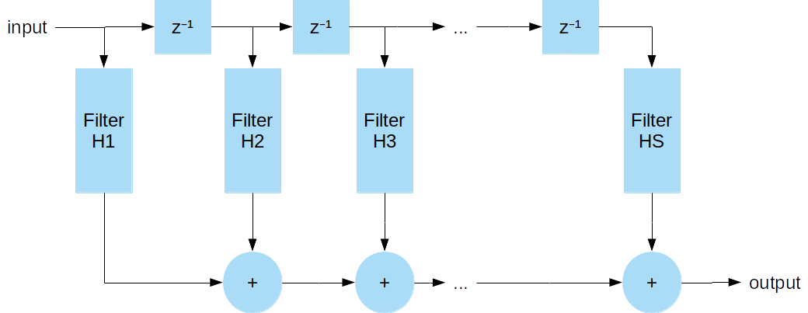
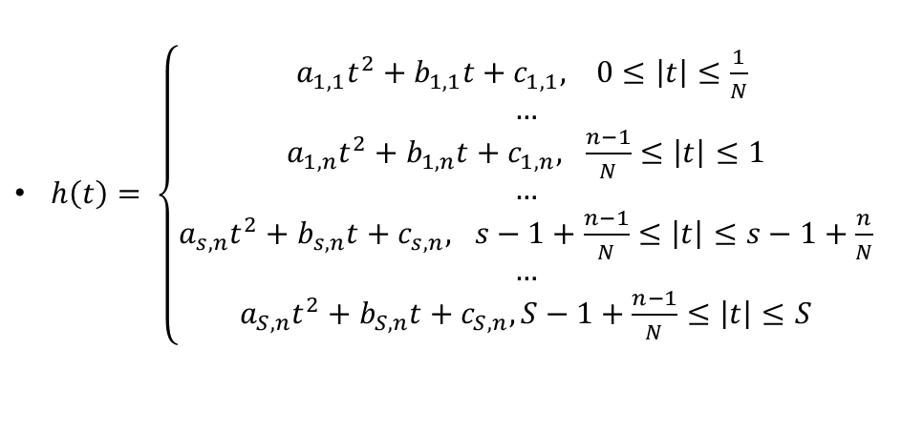
Approximation By Piecewise Quadratic Function
$h\left(t\right)= \left\{\begin{aligned}a_{1,1}t^{2}+b_{1,1}t+c_{1,1}, 0≤\left|t\right|≤\frac{1}{N} \\ … \\ a_{1,n}t^{2}+b_{1,n}t+c_{1,n}, \frac{n−1}{N}≤\left|t\right|≤1 \\ … \\ a_{s,n}t^{2}+b_{s,n}t+c_{s,n}, s−1+\frac{n−1}{N}≤\left|t\right|≤s−1+\frac{n}{N} \\ … \\ a_{S,n}t^{2}+b_{S,n}t+c_{S,n}, S−1+\frac{n−1}{N}≤\left|t\right|≤S\end{aligned}\right.$

Slide 12
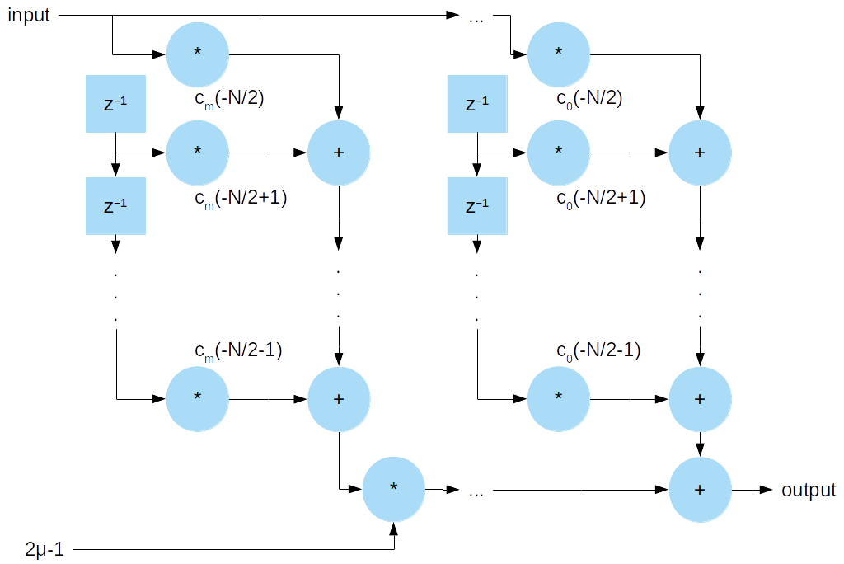

Farrow Structure
$h\left[n\right]= \sum_{m=0}^{q}{c_{m}\left[n\right]d^{m}}$
$μ=\frac{k}{M}$
$C_{m}\left(z\right)= \sum_{k=0}^{N−1}{c_{m}\left(k−\frac{N}{2}\right)z^{−k}}$

Slide 13
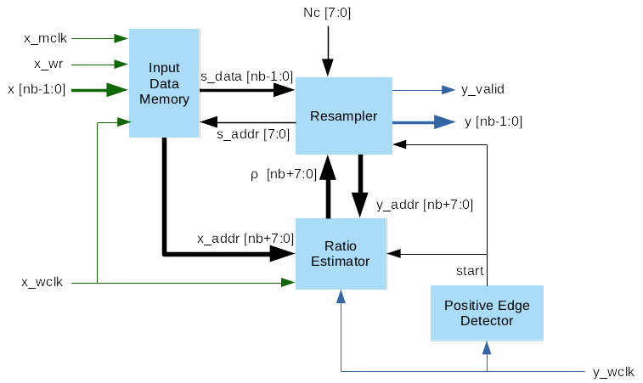
Proposed Design – Top Module

Slide 14
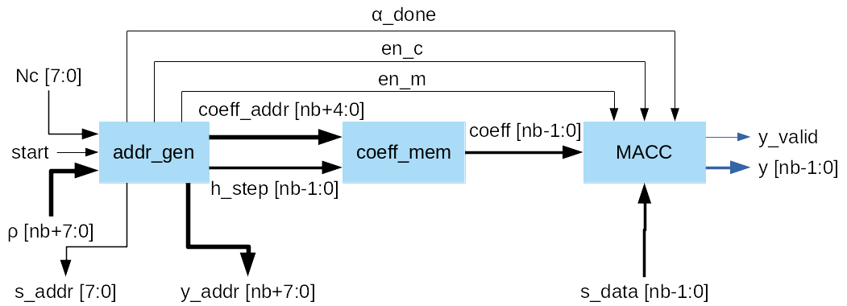
Proposed Design – Resampler

Slide 15
Simulation
Coefficients and input signal generated using Octave
Simulated using NCSim
Output analyzed using Octave:
Total harmonic distortion plus noise ratio measured
Fast Fourier Transform used
Small tolerance around the test frequency is considered signal, rest is considered distortion and noise

Slide 16
Simulation – Preliminary Results
Conversion Ratio | THD+N
44.1 kHz : 48 kHz | -131,94 dB
48 kHz : 44.1 kHz | -53,45 dB
48 kHz : 96 kHz | -140,44 dB
44.1 kHz : 192 kHz | -131.82 dB
96 kHz : 48 kHz | - 143.31 dB
192 kHz : 32 kHz | -46.21 dB
Expected worst THD+N: -130 dB

Slide 17
Implementation
Interfaces attached to core: AXI-Lite, I2S/Parallel
Implementation in System-on-Chip (using picoRV32)
Ethernet or UART for PC to FPGA data transfers.

Slide 18
Future Work
Task | Schedule
Improve sample rate converter prototype | 17/02 – 15/03
Implement ratio estimator | 16/03 – 12/04
Insert pipelines and control units | 13/04 – 19/04
Optimize resources usage | 20/04 – 03/05
Design and implement interfaces | 04/05 – 10/05
Test and debug core in FPGA | 11/05 – 31/05
Write thesis report | 1/06 – 19/07

Slide 19
Conclusions
A prototype was already done but does not fulfill specifications.
Optimization and bug fixing is essential to obtain high precision and low area consumption.
There are alternate structures to the resampler. Farrow structure is the most common.

