Slide 1
Computer Electronics
Lecture 8: Adder Circuits – Part 2

Slide 2
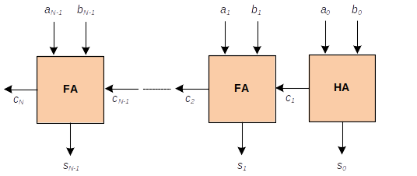
Ripple Carry Adder problem: how long will it take for the carry to ripple?
Answer: it will take the time to traverse all single bit adder blocks…. !

Slide 3
The Carry Look-ahead Adder (CLA)
Speeds up carry computation by using a tree structure instead of a linear structure
Linear structure length: N
Tree structure height: log(N)
Think of N=1000…. Dramatic speedup!

Slide 4
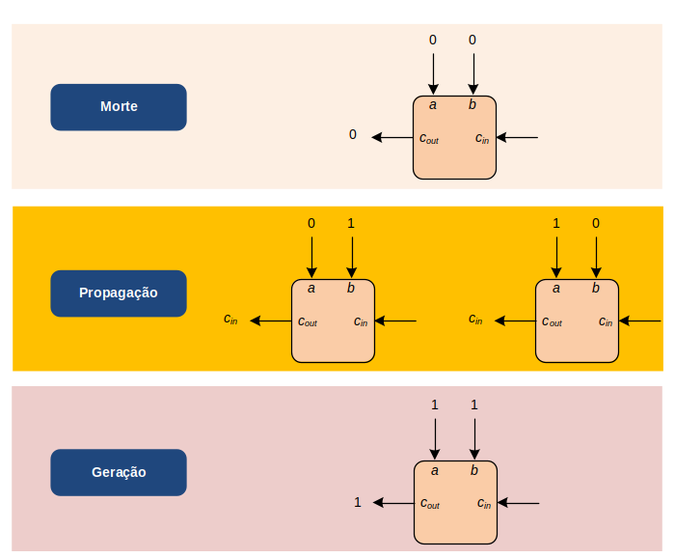
Carry prediction from inputs
Death
Propagation
Generation

Slide 5
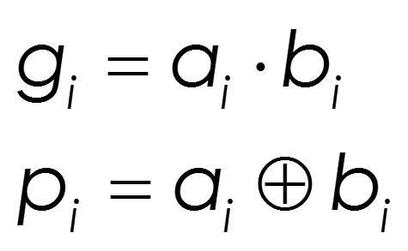

Mathematically

Slide 6
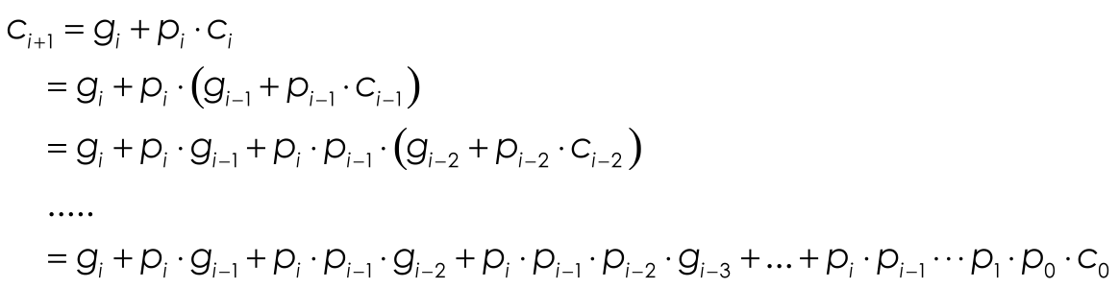
Carry recursive computation
Can use a 2-level SUM OF PRODUCTS circuit
Multi-input OR and AND gates
Implement as 2-input gate trees!
CARRY AS TREE FUNCTION OF ALL INPUTS!

Slide 7
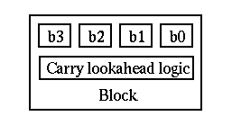
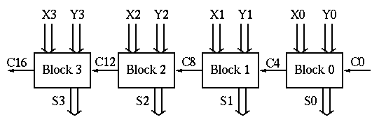
Block Carry Look-ahead Adder
Combine CLA and RCA

Slide 8
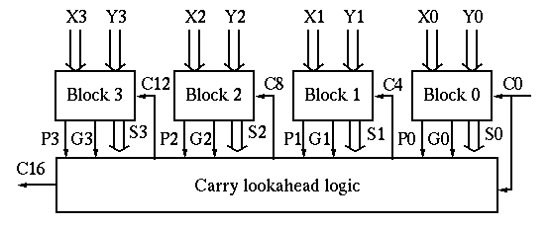
Using multiple levels

Slide 9
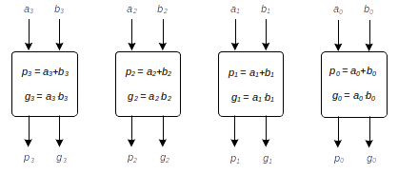
Tree Carry Look-Ahead Adder

Slide 10
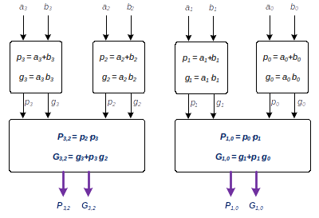
Tree Carry Look-Ahead Adder

Slide 11
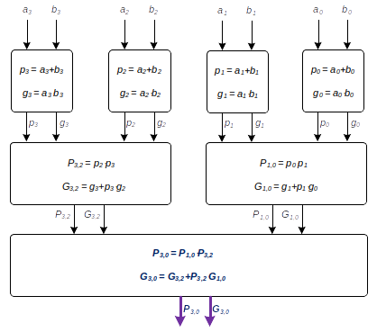
Carry Look-Ahead Tree

Slide 12
Carry out of a block

Slide 13
4-bit CLA
b3
a3
b2
a2
b1
a1
b0
a0
c0
s0 = a0 XOR b0 XOR c0
p0 = a0 XOR b0
g0 = a0*b0
c2
c1
s3
c3
s2
s1
s0
p3
g3
p2
g2
p1
g1
p0
g0
P1,0 = p1*p0
G1,0 = g1+p1*g0
c1 = g0+p0*c0
P3,2
G3,2
P1,0
G1,0
P3,0=P3,2*P1,0
G3,0=G3,2+P3,2*G1,0
c2 = G1,0+P1,0*c0
c4 = G3,0+P3,0*c0
c4
Critical Path Length = 2 * log(N) * (Node delay)

Slide 14
Worksheet 8: design this Verilog
b3
a3
b2
a2
b1
a1
b0
a0
c0
s0 = a0 XOR b0 XOR c0
p0 = a0 XOR b0
g0 = a0*b0
A
c2
c1
s3
c3
s2
s1
s0
p3
g3
p2
g2
p1
g1
p0
g0
P1,0 = p1*p0
G1,0 = g1+p1*g0
c1 = g0+p0*c0
B
P3,2
G3,2
P1,0
G1,0
P3,0=P3,2*P1,0
G3,0=G3,2+P3,2*G1,0
c2 = G1,0+P1,0*c0
c4 = G3,0+P3,0*c0
c4
C
Critical Path Length = 2 * log(N) * (Node delay)

