Slide 1
Computer Electronics
Lecture 7: Multiplier Circuits – Part 2

Slide 2
Lecture outline
Subtraction
Sign-extension
Signed multiplication
Add-Shift multiplier
Radix-2 Booth multiplier
Radix-4 Both multiplier

Slide 3
Subtraction: fundamentals
Adder circuits work equally well with unsigned and signed numbers
A-B = A + (-B)
  To subtract simply add the symmetric
  Symmetric is 2’s complement
  Easiest way to compute 2’s complement in hardware
    Complement and add 1

Slide 4
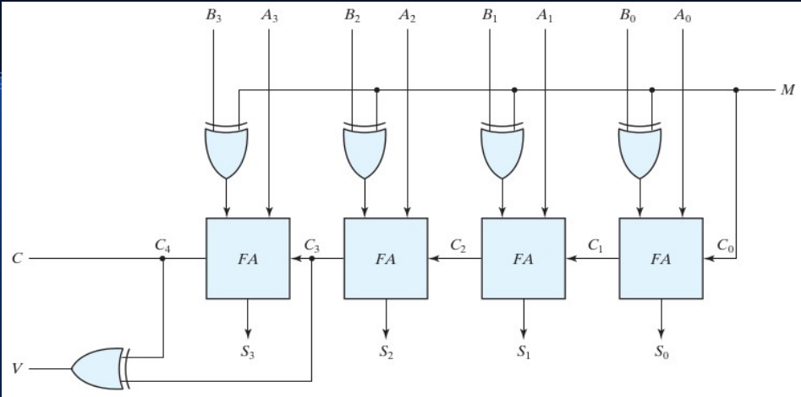
Subtraction: circuit

Slide 5
Sign extension
Sometimes there’s need to increase the number of bits for number representation
Sign of the number should be preserved
Q1: represent signed number 1000 (8₁₀) with 8 bits
A1: 11111000 (sign extension in red)
Q2: represent signed number 0111 (7₁₀) with 8 bits
A2: 00000111(sign extension in red)

Slide 6
Logical/Arithmetic right shift
Shifting a number left by p positions is the same as multiplying it by 2^{p}
Shifting a signed number right by p positions is the same as dividing it by 2^{p}
Sign must me preserved: arithmetic right shift
1000 (-8₁₀) shift right by 2 (divide by 4)
  Logical right shift 0010 (2₁₀): wrong!
  Arithmetic right shift 1110 (-2₁₀): correct!

Slide 7
Signed multiplication: fundamentals
A = a3 a2 a1 a0, B = b3 b2 b1 b0
In decimal notation
B = -b3*2³ + b2*2² + b1*2¹ + b0*2⁰
A*B = A * [-b3*2³+ b2*2² + b1*2¹ + b0*2⁰]
Algorithm:
  Add least significant partial products, subtract most significant partial product

Slide 8
Signed multiplication: circuit
₁
a₃b₀
a₂b₀
a₁b₀
a₀b₀
a₃b₁
a₂b₁
a₁b₁
a₀b₁
FA
FA
FA
HA
a₃b₂
a₂b₂
a₁b₂
a₀b₂
FA
FA
FA
HA
a₃b₃
a₂b₃
a₁b₃
a₀b₃
FA
FA
FA
FA
1
p₇
p₆
p₅
p₄
p₃
p₂
p₁
p₀

Slide 9
Add-shift multiply: fundamentals
Use accumulator register
Successively add and shift the partial products
Multiplication ready after N partial products are accumulated
One accumulation per clock cycle

Slide 10
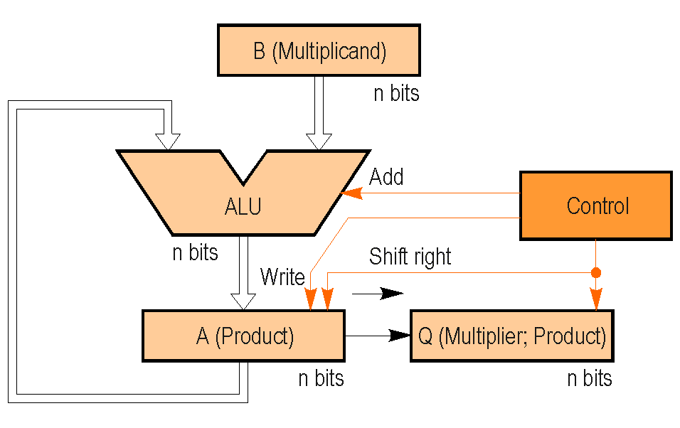
Add-shift multiply: circuit
/Sub/Nop

Slide 11
Add-shift signed multiply: example
Clock cycle | Product /multiplier reg | Comments
0 | 00000010 | Initial: P=0, m=0010
1 | 00000001 | Nop, SRA
2 | 11001000 | Add M, SRA
3 | 11100100 | Nop, SRA
4 | 11110010 | Subtract M, SRA
M=-7₁₀=1001 , m=2₁₀=0010
M*m = -14₁₀ = 11110010

Slide 12
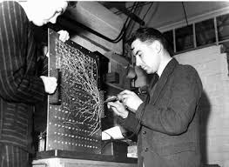
Booth multiply
Andrew Donald Booth
  British electrical engineer, physicist and computer scientist
  Early developer of the magnetic drum memory for computers
  Invented Booth's multiplication algorithm.

Slide 13
Booth multiply: observation
Multiply by small positive numbers is fast because of many leading 0s
  Example: multiply by 00000011 (3₁₀)
  Only 2 non-zero partial products
  Computation can stop after the 2 partial products are accumulated

Slide 14
Booth multiply: negative numbers
Similar observation for small negative numbers
  Many leading 1s: 11111100 (-4₁₀)
Add-shift multiply: many partial products to add!
Booth’s idea: recode the multiplier

Slide 15
Booth recoding
00111100 = 01000000 - 00000100
M*00111100 =
– M*00000100 + M*01000000
Partial products reduced from 4 to 2!

Slide 16
Booth algorithm
With multiplicand M and multiplier m:
Scan multiplier m from right to left
If 0 to 1 transition in positions p-1 to p:
Subtract M*2^{p}
If 1 to 0 transition in positions q-1 to q:
Add M*2^{q}

Slide 17
Booth algorithm: advantages
Worst case: 01010101
#transitions = N, N partial products
No advantage
Average case for random numbers
#transitions = N/2
Half of the additions
Real average case
  Small numbers common: low #transitions
  Few additions
Works for both unsigned and signed numbers!

Slide 18
Booth multiply: same circuit, different control
/Sub/Nop

Slide 19
Booth implementation: discussion
The above implementation does add-shift in the same clock cycle
  Advances 1 bit per cycle
  No time advantage for Booth compared to Add-Shift
  Power advantage? lower node activity…
How to improve the above implementation
  Advance by number of trailing 0s or 1s
    Need Count Leading Zeros (CLZ) hardware: O(N log N)
    Need Barrel Shifter (BS) hardware: O(N log N)
    Why not simply use a matrix multiplier?
Speeds up basic implementations, including assembly ones, that can’t do simultaneous add-shift

Slide 20
Booth multiply: example
Clock cycle | Product /multiplier register | Comments
0 | 00000010(.0) | Initial: P=0, m=0010, T=0.0
1 | 00000001(.0) | SRA, no transition, T=1.0
2 | 00111000(.1) | Sub M, RA, T=0.1
3 | 11100100(.0) | Add M, SRA, T=0.0
4 | 11110010 | SRA
M=-7₁₀=1001, -M=0111, m=2₁₀=0010
M*m = -7 x 2 = -14, 1001 x 0010 = 11110010

Slide 21
Radix-4 Booth multiply
Same principle but sequences of 2 bits are analyzed (radix = 2²=4)
Each 2-bits form a quaternary digit
Advantage: halves the number of partial products

Slide 22
Radix-4 Booth algorithm
Current digit | Previous bit | Operation
00 | 0 | 0-sequence: do nothing
00 | 1 | Ends 1-sequence: +M
01 | 0 | Lonely 1: +M
01 | 1 | Terminal 0: +2M
10 | 0 | Terminal 1: -2M
10 | 1 | Lonely 0: -M
11 | 0 | Ends 0-sequence: -M
11 | 1 | 1-sequence: do nothing

Slide 23
Radix-4 Booth multiply: example
Clock cycle | Product /multiplier reg | Comments
0 | 0000000011110110(.0) | Initial: P=0, m=-10₁₀,T=10.0
1 | 1111101000111101(.1) | , Sub 2M and SRA-2
2 | 0000010010001111(.0) | T=01.1, Add 2M and SRA-2
3 | 1111111000100011(.1) | T=11.0, Sub M and SRA-2
4 | 1111111110001000 | T=11.1, SRA-2
M=12₁₀=00001100, m=-10₁₀=11110110
-M =11110100, -2M=11101000, 2M=00011000
12₁₀ * -10₁₀ = -120₁₀ = 10001000

Slide 24
Worksheet #7
Write a 32-bit Radix-2 Booth Multiplier in Verilog

