Slide 1
Computer Electronics
Lecture 8: Divider and Shifter Circuits

Slide 2
Lecture outline
Division algorithm
  Unsigned only
Matrix divider
Subtract-Shift divider
1-bit shifting
Barrel shifting

Slide 3
Division algorithm
 |  | 1 | 4 |  | 0 | 3
- | 0 | 3 |  |  | 0 | 4
 |  | 1 | 4
 | - | 1 | 2
 |  | 0 | 2
 |  |  |  | 1 | 1 | 1 | 0 |  | 0 | 0 | 1 | 1
- | 0 | 0 | 1 | 1 |  |  |  |  | 0 | 1 | 0 | 0
 |  | 0 | 0 | 1 | 1
 | - | 0 | 0 | 1 | 1
 |  |  | 0 | 0 | 0 | 1
 |  | - | 0 | 0 | 1 | 1
 |  |  |  | 0 | 0 | 1 | 0
 |  |  | - | 0 | 0 | 1 | 1
 |  |  |  | 0 | 0 | 1 | 0
Dividend: 14 or 1110
Divisor: 3 or 11
Quotient: 4 or 100
Remainder: 2 or 10

Slide 4
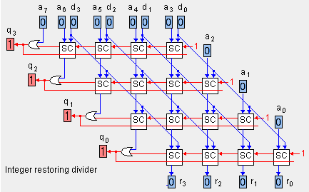
Matrix divider

Slide 5
Subtract-shift divider: fundamentals
Very similar to add-shift multiply
  Same circuit with few additions does both
Successively subtract divisor from current remainder and shift left
Division ready after N subtractions are accumulated
One accumulation per clock cycle

Slide 6
Subtract-shift divider: circuit
Divisor reg (n bits)
C_{out}
Adder
C_{in} = ‘1’
1
0
Remainder/Quotient reg (2n bits)
Shift left every cycle

Slide 7
Subtract-shift divide: example
Clock cycle | Remainder/quotient reg | Comments
0 | 00001110 | Initial: r=0000, D=1110
1 | 00011100 | No Sub, SL, q3=0
2 | 00001001 | Sub d, SL, q2=1
3 | 00010010 | No Sub, SL, q1=0
4 | 00100100 | No Sub, SL, q0=0
D=14, d=3 D=1110, d=0011
D/d = q =4, D%d = r = 2, q=0100, r=0010

Slide 8
Bit shifting
Left or right bit shifting is a useful operation
1-bit shifting can be accomplished with a shift register
N-bit shifting is accomplished with a barrel shifter circuit

Slide 9
Single bit shifting
Legend
l/r: left/right
L/A: logical/arithmetic
L/A select
‘0’
L
A
r
r
r
r
FFD
l
FFD
l
FFD
l
FFD
l
‘0’
l/r select

Slide 10
Shifting types (1-bit displace)
Left: b₀ <= 0, b_{i} <= b_{i-1}
Left circular: b₀ <= b_{n-1}, b_{i} <= b_{i-1}
Right logical; b_{n-1} <= 0, b_{i-1} <= b_{i}
Right Arithmetic: b_{n-2} <= b_{n-1}, b_{i-1} <= b_{i}
Right circular: b_{n-1} <= b₀, b_{i-1} <= b_{i}

Slide 11
Barrel shifting (d-bit displacement)
Displace by d bits left or right
Circular or not
Arithmetic or logical if right shift

Slide 12
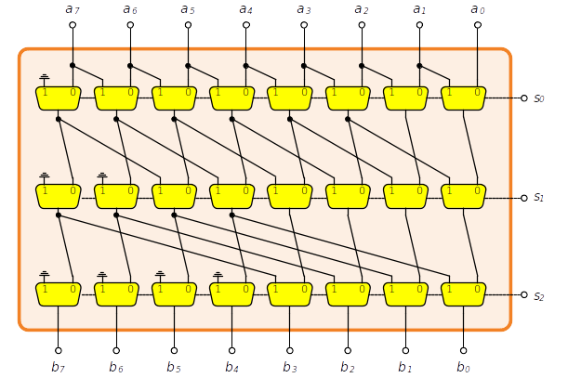
Barrel shifter using multiplexers
Spatial complexity O(N*logN)
Right logical

Slide 13
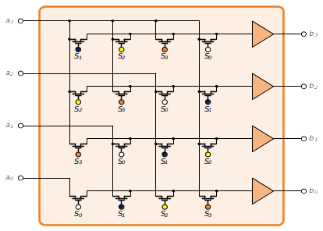
Barrel shifter using transistor matrix
Spatial complexity O(N²)
Right arithmetic

Slide 14
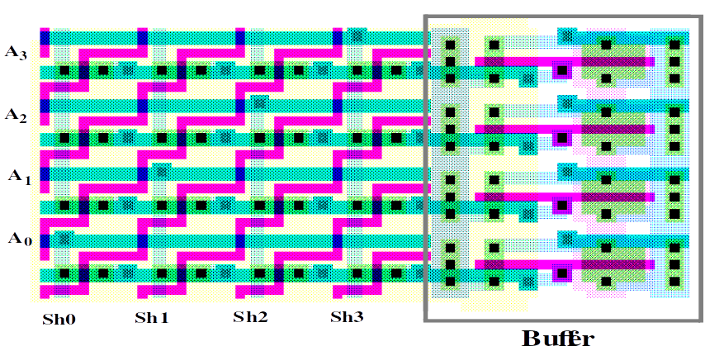
Transistor matrix BS – layout
Most space taken by interconnects rather than transitors

Slide 15
Worksheet 13
Write the Verilog description of a sub-shift divider

