Slide 1
Computer Electronics
Lecture 20: Fixed-point and floating-point

Slide 2
Fixed-point numbers
Integer part and fractional part separated by a radix point
Example, decimal: 123.456₁₀
Example, binary: 10011.11100011
Fixed-point format notation
  Q5.8 for the above example or simply 5Q8

Slide 3
Converting fixed-point binary to decimal: 4Q6 example
1 | 1 | 0 | 1 | 0 | 1 | 1 | 0 | 0 | 1
2³ | 2² | 2¹ | 2⁰ | 2⁻¹ | 2⁻² | 2⁻³ | 2⁻⁴ | 2⁻⁵ | 2⁻⁶
+8 | +4 | +0 | +1 | +0 | +0.25 | +0.125 | +0 | +0 | +0.015625
Result = 13.390625

Slide 4
Fixed-point addition/subtraction
mQn + mQn = (m+1)Qn
2’s complement used in subtraction
mQn - mQn = mQn+(- mQn)= (m+1)Q(2n)
Number of fractional bits unchanged
Number of integral bits may increase by 1

Slide 5
Fixed-point multiplication
mQn * mQn = (2m)Q(2n)
  In general: mQx * nQy = (m+n)Q(x+y)
  Number of integral and fractional bits add
Normalize (2m)Q(2n) back to mQn
  Throw away m MSBs and (overflow may occur)
  Throw away n LSBs (truncate or round)
1Q(n-1): common format for numbers in [-1,1[
  Multiply and get 2Q(2n-2) result
  Result is always in [-1,1[ => integer part is 00 or 11, only
  Shift left by 1 to get rid of insignificant bit
  Discard n LSBs (truncate or round)
  1Q(n-1) result is obtained

Slide 6
Fixed-point division
mQn / mQn = mQ0
  Number of fractional bits subtract
To keep same format add n 0s to right before division
  mQ(2n) / mQn = mQn

Slide 7
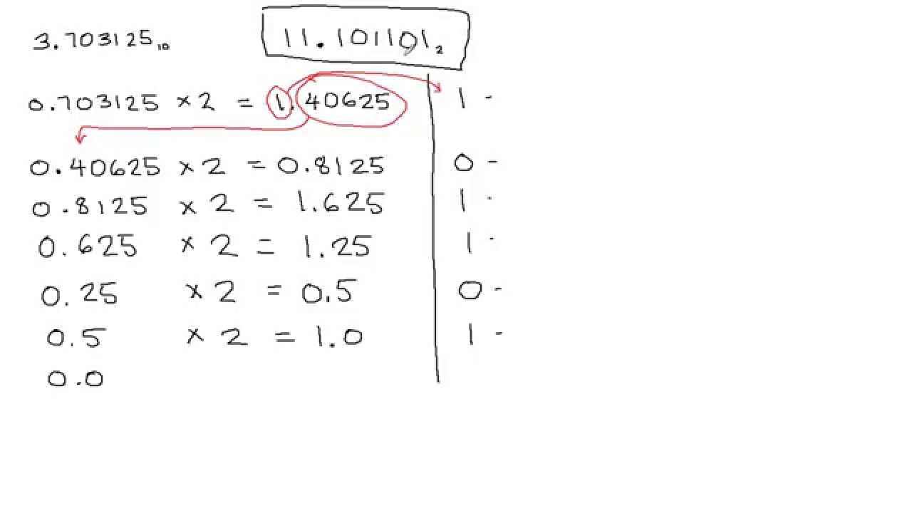
Converting fixed-point decimal to binary
Div by 2 | remainder | Power of 2
3 | 1 | 0
1 | 1 | 1
0 | Done
Answer: 3₁₀ = 11₂
https://www.youtube.com/watch?v=3FA8yQ0cZyE

Slide 8
Floating-point numbers
Floating point greatly simplifies working with large (e.g., 2⁷⁰) and small (e.g., 2⁻¹⁷) numbers
Representation of FP numbers
Limitations of FP numbers
FP addition and multiplication circuits

Slide 9
Floating-point representation
Single (float) / double precision: ±mantissa *2^{exponent}
Integers use 2s complement, floats use sign+magnitude
float=32 bits: s(1)+exp(8)+significand(23)
double=64bits: s(1)+exp(11)+significand(52)
Many possible conventions for exponent and mantissa
  Makes code not portable
Standardization needed: IEEE754
S
Exponent
Mantissa

Slide 10
Mantissa
Scientific notation: only one digit to the left of the decimal point
  Example: 2.53*10², not 25.3*10¹
Normalized representation of 00101101.101 = 1.01101101× 2⁵
0.0001101001110 = 1.110100111 × 2⁻⁴

Slide 11
Mantissa(2)
s
e
f
f is the fractional part of the mantissa
The integer part is an implicit 1
Example: if f=01101 then mantissa=1.01101
Advantage: 23 bits to represent a 24-bit number
Disadvantage: no representation for zero!

Slide 12
Exponent
s
e
f
Special cases:
  Infinities: overflown results
  Not a Number (NaN): division by 0
8 bits in e: 256 codes
11111111=255₁₀ reserved for special cases
0000000=0₁₀ reserved for zero
Remaining 254 codes: 127 positive and 127 negative exponents

Slide 13
Exponent(2)
s
e
f
e = exponent + 127 (biased exponent)
Codes 1 to 254 represent exponents from -126 to 127 (0 is reserved for 0)
Examples:
exponent=-34 => e=93
e=131 => exponent=4
Great advantage:
  float compare = signed integer compare

Slide 14
Conversion from IEEE754 to decimal
Convert to decimal: (-1)^{s}(1+f)2^{e-127}
Example: n = 1 01111100 11000000000000000000000
s=1 then number is negative
e=01111100=124₁₀ then exponent=124-127=-3
f=11000000000000000000000=0.75₁₀ then mantissa=1+f=1.75
Finally: n=-1.75 * 2 ⁻³ = -0.21875.

Slide 15
Conversion from decimal to IEEE754
Convert n = 347.625₁₀ to IEEE754
Convert to binary: n = 101011011.101₂
Move radix point left and increment exponent:
n = +1.01011011101 * 2⁸
Sign bit: 0 (positive)
Fractional part f = 01011011101
Biased exponent e = 8+127=135
347.625₁₀ =
01000011101011011101000000000000 _{IEEE754}

Slide 16
Full range and special values
e | f | Meaning | Notes
00000000 | 0...0 | Zero | 0 and -0
00000000 | X…X | (-1)^{S} x 2⁻¹²⁶ x (0.f) | Valid, unnormalized
11111111 | 0...0 | Infinity | Results from overflow
11111111 | X…X | Not a Number | Division by 0
00000001 | X…X | Exponent = -126₁₀ | Valid, normalized
… | X…X | Intermediate values
11111110 | X…X | Exponent = 127₁₀

Slide 17
Range (positive numbers only)
Normalized
  Smallest: 00000000100000000000000000000000 = 2⁻¹²⁶
  Largest: 01111111011111111111111111111111= 2¹²⁷(2-2⁻²³)
Unnormalized
  Smallest: 00000000000000000000000000000001 = 2⁻¹⁴⁹
  Largest: 00000000011111111111111111111111 = 2⁻¹²⁶(1-2⁻²³)
0
2⁻¹⁴⁹
2⁻¹²⁶(1-2⁻²³)
2⁻¹²⁶
2¹²⁷(2-2⁻²³)
Underflow
Overflow

Slide 18
Floating-point visualization
There are more 32-bit integers than 32-bit point floating-point numbers
It’s just a different scale
Some numbers including integers have no float representation
2
4
8
16
12/30/20
EC/SEC: DEEC/Instituto Superior Técnico

Slide 19
Floating-point issues
Small round-off errors can accumulate with multiplications or exponentiations, resulting in big errors
The IEEE 754 standard guarantees that all machines will produce the same results—but those results may not be mathematically accurate!
During the Gulf War in 1991, a U.S. Patriot missile failed to intercept an Iraqi Scud missile, and 28 Americans were killed.
A later study determined that the problem was caused by the inaccuracy of the binary representation of 0.10
After 100 hours a timer (accumulator of the inaccurate number) was off by 0.34 s, enough for a Scud missile to travel 500m….

Slide 20
Floating-point addition
Equalize to largest exponent
Add mantissas
Renormalize the result if necessary
Round if necessary
Renormalize the result if necessary

Slide 21
Floating-point addition: example
Compute 0 10000001 110...0 + 0 10000010 00110..0
1st number: 1.11₂×2 ¹²⁹⁻¹²⁷, 2nd number: 1.0011₂×2¹³⁰⁻¹²⁷
Compare the e field: 10000001 < 10000010
Align exponents to 10000010
1st number becomes: 0.111*2³
Add mantissas: 1.0011 + 0.1110 = 10.0001
Renormalize so the sum is: 10.0001 ×2³= 1.00001 ×2⁴
So the IEEE 754 format is: 0 10000011 000010...0

Slide 22
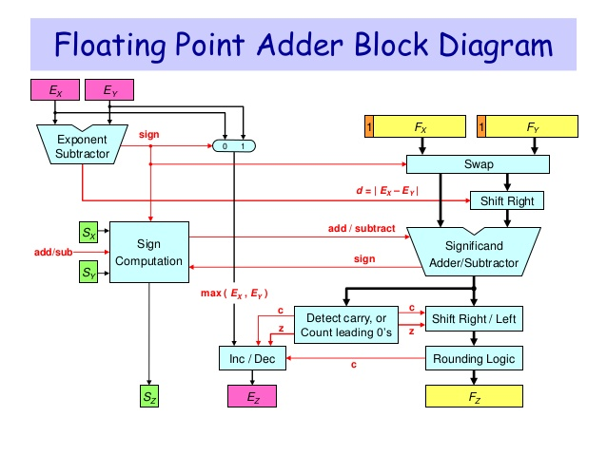

Slide 23
Floating point multiplication
Multiply mantissas, Add exponents
Renormalize the result if necessary
Round
Renormalize the result if necessary
Compute sign as s1 XOR s2

Slide 24
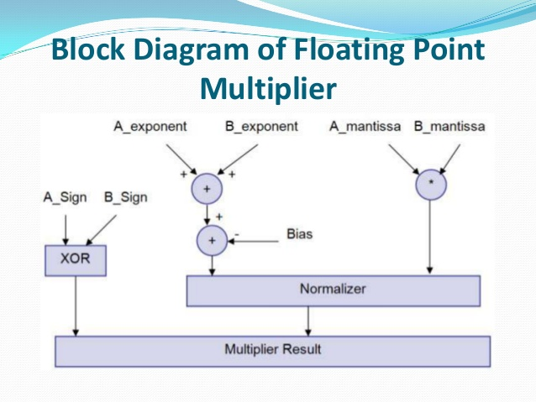

Slide 25
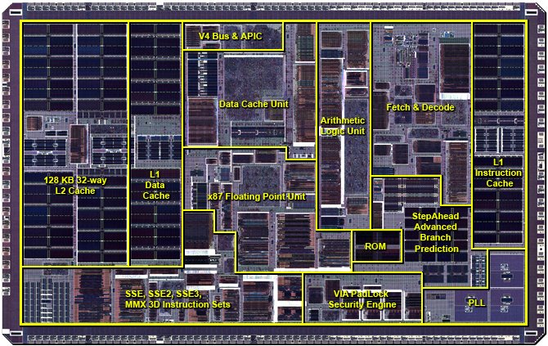
Via C7 processor (x87 architecture)

