Slide 1
Computer Electronics
Lecture 6: Digital Circuits and Verilog

Slide 2
Recap: Digital circuits
Combinational (no feedback paths)
Sequential (with feedback paths – remembers the past)
  Asynchronous (no clock signal)
  Synchronous (with clock signal)
Asynchronous circuits
  Very difficult to design: need to account for physical propagation delays and logic glitches
  Only small designs: latches and flip-flops
Synchronous circuits
  Easy to design: propagation delays and glitches are forced out of the equation
    During the clock period we wait for them to go way!
  Really large designs: CPUs, GPUs, FPGAs, custom

Slide 3
Recap: what is inside of a digital circuit?
τ_{P} < T
Inputs
Combinatorial circuit
Outputs
Current state
Register
Next state

Slide 4
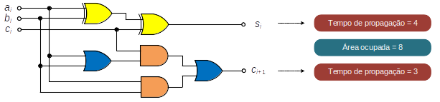
Recap: what is a combinatorial circuit?
Full adder circuit
S_{i} = S_{i}(a_{i}, b_{i}, c_{i});
C_{i}+1=C_{i}+1(a_{i}, b_{i}, c_{i})
Propagation delays!
Glitches!

Slide 5
Recap: what is a register
It is a set of memory elements (flip-flops or latches)
Latches are transparent, the output changes with the input if enabled: RARELY USED
Flip-flops are not transparent, the output only changes at on of the active clock signal edge: THEY ARE EVERYWHERE

Slide 6
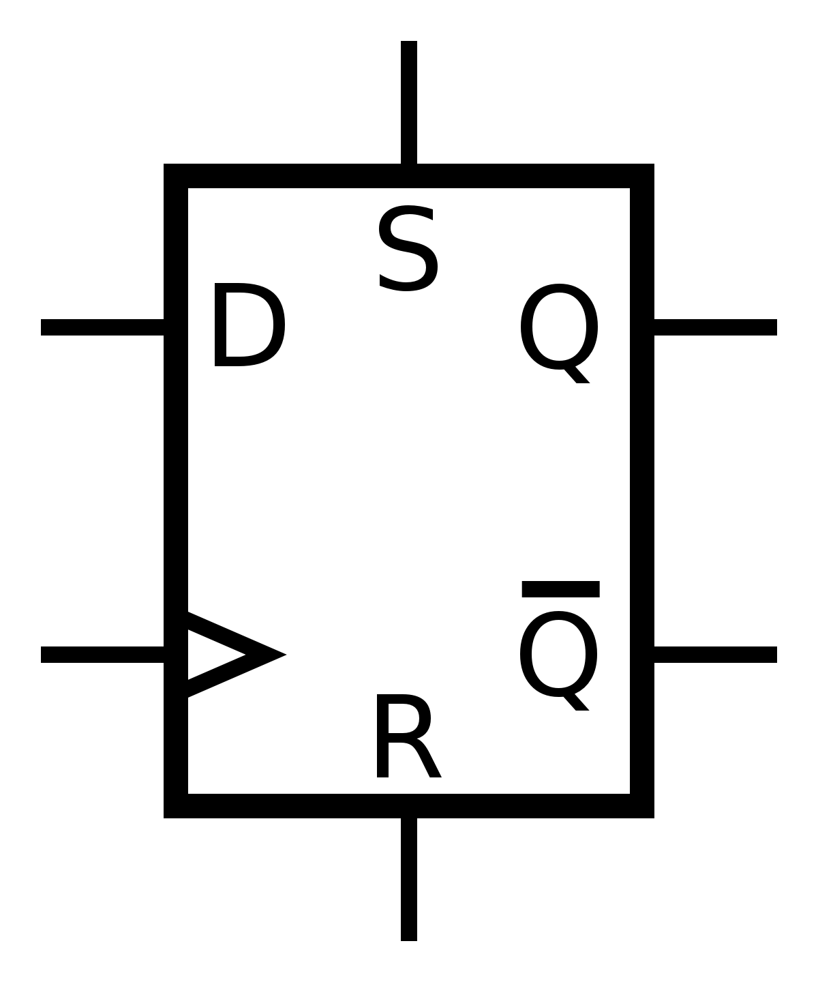
The FLIP-FLOP!
Only D type is studied
Verilog description is directly mapped to a library component
Set (S) and Reset (R) are optional
It is rare that S and R are simultaneously supported: no library component
Responds to the rising (positive) edge of the clock (CLK)
Responds to the falling (negative) edge of the clock if an inverter is placed at the CLK input (DANGER ZONE!)
The optional Enable signal (EN) determines whether the flip-flop will respond or not to the clock edge
EN
CLK

Slide 7
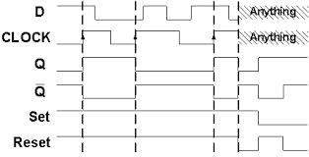
The FLIP-FLOP Timing Diagram
Setup time t_{S}
Hold time t_{H}
NO GLITHES!
T > t_{S}+max(t_{P,}t_{H})
f < (t_{S}+max(t_{P,}t_{H}))⁻¹
Propagation delay t_{P}

Slide 8
Behaviour summary
The output Q takes the value of the input D at the active clock edge after time t_{P}
The input D must be stable for at least a time t_{S} before the clock edge
The input D must be stable for at least a time t_{H} after the clock edge (automatically guaranteed by propagation time)
Violations of t_{S} and t_{H} result in malfunction!

Slide 9
The Flip-flop Set/Reset types
Asynchronous
  Output Q responds IMMEDIATELY (after small t_{P}) to assertions of S and R
Synchronous
  Output Q responds to S/R assertions present before the clock edge (before t_{S})

Slide 10
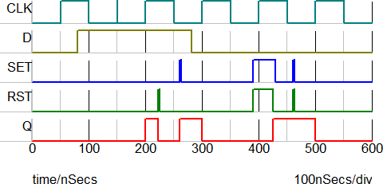
The FLIP-FLOP with asynchronus reset

Slide 11
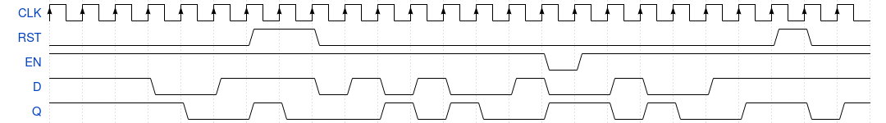
The FLIP-FLOP with synchronous reset and enable

Slide 12
So let’s learn Verilog! Or NOT!
The iob-lib repo has gone public as of today!
The iob-lib repo contains
  Useful Verilog macros to avoid writing the same Verilog description over and over again
  Useful components (modules) to avoid writing the same Verilog description over and over again
Enjoy!

Slide 13
Just learn 2 things!
τ_{P} < T
If any digital circuit is just this then you just need to learn to describe:
  combinatorial circuits
  registers
Not bad, is that?
Inputs
Combinatorial circuit
Outputs
Register
Current state
Next state

Slide 14
Signal Wires
Verilog describes circuits
Circuits are blocks connected by wires that carry digital signals (0 or 1)
So we need to declare and use wires
Verilog describes two types of wires: wire and reg
And the mess begins:
  A wire is a wire but it cannot be used in all situations
  A reg is a wire (not a register as the name suggests) but it cannot be used in all situations
What a start!!!

Slide 15
wire versus reg
So when do we use wire?
  A component output must be a wire
  The left hand side of an assign statement must be a wire
  A resolved signal must be a wire
So when do we use reg?
  In the left hand side of expressions inside a process
So what is assign, resolved signal, process?
It’s a long story to be made short with iob-lib!

