Slide 1
Computer Electronics
Lecture 7: Multiplier Circuits – Part 2

Slide 2
Lecture outline
Subtraction
Sign-extension
Signed multiplication
Add-Shift multiplier

Slide 3
Subtraction: fundamentals
Adder circuits work equally well with unsigned and signed numbers
A-B = A + (-B)
  To subtract simply add the symmetric
  Symmetric is 2’s complement
  Easiest way to compute 2’s complement in hardware
    Complement and add 1

Slide 4
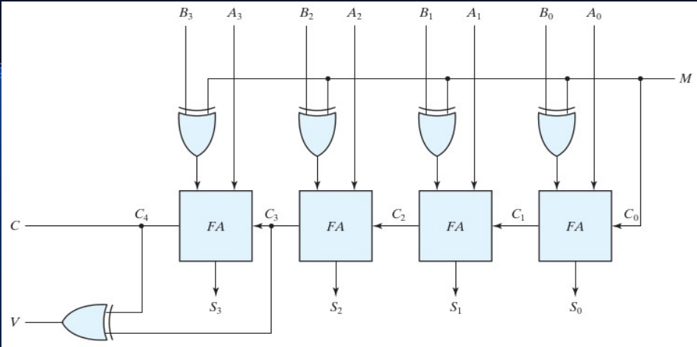
Subtraction: circuit

Slide 5
Sign extension
Sometimes there’s need to increase the number of bits for number representation
Sign of the number should be preserved
Q1: represent signed number 1000 (-8₁₀) with 8 bits
A1: 11111000 (sign extension in red)
Q2: represent signed number 0111 (7₁₀) with 8 bits
A2: 00000111(sign extension in red)

Slide 6
Logical/Arithmetic right shift
Shifting a number left by p positions is the same as multiplying it by 2^{p}
Shifting a signed number right by p positions is the same as dividing it by 2^{p}
Sign must me preserved: arithmetic right shift
1000 (-8₁₀) shift right by 2 (divide by 4)
  Logical right shift 0010 (2₁₀): wrong!
  Arithmetic right shift 1110 (-2₁₀): correct!

Slide 7
Signed multiplication: fundamentals
A = a3 a2 a1 a0, B = b3 b2 b1 b0
In decimal notation
B = -b3*2³ + b2*2² + b1*2¹ + b0*2⁰
A*B = A * [-b3*2³+ b2*2² + b1*2¹ + b0*2⁰]
Algorithm:
  Add least significant partial products, subtract most significant partial product

Slide 8
Signed multiplication: circuit
₁
a₃b₀
a₂b₀
a₁b₀
a₀b₀
a₃b₁
a₃b₁
a₂b₁
a₁b₁
a₀b₁
FA
FA
FA
FA
HA
FA’
a₃b₂
a₃b₂
a₂b₂
a₁b₂
a₀b₂
FA’
FA
FA
FA
HA
a₃b₃
a₃b₃
a₂b₃
a₁b₃
a₀b₃
FA’
FA
FA
FA
FA
1
p₇
p₆
p₅
p₄
p₃
p₂
p₁
p₀

Slide 9
Add-shift multiply: fundamentals
Use accumulator register
Successively add and shift the partial products
Multiplication ready after N partial products are accumulated
One accumulation per clock cycle

Slide 10
Add-shift multiply: circuit
zeroer
Multiplicand
register (n)
n
inverter
i==n
n
Counter
adder
c_{in}
n
n+1
Product-Multiplier (PM)
Right-Shift register (2n bits)

Slide 11
Add-shift signed multiply: example
Clock cycle | Product /multiplier reg | Comments
0 | 00000010 | Initial: P=0, m=0010
1 | 00000001 | Nop, SRA
2 | 11001000 | Add M, SRA
3 | 11100100 | Nop, SRA
4 | 11110010 | Subtract M, SRA
M=-7₁₀=1001 , m=2₁₀=0010
M*m = -14₁₀ = 11110010

Slide 12
Worksheet 11
Consider the add-shift multiplier in ecomp/verilog/add_shft_mul.v
Compile: iverilog add_shft_mul.v
Run: ./a.out
Modify the circuit to support signed multiplication, recompile and rerun

