Slide 1
Computer Electronics
Lecture 10
The iob-knn core and
the iob-soc-knn repository

Slide 2
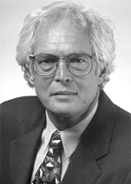
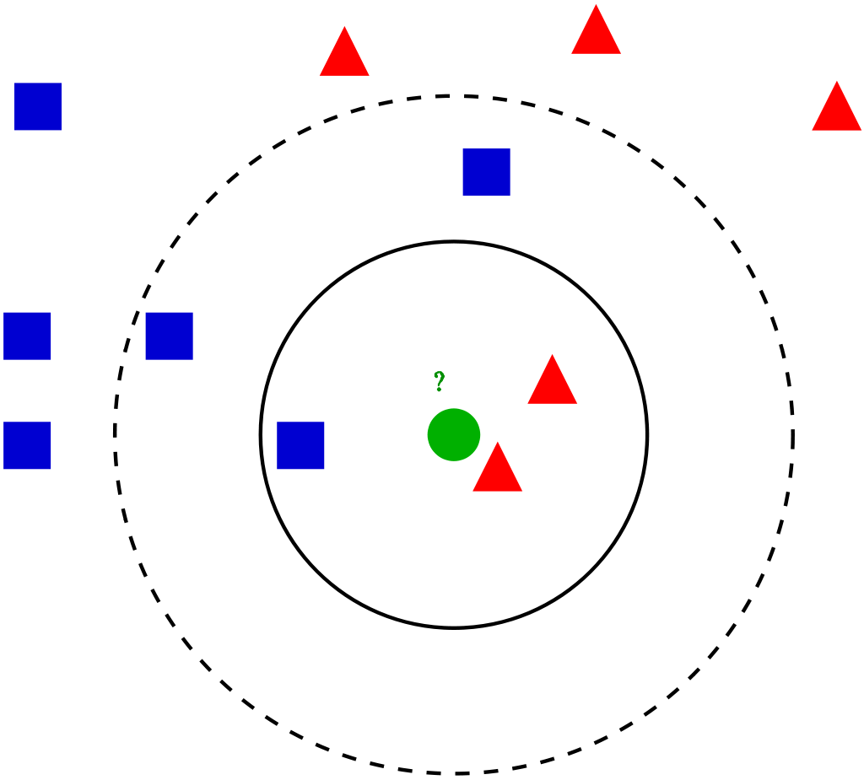
The KNN algorithm
Used for classifying data items
Requires dataset of already classified data: the labeled dataset
Will classify a set of data items: the test set
Thomas M. Cover KNN inventor

Slide 3
The KNN algorithm steps
Set K, the number of neighbors
For each test item
Compute the “distance” to all dataset items
Keep the k-nearest neighbours
Set the label of the test item as the most common label among the k neighbors

Slide 4
The IOb-KNN core
Git repository: github.com/IObundle/iob-knn
Let’s visit it

Slide 5
The IOb-KNN core software implementation
Constants
  S: random seed
  N: data set size
  K: number of neighbours (K)
  C: number of data classes
  M: samples to be classified (test set size)

Slide 6
The IOb-KNN core software implementation
Data structures
  Datum:
    X coordinate
    Y coordinate
    Label (unknown for test set)
    Both dataset and testset are arrays of Datum elements
  Neighbor:
    Index in dataset array
    Distance to test point
    A k-neighbor array is formed for each test-point
  Votes:
    Array of C positions, one per class, to hold the votes in each class

Slide 7
The IOb-KNN core software implementation
Functions
  Square distance:
    Euclidean distance not needed
    Square distance is enough for comparisons
  Insert element in position P of an array
Copy elements from P to N-1 to P+1 to N
To insert
here
P
P
P
Inserted
here
P+1
N-1
N

Slide 8
The IOb-KNN core software implementation (random numbers)
Used to create the dataset and testset internally and avoid communication with host
Used custom random number generator functions
Does the stdlib srand and rand functions work? How complex it is? How long do they take to execute?
To avoid these questions, we used our own
Uses generate polynomial, Linear Feedback Shift Register (LFSR)
  Algorithm not explained
  Can be implemented in hardware
2 Functions
  random_init(seed): similar to srand
  cmwc_rand(): similar rand, returns next pseudo random number

Slide 9
The IOb-KNN core software implementation of the algorithm
Initialize dataset and testset randomly
x,y coordinates, dataset has label, testset has not
Process each test point in test set

Slide 10
The IOb-KNN core software: process each test point
Init list of neighbors
  leave index blank
  assign distance to Infinity
Find the k neighbors; for each point in dataset
  compute distance to test point
  find P, the position of the first farther neighbor in list
  insert data point at position P in neighbor list
Compute the label using the k neighbors

Slide 11
The Iob-SoC-KNN system
Git repository: github.com/IObundle/iob-soc-knn
Let’s visit it

