Slide 1
Computer Electronics
Lecture 3: The picoVersat Processor

Slide 2
Outline
picoVersat architecture
PicoVersat instruction set
PicoVersat assembler
Example program
Assembling and running the program the Icarus Verilog simulator
Worksheet #3

Slide 3


The picoVersat Controller
A really tiny controller processor (500 logic gates)
Originally used to control the Versat CGRA (sort of FPGA)
16 instructions, accumulator machine

Slide 4
picoVersat Load/Store instructions
RDW: Load to RA (address as immediate)
WRW: Store from RA (address as immediate )
RDWB: Load to RA (address in RB)
WRWB: Store from RA (address in RB)
LDI: Load immediate to low part (15:0) of RA, sign extension in high part
LDIH: Load immediate to high part (31:16) of RA, keep low part

Slide 5
picoVersat Arithmetic/Logical instructions
AND: Logic AND with RA (address as immediate)
SHFT: Shift RA 1 bit to left/right (direction as immediate, arithmetic shift)
ADDI: Add immediate to RA
ADD: Add to RA (address as immediate)
SUB: Subtract from RA (address as immediate)

Slide 6
Versat branch instructions
BEQI: Branch to immediate address if RA=0
BNEQI: Branch to immediate address if RA!=0
BEQ: Branch to address if RA=0 (immediate is the pointer to address)
BNEQ: Branch to pointer if RA!=0 (immediate is the pointer to address)

Slide 7
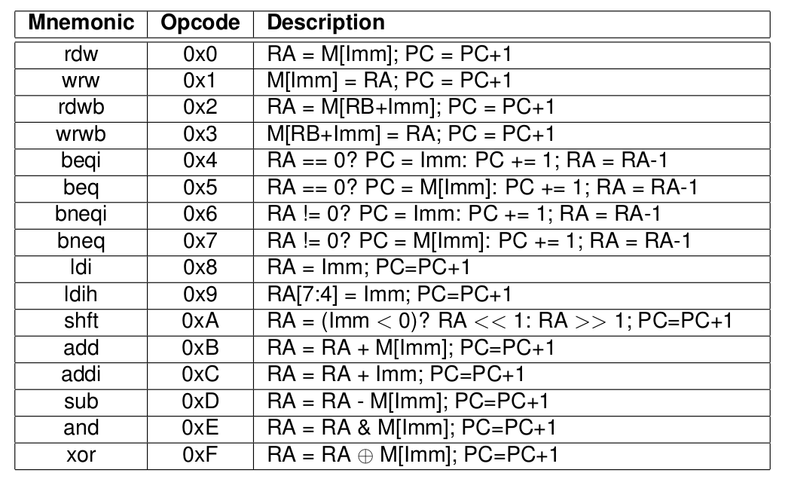
Versat instruction set summary

