Slide 1
Computer Electronics
Lecture 10: Presentation of the lab project: the k-nearest neighbors algorithm

Slide 2
The timer design: what we have learned
Creating a hardware peripheral for the iob-soc system using Verilog and the iob-lib macros and python scripts
Creating the software driver for the peripheral using the C language and the iob-lib python scripts
Creating documentation for the peripheral
  Not fully explained
  Visit the ug.pdf file

Slide 3
The User Guide
Title page: ug.tex, version.txt, shortHash.txt
  Visit and/or grep
Table of contents, list of figures and tables
Introduction: intro.tex
Symbol: symb.odg
Features: features.tex
Benefits: benefits.tex
Deliverables: deliverables.tex
Block diagram: bdd.tex, bd.odg
Table of block descriptions: bd_tab.tex, iob-timer.v

Slide 4
The User Guide (continued)
Synthesis parameters: sp_tab.tex, iob-timer.v
Interface signals: iob-timer.v, cpu_nat_s_if.v, gen_if.v
Table of registers: timer_sw_reg.v
Tables of FPGA results: ir.tex, alt_results.tex, xil_results.tex

Slide 5
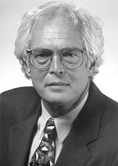
The k-nearest neighbors (KNN) algorithm
Machine learning algorithm
Invented by Thomas M. Cover, Stanford University
Useful in pattern recognition
Several application in biomedical sciences and technology

Slide 6
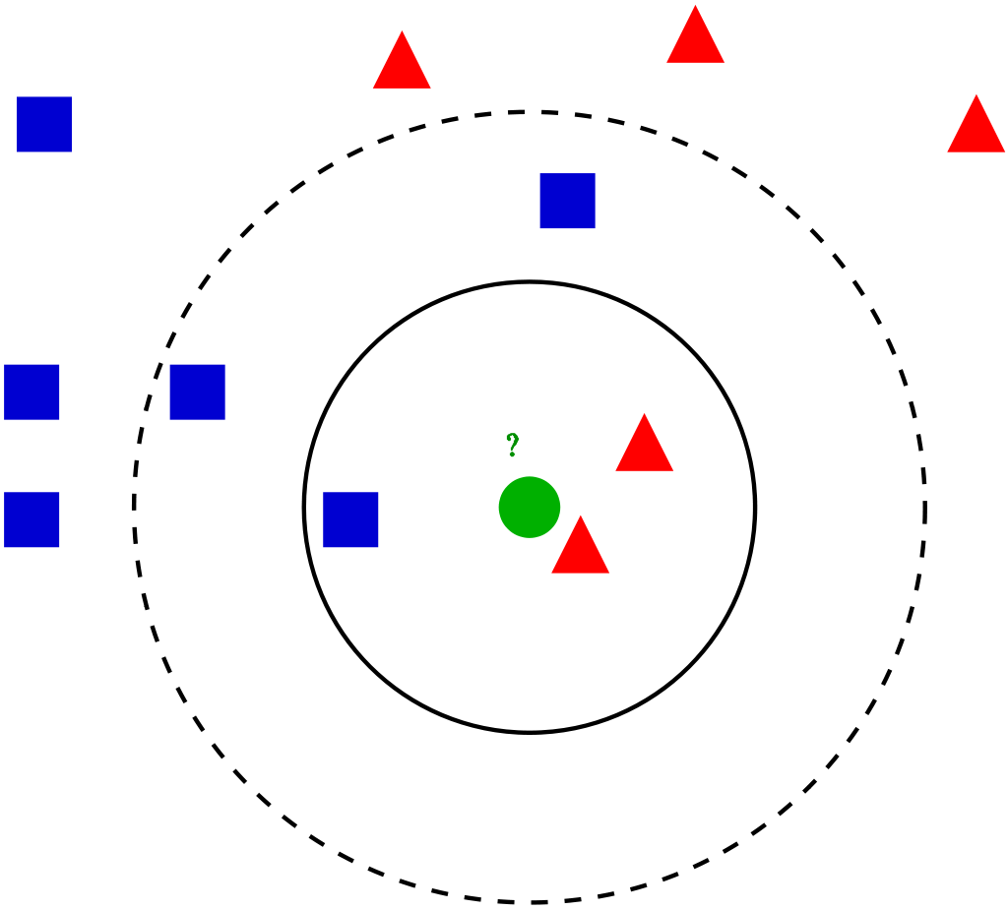
The KNN algorithm
Used for classifying data items
Requires dataset of already classified data: the labeled dataset
Will classify a set of data items: the test set

Slide 7
The KNN algorithm steps
Set K, the number of neighbors
For each test item
Compute the “distance” to all dataset items
Keep the k-nearest neighbours
Set the label of the test item as the most common label among the k neighbors

