Slide 1
Electronic Systems of Computers
Lecture 5: IOb-SoC Purpose, Digital Circuits and Verilog

Slide 2
Recap last lesson: the IOb-SoC submodules directory
System submodules
  CPU
  CACHE
  UART
A git submodule is a pointer to another git repository
  Allows for modular and distributed development
  Easy to add with the git submodule add <url> path/to/the/submodule
  Easy to remove: git rm path/to/the/submodule
The way the system collects hardware and software components from the submodules and assembles them in the system is discussed in this lecture.

Slide 3
IOb-SoC: use cases
Tool to develop SoCs
Tool to develop new processor Peripherals
Tool to develop new Embedded Software
Tool to develop interesting new applications that rely on new custom designed hardware blocks

Slide 4
IOb-SoC: exploiting parallelism
Moore’s (INTEL’s co-founder) law is dying (is it?):
  #transistors per m² is not doubling every 2 years!
  Frequency of operation is not steadily increasing, it has stagnated
Huang’s (NVIDIA’s chief) law is being born:
  GPU performance is doubling every 2 years!
  A GPU is a many (simple) core solution: exploits parallelism in hardware
Any parallel design can do the same, not just GPU
AI and Machine Learning provide plenty of opportunities
Daniel Garigali & Pedro Miranda Yolo V3 implementation!

Slide 5
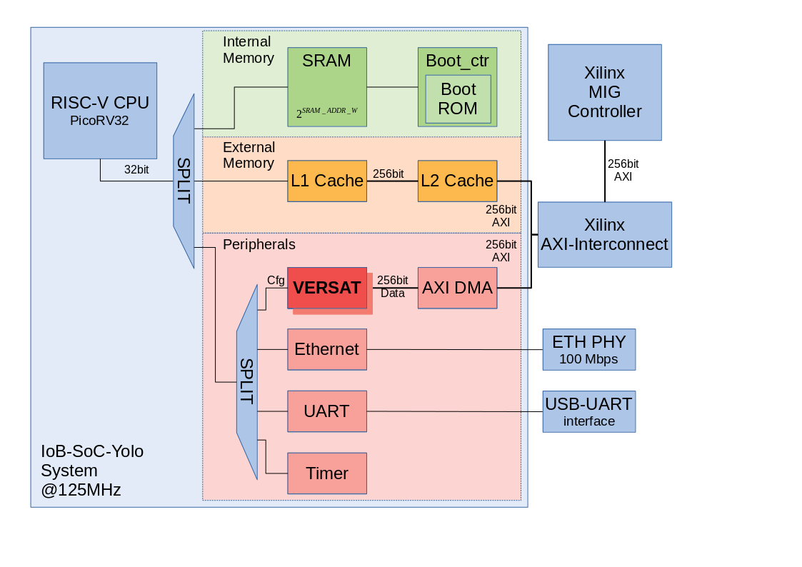
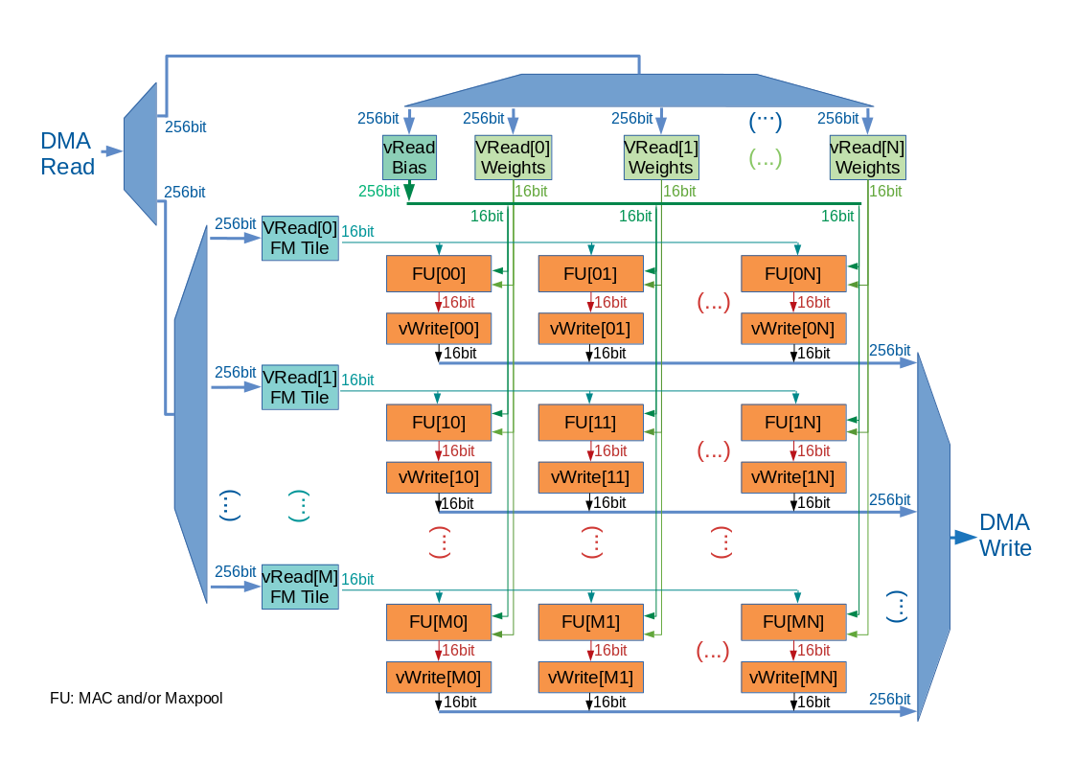
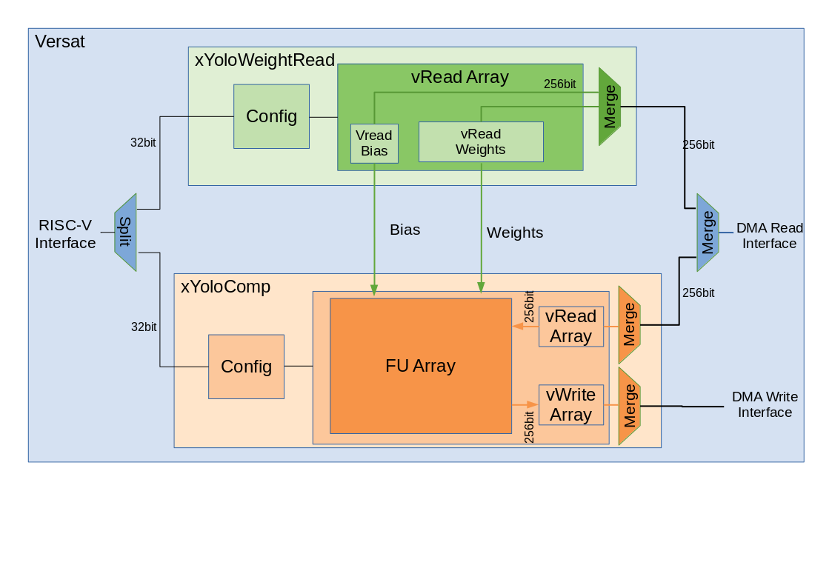
IOb-SoC: Yolo V3
CPU is less than 1% of design
Me: could you use a more powerful CPU?
Daniel and Pedro: what for? The bottleneck is not the CPU!
Two brilliant master theses!

Slide 6
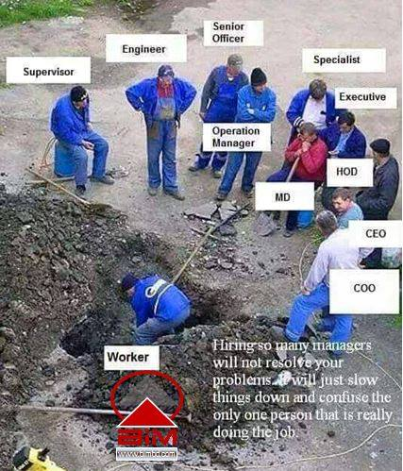
IOb-SoC: using silicon to do WORK, not management
CPUs have evolved to use silicon for managing purposes rather than doing the actual work
Memory management units
Out of order execution management
Cache management
ALU!

Slide 7
IOb-SoC: import components with git submodules
Easy way to import hardware and respective software components into IOb-SoC
Add peripheral as git submodule in the submodules directory
  Example: /home/user/sandbox/iob-soc/submodules/TIMER
In config.mk, add peripheral name to PERIPHERALS list variable
  PHERIPHERALS := UART TIMER

Slide 8
IOb-SoC: how peripherals are imported
The Makefile inserts peripherals automatically
Visit hardware.mk
Visit software.mk:
  Address structure:
  {Pbit, Slave ID, Not Used, Slave Internal Address}
  Pbit: 1 bit
  Slave ID: $clog2(N_SLAVES) bits
  Slave internal address width: $clog2(#addresses)
  (TIMER_ADDR_W, UART_ADDR_W)
What do you do next?
  Test in simulation: short tests with icarus, longer tests with Verilator(!)
  Test in FPGA: prove in silicon, run longer tests

Slide 9
Verilog module (a digital circuit)
Verilog module
A Digital Circuit
Inputs
Outputs
inouts (bidirectional wires)

Slide 10
Verilog module (a circuit)
module my_peripheral
(
input clk,
input rst,
// native bus
input valid, //denotes a valid read or write operation
input [`SRAM_ADDR_W-3:0] addr, //address to read or write
input [`DATA_W-1:0] wdata, //data to be written
input [`DATA_W/8-1:0] wstrb, //bytes to be written
output [`DATA_W-1:0] rdata, //data to be read
output ready //read or write completed and ready for next
);
//description of module goes here
endmodule

Slide 11
The testbench
The testbench
Output
Input
UUT
Signal analyzers
Signal sources
Pass/Fail

Slide 12
Verilog testbench
(not a real circuit!)
Used in Verilog simulation!
module my_testbench;
//description of test hardware
//instance of the Unit Under Test
endmodule

Slide 13
Verilog header files
`include “my_header_file.vh”
// this like the C language #include
module my_testbench;
//description of test hardware
//instance of the Unit Under Test
endmodule

Slide 14
Verilog macros
`define X 13
// this like the C language #define
`define SUM(A,B) A+B
//macros with arguments are supported
ATTENTION: macros are not functions!
They are just a clever Cut & Paste mechanism
They are handled by the pre-processor that does the Cut & Paste
assign C = `SUM(A,B);
assign C = A + B;

Slide 15
What is inside of ANY digital circuit?
Inputs
Combinatorial circuit
Outputs
Current state
Register
Next state

Slide 16
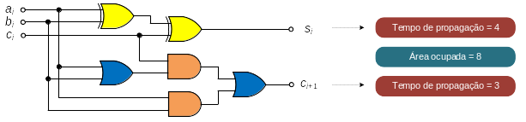
What is a combinatorial circuit?
Full adder circuit
S_{i} = S_{i}(a_{i}, b_{i}, c_{i});
C_{i}+1=C_{i}+1(a_{i}, b_{i}, c_{i})
Propagation delays!
Glitches!

Slide 17
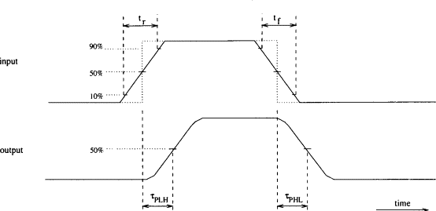
Propagation delay

Slide 18
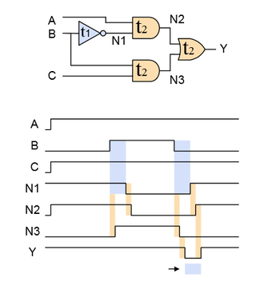
Combinational glitches!

Slide 19
Digital circuits
Combinational (no feedback paths)
Sequential (with feedback paths – remembers the past)
  Asynchronous (no clock signal)
  Synchronous (with clock signal)
Asynchronous circuits
  Very difficult to design: need to account for physical propagation delays and logic glitches
  Only small designs: latches and flip-flops
Synchronous circuits
  Easy to design: propagation delays and glitches are forced out of the equation
    During the clock period we wait for them to go away!
  Really large designs: CPUs, GPUs, FPGAs, custom

Slide 20
What is a register
It is a set of memory elements (flip-flops or latches)
Latches are transparent, the output changes with the input if enabled
Flip-flops are not transparent, the output only changes at on of the clock signal edges

