Slide 1
Computer Electronics
Lecture 9: Multiplier Circuits – Part 1

Slide 2
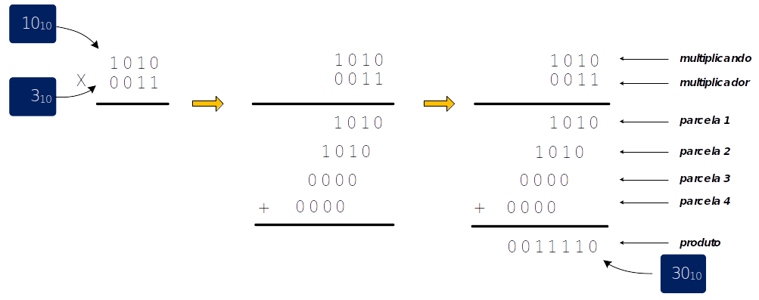
Matrix multipliers: algorithm
multiplicand
multiplier
partial product0
partial product1
partial product2
partial product3
product

Slide 3
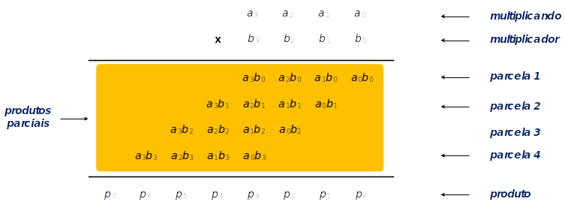
Matrix multiplier: notation

Slide 4
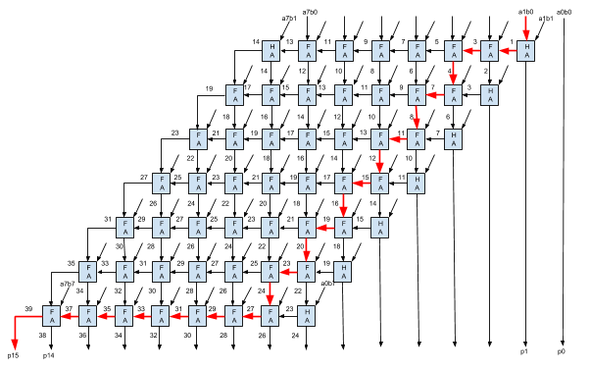
Matrix multiplier with ripple carry

Slide 5
Pipelined MM w/ RCA
Pipeline stages after each partial product addition
What is the maximum clock frequency?

Slide 6
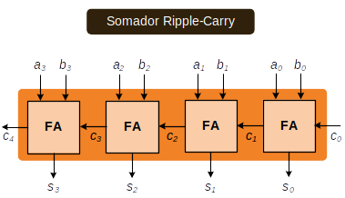
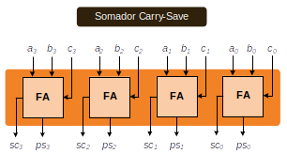
Carry-Save Adder Principle
Ripple-carry
adder
Carry-save
Adder stage

Slide 7
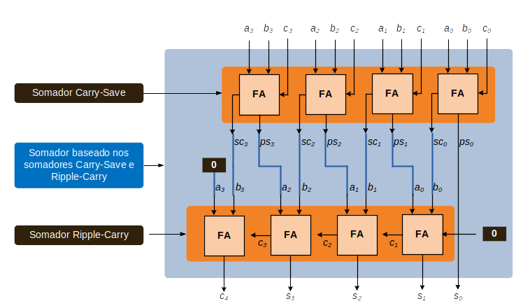
3-input adder using carry-save stage
Carry-save
Adder stage
Carry-save
based adder
Ripple-carry
adder

Slide 8
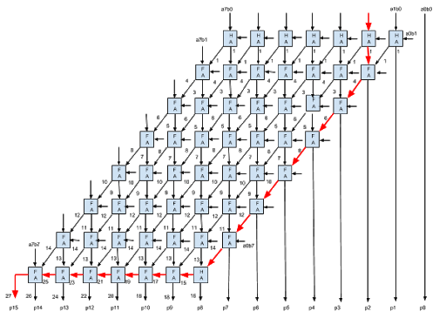
Matrix multiplier with carry save

Slide 9
Pipelined MM w/ CSaA
Pipeline stages after each partial product addition
What is the maximum clock frequency?
  What is the stage responsible for it?
Solution for increasing the frequency
  Work at the CSaA clock frequency
  Use N-1 clock cycles to compute the last stage

Slide 10
Worksheet #9
Design a 2-bit carry-save unsigned multiplier and simulate all possible 16 combinations of the inputs

