Slide 1
Computer Electronics
Lecture 1: Course introduction

Slide 2
About the course
Basic organization of a modern computer system
Main digital electronic components
Practical approach: design, verify (simulate), and implement in silicon
Commercial design tools and IP are very expensive (millions)
Today there are open-source design tools and IP
  Hardware design is being democratized!

Slide 3
About me
José Teixeira de Sousa
  IST/DEEC professor
  IObundle manager
https://www.linkedin.com/in/jose-t-de-sousa-a34b86/

Slide 4
The classes
Theory lectures
  2 x 1h30 per week
Laboratory sessions
  1 x 1h30 per week

Slide 5
Theory lectures
Presentation of materials: 1 hour or less
Online Google Form Quiz: ½ hour

Slide 6
Lab sessions
Groups of 1, 2 or 3 students
1 introductory lab assignment
1 project during the whole semester
  A simple computing system will be developed
Each group must have a git repository
  Software: C code
  Hardware: Verilog code of an accelerator for the software
  Documentation: user guide done in Latex

Slide 7
Lab tools
Linux distro and associated tools: Make, code editor (Emacs recommended), bash, sed, etc. 40+GB recommended size
Icarus Verilog for digital circuit simulation
Gtkwave for visualizing waveforms
Tex Live (full installation)
FPGA synthesis and implementation
  Xilinx ISE/Vivado?
  Intel Quartus?
OpenRoad ASIC synthesis and implementation?

Slide 8
Evaluation
Exam or 2 tests (T)
Lab (L)
Google form quizzes (E, optional)
Minimum mark on T or L: 8/20
Mark:
  M = max(0.4T+0.2E+0.4L, 0.6T+0.4L)

Slide 9
Tests and exams
2 Tests or Exam
Duration:
  Tests: 1h30
  Exam: 3h00
Check Fénix for dates
Exam is divided in 2 parts which may be used to recover one of the tests

Slide 10
Lab evaluation criteria
Instructor will
  Git clone your group’s git repository
  Run simulation (make sim)
  Run FPGA implemenation (make fpga)
  Generate document (make doc)
  Make sure the above works flawlessly
  Quality of the solution (performance, frequency, size trade-offs and presentation)

Slide 11
Course program
Processor Systems on Chip
The Verilog Hardware Description Language (HDL)
The Arithmetic and Logic Unit
Memories (SRAM, DRAM, CACHE)
Peripherals, especially for acceleration

Slide 12
Bibliography
The Internet!
Lecture slides
Exercises and their resolution
Lab materials

Slide 13
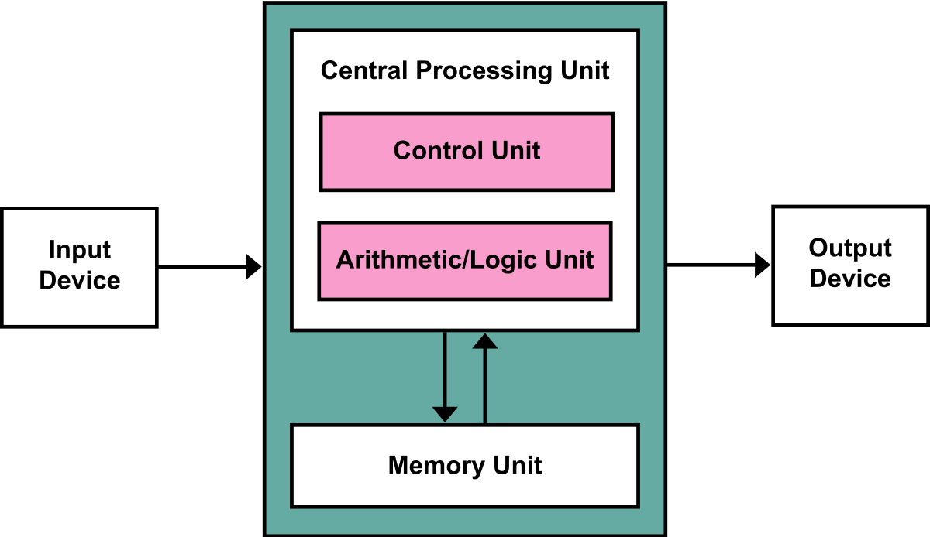
The von Neumann Architecture
Notes:
This is a classical von Neumann Computer Architecture.
Most computers follow this architecture.
A computer takes data from an input device, performs some computation and sends data to an output device
The input device is optional but the output is mandatory. The computer must produce something or otherwise it does nothing.
The computation is performed in the Central Processing Unit comprising the CU and ALU
The memory Unit stores the Program (instructions) and the Data (constants,temporary variables)

Slide 14
The von Neumann Architecture in practice
CPU
Processor Bus
MASTER
SLAVES
Output bus
BUS SPLIT
Input bus
Output
Devices
Output
Devices
Output
Devices
Output
Devices
Output
Devices
Output
Devices
Output
Devices
Input
Devices
Output
Devices
Memory
Accelerators’ bus
Output
Devices
Output
Devices
Output
Devices
Output
Devices
Output
Devices
Compute
Devices
Memory bus
Notes:
Let’s simplify the vNA.

Slide 15
The Processor Bus
Processor buses can be complex, for example ARM’s AXI
In this course a minimalistic yet effective 6-signal bus called the Native Bus will be used:
Signal Name | Direction wrt CPU | Width in bits (wires) | Description
Valid | Output | 1 | CPU wants to access data or instructions
Address | Output | 32 | Address of the data
Wdata | Output | 32 | Data to write
Wstrb | Output | 4 | Byte write
Rdata | Input | 32 | Data read
Ready | Input | 1 | Slave is ready
REQUEST
RESPONSE
Notes:
Let’s simplify the vNA.

Slide 16
Static Random Access Memory (SRAM): the simplest memory
SRAM
Enable
Address (AW bits)
Read Data (DW bits)
Write
Write data (DW bits)
Notes:
Let’s simplify the vNA.

Slide 17
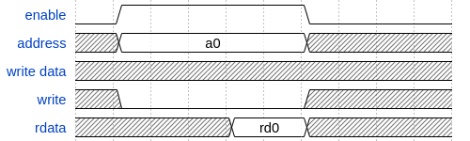
SRAM: reading the memory
Wait time
Hold time
Read access time
Notes:
Let’s simplify the vNA.

Slide 18
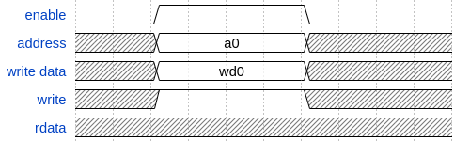
SRAM: writing the memory
Write access time
Notes:
Let’s simplify the vNA.

Slide 19
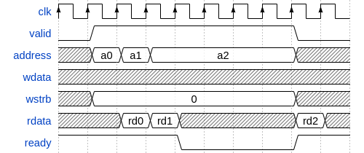
Master reading from slave
Notes:
Let’s simplify the vNA.

Slide 20
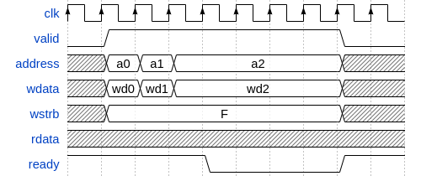
Master writing to slave
Notes:
Let’s simplify the vNA.

