Slide 1
Computer Electronics
Lecture 22: SRAM

Slide 2
Outline
Static memory cells
DRAM vs. SRAM
SRAM read operation
SRAM write operation
SRAM sense and write amplifiers

Slide 3
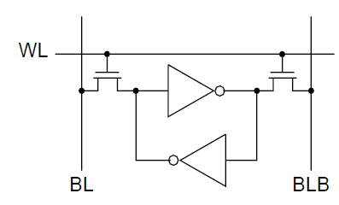
A static memory cell

Slide 4
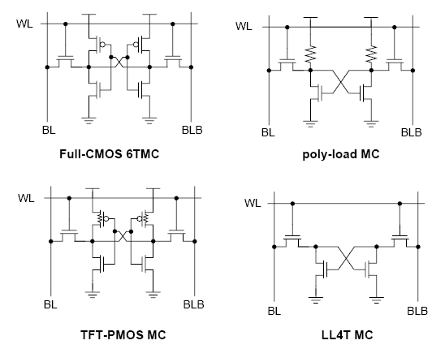
Static cell types

Slide 5
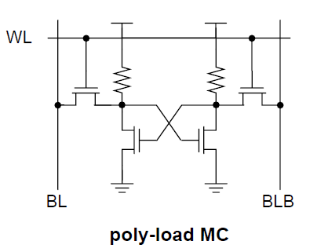
Poly load
Implemented in a separate polysilicon layer
Advantage:
  30% area reduction
Disadvantages
  Non standard technology
  Resistors can’t be shrunk anymore

Slide 6
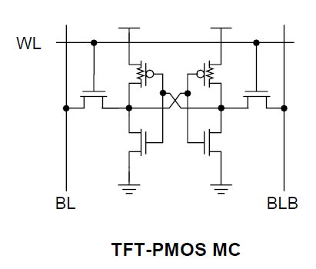
TFT PMOS
Polysilicon transistor built on top of NMOS transistor
Advantage:
  Area reduction
Disadvantage
  Non standard technology

Slide 7
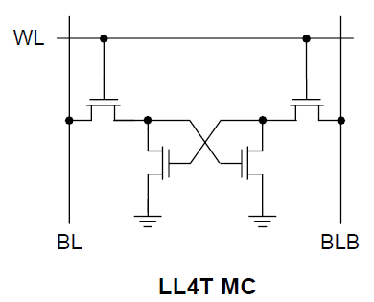
Loadless SRAM Cell
Information stored in gate capacitor
Advantages:
  Standard technology
  Up to 65% area reduction!
Disadvantage
  Leakage current may wipe info away

Slide 8
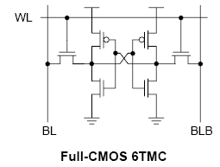
6T standard SRAM cell
Most common SRAM cell
Advantage:
  Implemented with regular CMOS technology
Disadvantage
  Larger area

Slide 9
SRAM vs DRAM
Cells are much larger: 6T instead of 1T+1C(parasitic). DRAM is denser
Cells consume only leakage current, no expensive periodic refresh. SRAM is lower power
Cost is exponential with area due to Yield problems
SRAM much more expensive than DRAM (cost per bit)

Slide 10
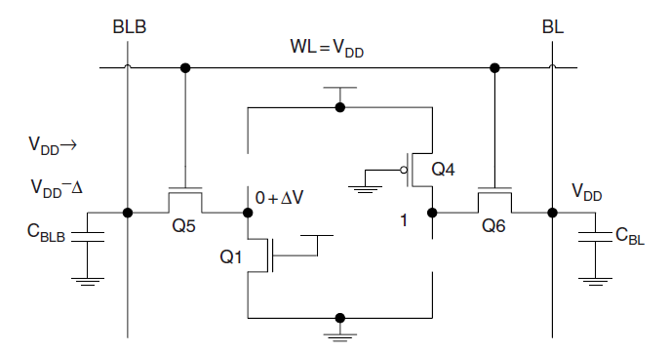
SRAM read operation

Slide 11
SRAM read circuit
V_{DD}
Pre-charge BL at VDD
Turn on the access switch
Wait for a voltage at BL to drop
Note that BLB voltage stuck at V_{DD}
I_{D} = k(V_{DD}-V_{T})² (constant current discharge)
Δ t = C_{d} ΔV / I_{D}
Ideal switch
BL
VDD-ΔV
V_{DD}

Slide 12
SRAM read procedure
Pre-charge BL and BLB at the same voltage VDD
Turn on the access transistors (row decoder)
Wait for a voltage difference to develop between BL and BLB
Select the column (column decoder) to access the (shared) sense amplifier and wait for voltage levels to be restored
Read the SRAM data IO pins

Slide 13
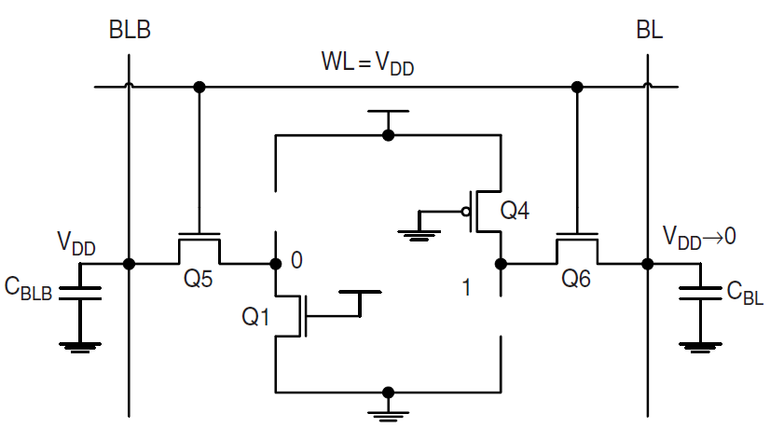
SRAM write operation

Slide 14
SRAM write circuit
Pre-charge BLB at VDD
Turn on the access switch (row)
Apply write amp (column)
BL discharges slowly via cell
BLB discharges fast via write transistor
Simple model: write transistor is resistor Ra, cell transistor too weak, ideal switch
V_{DD}
‘0’
SRAM cell
pull-up
V_{DD}
Ideal switch
BL
V_{DD}→V_{DD}/2
Initially stored ‘1’:
BL = ‘1’, BLB=’0’
Write ‘0’:
BL=’1’
BLB=’0’
V_{DD}
X
Y
Δt = RC ln(X/Y)

Slide 15
SRAM write procedure
Pre-charge BL and BLB at VDD
Apply the write values to the chip IO pins
Select the row to provide an electrical access to the cell
Select the column so that the (shared) write amplifier will drive and force the cell to the desired state

Slide 16
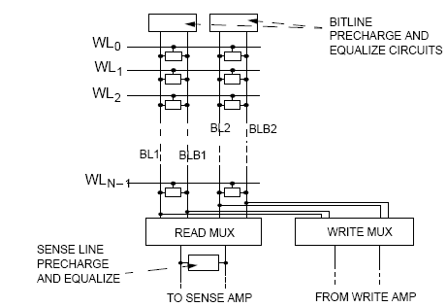
Shared sense and write amps

Slide 17
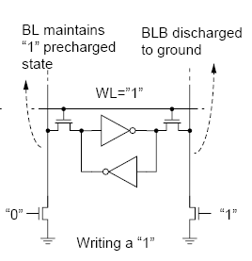
SRAM write amplifier
Use pre-charge facility already in place for reading
Use simple pull-down transistors for writing
If pre-charge value is VDD then only one line needs to be pulled down!

