Slide 1
Computer Electronics
Lecture 23: Memory Organization

Slide 2
Outline
Organization of memory cells
Address and data busses
Memory hierarchy
DRAM devices revisited
Bank interleaving
SIMM and DIMM
Combining memory chips for width and depth
Rank, bank, row, column

Slide 3
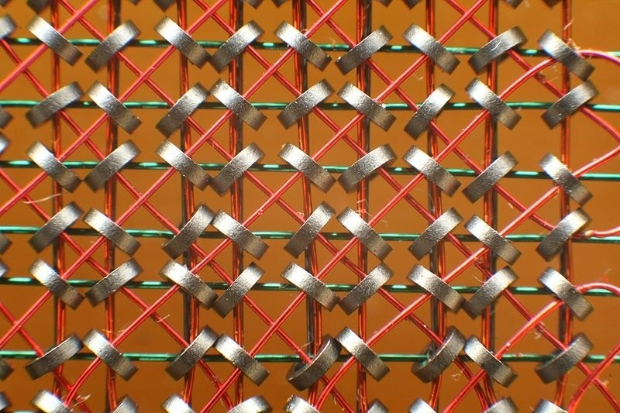
Memory cell organization
Matrix organization since ferrite memories
Optimal 2D organization
Future
  3D organization (layer, row, column)
  nD organization with quantum memories

Slide 4
Address and data busses
Row decoder
Time demux or splitter
2D
memory
array
Address bus
(row+column, time multiplexed or not)
2D
memory
array
2D
memory
array
2D
memory
array
Row address
Column decoder
Column address
Data bus (n bits)

Slide 5
Memory hierarchy
CPU
Registers
Hundreds of bytes, same cycle access
L1 Cache
SRAM, Tens of K bytes, 1 clock cycle
L2 Cache
SRAM, Hundreds of K bytes, tens of nanoseconds
Main memory DRAM, giga bytes, hundreds of nanoseconds
Secondary memory
Disk, terabytes, hundreds of microseconds
On-chip memory
Off-chip memory

Slide 6
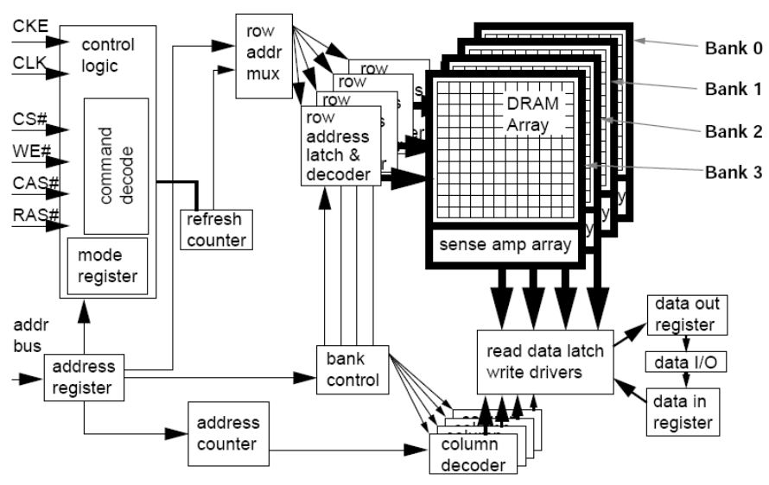
SDRAM chip example architecture

Slide 7
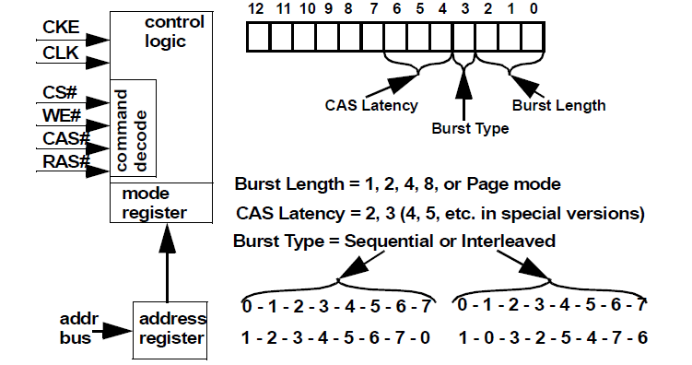
SDRAM chip control

Slide 8
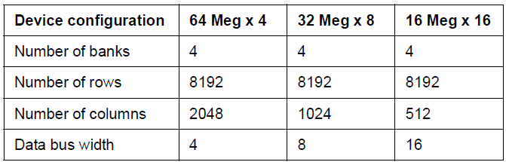
Possible device configurations
Super cell size
1
2
4

Slide 9
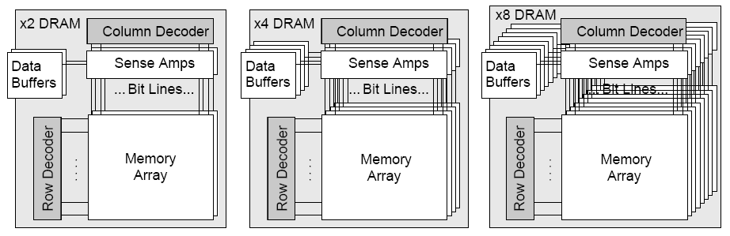
DRAM: different data widths

Slide 10

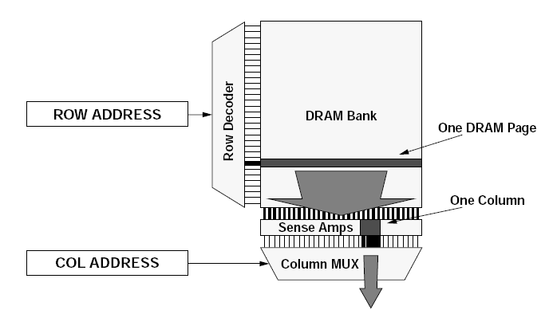
DRAM page

Slide 11
Bank interleaving
Increase bandwidth by interleaving
Without interleaving – slower
Bank 1
D1 Access
D1 available
D2 Access
D2 available
….
With interleaving – faster, pipelined
Bank 1
D1 Access
D1 available
Bank 2
D2 Access
D2 available
Bank 3
D3 Access
D3 available
Bank 4
D4 Access
D4 available

Slide 12
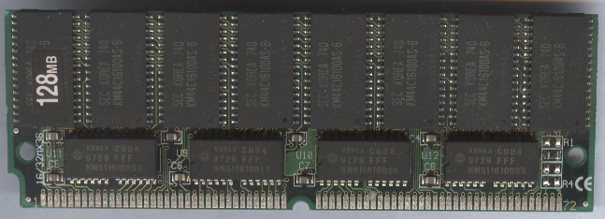
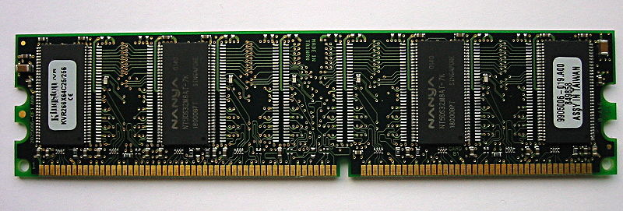
SIMM and DIMM
Single Inline Memory Module
  Same connectors on both sides
  Obsolete
Dual Inline Memory Module
  Different connectors on either side

Slide 13
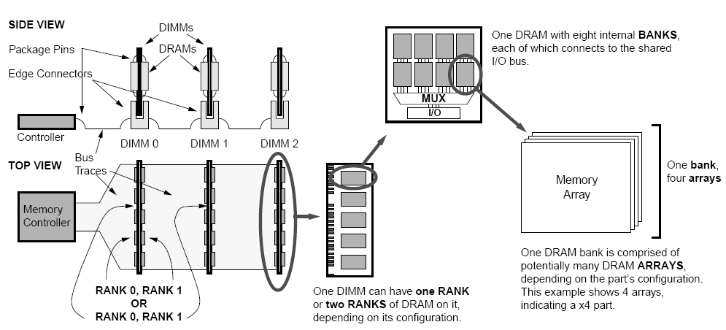
Dual Inline Memory Module (DIMM)

Slide 14
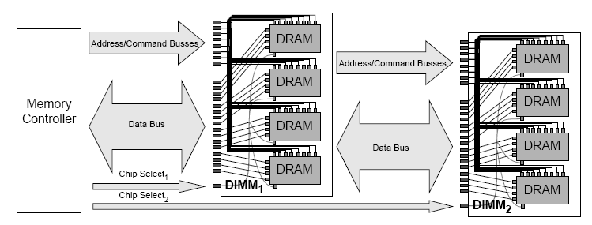
DIMM connections

Slide 15
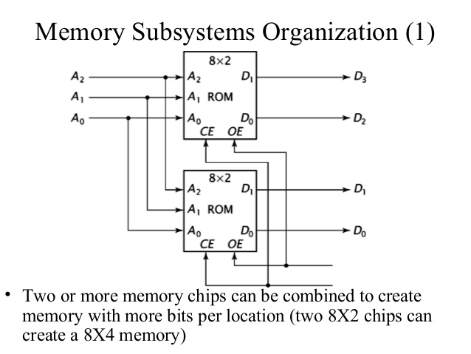
Combining memory chips to increase data width

Slide 16
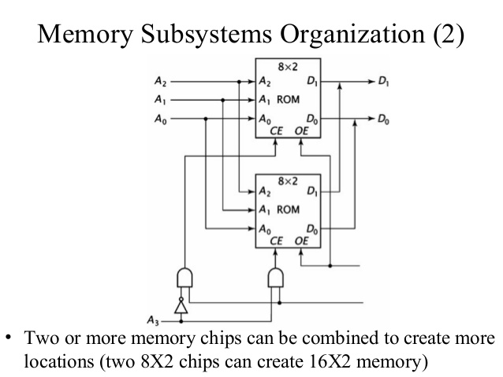
Combining memory chips to increase memory locations

Slide 17
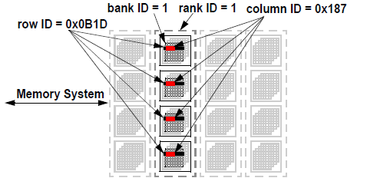
Rank, Bank, Column, Row

Slide 18
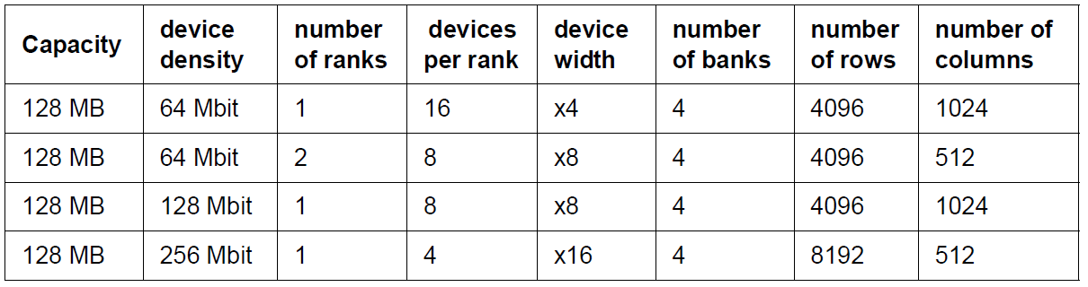
128MB module example

