Slide 1
Computer Electronics
Lecture 7: Adder Circuits – Part 1

Slide 2
Outline
The Arithmetic and Logic Unit (ALU)
Representation of integer numbers
Adder types:
  Ripple carry adder
  Carry select adder
Worksheet

Slide 3
Typical ALU operations
Arithmetic: Addition, subtraction
Logical: NOT, AND, OR, XOR, …
Less common (normally performed by dedicated FUs):
  Bit shifting: left, right (logical or arithmetic)
  Multiplication
  Division

Slide 4
Why only simple operations?
Complex operations require more hardware whose cost must be justified
Certain complex functions can be added as needed:
  Dedicated IP cores integrated in the same chip
  Dedicated chips integrated in the same board

Slide 5
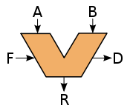
The origin of the ALU
John von Neumann proposed it
EDVAC computer, 1945

Slide 6
Integer number representation
Binary: easy to implement and robust to noise
Resolution: number of bits
Unsigned numbers: 0, 1, 2, …., N
Signed numbers: -N/2, -N/2+1, -1, …, 0, +1, …, N/2-1

Slide 7
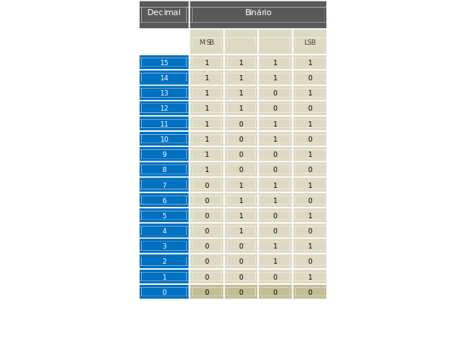
Unsigned numbers

Slide 8

Signed numbers in 2’s complement

Slide 9
How to compute the 2’s complement
Method 1:
  Invert all bits
  Add 1
Method 2:
  Scan number from right to left
  Up to the first 1 inclusively: leave unchanged
  Invert all remaining bits
Visualize in a circle

Slide 10
Adder circuits
Addition is the most basic arithmetic operation
Basis for more complex operations, e.g. multiplication
Different possible implementations
  Simple implementation: small and cool but slow
  Complex implementation: fast but big and power hungry
Technology used influences architecture choice

Slide 11
Unsigned addition
Add 1010 = 10 base 10 and 0011 = 3 base 10
1010
+0011
1101
0010 -> Carry
Overflow happens if
result < some operand
1010 -> 10
+1010 -> 10
0100 -> 4 (!)
1010 -> Carry

Slide 12
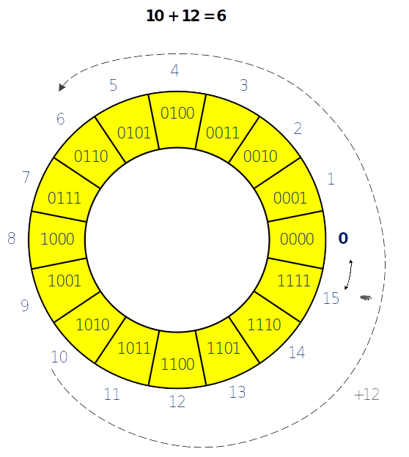
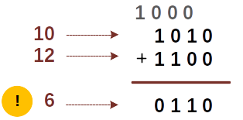
Overflow
Just check the last carry bit

Slide 13
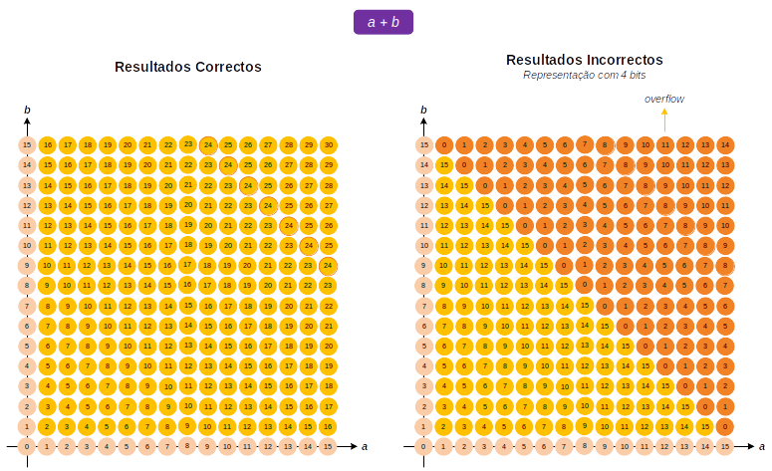
Overflow pairs

Slide 14
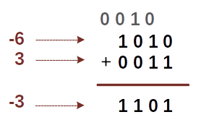
Signed addition

Slide 15
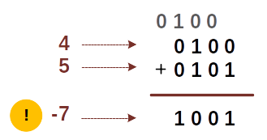
Signed addition overflow

Slide 16
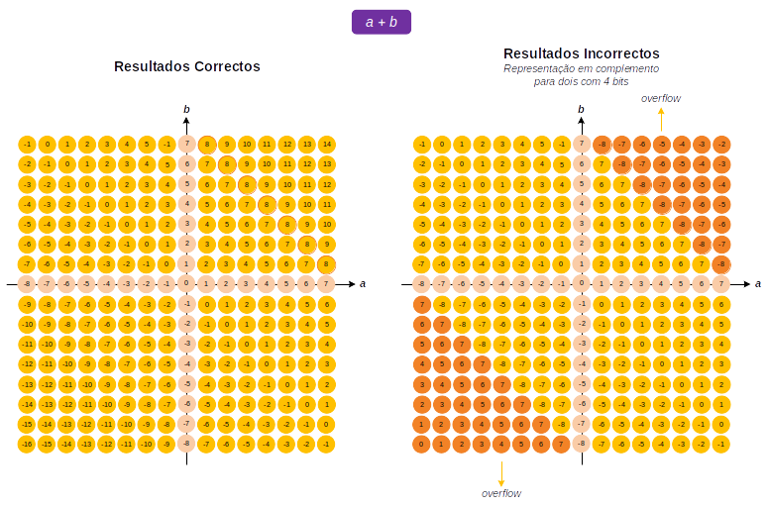
Signed addition pairs

Slide 17
Detect signed addition overflow
Adding 2 positive numbers results in negative number
Adding 2 negative numbers results in positive number
Can be checked by testing the last 2 carry bits
  If they are equal (00 or 11) then no overflow
  If they are different (01 or 10) then overflow

Slide 18
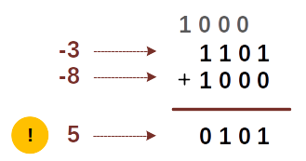
Unsigned vs. signed addition
Same adder supports both unsigned and signed
Overflow detection logic different
  Unsigned: Carry(n-1)
  Signed: Carry(n-1) XOR Carry(n-2)

Slide 19
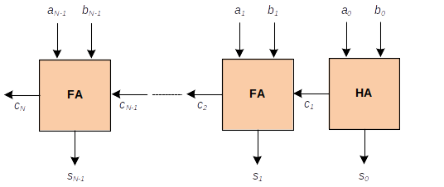
Ripple carry adder

Slide 20

Half Adder (HA) truth table
Inputs
Outputs
No input carry

Slide 21
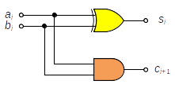
Half adder logic circuit
Area: 2 gates
Delay: 1 gate

Slide 22
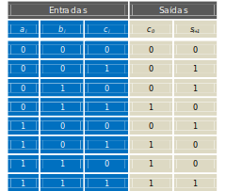
Full Adder truth table
Input carry
Generate
Propagate

Slide 23
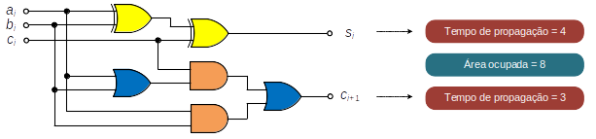
Full Adder logic circuit
Area: 6 (2-input) gates
Propagation delay: 3 gate delays
Carry delays will add up!

Slide 24
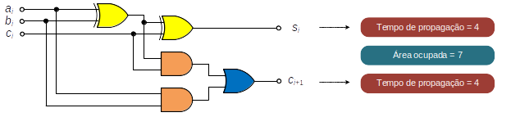
Full Adder simplification
Area: 5 gates (1 less!)
Delay: 3 gates (same)
Carry delays will add up!

Slide 25
Ripple carry adder
Compute area and delay

Slide 26
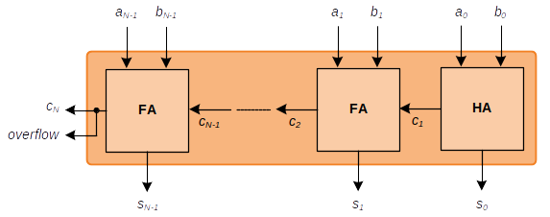
RCA: compute unsigned overflow

Slide 27
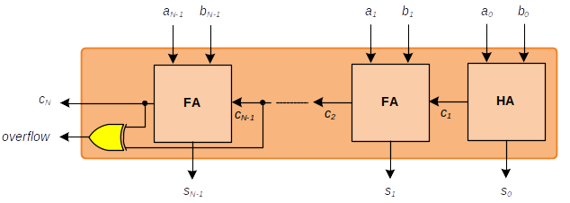
RCA: compute signed overflow

Slide 28
RCA: advantage and disadvantage
Advantage: simplest adder circuit, lowest area and power dissipation
Disadvantage: it is slow
  Delay is O(N), where N is number of bits
  Carry computation is sequential:
    Wait for C(i-1) to compute C(i)

Slide 29
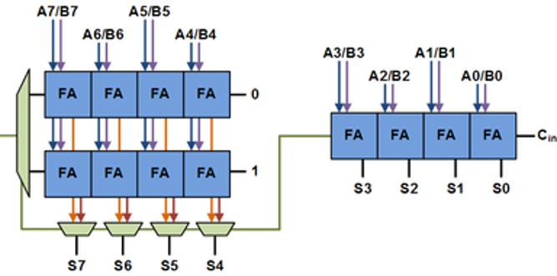
Carry-select adder

Slide 30
CSA algorithm summary
Split N bit addition into N/2 bit additions
Use 1 RCA for lower part
Use 2 RCAs for higher part
  One of the assumes carry from lower part is 0
  The other assumes carry from lower part is 1
When carry from lower part arrives it selects the correct higher part
CSA delay is half RCA delay + mux delay
Faster than RCA but bigger and more power hungry

Slide 31
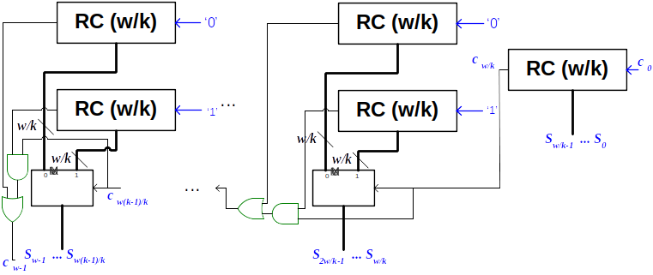
K-stage CSA

Slide 32
Worksheet 7
Design a full adder (FA) in Verilog
Build a 4-bit adder using the FA
Simulate in Icarus

