Slide 1
Computer Electronics
Lecture 17: Dynamic Random Access Memory (DRAM)

Slide 2
Outline
DRAM cell
DRAM matrix
DRAM read
DRAM write
DRAM high-level operation
DRAM module organization
DRAM refresh
Real DRAM chips

Slide 3
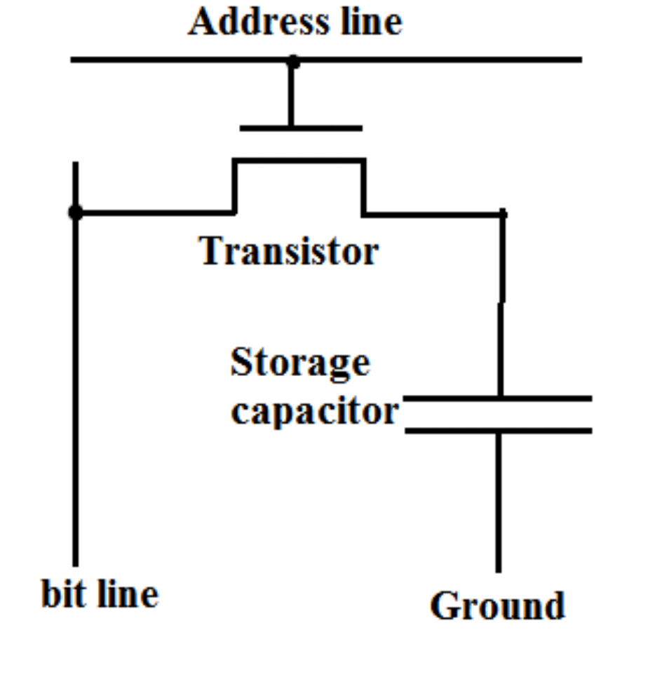
DRAM Cell

Slide 4
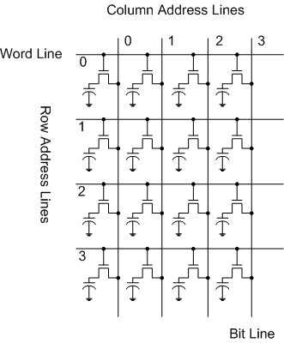
DRAM cell matrix

Slide 5
DRAM Reading problem
Select Row using address
Cell charge has little effect on line voltage Vd because Cc << Cd
Final voltage
For Cc=40fF, Cd=1pF, Vc=5V then the variation in Vd is only 200mV
Since the transistors leak current, then variation is even smaller
Difficult to detect this small variation!
Cc
Cd

Slide 6
Charge redistribution
Switch closes at time t=0
Charge is conserved
S
C_{d}
C_{c}
Energy NOT conserved: part of it is dissipated in the switch S (resistance Rs)

Slide 7
Solving the read problem
Use complementary column bit lines to store d and ~d (doubles circuit area, not necessary but eases explanation)
Pre-charge the bit lines at Vdd/2
Select row and cells will drive bit lines
Vd=Vdd/2+ΔV/2 and V~d=Vdd/2-ΔV/2
Amplify ΔV using sense amp
Select column to read data

Slide 8
Pre-charge complementary bit lines
d
~d
Vdd/2
Voltage equalization circuit
Pre-charge enable
(disable after complete)

Slide 9
Select row, sense and read
d
~d
Select row to drive bit lines
  Vd=Vdd/2+ΔV/2
  V~d=Vdd/2-ΔV/2
Amplify ΔV using sense amp – This also restores the cells!
Select column to read data
Select Row
Power Up
Sense Amp
Select Column

Slide 10
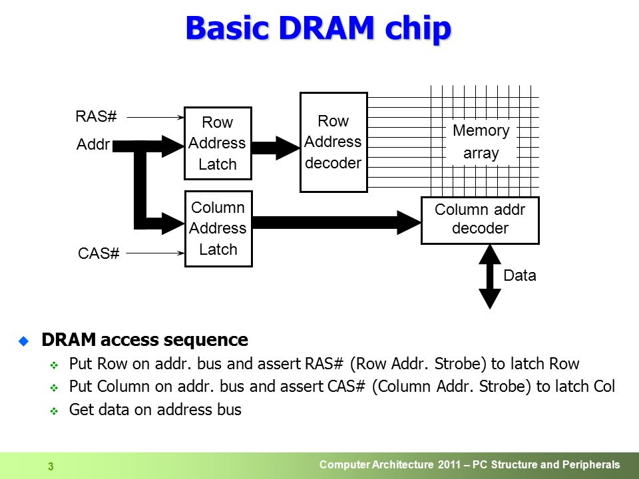
DRAM high-level view
Example:
1024 x 1024 mem array
20 address bits
Only 10 address pins
Send row address
Then send column address

Slide 11
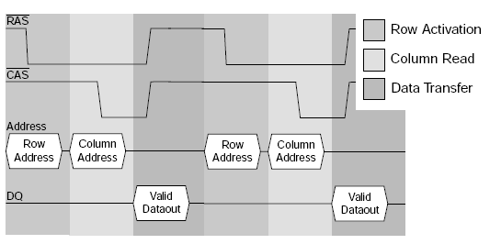
DRAM timing diagram

Slide 12
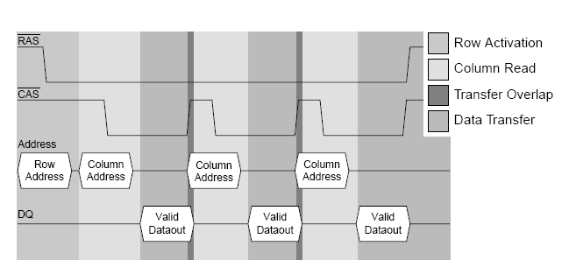
DRAM fast page mode

Slide 13
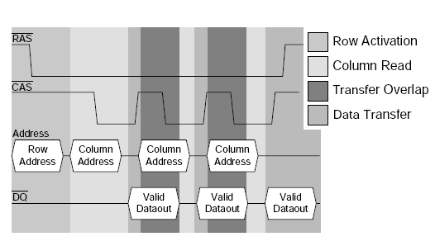
DRAM Extended Data Output (EDO)
Uses register to hold previously read data while new data is read
Pipelined access!

Slide 14
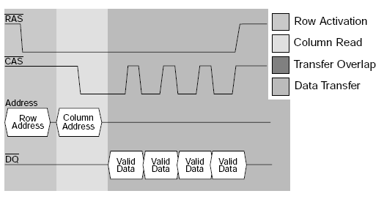
Burst Extended Data Output (BEDO)
Column address is incremented internally for greater speed!

Slide 15
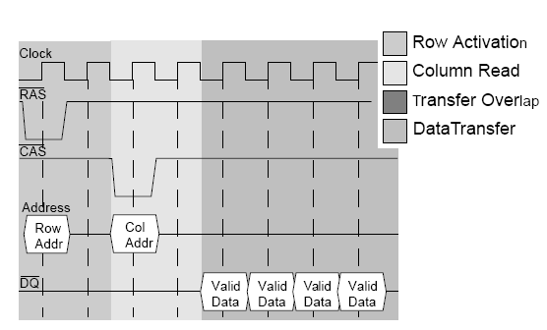
Synchronous (SDRAM)
Synchronous operation facilitates external generation of signals
Column address still incremented internally like BEDO

Slide 16
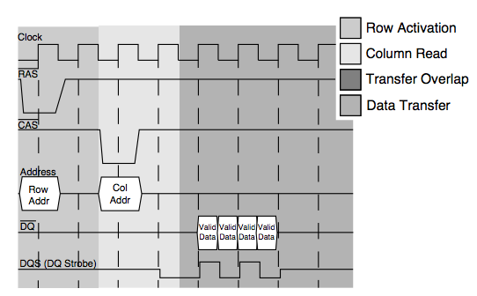
Double Data Rate (DDR)
Like SDRAM but data made available at both clock edges
Bandwidth is doubled!

Slide 17
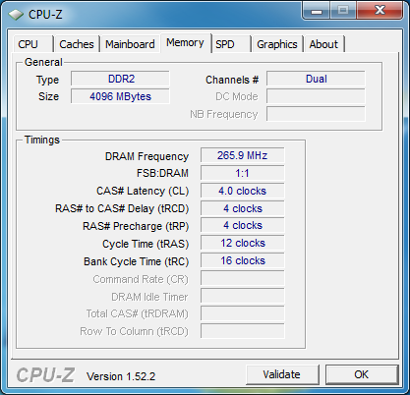
Configuring CPU to use some DRAM
BASIC COMMANDS
Next row precharge
Activate row
Activate column
Read/Write data
tRP: precharge time new row
tRCD: RAS to CAS delay
tCL: CAS to data delay
tRAS = tRCD+2tCL
tRC = tRAS+tRP

Slide 18
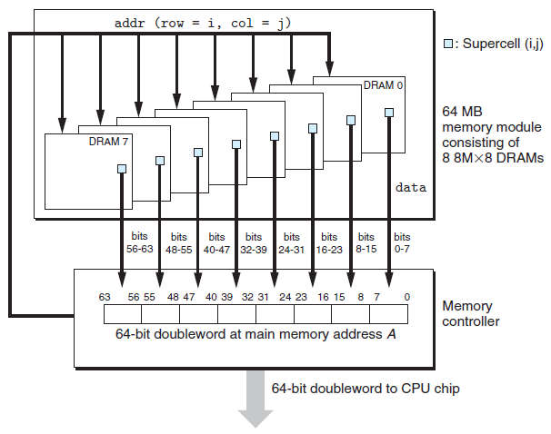
Memory module organization

Slide 19
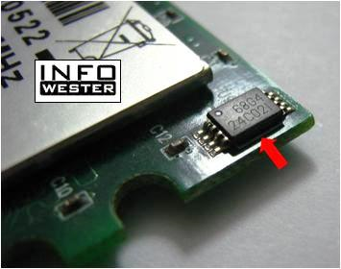
Serial presence detect
Modules have a small chip to inform whether they are present
Useful in Power On Self Test (POST)

Slide 20
DRAM refreshing
Cell transistors leak and lose charge
Cell needs refreshing before stored info is lost
When a cell is read it is restored (refreshed)

Slide 21
DRAM refresh modes
RAS only
CAS before RAS
Hidden

Slide 22
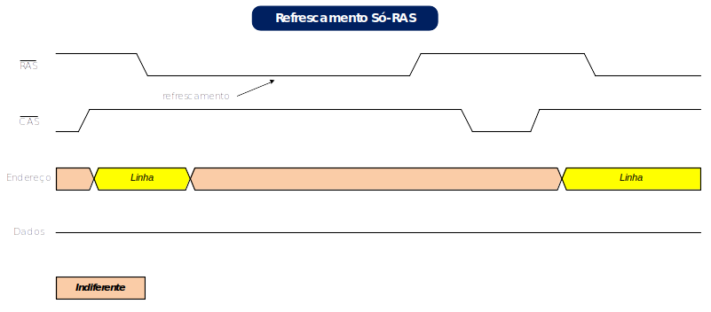
RAS only refresh
address
data
Provide Row address and activate RAS
No need to activate CAS

Slide 23
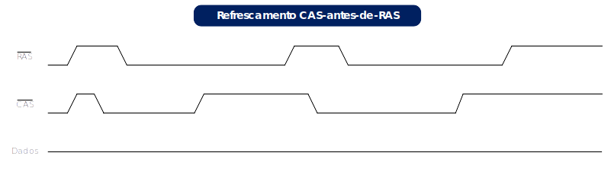
CAS before RAS refresh
No need to provide Row address (incremented internally)
This is signaled by activating CAS before RAS

Slide 24
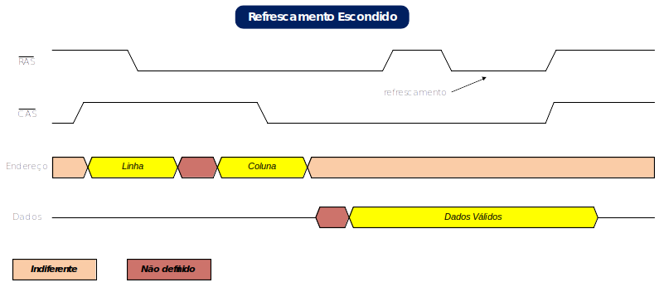
Hidden refresh
Performs refresh while data is output
Reduces refresh overhead

Slide 25
Refresh overhead
Refresh interval: every row must be refreshed within this interval
Refresh time: time to refresh all rows
Overhead = refresh time/refresh interval

