Slide 1
Computer Electronics
Lecture 4: FPGAs

Slide 2
Programmable Hardware
Designing hardware is challenging, expensive and error prone
A re-spin of an IC can cost 100s of M$ in modern nodes (e.g. 22 nm)
Is there a way to “program circuits” and fix them if there are errors or updates?
YES: electrically programmable digital circuits!

Slide 3
Field Programmable Gate Array (FPGA)
Can implement any digital circuit, if it fits in the device
Useful in prototyping chips
Traditionally useful in low production volume products
  100s of K units and below
  Beats IC unit costs!
Clock frequencies well below ICs
Cheap development cost
  FPGA tools are cheap, design flow is relatively simple
Nowadays useful as a general purpose processor, with high production volumes, like GPUs!!

Slide 4
Early FPGA History
Early 1980
  Standard IC circuits (microprocessors, bus, I/O controllers, timers, …) had to be interconnected (serial/parallel, multiplexing, …)
  Custom ICs were used for the interconnection logic but had huge cost and long development.
1984
  Xilinx started selling FPGAs
  Concept invented in 1967 by Wahlstrom
  No physical layout, no mask making, no IC manufacturing, lower NRE costs and short time to market.

Slide 5
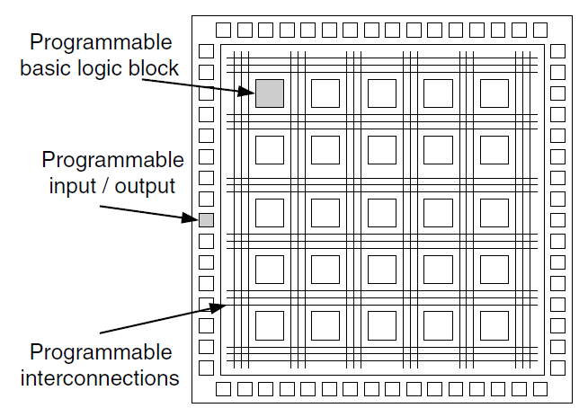
FPGA basic architecture

Slide 6
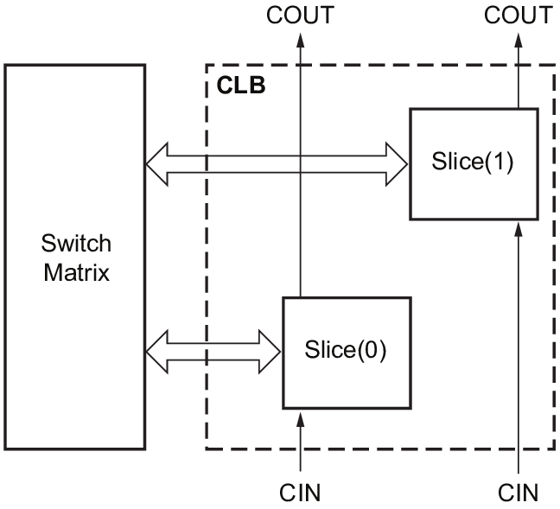
Basic Programmable Logic Block

Slide 7
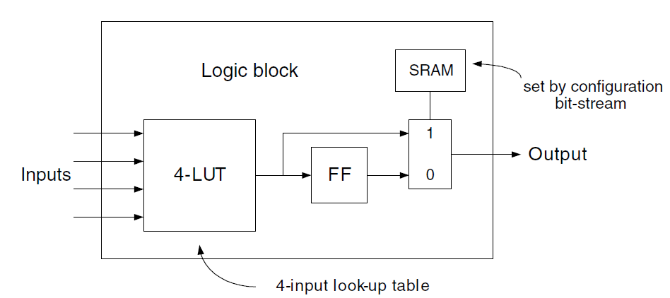
Basic slice

Slide 8
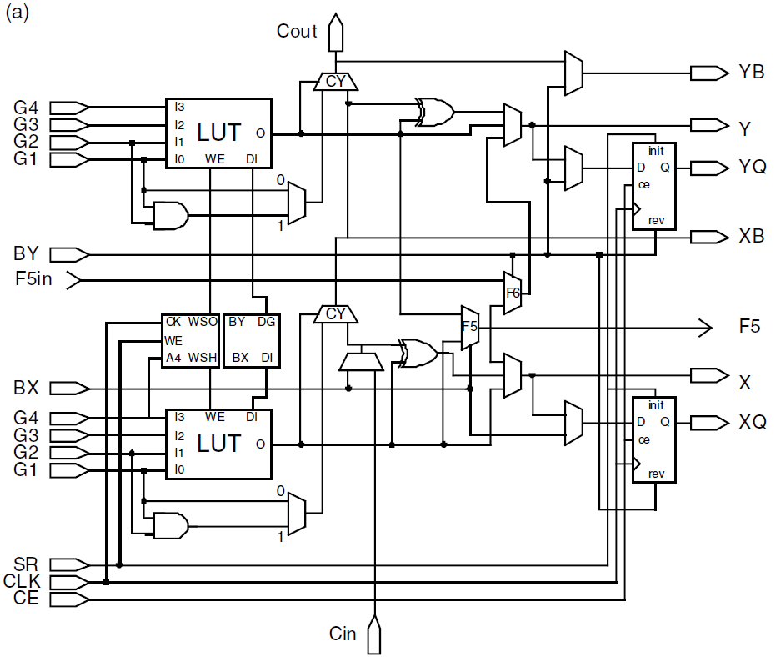
Real slice

Slide 9
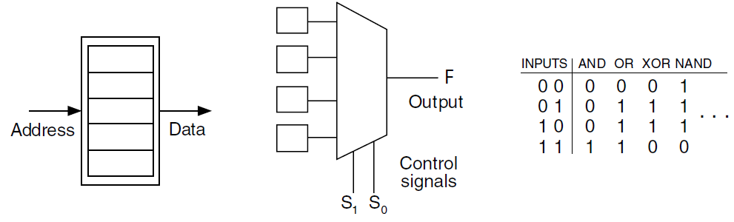
Look-Up Table (LUT)
Structure: a very small memory
Implementation: Latch + Multiplexer
LUT inputs
(memory address)
Configuration bits (memory contents)

Slide 10
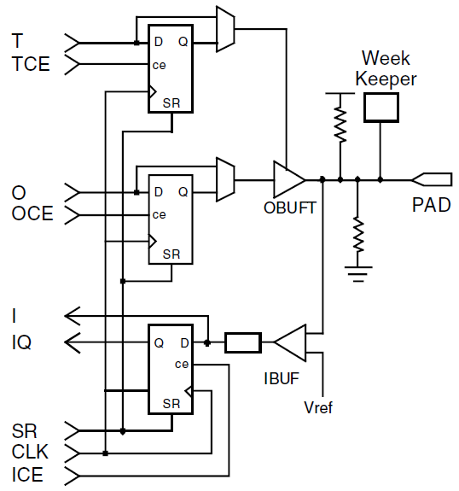
Programmable IO

Slide 11
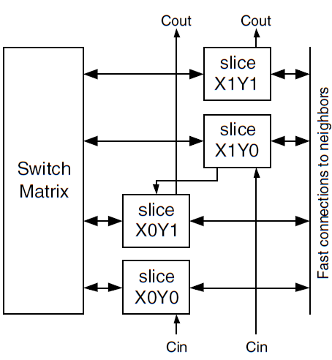
Programmable interconnections
Local CLB interconnection
Connection to neighbor CLBs
Connection to distant CLBs

Slide 12
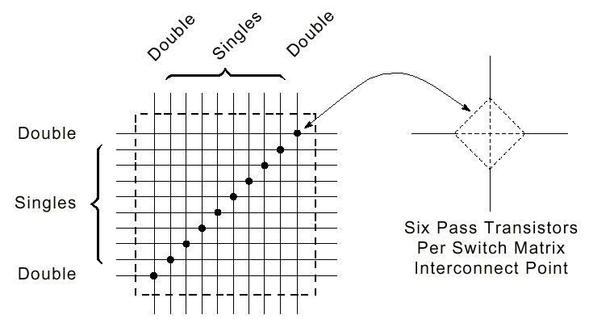
Switch matrices
A
B
0/1
Configuration bit:
0: A not connected to B
1: A connected to B

Slide 13
Interconnect line types
Long Lines: bidirectional wires that distribute signals across the device. Vertical and horizontal long lines span the full height and width of the device.
Hex Lines: route signals to every third or sixth block away in all four directions.
Double Lines: route signals to every first or second block away in all four directions.
Direct Lines: route signals to neighboring blocks—vertically, horizontally, and diagonally.
Fast Lines: internal CLB local interconnections from LUT outputs to LUT inputs.

Slide 14
Configuration architecture
RAM organization
Address decoder
Address and configuration data
(bitstream)
Configuration bits/nibbles/bytes/words

Slide 15
Memory and arithmetic
FPGAs can be programmed to implement registers, register files or larger memories
The LUTs can be used to implement larger register files or small memories
FPGAs can be programmed to implement complex arithmetic units such as multipliers
But, this consumes a lot of LUTs

Slide 16
Heterogenous FPGAs
Contain embedded RAMs
Contain embedded DSP blocks
  Multiply Accumulate units (MACC) and variations
    Multiply only
    Add only
    Multiply an accumulate: mul + add
Result: better silicon utilization leads to lower price products

Slide 17
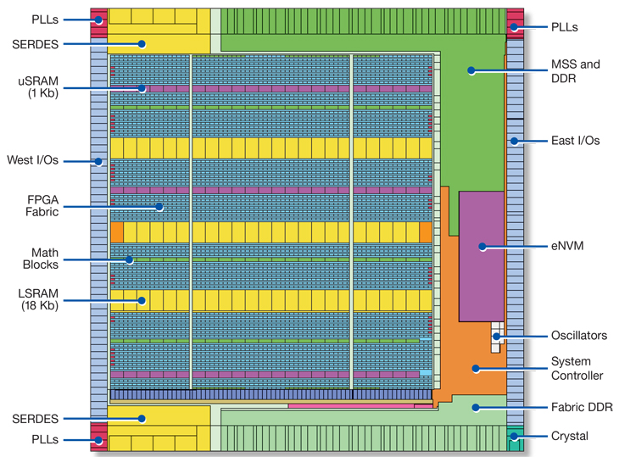
FPGA layout

Slide 18
Example FPGA
P0..3: pins, programmable with the following word:
  Bit 3 – function select bit: input (0) or output (1)
  Bits 2:1 – select which pin or LUT output
  Bit 0 – selects FPGA pins (0) or LUT outputs (1);
L0..3: 2-input (A and B) LUTs, programmable with the following word:
  Bits 9:6 – function select bits F(A,B)
  Bits 5:3 – input B selection bits;
  Bits 2:0 – input A selection bits;
P0
L0
L1
P3
P1
L3
L2
P2

Slide 19
Example FPGA
P0
FPGA configuration (bitstream)
L0
L1
PIN config
LUT2 config
P3
P1
L3
L2
P0
P1
P2
P3
L0
L1
L2
L3
P2
FUNCTION
IN
FUNCTION
INB
INA
1 + 3 = 4 4 + 3 + 3 = 10
Total configuration bits: 4*4 + 4*10 = 56 bits

Slide 20
Example FPGA
Configure logic function Y = X1 X2 X3
P0..2 are inputs
Config: 0 - - - (0 selects input function, since it is not an output the selection bits are don't care)
P3 is output:
Config: 1 10 1 (1 selects output function, 10 selects L2, 1 selects LUTs)
L0 and L1 are AND2:
L0 config: 1000 01 0 00 0 ( 1000 selects function AND, 01 0 selects P1 and 00 0 select P0 )
L1 config: 1000 10 0 00 1 (1000 selects function AND, 10 0 selects P2 and 00 1 selects L0 )
P0
L0
L1
P3
P1
L3
L2
P2
PIN X1
(P0)
A
PIN X2
(P1)
AND2
(L0)
A
AND2
(L1)
B
PIN Y
(P3)
PIN X3
(P2)
B

