Slide 1
Computer Electronics
Lecture 19: SRAM

Slide 2
Outline
Static memory cells
SRAM read operation
SRAM write operation
SRAM sense and write amplifiers
Worksheet 19

Slide 3
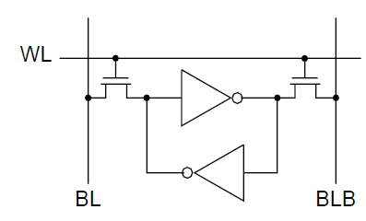
A static memory cell

Slide 4
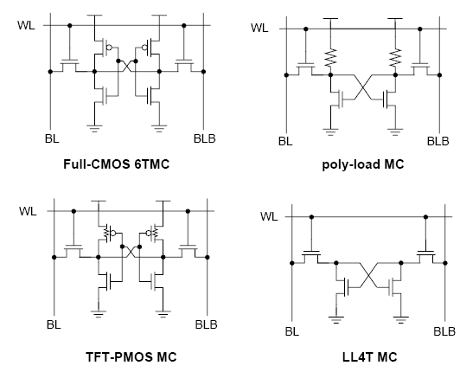
Static cell types

Slide 5
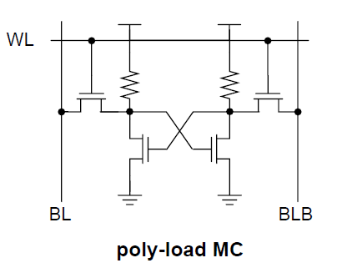
Poly load
Implemented in a separate polysilicon layer
Advantage:
  30% area reduction
Disadvantages
  Non standard technology
  Resistors can’t be shrunk anymore

Slide 6
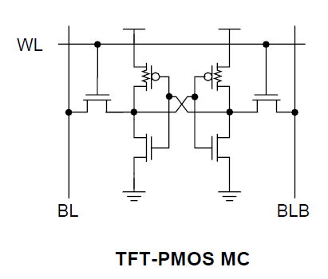
TFT PMOS
Polysilicon transistor built on top of NMOS transistor
Advantage:
  Area reduction
Disadvantage
  Non standard technology

Slide 7
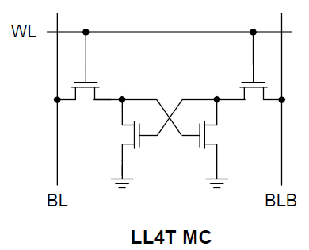
Loadless SRAM Cell
Information stored in gate capacitor
Advantages:
  Standard technology
  Up to 65% area reduction!
Disadvantage
  Leakage current may wipe away info

Slide 8
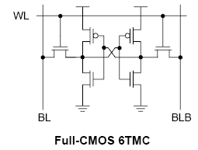
6T standard SRAM cell
Most common SRAM cell
Advantage:
  Implemented with regular CMOS technology
Disadvantage
  Larger area

Slide 9
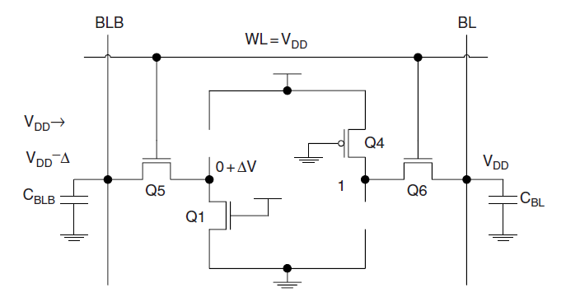
SRAM read operation

Slide 10
SRAM read procedure
Pre-charge BL and BLB at the same voltage: VDD, VDD/2 or other
Turn on the access transistors (WL decoder)
Wait for a voltage difference to develop between BL and BLB
Select the column (CL decoder)
Turn on the (column shared) sense amplifier and wait for voltage levels to be restored
Read the SRAM data IO pins

Slide 11
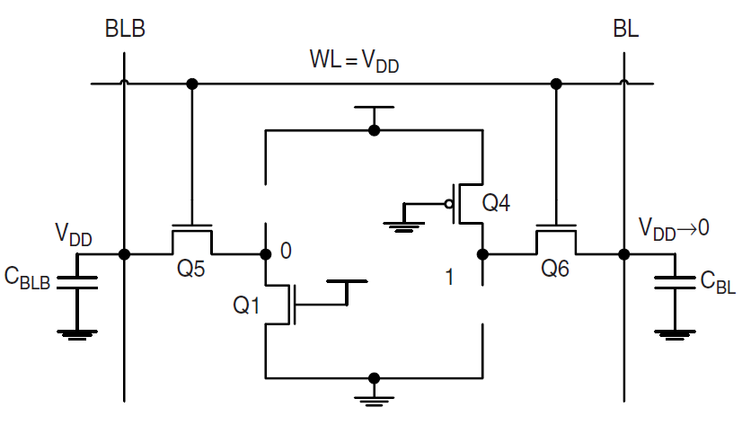
SRAM write operation

Slide 12
SRAM write procedure
Pre-charge BL and BLB
Apply the write values to the chip IO pins
Select the column (CL decoder) and row (WL decoder) so that the write amp will force the cell to the desired state

Slide 13
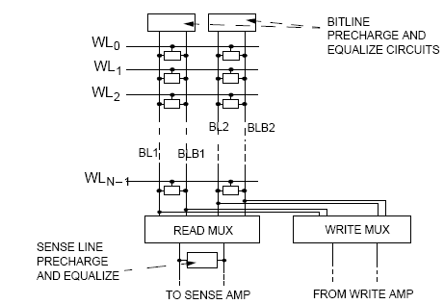
Shared sense and write amps

Slide 14
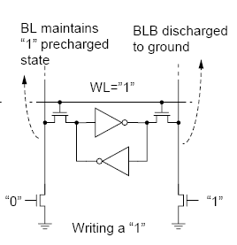
SRAM write amplifier
Use simple pull-down transistors
If pre-charge value is VDD then only one line needs to be pulled down!

Slide 15
Youtube video
CMOS SRAM lecture
By Prof. Amitava Dasgupta (IIT, Madras)
https://www.youtube.com/watch?v=KrqyvpU9Cu0

Slide 16
Worksheet #19
Design the pre-charge and equalization circuit
Try to design the sense amplifier in verilog
Compute the read access time if
  For WL, RC=1ns and t_{RISE} or t_{FALL} is defined for 90% of final value
  For BL and BLB, ΔV/Δt=1V/ns
  Pre-charge value is VDD*2/3, VDD=3.3V
  Sense amp is turned on when ΔV=100mV and responds in 20ps.

