Slide 1
Computer Electronics
Lecture 13: FPGAs and CGRAs

Slide 2
Outline
Programmable hardware
  FPGAs
  CGRAs
The Versat CGRA

Slide 3
Programmable Hardware
Designing hardware is challenging, expensive and error prone
A re-spin of an IC can cost 100s of M$ in modern nodes (e.g. 22 nm)
Is there a way to “program circuits” and fix them if there are errors or updates?
YES: electrically programmable digital circuits!

Slide 4
Types of Programmable Hardware
Fine grain:
  Field Programmable Logic Arrays (FPGAS)
Coarse Grain:
  Coarse Grained Reconfigurable Arrays (CGRAs)
Mixed

Slide 5
FPGAs
Can implement almost any digital circuit
Useful in prototyping chips
Useful in low volume products
  100s of K units and below
  Beats IC unit costs!
Clock frequencies well below ICs
Cheap development cost
  FPGA tools are cheap, design flow is relatively simple

Slide 6
FPGAs
Early 1980
  Standard IC circuits (microprocessors, bus, I/O controllers, timers, …) had to be interconnected (serial/parallel, multiplexing, …)
  Custom ICs were used for the interconnection logic but had huge cost and long development.
1984
  Xilinx started selling FPGAs
  Concept invented in 1967 by Wahlstrom
  No physical layout, no mask making, no IC manufacturing, lower NRE costs and short time to market.

Slide 7
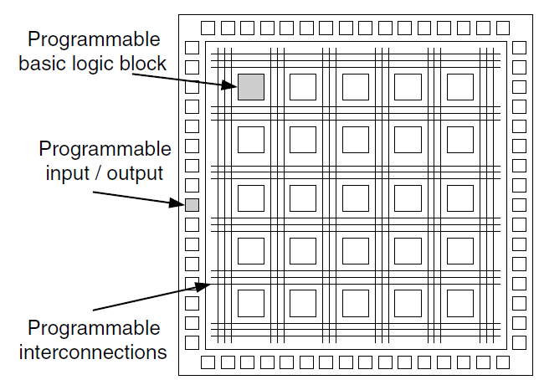
FPGA basic architecture

Slide 8
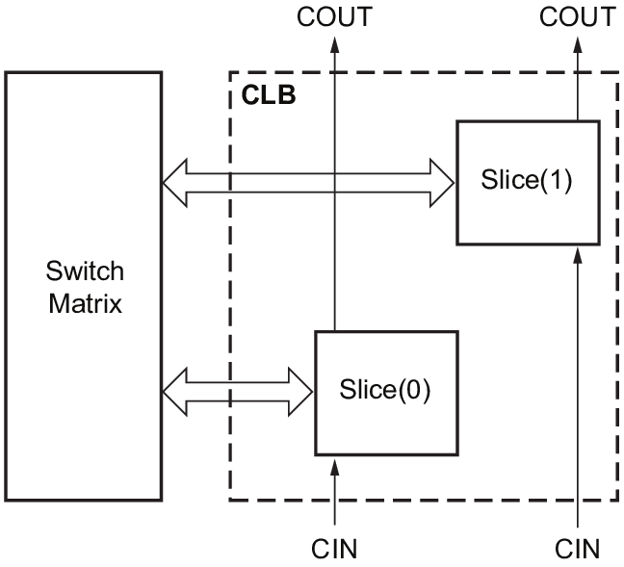
Basic Programmable Logic Block

Slide 9
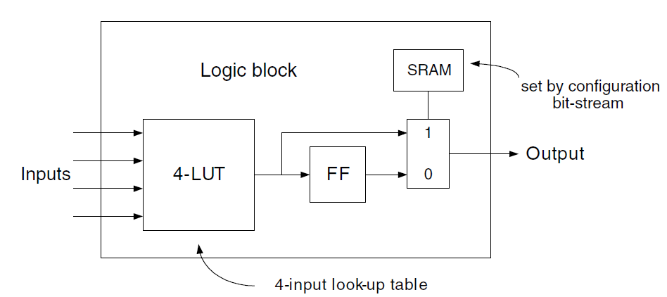
Basic slice

Slide 10
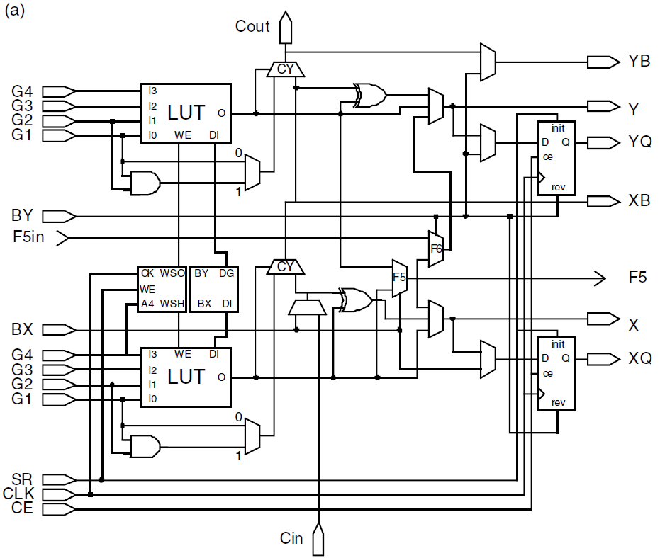
Real slice

Slide 11
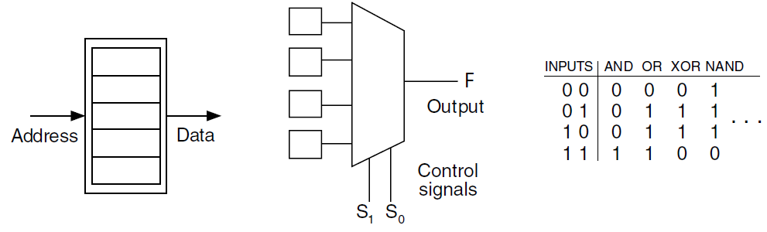
Look-Up Table (LUT)
Structure: memory
Implementation: Latch+ Multiplexer (!cost)
LUT inputs
(memory address)
Configuration bits (memory contents)

Slide 12
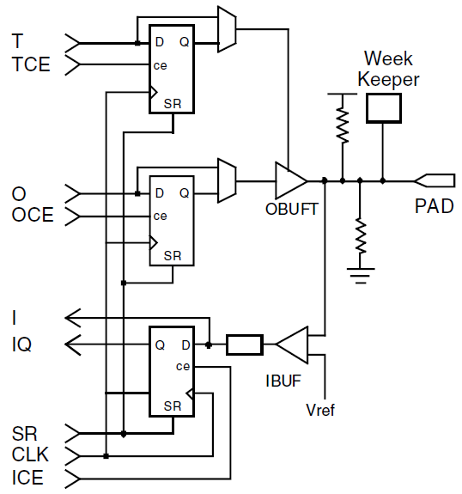
Programmable IO

Slide 13
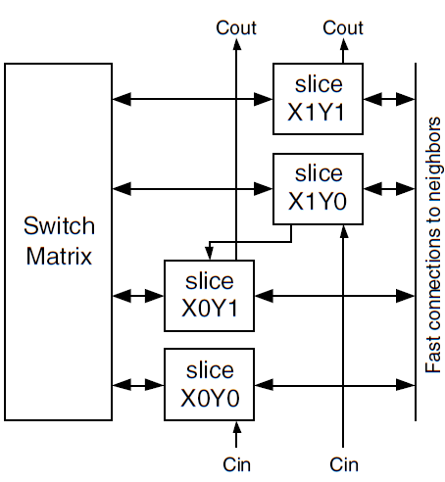
Programmable interconnections
Local CLB interconnection
Connection to neighbor CLBs
Connection to distant CLBs

Slide 14
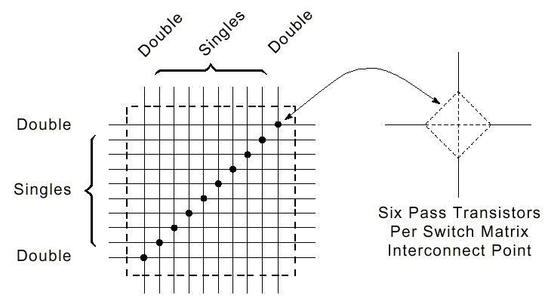
Switch matrices
A
B
0/1
Configuration bit:
0: A not connected to B
1: A connected to B

Slide 15
Interconnect line types
Long Lines: bidirectional wires that distribute signals across the device. Vertical and horizontal long lines span the full height and width of the device.
Hex Lines: route signals to every third or sixth block away in all four directions.
Double Lines: route signals to every first or second block away in all four directions.
Direct Lines: route signals to neighboring blocks—vertically, horizontally, and diagonally.
Fast Lines: internal CLB local interconnections from LUT outputs to LUT inputs.

Slide 16
Configuration architecture
RAM organization
Address decoder
Address and configuration data
(bitstream)
Configuration bits/nibbles/bytes/words

Slide 17
Memory and arithmetic
FPGAs can be programmed to implement registers, register files or larger memories
FPGAs can be programmed to implement complex arithmetic units such as multipliers
But, this consumes a lot of LUTS

Slide 18
Heterogenous FPGAs
Contain embedded RAMs
Contain embedded DSP blocks
  Multiply Accumulate units (MACC) and variations
    Multiply only
    Add only, etc
Result: better silicon utilization leads to lower price products

Slide 19
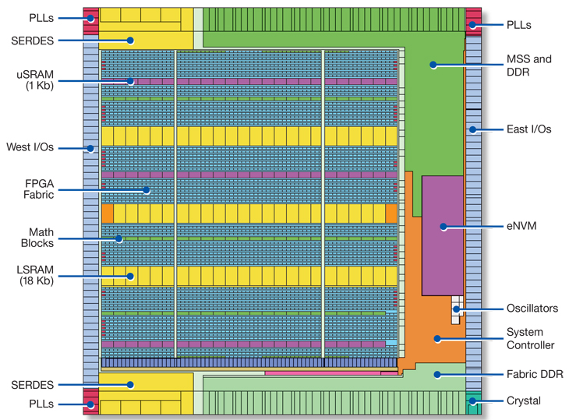
FPGA layout

