Slide 1
Computer Electronics
Lecture 18: Multiplier Circuits – Part 1

Slide 2
Lecture outline
Parallel unsigned multiplier
Parallel carry-save multiplier
Signed multiplier
  Subtraction review
  Parallel signed multiplier

Slide 3
Unigned matrix multiplier: algorithm
multiplicand
a3 a2 a1 a0
x b3 b2 b1 b0
a3b0 a2b0 a1b0 a0b0
a3b1 a2b1 a1b1 a0b1
a3b2 a2b2 a1b2 a0b2
+ a3b3 a2b3 a1b3 a0b3
p7 p6 p5 p4 p3 p2 p1 p0
multiplier
partial product
product

Slide 4
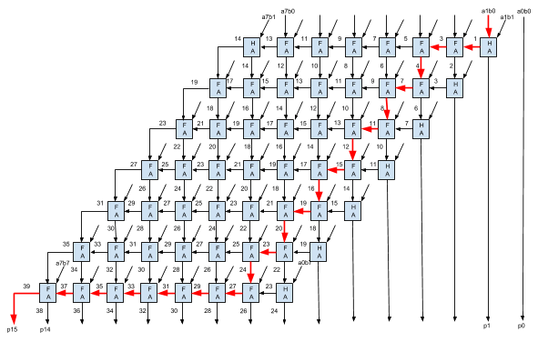
Matrix multiplier with ripple carry
cd
ab

Slide 5
Pipelined MM w/ RCA
Pipeline stages after each partial product addition
What is the maximum clock frequency?

Slide 6
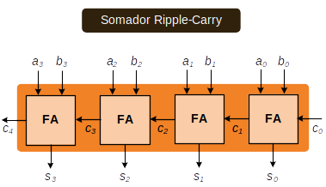
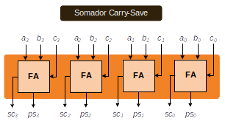
Carry-Save Adder Principle
Ripple-carry
adder
Carry-save
Adder stage

Slide 7
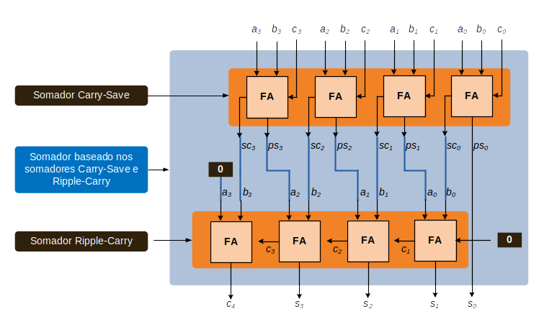
3-input adder using carry-save stage
Carry-save
Adder stage
Carry-save
based adder
Ripple-carry
adder

Slide 8
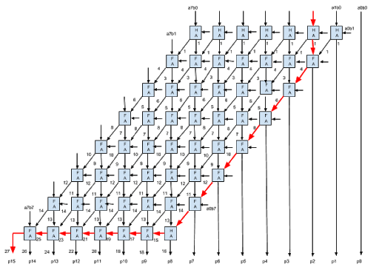
Matrix multiplier with carry save

Slide 9
Pipelined MM w/ CSaA
Pipeline stages after each partial product addition
What is the maximum clock frequency?
  What is the stage responsible for it?
Solution for increasing the frequency
  Work at the CSaA clock frequency
  Use N-1 clock cycles to compute the last stage

Slide 10
Subtraction: fundamentals
Adder circuits work equally well with unsigned and signed numbers
A-B = A + (-B)
  To subtract simply add the symmetric
  Symmetric is 2’s complement
  Easiest way to compute 2’s complement in hardware
    Complement and add 1

Slide 11
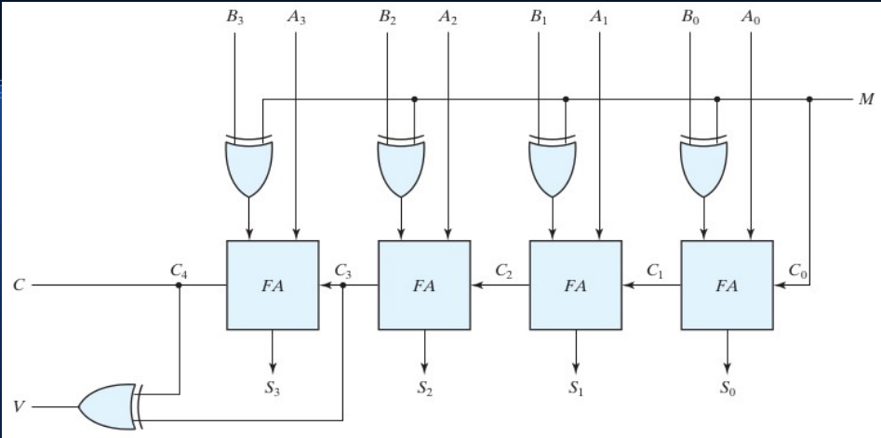
Subtraction: circuit

Slide 12
Sign extension
Sometimes we need to increase the number of bits for representation in different signed integer format
Sign of the number should be preserved
Q1: represent signed number 1000 (-8₁₀) with 8 bits
A1: 11111000 (sign extension in red)
Q2: represent signed number 0111 (7₁₀) with 8 bits
A2: 00000111(sign extension in red)

Slide 13
Logical/Arithmetic right shift
Shifting a number left by p positions is the same as multiplying it by 2^{p}
Shifting a signed number right by p positions is the same as dividing it by 2^{p}
Sign must me preserved: arithmetic right shift
1000 (-8₁₀) shift right by 2 (divide by 4)
  Logical right shift 0010 (2₁₀): wrong!
  Arithmetic right shift 1110 (-2₁₀): correct!

Slide 14
Signed multiplication: fundamentals
A = a3 a2 a1 a0, B = b3 b2 b1 b0
In decimal notation
B = -b3*2³ + b2*2² + b1*2¹ + b0*2⁰
A*B = A * [-b3*2³+ b2*2² + b1*2¹ + b0*2⁰]
Algorithm:
  Add least significant partial products, subtract most significant partial product

Slide 15
Signed multiplication: circuit
₁
a₃b₀
a₂b₀
a₁b₀
a₀b₀
a₃b₁
a₃b₁
a₂b₁
a₁b₁
a₀b₁
FA
FA
FA
FA
HA
FA’
a₃b₂
a₃b₂
a₂b₂
a₁b₂
a₀b₂
FA’
FA
FA
FA
HA
a₃b₃
a₃b₃
a₂b₃
a₁b₃
a₀b₃
FA’
FA
FA
FA
FA
1
p₇
p₆
p₅
p₄
p₃
p₂
p₁
p₀

